Slide 1
Mixture of Gaussian distribution
Simulating D.I. values

Slide 2
What has been achieved
Quantitative Risk Stratification of Oral Leukoplakia with Exfoliative Cytology
Liu, Y, et al. April, 2015
PLoSONE

Slide 3
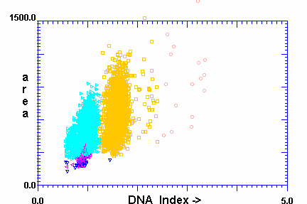
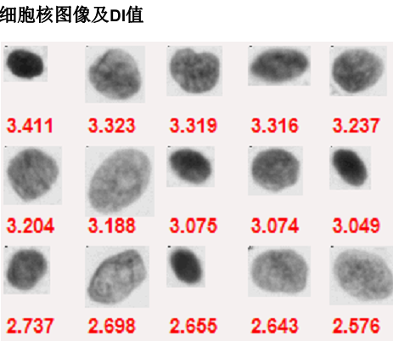
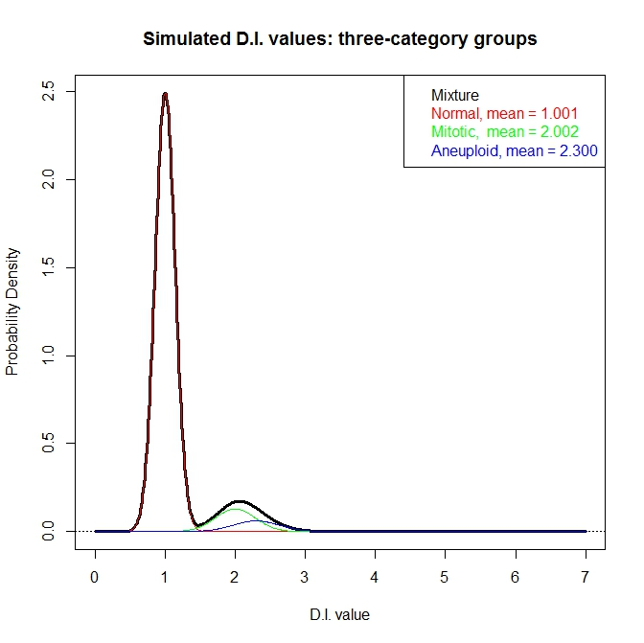
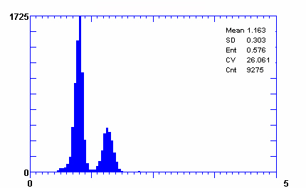
Figure 1
Liu, et al.
A
B
C
D
Notes:
Figure 1 DNA imaging data

Slide 4
Figure 2
Liu, et al.
DI values
Peak identification
Extraction of diploid/tetraploid and isolation of aneuploid peaks
Expert-guided
data transformation and reconstruction (EdTAR)
Signal amplification
Data reconstruction
Statistical modeling
Calculation of Oral Cancer Risk Index (OCRI)

Slide 5
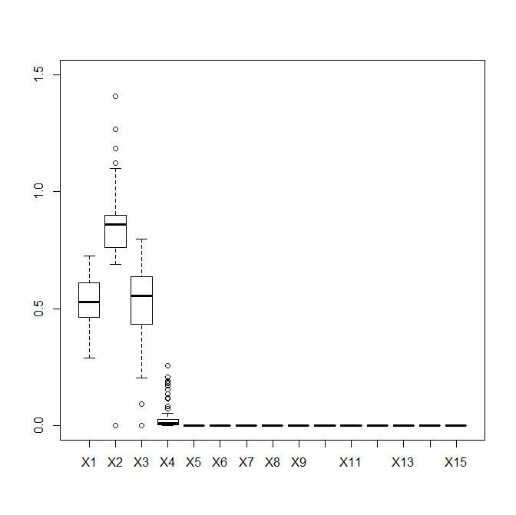
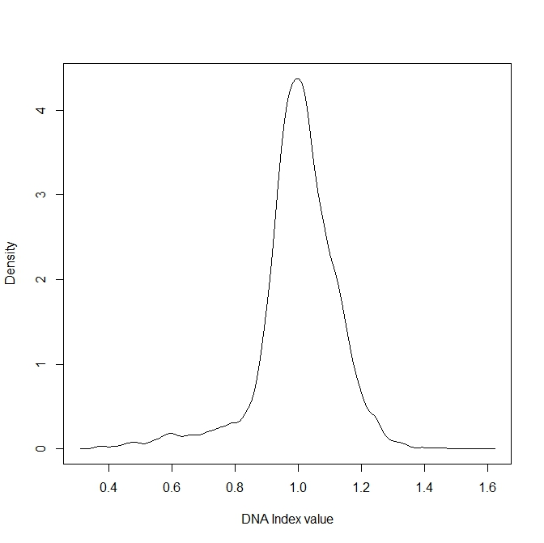
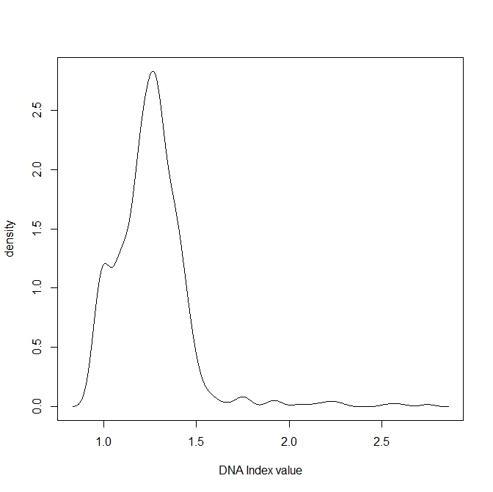
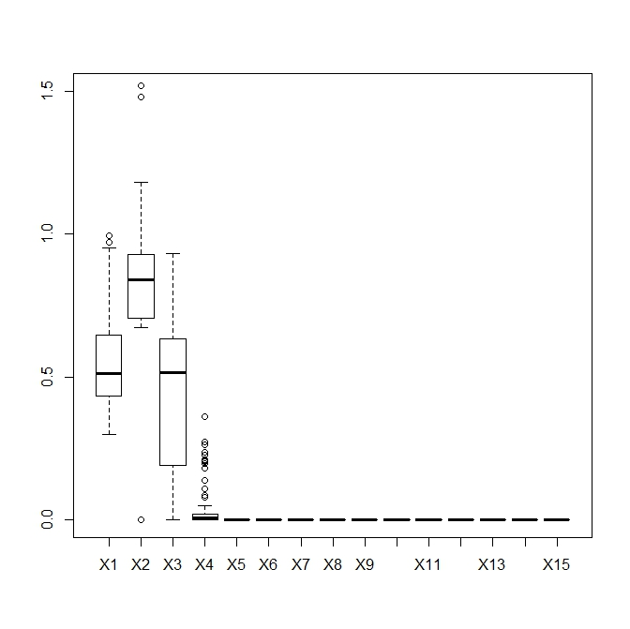
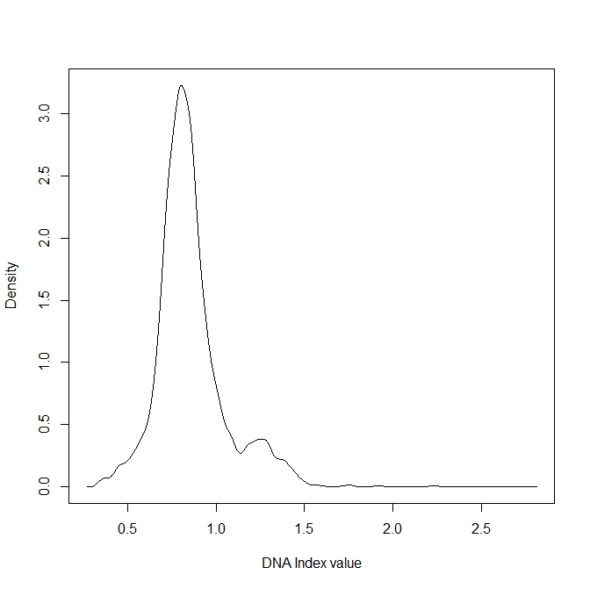
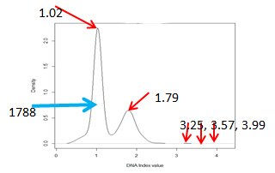
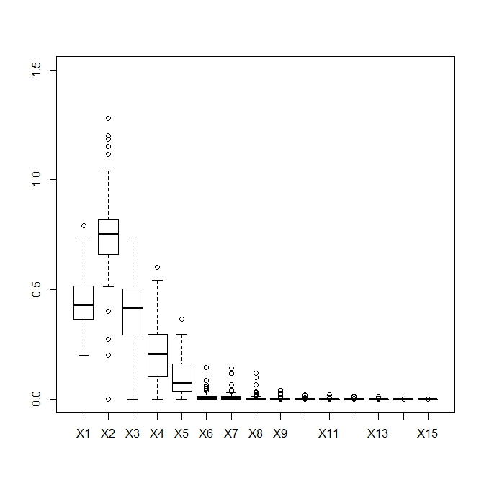
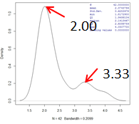
Figure 3
Liu, et al.
C
A
B
0.995
0.995
Normal
0.594
0.594
D
E
F
0.798
1.25
OLK
1.25
3590
1.75
2.22
1.75
2.22
2.74
2.74
G
H
I
OSCC
Before EdTAR
Signal amplification
After EdTAR

Slide 6
Figure 4
Liu, et al.

Slide 7
Figure 5
Liu, et al.

Slide 8
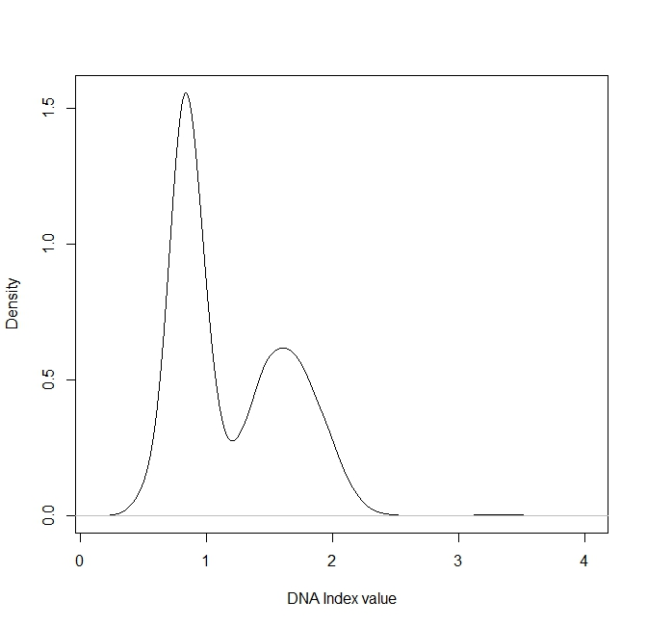

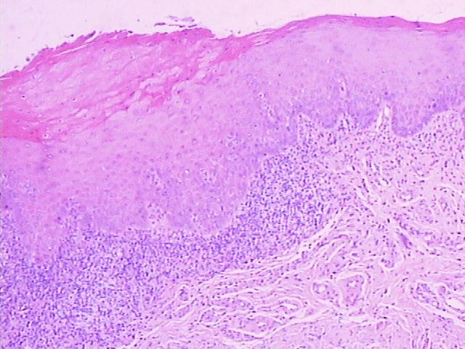
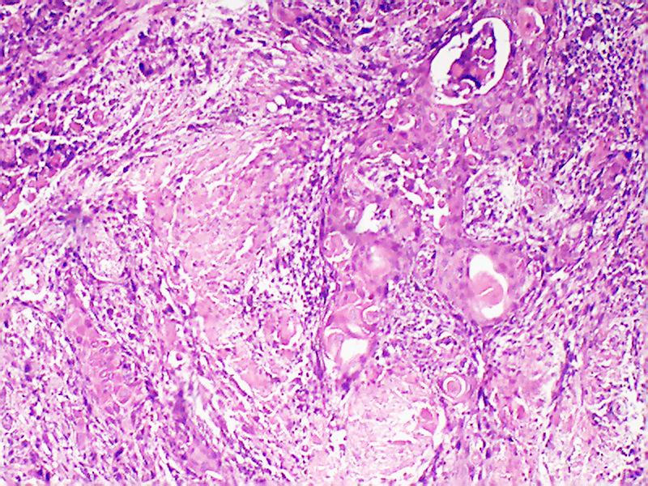
Figure 6
Liu, et al.
A
0.831
B
1.60
1.59
1608
1118
2.82
2.82
3.22
3.45
3.76
3.18
3.25
3.48
3.76
C
D

Slide 9
Objectives
Understanding the exfoliative cytology data
Understanding the density and plotting density
Identifying the peaks from the density plot
Density plot of data from a single family
Density plot of data with mixture of families of relatively trackable density proportion
Density plot of data with mixture of families of extremely unbalanced densities
Cleaning the image data
EdTAR process
Building the prediction models

Slide 10
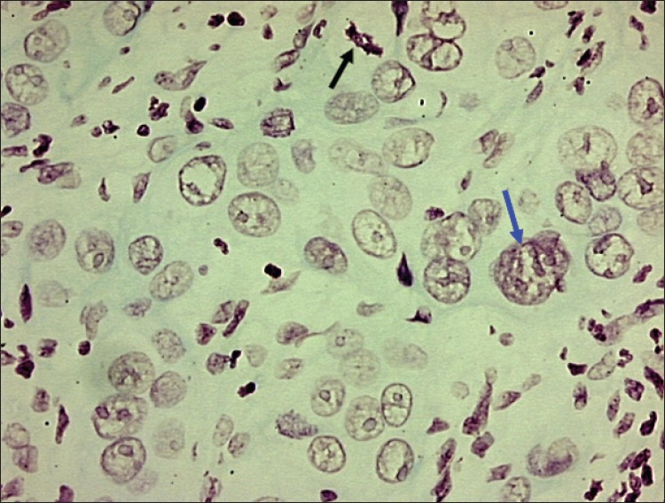
Photomicrograph of moderately well differentiated OSCC showing large tumor nucleus
with multiple prominent nucleoli (blue arrow) and abnormal mitotic figure (black arrow)
DB Nandini and RV Subramanyam, 2011, Nuclear features in oral squamous
cell carcinoma: A computer-assisted microscopic study, V.15:2, 177-181,JOMFP

Slide 11
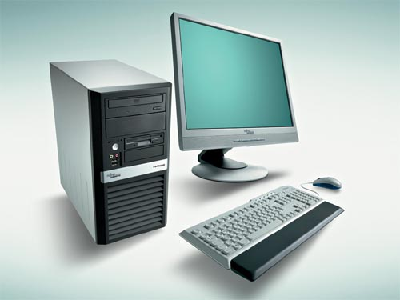
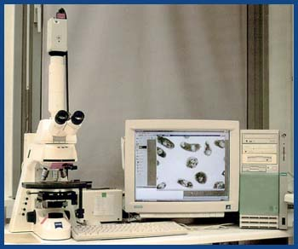
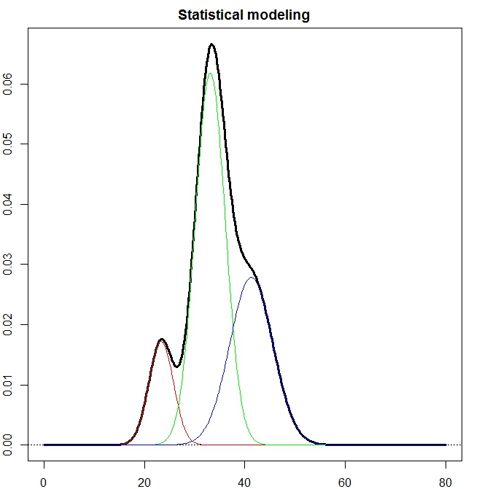
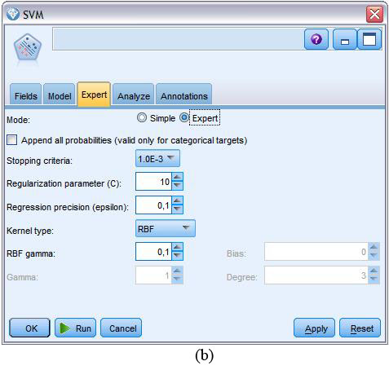

Raw dataDB

Slide 12
Objectives
Understanding and unveiling the biological mechanism of oral squamous cell carcinoma
Leveraging nuclei stain imaging technology (Feulgen staining)
Extracting the determining digitized information
Developing data processing protocol
Building predicting model for detecting abnormal cell dividing – cancer diagnosis
Establishing the standard for oral cancer early diagnosis

Slide 13
Rationale
Nuclei images available with “potential digitized report”
Focus on selected cell population with DNA indices report
Build statistical prediction model
Cumulative data collection and model pruning
Desktop application development for clinicians
Mobile device application allowing patient accessibility to their data

Slide 14
Building the statistical model
Get sufficient summary statistics from ten of thousands cells (i.e. D.I. values)
Evaluating the summary statistics
Reflect the mixture of distribution
Robust enough (enough information) to differentiation cell population
Capture cell population characteristics
Building the prediction model
Assess model performance
Provide accurate diagnosis guidance
Constantly improve the model

Slide 15
Desktop application
Easy to use
Stable cross-platform performance
Link to backend database to data importing and writing back
Constantly improving algorithm and pruning model
Data-driven approach self-updating

Slide 16
Mobile device application
Free to patient
Easy to use
Link to central database for reporting
Educate patient for public health value

Slide 17
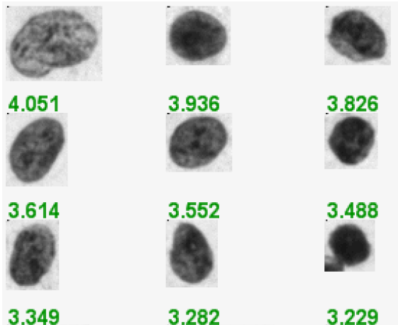
Abnormal nucleus image (D.I. value)
Papanicolaou (Pap) smears and nucleus was stained with Feulgan stain

Slide 18
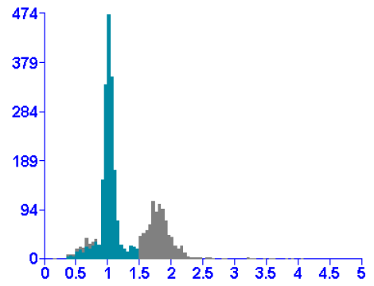
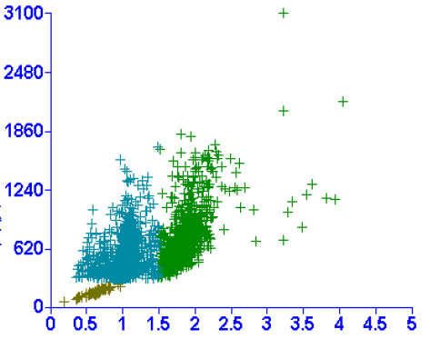
Cell population distribution

Slide 19
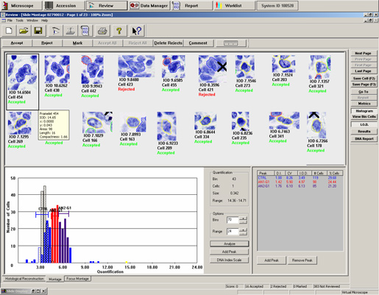

Slide 20
Summary statistics
Group | Mean1 | SD1 | Mean2 | SD2 | Mean3 | SD3
normal1 | 0.96 | 0.155 | 1.961 | 0.22 | 2.321 | NA
normal2 | 0.878 | 0.178 | 1.675 | 0.361 | 2.355 | NA
normal3 | 0.925 | 0.153 | 1.642 | 0.349 | NA | NA
normal4 | 1.001 | 0.088 | 1.878 | 0.237 | NA | NA
normal5 | 0.96 | 0.133 | 1.778 | 0.267 | 2.307 | 0.009
normal6 | 0.974 | 0.1 | 1.588 | 0.32 | NA | NA
normal7 | 0.888 | 0.182 | 1.407 | 0.278 | 2.391 | 0.046
normal8 | 0.963 | 0.155 | 1.71 | 0.256 | NA | NA
normal9 | 0.995 | 0.085 | 1.434 | 0.294 | NA | NA
OLK1 | 0.751 | 0.137 | 1.578 | 0.172 | 3.675 | NA
OLK2 | 0.959 | 0.117 | 1.718 | 0.368 | NA | NA
OLK3 | 0.94 | 0.14 | 1.938 | 0.19 | NA | NA
OLK4 | 0.992 | 0.074 | 1.66 | 0.172 | 3.2 | 0.261
OLK5 | 0.912 | 0.155 | 1.818 | 0.272 | 3.366 | 0.808
OLK6 | 0.949 | 0.138 | 1.798 | 0.315 | 2.332 | NA
OLK7 | 0.95 | 0.129 | 1.771 | 0.27 | NA | NA
OLK8 | 0.925 | 0.15 | 1.696 | 0.358 | 2.42 | 0.057
OLK9 | 0.898 | 0.172 | 1.54 | 0.391 | 2.483 | NA
OSCC1 | 0.979 | 0.096 | 1.959 | 0.278 | 2.41 | 0.289
OSCC2 | 0.911 | 0.128 | 1.604 | 0.193 | 3.185 | 0.734
OSCC3 | 0.88 | 0.14 | 1.564 | 0.327 | 2.393 | 0.127
OSCC4 | 0.989 | 0.147 | 1.848 | 0.179 | 2.613 | 0.442
OSCC5 | 0.991 | 0.091 | 1.596 | 0.123 | 2.772 | 0.396
OSCC6 | 0.955 | 0.955 | 1.855 | 0.299 | 2.441 | 0.233
OSCC7 | 0.983 | 0.099 | 1.579 | 0.148 | 3.2 | 0.265
OSCC8 | 0.871 | 0.211 | 1.402 | 0.121 | 2.743 | 0.263
OSCC9 | 0.884 | 0.104 | 1.694 | 0.225 | 2.605 | 0.238

Slide 21
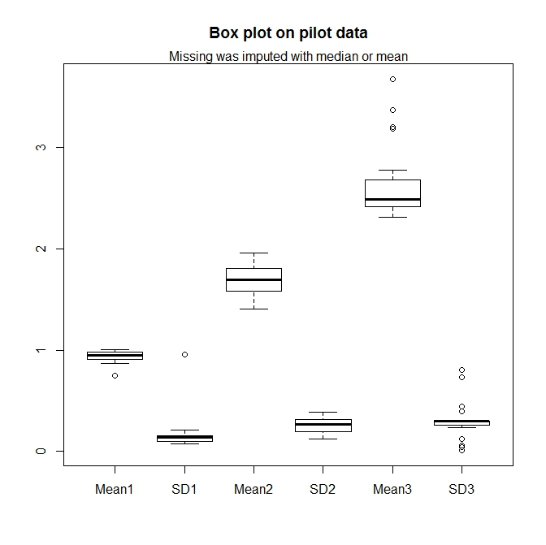

Slide 22
Our goal -- step
Three basic clusters of cell populations
D.I. value: 0.9 – 1.249
D.I. value: 1.250 – 2.299
D.I. value: > 2.300
Assuming equal C.V. across three populations, and estimated from “normal sample”:
Three means: 1.001, 2.002, 3.003

Slide 24
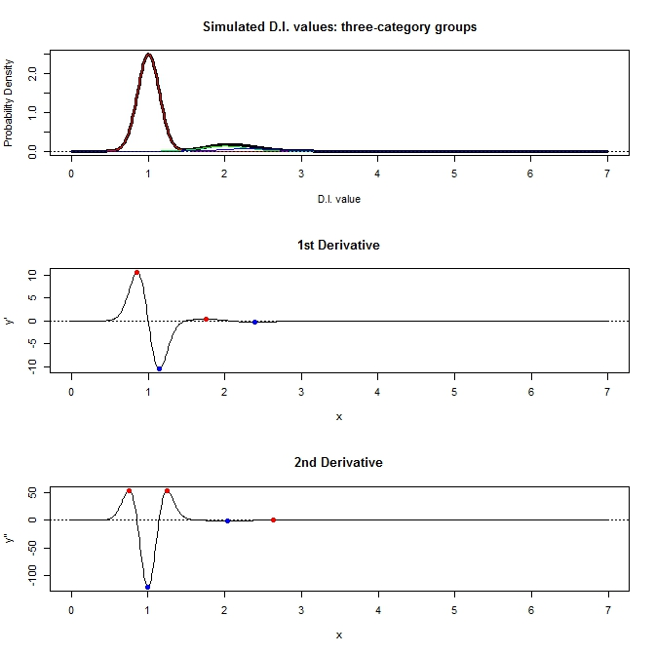

Slide 25
Our hurdle
Too much information from “normal” cluster
Possible to detect the “mitotic” stage
Impossible to detect “aneuploidy” stage
Need to strip out the “normal” information first, but how?
Don’t know
Don’t know
Don’t know

Slide 26
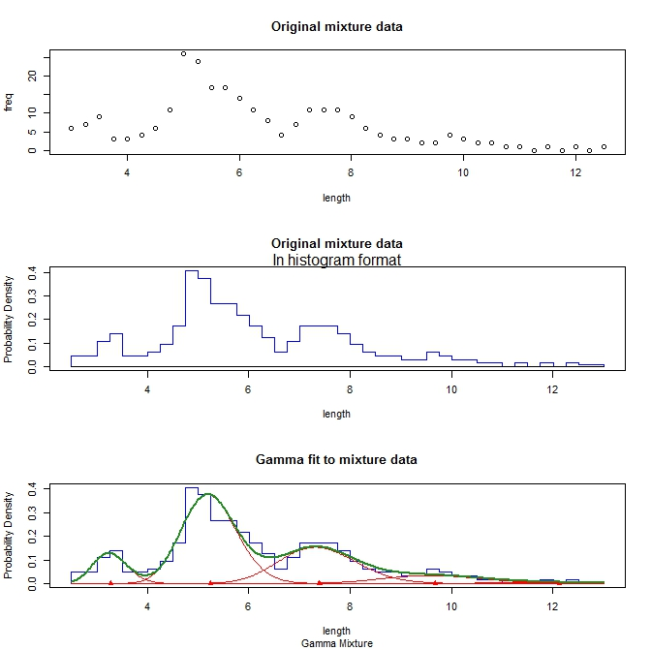

Slide 27
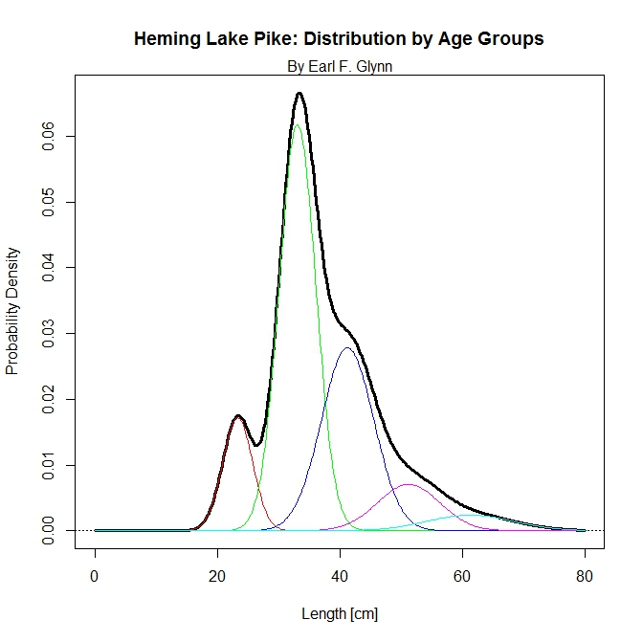
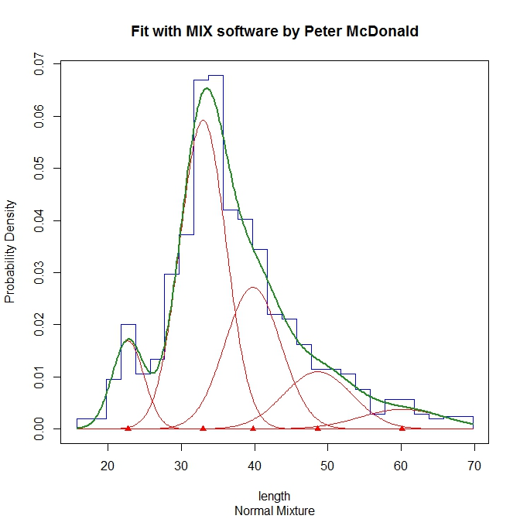
Mixture of five group data

