Slide 1

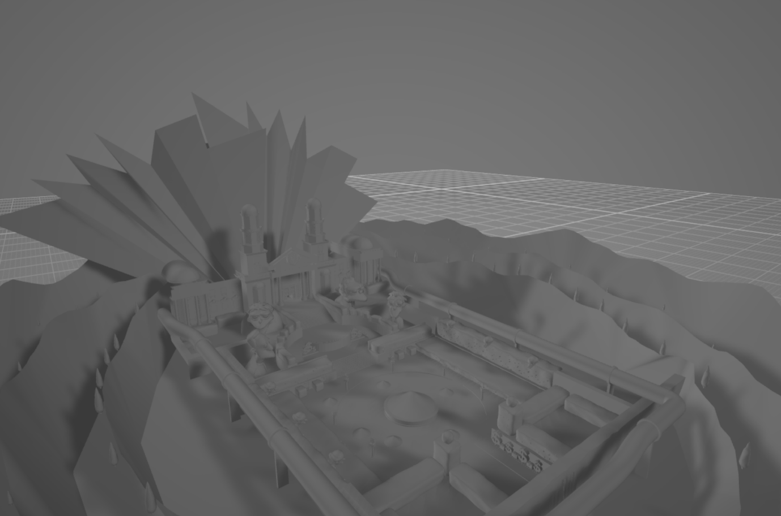
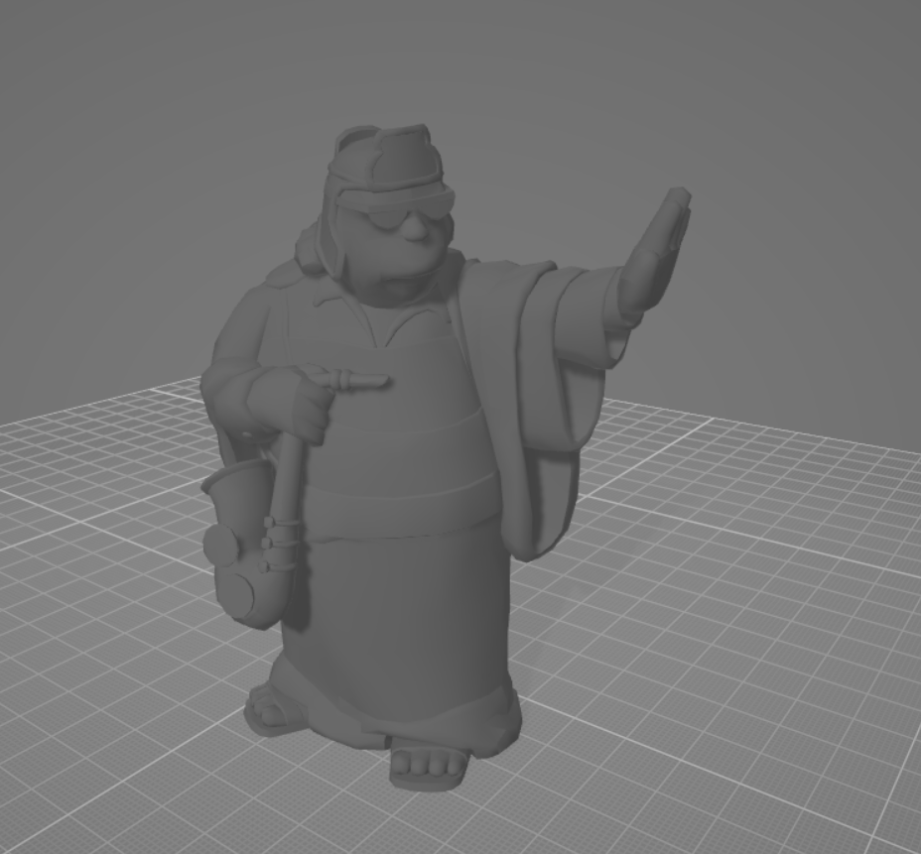
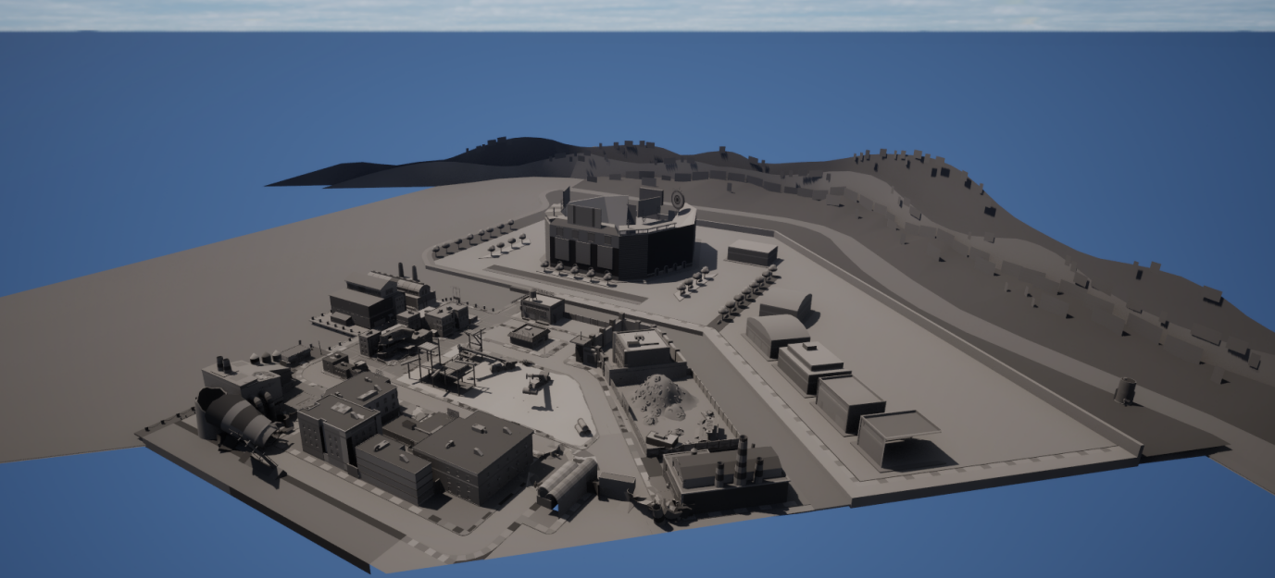
File Reverse engineering for the purpose of Game Preservation and Restoration to creating abstract tool for future Reverse engineering.
Name : Khai Ailyan
Student Id : 22130235
Introduction:
Games preservation is the practice of preserving games, game files and game code for the purposes of long-term maintenance and accessibility of the games for the consumers and companies.
File reverse engineering and converting can be used to preserve games by virtue of reverse engineering the files and converting them to contemporary files formats. These can then be used in modern game engines therefore preserving their contents for further use.
The aim of the report was to create a Graphical tool to aid programmers in reverse engineering game asset files. Called the GAD (Game Abstract Diagram, This was done through reverse engineering and converting .Str/.Rws/.Dff files to contemporary formats such as .Obj model files.
This was done to the “Simpsons game 2008” game asset files.
Method And Implementation:
Discussion And Results:
The results were shown to be accurate; this was validated with the lack of graphics artefacts when the converted .Objs were parsed into 3d rendering software e.g. unreal, Object viewer etc.
Conclusions:
The main takeaways are that the given game asset files were reverse engineered, decoded and converted correctly.
The GAD details the breakdown of reverse engineering files correctly, as the processes detailed in the methodology reflect the process of the GAD development of the file decorers.
References - Tito waluyo purboyo, 2017, a review of data compression techniques, international journal of applied engineering research, 8596 - 8963, (PDF) A review of data compression techniques. SIDDEQ, mohammed M and Rodrigues, marcos, 2016, Novel 3D compression methods for geometry connectivity and texture, Sheffield hallam university research archive, 1 - 16, Microsoft Word - Research_No_7_MR_final.docx Mustafa ORAL, Ammar abbas Elmas, 2017, A brief history of 3d mesh compression, Cukorva university, 1-6, , https://www.researchgate.net/publication/327905583_A_Brief_History_of_3D_Mesh_Compression Amandeep Singh Sidhu, 2014, Research paper on text data compression algorithm using hybrid approach, International Journal of Computer Science and Mobile Computing,volume 3 issue 12, 1 - 10, https://ijcsmc.com/docs/papers/December2014/V3I12201404.pdf.Sjöstrand, M. (2005). A study in compression algorithms. https://www.diva-portal.org/smash/get/diva2:830266/FULLTEXT01.pdf. Peng, J., Kim, C.-S. and Jay Kuo, C.-C. . (2005). Technologies for 3D mesh compression: A survey. Journal of Visual Communication and Image Representation, 16(6), pp.688–733. doi:https://doi.org/10.1016/j.jvcir.2005.03.001. Girard, J.-F. and Koschke, R. (2000). A comparison of abstract data types and objects recovery techniques. Science of Computer Programming, 36(2-3), pp.149–181. doi:https://doi.org/10.1016/s0167-6423(99)00035-0. Guttag, J.V., Horowitz, E. and Musser, D.R. (1978). Abstract data types and software validation. Communications of the ACM, 21(12), pp.1048–1064. doi:https://doi.org/10.1145/359657.359666. Guttag, J. (1977). Abstract data types and the development of data structures. Communications of the ACM, 20(6), pp.396–404. doi:https://doi.org/10.1145/359605.359618. Liskov, B. and Zilles, S. (1974). Programming with abstract data types. ACM SIGPLAN Notices, 9(4), pp.50–59. doi:https://doi.org/10.1145/942572.807045. Musser, D.R. (1980). On proving inductive properties of abstract data types. doi:https://doi.org/10.1145/567446.567461. Bertoni, A., Mauri, G. and P. Miglioli (2006). Towards a theory of abstract data types: A discussion on problems and tools. Lecture Notes in Computer Science, [online] pp.44–58. doi:https://doi.org/10.1007/3-540-09981-6_4. A, A. (2021). Reverse Engineering Research. [online] doi:https://doi.org/10.13140/RG.2.2.28030.51520. Mantovani, A., Aonzo, S., Fratantonio, Y., Talos, C. and Balzarotti, D. (n.d.). RE-Mind: a First Look Inside the Mind of a Reverse Engineer. [online] Available at: https://www.usenix.org/system/files/sec22summer_mantovani.pdf. Jain, A., Swapnil Soner and Anand Gadwal (2011). Reverse engineering: Journey from code to design. doi:https://doi.org/10.1109/icectech.2011.5941966.Singh, R. (2013). A Review of Reverse Engineering Theories and Tools. [online] 2, pp.35–38. Available at: https://www.ijesi.org/papers/Vol(2)1/G213538.pdf. Cipresso, T. and Stamp, M. (2010). Software Reverse Engineering. Handbook of Information and Communication Security, pp.659–696. doi:https://doi.org/10.1007/978-3-642-04117-4_31. Müller, H.A., Jahnke, J.H., Smith, D.B., Storey, M.-A., Tilley, S.R. and Wong, K. (2000). Reverse engineering. Proceedings of the conference on The future of Software engineering - ICSE ’00. doi:https://doi.org/10.1145/336512.336526. Google Books. (2024). Reversing. [online] Available at: https://books.google.co.uk/books?hl=en&lr=&id=_78HnPPRU_oC&oi=fnd&pg=PR23&dq=reverse+engi neering+software&ots=EP1MLkmRVn&sig=stA7p1aP8xPSkUcFJi6jOCmA_Is&redir_esc=y#v=onepage &q=reverse%20engineering%20software&f=false [Accessed 25 Nov. 2024]. Davis, K.L. and Alken, P.H. (2002). Data reverse engineering: a historical survey. doi:https://doi.org/10.1109/wcre.2000.891454. Bachell, A. and Barr, M. (2014). Video Game Preservation in the UK: A Survey of Records Management Practices. International Journal of Digital Curation, 9(2), pp.139–170. doi:https://doi.org/10.2218/ijdc.v9i2.294. Davide V (2024). GTA-Modding.com - Download Area» GTA San Andreas» Tools» RW Analyze. [online] Gta-modding.com. Available at: https://www.gta-modding.com/area/file-33-rw-analyze.html [Accessed 25 Nov. 2024]. Winget, M.A. and Murray, C. (2008). Collecting and preserving videogames and their related materials: A review of current practice, game-related archives and research projects. Proceedings of the American Society for Information Science and Technology, 45(1), pp.1–9. doi:https://doi.org/10.1002/meet.2008.1450450250. Todd, B. and Hopkins, J. (2019). Running head: PRESERVING VIDEO GAME SIGNIFICANCE Preserving Video Game Significance: A Practical Guide for Video Game Preservation, Exhibition, and their Significant Properties. [online] Available at: https://jscholarship.library.jhu.edu/server/api/core/bitstreams/49d19d02-a439-4a7d-8243-a685429cbcac/c ontent.Guay-Bélanger, D. (2021). Assembling Auras: Towards a Methodology for the Preservation and Study of Video Games as Cultural Heritage Artefacts. Games and Culture, p.155541202110203. doi:https://doi.org/10.1177/15554120211020381. Digra.org. (2024). View of Before It’s Too Late: Preserving Games across the Industry / Academia divide. [online] Available at: https://dl.digra.org/index.php/dl/article/view/468/468 [Accessed 25 Nov. 2024]. Johansson, C. and Koenitz, H. (n.d.). Video Game Preservation and Emulation from Three Perspectives: Developers, Archivists and Gamers Video Game Preservation and Emulation from Three Perspectives: Developers, Archivists and Gamers. [online] Available at: http://sh.diva-portal.org/smash/get/diva2:1807915/FULLTEXT02.pdf. Haydock, C. (2018). Challenges in Preserving Video Games. [online] Carolina Digital Repository. Available at: https://cdr.lib.unc.edu/concern/masters_papers/fn107276t [Accessed 25 Nov. 2024]. Folk, M. and Barkstrom, B.R. (2003). Attributes of file formats for long-term preservation of scientific and engineering data in digital libraries. [online] Available at: https://www.researchgate.net/publication/228726593_Attributes_of_file_formats_for_long-term_preservation_of_scientific_and_engineering_data_in_digital_libraries. THE DEFINITIVE GUIDE TO EXPLORING FILE FORMATS Mr.Mouse and WATTO. (n.d.). Available at: https://www.gamedevs.org/uploads/the-definitive-guide-to-exploring-file-formats.pdf [Accessed 25 Nov. 2024]. File Formats for Big Data Storage Systems. (2019). International Journal of Engineering and Advanced Technology, 9(1), pp.2906–2912. doi:https://doi.org/10.35940/ijeat.a1196.109119. Zhenhua, W. (2018). Design and Research of an Image File Format with Rich Information. Journal of Electrical and Electronic Engineering, 6(2), p.71. doi:https://doi.org/10.11648/j.jeee.20180602.16. Ontology of Heterogeneous Image File Formats and their Disparate Applications. (2021). International Journal of Advanced Trends in Computer Science and Engineering, 10(6), pp.3138–3143. doi:https://doi.org/10.30534/ijatcse/2021/091062021. Dinneen, J.D. and Julien, C.-A. (2021). The ubiquitous digital file: A review of file management research. [online] doi: https://doi.org/10.48550/arXiv.2109.09668.Underwood, W. (2012). Grammar-Based Specification and Parsing of Binary File Formats. International Journal of Digital Curation, 7(1), pp.95–106. doi:https://doi.org/10.2218/ijdc.v7i1.217. Fred brooks, Data definition and file syntax for ISO/TS 14048 data exchange with data storage format based on ISO/TS 14048, RAUL CARLSON JOHAN TIVANDER, CHALMERS UNIVERSITY OF TECHNOLOGY, 2001, https://citeseerx.ist.psu.edu/document?repid=rep1&type=pdf&doi=676dc77da1217c8cdd1b61d76c83cad5 30bc3159

