Slide 1

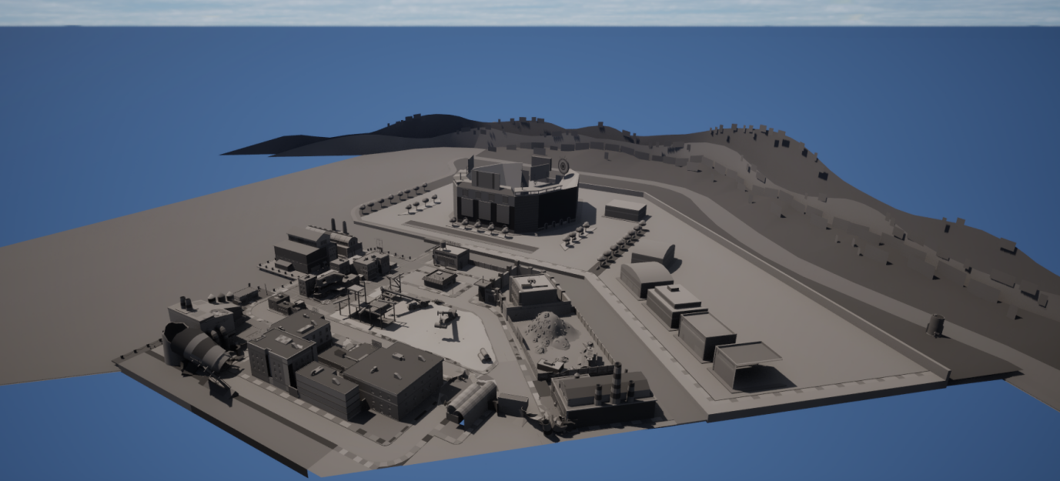
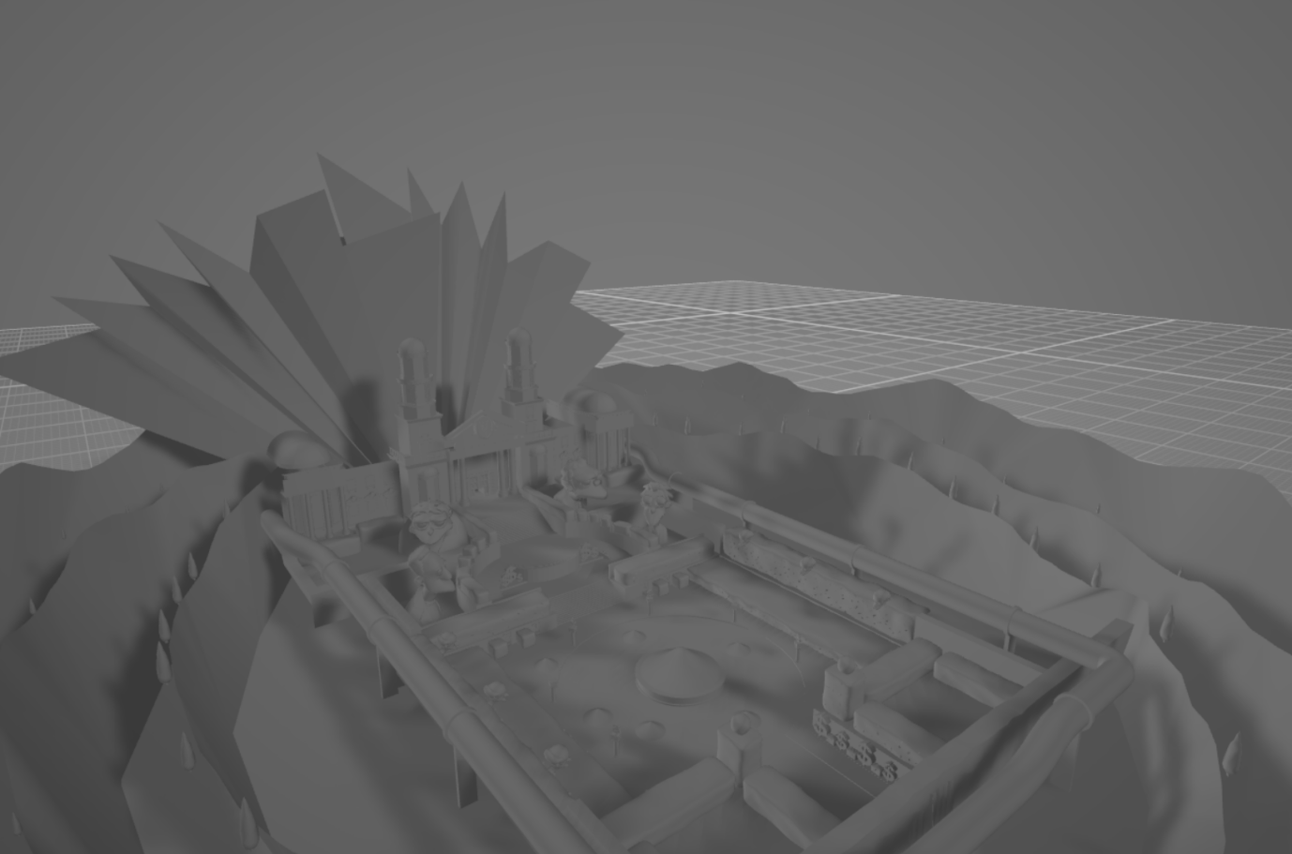
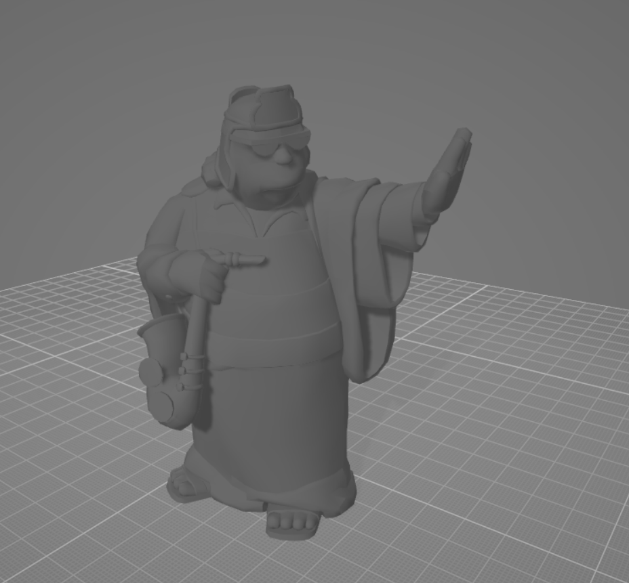
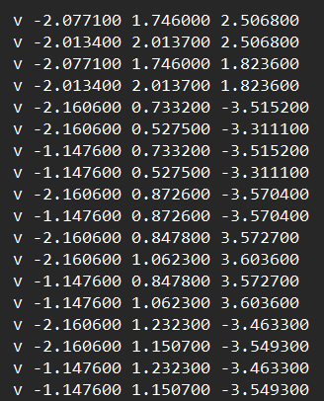
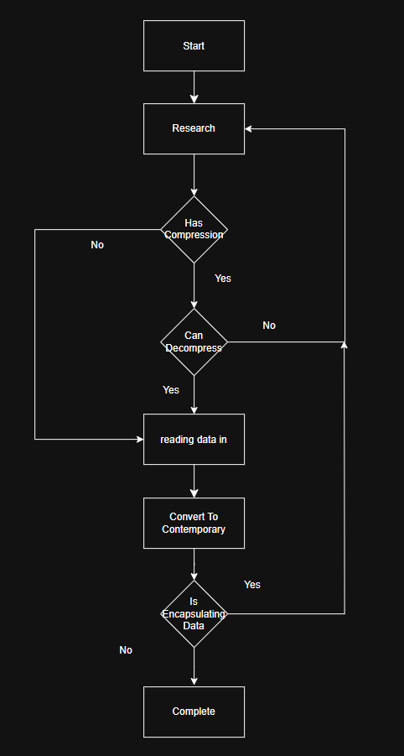
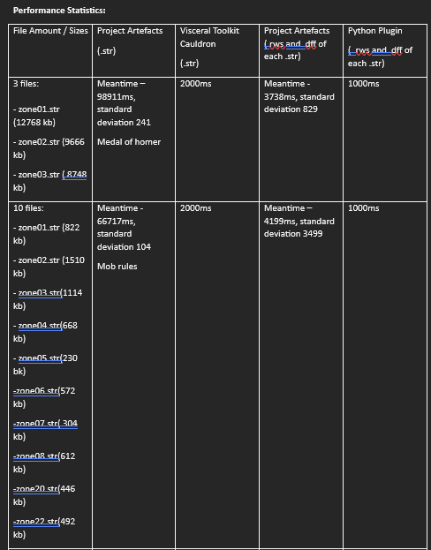
File Reverse engineering for the purpose of Game Preservation and Restoration For creating An abstract tool for future Reverse engineering.
By Khai Ailyan 22130235
Project Aim:
The aim of the report was to reverse engineer game asset files and convert them into contemporary file formats. As well as create a Diagram to aid future reverse engineers preserve games. This will be called the GAD.
This was done to the Simpsons game 2008, the chosen files were .Str files (Ps3 Stream files) and.Rws /.Dff files.
Literature and Research:
Reverse engineering: Reverse engineering as a practice can be used to preserve games through means of understanding the games contents (Singh 2013) and converting them to contemporary format.
File Syntax: File syntax is needed in preserving the games contents, as to convert the files they first need to be understood (Mouse; Watto 2004). A profile is to be made to create code to read/write to files and preserve their contents.
ADT: ADTs are ways of containing data in specific configurations with specific functionality (Liskov 1974), game asset files need their contents parsed to ADTs or ADT-LIKE structures to then be outputted to a contemporary file type.
Compression: game asset files are usually compressed to take up less space on proprietary hardware (Elmas 2017), therefore, to preserve the contents of the game, each file must be uncompressed to express their true values as data to then be reverse engineered successfully so that preserving the game can be done.
Games Preservation: games preservation can be done through preserving the games assets files(Mike Fold 2003), this is an effective method of preserving the game, as the games contents are secured for further use, either to play or be reconstructed by programmers and reverse engineers.
Background:
As Games become older there is less investment from their creators, as a result games go obsolete with time. This makes games preservation vital in ensuring these games do not go obsolete and forgotten for public and professional use.
Games preservation is the act of preserving and maintain games, games systems and their files Games preservation as a practice can be done through preserving the contents of the game asset files for further use.
4 Artefacts were created in total for this purpose, .Str file exporter, .Rws and .Dff file converter to .Obj and the GAD which is a diagram detailing the process in reverse engineering file types. Software Artefacts were Written in c++ for speed and memory efficiency.
Method And Implementation:
Each .Str file had its syntax profile built through static analysis, i.e reading the file as raw binary in a hex editor to discern patters, a syntax profile was built, and code was written to read in the files. Each Section in the .Str files were decompressed and its contents exported.
The data was read into lists to be exported as subfiles, each individual sub file was determined, via their file extension, if they were a geometry file i.e .Rws and .Dff. Each geometry file was processed into .Obj files by understanding their syntax, parsing their data into appropriate ADTs such as lists, and exporting them as “v”, “vt”, “vn” and “f” rows.
Each file is then determined whether or not they have subsequent encapsulating data, if they do not, then the process is complete. If they do the process repeats until the contents are successfully converted to contemporary formats.
Below is an .Obj file and the GAD.
Discussion and Results:
The results were the successful conversion of the .Str/.Rws/.Dff files and the creation of .Obj files from .Rws and .Dff files. These .Objs include models from the colossal doughnut, never quest and Kill lawyer's level.
These results were validated through using 3d rendering software i.e unreal engine and the inbuilt windows object viewer. There were no graphical artefacts such as error with lighting or geometry. As well as each file being compared to their in-game counterpart.
Figure 1 shows the Colossal Doughnut Level
Figure 2 shows the Kill all lawyers Level
Figure 3 shows A statue in the Never Quest Level
Results Table:
These results detail the speed of which the artefact process their respective files. These speeds are compared with the artefacts that also process these files types.
The reports software artefacts were slower, but this was due to the report's artefacts doing more computations such as vertex normal calculations.
Figure 4 shows the .Obj values of a converted file
Figure 5 shows the GAD
Conclusions And Future work:
The key take aways from this project are the successfully reverse engineered game asset files from the Simpsons game 2008.Such files are a proof of concept for the sucess of the GAD as a means of games prservation and reverse engineering.
For future work, more of the Simpsons games asset files are to be converted, such as textures i.e .TXD files, to be converted to .DDS.
Figure 6 shows the contrasting performance statistics between artefacts
References - Tito waluyo purboyo, 2017, a review of data compression techniques, international journal of applied engineering research, 8596 - 8963, (PDF) A review of data compression techniques. SIDDEQ, mohammed M and Rodrigues, marcos, 2016, Novel 3D compression methods for geometry connectivity and texture, Sheffield hallam university research archive, 1 - 16, Microsoft Word - Research_No_7_MR_final.docx Mustafa ORAL, Ammar abbas Elmas, 2017, A brief history of 3d mesh compression, Cukorva university, 1-6, , https://www.researchgate.net/publication/327905583_A_Brief_History_of_3D_Mesh_Compression Amandeep Singh Sidhu, 2014, Research paper on text data compression algorithm using hybrid approach, International Journal of Computer Science and Mobile Computing,volume 3 issue 12, 1 - 10, https://ijcsmc.com/docs/papers/December2014/V3I12201404.pdf.Sjöstrand, M. (2005). A study in compression algorithms. https://www.diva-portal.org/smash/get/diva2:830266/FULLTEXT01.pdf. Peng, J., Kim, C.-S. and Jay Kuo, C.-C. . (2005). Technologies forProgramming, 36(2-3), pp.149–181. doi:https://doi.org/10.1016/s0167-6423(99)00035-0. Guttag, J.V., Horowitz, E. and Musser, D.R. (1978). Abstract data types and software validation. Communications of the ACM, 21(12), pp.1048–1064. doi:https://doi.org/10.1145/359657.359666. Guttag, J. (1977). Abstract data types and the development of data structures. Communications of the ACM, 20(6), pp.396–404. doi:https://doi.org/10.1145/359605.359618. Liskov, B. and Zilles, S. (1974). Programming with abstract data types. ACM SIGPLAN Notices, 9(4), pp.50–59. doi:https://doi.org/10.1145/942572.807045. Musser, D.R. (1980). On proving inductive properties of abstract data types. doi:https://doi.org/10.1145/567446.567461. Bertoni, A., Mauri, G. and P. Miglioli (2006). Towards a theory of abstract data types: A discussion on problems and tools. Lecture Notes in Computer Science, [online] pp.44–58. doi:https://doi.org/10.1007/3-540-09981-6_4. A, A. (2021). Reverse Engineering Research. [online] doi:https 3D mesh compression: A survey. Journal of Visual Communication and Image Representation, 16(6), pp.688–733. doi:https://doi.org/10.1016/j.jvcir.2005.03.001. Girard, J.-F. and Koschke, R. (2000). A comparison of abstract data types and objects recovery techniques. Science of Computer ://doi.org/10.13140/RG.2.2.28030.51520. Mantovani, A., Aonzo, S., Fratantonio, Y., Talos, C. and Balzarotti, D. (n.d.). RE-Mind: a First Look Inside the Mind of a Reverse Engineer. [online] Available at: https://www.usenix.org/system/files/sec22summer_mantovani.pdf. Jain, A., Swapnil Soner and Anand Gadwal (2011). Reverse engineering: Journey from code to design. doi:https://doi.org/10.1109/icectech.2011.5941966.Singh, R. (2013). A Review of Reverse Engineering Theories and Tools. [online] 2, pp.35–38. Available at: https://www.ijesi.org/papers/Vol(2)1/G213538.pdf. Cipresso, T. and Stamp, M. (2010). Software Reverse Engineering. Handbook of Information and Communication Security, pp.659–696. doi:https://doi.org/10.1007/978-3-642-04117-4_31. Müller, H.A., Jahnke, J.H., Smith, D.B., Storey, M.-A., Tilley, S.R. and Wong, K. (2000). Reverse engineering. Proceedings of the conference on The future of Software engineering - ICSE ’00. doi:https://doi.org/10.1145/336512.336526. Google Books. (2024). Reversing. [online] Available at: https://books.google.co.uk/books?hl=en&lr=&id=_78HnPPRU_oC&oi=fnd&pg=PR23&dq=reverse+engi neering+software&ots=EP1MLkmRVn&sig=stA7p1aP8xPSkUcFJi6jOCmA_Is&redir_esc=y#v=onepage &q=reverse%20engineering%20software&f=false [Accessed 25 Nov. 2024]. Davis, K.L. and Alken, P.H. (2002). Data reverse engineering: a historical survey. doi:https://doi.org/10.1109/wcre.2000.891454. Bachell, A. and Barr, M. (2014). Video Game Preservation in the UK: A Survey of Records Management Practices. International Journal of Digital Curation, 9(2), pp.139–170. doi:https://doi.org/10.2218/ijdc.v9i2.294. Davide V (2024). GTA-Modding.com - Download Area» GTA San Andreas» Tools» RW Analyze. [online] Gta-modding.com. Available at: https://www.gta-modding.com/area/file-33-rw-analyze.html [Accessed 25 Nov. 2024]. Winget, M.A. and Murray, C. (2008). Collecting and preserving videogames and their related materials: A review of current practice, game-related archives and research projects. Proceedings of the American Society for Information Science and Technology, 45(1), pp.1–9. doi:https://doi.org/10.1002/meet.2008.1450450250. Todd, B. and Hopkins, J. (2019). Running head: PRESERVING VIDEO GAME SIGNIFICANCE Preserving Video Game Significance: A Practical Guide for Video Game Preservation, Exhibition, and their Significant Properties. [online] Available at: https://jscholarship.library.jhu.edu/server/api/core/bitstreams/49d19d02-a439-4a7d-8243-a685429cbcac/c ontent.Guay-Bélanger, D. (2021). Assembling Auras: Towards a Methodology for the Preservation and Study of Video Games as Cultural Heritage Artefacts. Games and Culture, p.155541202110203. doi:https://doi.org/10.1177/15554120211020381. Digra.org. (2024). View of Before It’s Too Late: Preserving Games across the Industry / Academia divide. [online] Available at: https://dl.digra.org/index.php/dl/article/view/468/468 [Accessed 25 Nov. 2024]. Johansson, C. and Koenitz, H. (n.d.). Video Game Preservation and Emulation from Three Perspectives: Developers, Archivists and Gamers Video Game Preservation and Emulation from Three Perspectives: Developers, Archivists and Gamers. [online] Available at: http://sh.diva-portal.org/smash/get/diva2:1807915/FULLTEXT02.pdf. Haydock, C. (2018). Challenges in Preserving Video Games. [online] Carolina Digital Repository. Available at: https://cdr.lib.unc.edu/concern/masters_papers/fn107276t [Accessed 25 Nov. 2024]. Folk, M. and Barkstrom, B.R. (2003). Attributes of file formats for long-term preservation of scientific and engineering data in digital libraries. [online] Available at: https://www.researchgate.net/publication/228726593_Attributes_of_file_formats_for_long-term_preservation_of_scientific_and_engineering_data_in_digital_libraries. THE DEFINITIVE GUIDE TO EXPLORING FILE FORMATS Mr.Mouse and WATTO. (n.d.). Available at: https://www.gamedevs.org/uploads/the-definitive-guide-to-exploring-file-formats.pdf [Accessed 25 Nov. 2024]. File Formats for Big Data Storage Systems. (2019). International Journal of Engineering and Advanced Technology, 9(1), pp.2906–2912. doi:https://doi.org/10.35940/ijeat.a1196.109119. Zhenhua, W. (2018). Design and Research of an Image File Format with Rich Information. Journal of Electrical and Electronic Engineering, 6(2), p.71. doi:https://doi.org/10.11648/j.jeee.20180602.16. Ontology of Heterogeneous Image File Formats and their Disparate Applications. (2021). International Journal of Advanced Trends in Computer Science and Engineering, 10(6), pp.3138–3143. doi:https://doi.org/10.30534/ijatcse/2021/091062021. Dinneen, J.D. and Julien, C.-A. (2021). The ubiquitous digital file: A review of file management research. [online] doi: https://doi.org/10.48550/arXiv.2109.09668.Underwood, W. (2012). Grammar-Based Specification and Parsing of Binary File Formats. International Journal of Digital Curation, 7(1), pp.95–106. doi:https://doi.org/10.2218/ijdc.v7i1.217. Fred brooks, Data definition and file syntax for ISO/TS 14048 data exchange with data storage format based on ISO/TS 14048, RAUL CARLSON JOHAN TIVANDER, CHALMERS UNIVERSITY OF TECHNOLOGY, 2001, https://citeseerx.ist.psu.edu/document?repid=rep1&type=pdf&doi=676dc77da1217c8cdd1b61d76c83cad5 30bc3159

