Slide 1
Assignment 2
Task 1 - Implementation as a Group and Demonstrate

Slide 2
Team Formation – Members and Roles
Charlie Williams (2235685) – Network Administrator
Jonathan Morgan (2218940) – Network Administrator

Slide 3




Communication Methods
WhatsApp
Email
Face to face communication
Microsoft Teams

Slide 4

Objectives
Build basic IP networking setup with 7 devices and routing
Configure working SSH on Cisco devices
Build Linux VM with working Ansible install
Ansible working via SSH to the 4 Cisco networking devices
Ansible runs ‘Playbooks’ to automate further configuration of the 4 Cisco networking devices
Deliver demonstration – 7th January 2025

Slide 5
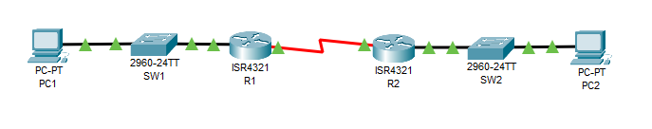
Basic Topology
LAN3
R1 Serial 0/1/0 | 10.0.0.1/30
R2 Serial 0/1/0 | 10.0.0.2/30
LAN1
R1 Gig 0/0/0 | 192.168.1.1/24
SW1 SVI | 192.168.1.2/24
PC1 | 192.168.1.3/24
AnsibleVM on PC1 | 192.168.1.4/24
LAN2
R2 Gig 0/0/0 | 192.168.100.1/24
SW2 SVI | 192.168.100.2/24
PC2 | 192.168.100.3/24

Slide 6
Planning
Option 1 – Use tools to automate configuring network devices
Reasons:
We both preferred the idea of working with Cisco networking devices over writing a python app that used REST API’s.
Using physical devices in the LAB – slightly trickier as can only work whilst ‘on-site’ but provides a more ‘realistic’ experience to learn from
Using Ansible as the primary tool to enable automation – it was the tool taught during lectures, but also seeing widespread real-world usage
Automations to achieve would ideally be information gathering, security stance setting and routing protocol configuration

Slide 7
Why Ansible for network automation?
As previously mentioned, Ansible is what was taught during lectures.
Ansible uses SSH to communicate with devices, so no need for an installed agent on recipient machines. Works well for this scenario [1]
Ansible uses YAML, which is human readable. This means it would be easier for us to learn and understand. [2]
[1]: https://ezeelive.com/ansible-advantages-disadvantages
[2]: https://orhanergun.net/introduction-to-ansible-for-network-automation

Slide 8
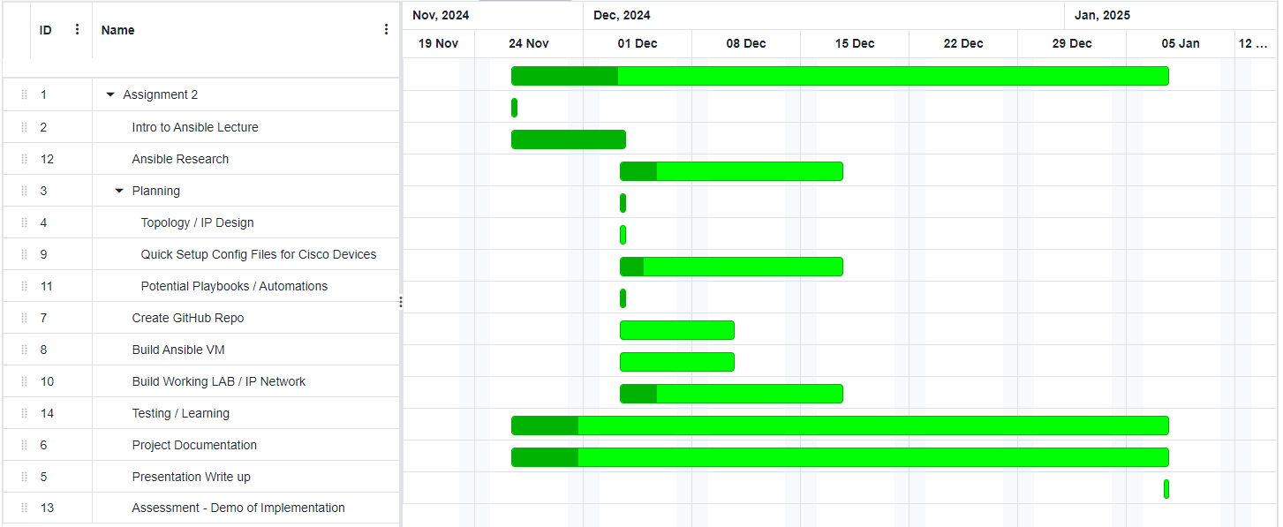
Projected Timeline
https://www.onlinegantt.com/ used to generate our Gantt chart

Slide 9
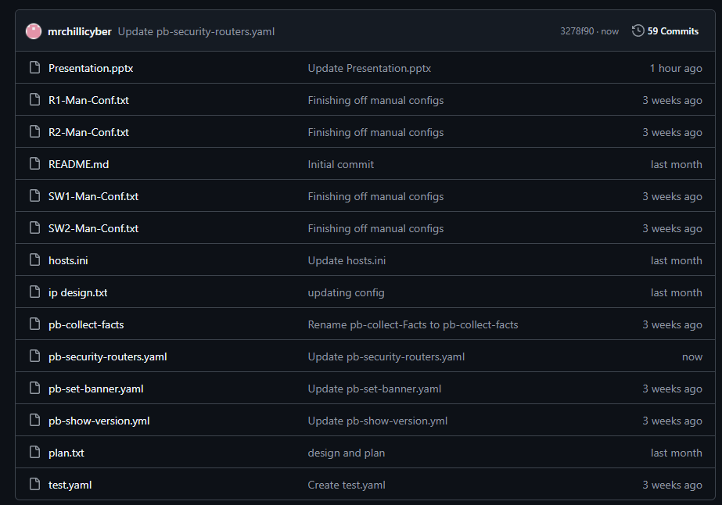
GitHub
A ‘private’ repository exists at:
https://github.com/2wheelsdown/NPAssignment2

Slide 10
Git on the VM
We installed the Git package on our AnsibleVM - allows push and pull changes to/from GitHub repo. This was done using a personal access token.
Enabled us to keep track of changes being made to individual files and utilise version control.
Gave us a centralised storage space for all our config and playbook files.
Backup of files in case the VM (or progress made on another devices) was lost.

Slide 11
Resources / References
Ansible Documentation site - https://docs.ansible.com/
Cisco Developer (DevNet) site - https://developer.cisco.com/
J. Geerling, Ansible for DevOps - 2nd Edition - Server and configuration management for humans, 2nd Ed. leanpub.com, 2023
YouTube – various channels (NetworkChuck, Jeff Geerling, Techno Tim, Learn Linux TV)

Slide 12
Demonstration
Pulling updated config files from Github repo
Ansible Configuration File
Ansible Hosts/Inventory File
Ansible executing ad-hoc commands
Ansible executing pre-constructed, planned ‘playbook’ files

Slide 13
Team Members Participation
I (Jon) will give Charlie a 5 out of 5 – he was excellent to work alongside and helped me out of several sticky problems.
I (Charlie) will also Jon a 5 out of 5. Jon was a pleasure to work with and his knowledge of networks allowed the project to proceed smoothly.

Slide 14
Future Enhancements
Learn how to configure routing protocols via Ansible
Learn how to implement more complicated ‘logic’ in playbooks so conditions can be evaluated and specific actions taken / settings made based on those evaluations
Learn how to use Ansible to apply software upgrades to Cisco devices

Slide 15
Q&A Time
?

