Slide 1
Assignment 2
Task 1 - Implementation as a Group and Demonstrate

Slide 2
Team Formation – Members and Roles
Charlie Williams (2235685) – Network Administrator
Jonathan Morgan (2218940) – Network Administrator

Slide 3




Communication Methods

Slide 4
Planning
Option 1 – Use tools to automate configuring network devices
Reasons:
We both preferred the idea of working with Cisco networking devices over writing a python app that used REST API’s
Using physical devices in the LAB – slightly trickier as can only work whilst ‘on-site’ but provides a more ‘realistic’ experience to learn from
Using Ansible as the primary tool to enable automation – it was the tool taught during lectures, but also seeing widespread real-world usage
Automations to achieve would ideally be information gathering, security stance setting and routing protocol configuration

Slide 5
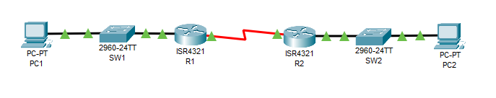
Basic Topology
LAN3
R1 Serial 0/1/0 | 10.0.0.1/30
R2 Serial 0/1/0 | 10.0.0.2/30
LAN1
R1 Gig 0/0/0 | 192.168.1.1/24
SW1 SVI | 192.168.1.2/24
PC1 | 192.168.1.3/24
AnsibleVM on PC1 | 192.168.1.4/24
LAN2
R2 Gig 0/0/0 | 192.168.100.1/24
SW2 SVI | 192.168.100.2/24
PC2 | 192.168.100.3/24

Slide 6

Objectives
Build basic IP networking setup with 7 devices and routing
Configure working SSH on Cisco devices
Build Linux VM with working Ansible install
Ansible working via SSH to the 4 Cisco networking devices
Ansible runs ‘Playbooks’ to automate further configuration of the 4 Cisco networking devices
Deliver demonstration – 7th January 2025

Slide 7
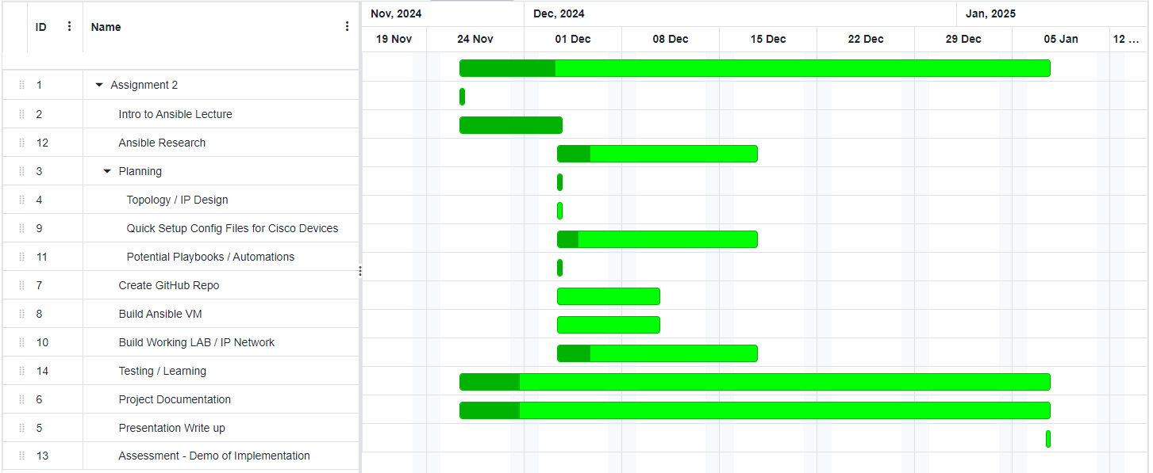
Projected Timeline

Slide 8
Github
A ‘private’ repository exists at:
https://github.com/2wheelsdown/NPAssignment2

