Slide 1
互联网概述
主讲：孟宁
电话：0512-68839303
E-mail：mengning@ustc.edu.cn
主页：http://staff.ustc.edu.cn/~mengning

Slide 2


互联网概述
计算机网络的发展
OSI模型与TCP/IP协议族
IPv4 and IPv6
ARP协议
网络程序设计中的几种不同视角
电信/通信行业软件开发主要涉及的领域

Slide 3
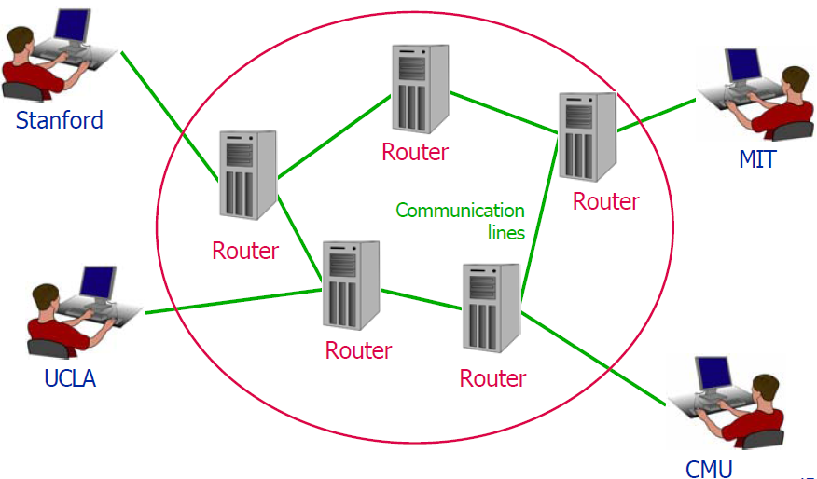
ARPANET (1970s)
Advanced Research Project Agency Network

Slide 4
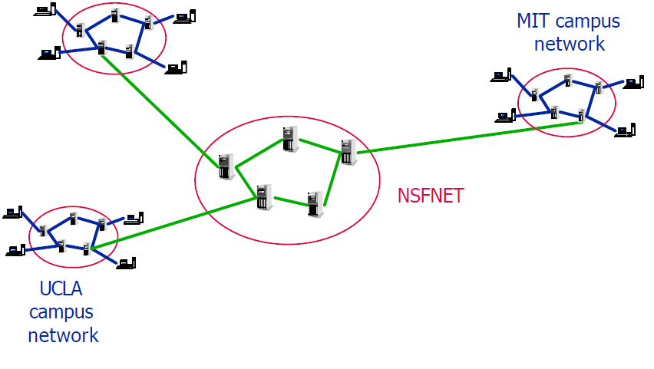

NSFNET (1980s)
National Science Foundation

Slide 5
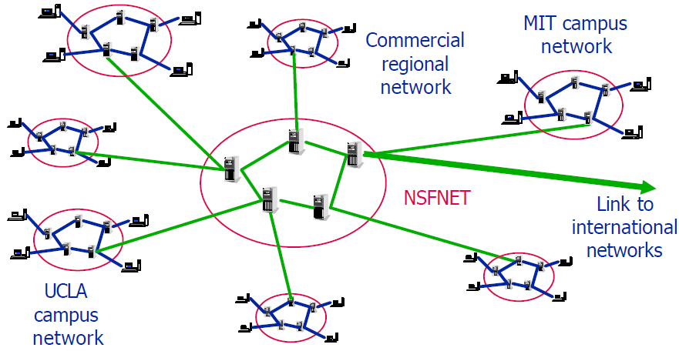
Growth of NSFNET

Slide 6
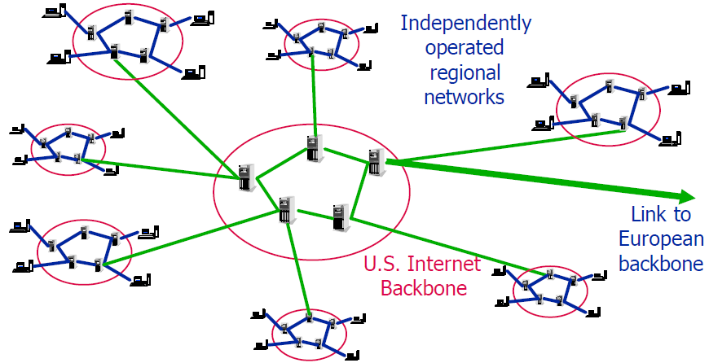
The Internet: a Network of Networks

Slide 7
Internet Properties
All hosts on the Internet communicate using common network protocols
TCP/IP, first developed for ARPANET
Different parts of the Internet are operated by different entities
governments, telephone companies, universities etc.
No single organization controls or owns the Internet

Slide 8
OSI Abstraction Layers
7: Application layer
E.g., terminal emulation, file transfer
6: Presentation layer
Handles encryption, compression, other translation of messages
5: Session layer
Establishes and terminates connections between applications
4: Transport layer
Divides messages into packets;assembles packets into messages
3: Network layer
Finds routes for packets; transmits them to next node
2: Link layer
Breaks packets into frames; sends frames between nodes
1: Physical layer
Sends bits over wires

Slide 9
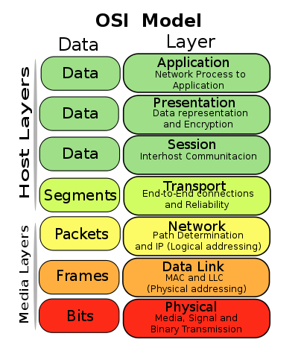
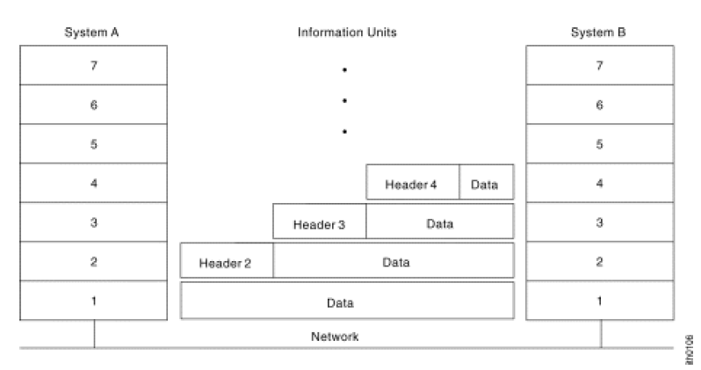
Information Exchange Process through OSI Layers

Slide 10
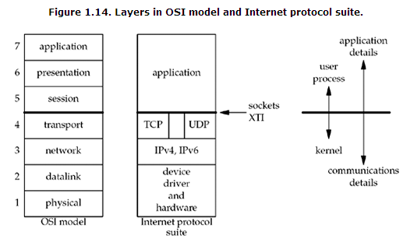
TCP/IP vs OSI Model

Slide 11
Byte Ordering
Different computer architectures use different byte ordering to represent multibyte values.
16 bit integer:
Low Byte
Address A
High Byte
High Byte
Address A+1
Low Byte

Slide 12
Byte Order and Networking
Suppose a Big Endian machine sends a 16 bit integer with the value 2:
A Little Endian machine will think it got the number 512:
0000000000000010
0000001000000000

Slide 13
Byte Order and Networking
Big Endian - PowerPC，Sparc64,etc
Little Endian - X86
网络字节顺序是Big Endian还是Little Endian？

Slide 14
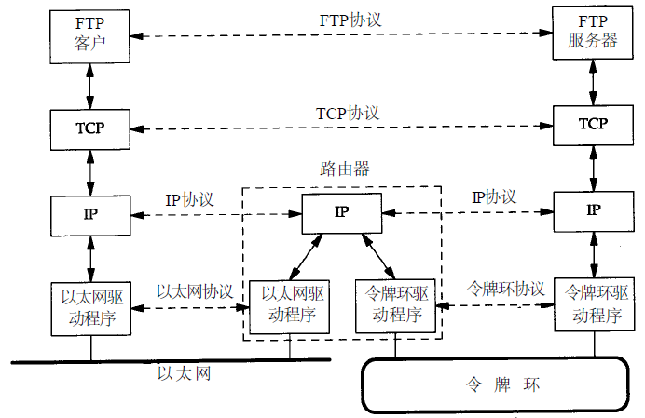
TCP/IP Layer

Slide 15
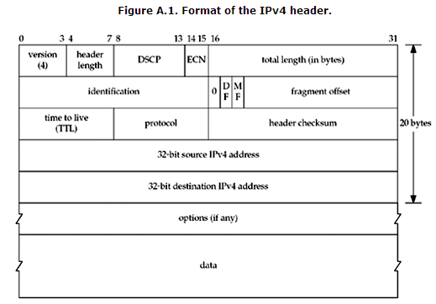
Format of the IPv4 header

Slide 16
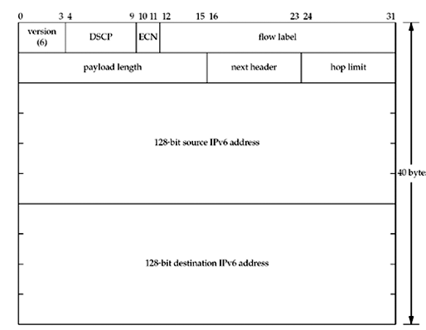
Format of the IPv6 header

Slide 17
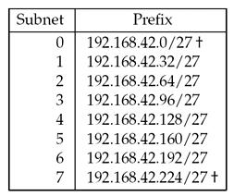


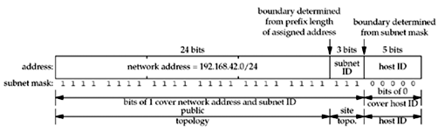
IPv4 Addresses

Slide 18
IP地址的分配与管理
192.168.10.0/24地址段需要分配给5个不同的部门来使用：
部门1-4均需要30个IP
部门5需要100个IP
您作为管理员该如何划分子网？

Slide 19
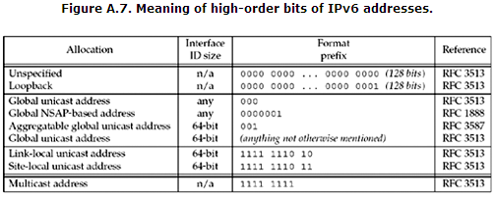
IPv6 Addresses

Slide 20
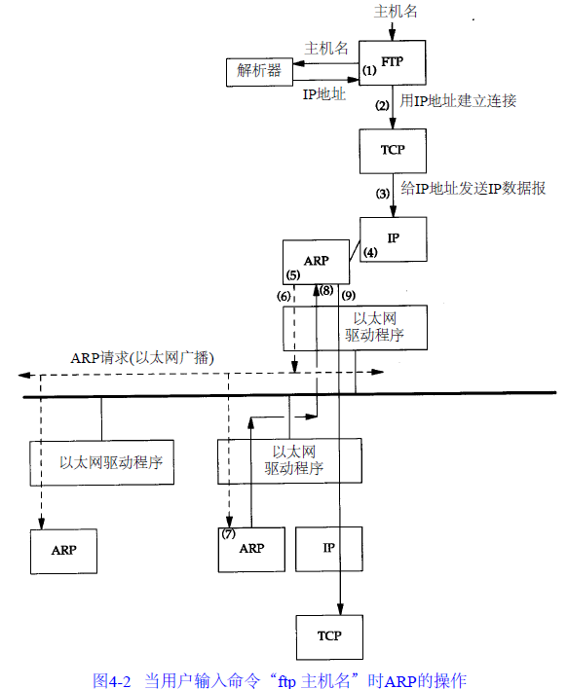
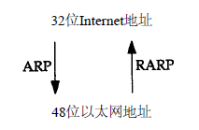
ARP：地址解析协议

Slide 21
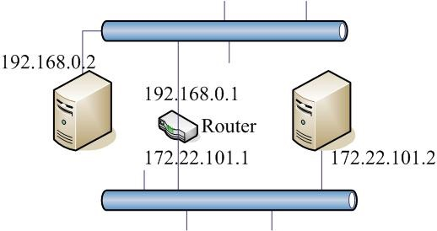
IP包是如何从A送到B？
B
A

Slide 22
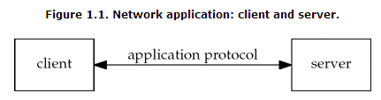
网络程序设计中的几种不同视角
Application

Slide 23
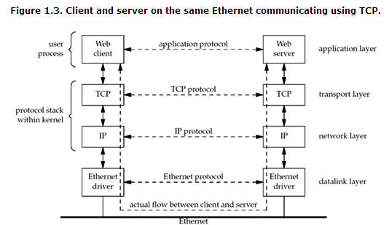
网络程序设计中的几种不同视角
Layering Protocols

Slide 24
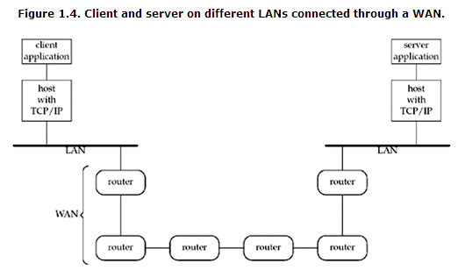
网络程序设计中的几种不同视角
Inter-Net/Internet

Slide 25
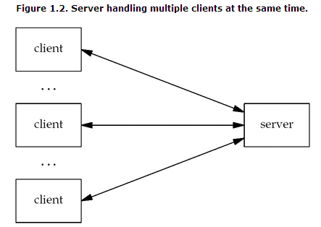
网络程序设计中的几种不同视角
Performance/Control

Slide 26
电信/通信行业软件开发 主要涉及的领域
局端管理系统
SNMP Manager网管系统
OSS/BOSS运营支撑系统
电信设备开发与设备管理
协议栈的实现
CLI
SNMP Agent
web管理

Slide 27
课后作业
请计算最多有多少个A类、B类和C类网络号。
获取一份RFC 1000的拷贝，了解R F C这个术语从何而来。
什么叫CIDR？
一个IP包是如何到达它的目的地IP主机的？

Slide 28
谢谢大家！
参考资料：
MIT Open Courseware - http://ocw.mit.edu UNIX® Network Programming Volume 1, Third Edition TCP/IP Illustrated Volume 1:The Protocols

