Slide 1
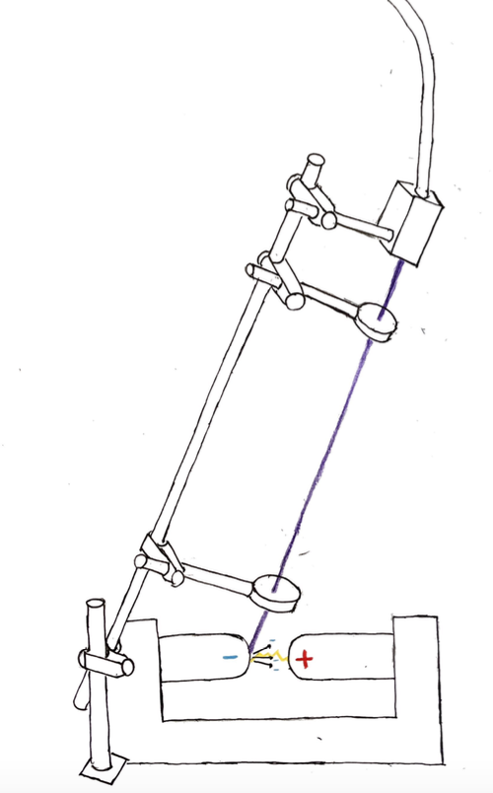
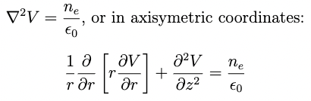
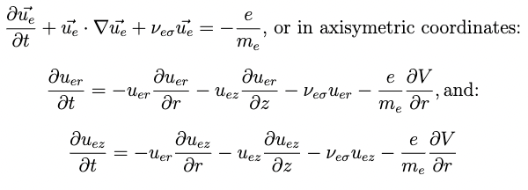
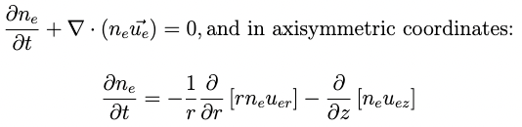
Experimental Setup
Two electrodes are held just below their breakdown voltage
Ultraviolet light is collected from a 275 nm UV-LED and transmitted through a liquid light guide; that light is then focused onto the cathode using UV-lenses.
Prebreakdown
Dynamics of a Spark
Gap Triggered with the
Photoelectric Effect
L. P. Keeley, A. D. Light
Light Lab at Colorado College, Colorado Springs, Colorado 80903
Physical Model
To solve our problem from the point in time where the UV-light is first shown onto the anode until the point when voltages above breakdown are reached, we begin by solving Poisson’s equation:
This gives us the electric potential because the magnetic field is negligible. The potential can then be used to solve the fluid equation, which gives the electron velocity at every point in space. Under the assumptions of this model, the fluid equation takes the form (see e.g. [1]):
Finally, now that we know the electron velocity, we can describe how the electron density will change by solving the continuity equation:
Important Observations
The following observations were made during experiments with the UV-LED on:
The timing jitter, or the uncertainty in the time between discharges, was reduced
The breakdown voltage was lowered
Intuitive Explanations
Before jumping into our mathematical and computational modeling, lets build some intuition for these two observations. The first is easy to explain: without an electron source, we rely on random events–such as stray cosmic rays–to produce the seed electron required to cause the breakdown chain reaction. In our experiment, the photoelectric effect produces these electrons reducing the reliance on random events.
The second observation is trickier to explain. We propose that the electron current is space charge limited, which means that the applied feel becomes screened by the electron cloud near the cathode and we cannot pull more electrons off by increasing the amount of UV-light. Now, if we imagine that we are an electron outside of this cloud but still within the gap–near the anode maybe–we will feel the applied field reinforced by the field due to this electron cloud. If the applied field is just below the breakdown field, the electron cloud will boost the field above breakdown and a streamer will form.
Boundary Conditions
The first step in solving our problem is to give the boundary conditions for each equation. For Poisson’s Equation:
We assume that the spark gap fully charges between discharges so at times of interest the anode is held at the applied voltage and the cathode is grounded
In r, we use the boundary condition that the potential vanishes at infinity. We approximate this by taking the potential to be zero at the edge of the computational domain. By symmetry, the first derivative with respect to r of the potential must vanish at r=0
For the continuity equation we use the following:
The electron density is a function of the amount of incident UV-light at the cathode. The exact dependence remains a difficult problem because we must consider both photoemission and field emission
We use diffuse boundary conditions (vanishing spacial derivatives) at all other boundaries, which lets density pass out of the computational domain
A spark gap is created by applying a sufficiently high voltage, known as the breakdown voltage, across two electrodes so that a free electron gains enough energy on its average path between collisions with air molecules to ionize those molecules. This results in a chain reaction in which a plasma, known as a streamer, forms and allows the built-up voltage to discharge across the gap. Last summer, we held a spark gap just below its breakdown voltage, and then concentrated ultraviolet light onto the cathode which pulls electron out of the metal due to the photoelectric effect. We observed that this lowered the breakdown voltage and caused a streamer discharge. We present a model describing why this occurs and propose using it to build a triggered spark gap.
Model Assumptions
The preliminary model we present here seeks to confirm that an electron current can boost an applied field just below breakdown to one above breakdown. To achieve this, we describe dynamics before breakdown under the following assumptions:
Magnetic fields and pressure gradients are small compared with the electric field
Enough electrons are emitted from the anode that we can track electron densities rather than individual particles
The field, electron density, and electron velocity functions are cylindrically symmetric so that we can treat our problem in axisymmetric coordinates

