Slide 1

Data Mining Project Using Telematics Data to Predict Engine Failures
CAT-A-THON 2021
- By
3-Brogrammers

Slide 2
Problem Breakdown
Unit
Remaining Useful Time
Candidate
Svrty_lvl
Date
Event
Problem Statement :
To develop a smart AI solution that reproduces and
possibly surpasses a human expert’s thought processes
in predicting equipment failures using telematics data.
What do we Infer from Dataset:
Output : Remaining Useful Time (RUL)
Input: Candidate (Machine)
Dependencies:
Date, Unit, Events, svrty_level.

Slide 3
Linear Regression - Model
Probable Failure Time
Sensor Out Units
Vs
Date Units
for a particular Machine
for a particular sensor event
PFTU
Max_Severity_1 + 5%
(or)
Max_Severity_2 + 25%
(or)
Max_Severity_3 + 50%
Severity 3
Severity 1
Probable Failure Threshold Unit (PFTU)
Severity 2

Slide 4
ALGORITHM
INPUT : CANDIDATE (Machine)
Fetch the sensor events relevant to the candidate
For each sensor, calculate the Probable Failure Threshold Units (PFTU)
Build a regression model for UNITS (sensor output) vs DATE
Use the regression model to predict the date when the PFTU would be reached

Slide 5
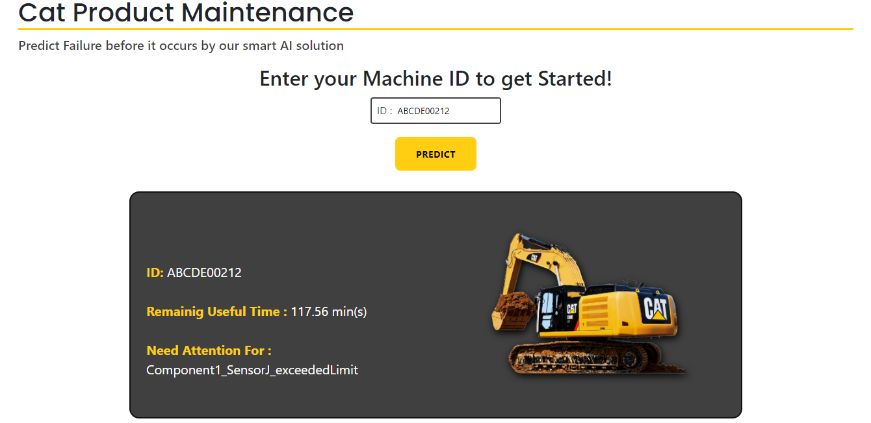
RealTime Recommendations
Action speak louder than Words
Customer
Enters the machine ID through web APP.
API
Fetch the data from client and transfers to the model to predict.
Model
Processes the input data and sends the predicted output back to API.
API
Receives the data from Model and displays the output in the user readable format.
Link:
https://github.com/3-bro-grammers/CAT-A-THON-Project
Can be further Improved by alerting user via mail or mobile alerts.

Slide 6
Thank You
Any Questions?

