Slide 1

无人机航拍场景下的语义三维重建
陈煜1701213988@pku.edu.cn
王尧 wangyao@pku.edu.cn
王旭普 wangyao@pku.edu.cn

Slide 2
CONTENTS
Introduction
Related Work
Our Work
Experiments
References
PART ONE
PART TWO
PART THREE
PART FOUR
PART SIX

Slide 3
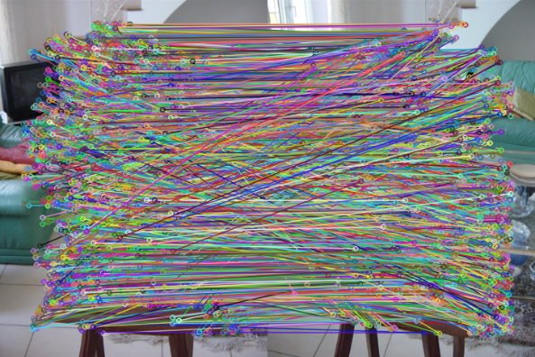
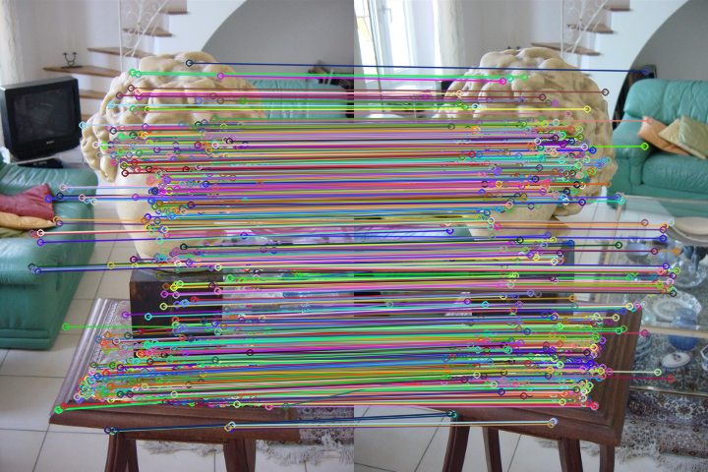
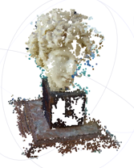
Pipeline for SfM
Pictures
Feature Matching
Geometric Verifying
Initial Pair Selection
Bundle Adjustment
Triangulation
Camera Registeration
sparse model

Slide 4
Two Main Bottlenecks
60%
30%
Feature Matching
Bundle Adjustment

Slide 5
Semantic Feature Extracts
- SIFT keypoint detector
- Extract semantic label by semantic segmentation result
- Group features by semantic label, then perform feature matching

Slide 6
Constrained Bundle Adjustment
- SIFT keypoint detector
- Extract semantic label by semantic segmentation result
- Group features by semantic label, then perform feature matching

Slide 7
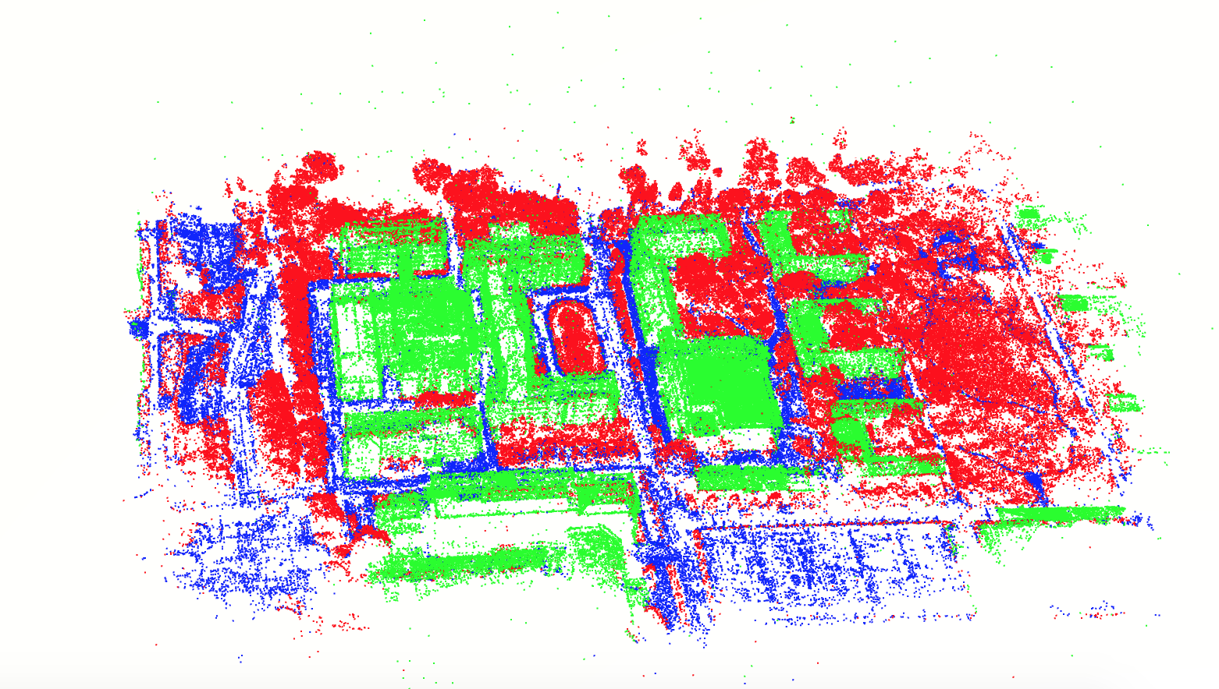
Reconstruction Results

Slide 8
Reconstruction Results
Original SfM
Semantic SfM
Dataset
Views
Poses
Residuals
RMSE
Views
Poses
Residuals
RMSE
PKU-m1
52
52
388096
0.421443
52
52
274027
0.376776
PKU-e3_3
60
60
272143
0.524914
60
60
178258
0.490911
Heda-Dalitang
97
97
789944
0.318991
97
97
689435
0.304753

Slide 9
Future Work
- Learning semantic features
- Dense reconstruction for automatic semantic segmentation

Slide 10
References
[1] Noah Snavely, Steven M. Seitz, Richard Szeliski. Photo Tourism: Exploring image collections in 3D. ACM Transactions on Graphics (Proceedings of SIGGRAPH 2006), 2006.
[2] Snavely K N. Scene reconstruction and visualization from internet photo collections[M]. University of Washington, 2008.
[3] Schönberger J L, Frahm J M. Structure-from-Motion Revisited[C]// Computer Vision and Pattern Recognition. IEEE, 2016.
Notes:
模板来自于 http://www.ypppt.com

Slide 11
THANKS FOR LISTENING

