Slide 1

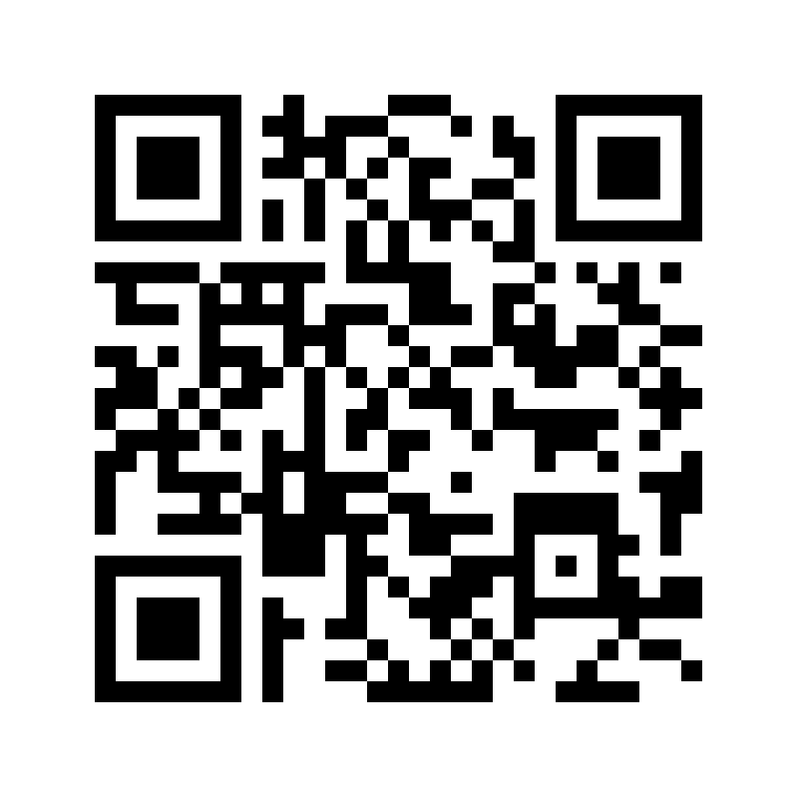
OpenNMS and LoraWAN for Agriculture Data Collection
Herb Garcia
Insitu Systems, Inc.
3001.io
Email : herb@insitusys.com
cell: 651-261-2072
Image: https://en.wikipedia.org/wiki/Internet_of_things

Slide 2
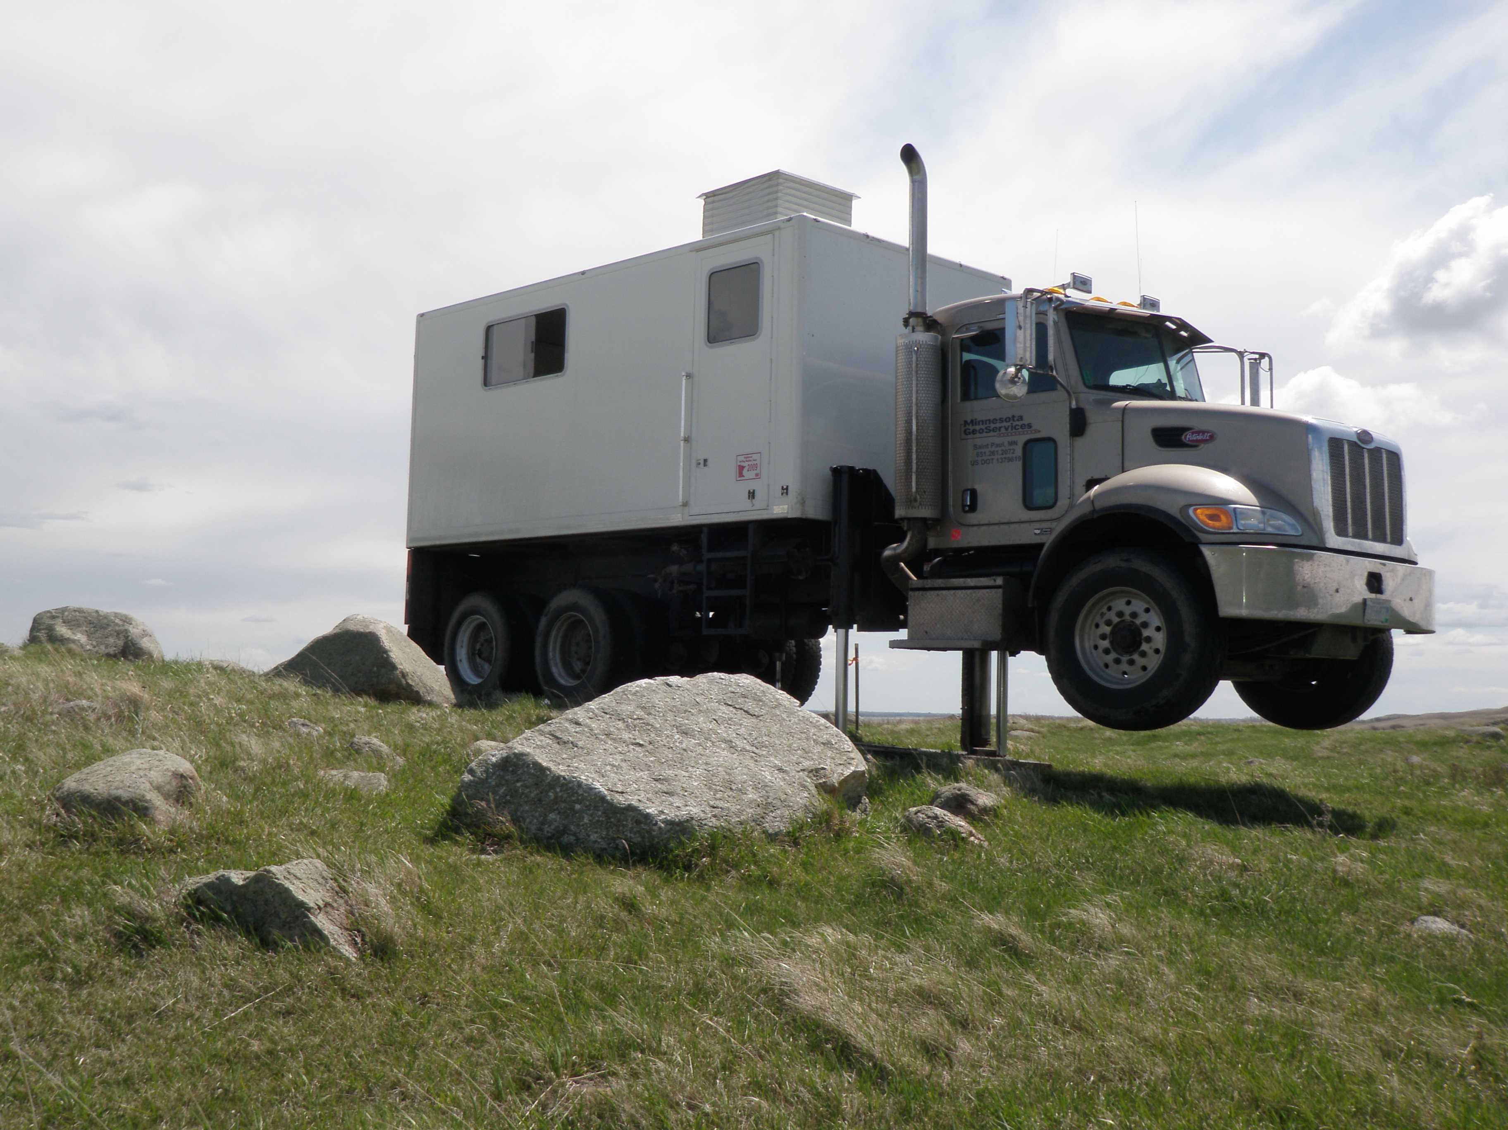
Who Am I?
Former Professional Geologist and Driller
30 years experience in Engineering/Consulting
Extensive fieldwork on farms and remote sites across the central US including over 9000 wind turbine locations
Instrumentation and monitoring

Slide 3
Contents
Challenges in Remote Data Collection
Why LoraWAN?
LoraWAN Description
Why OpenNMS?
OpenNMS Description
Use Cases

Slide 4
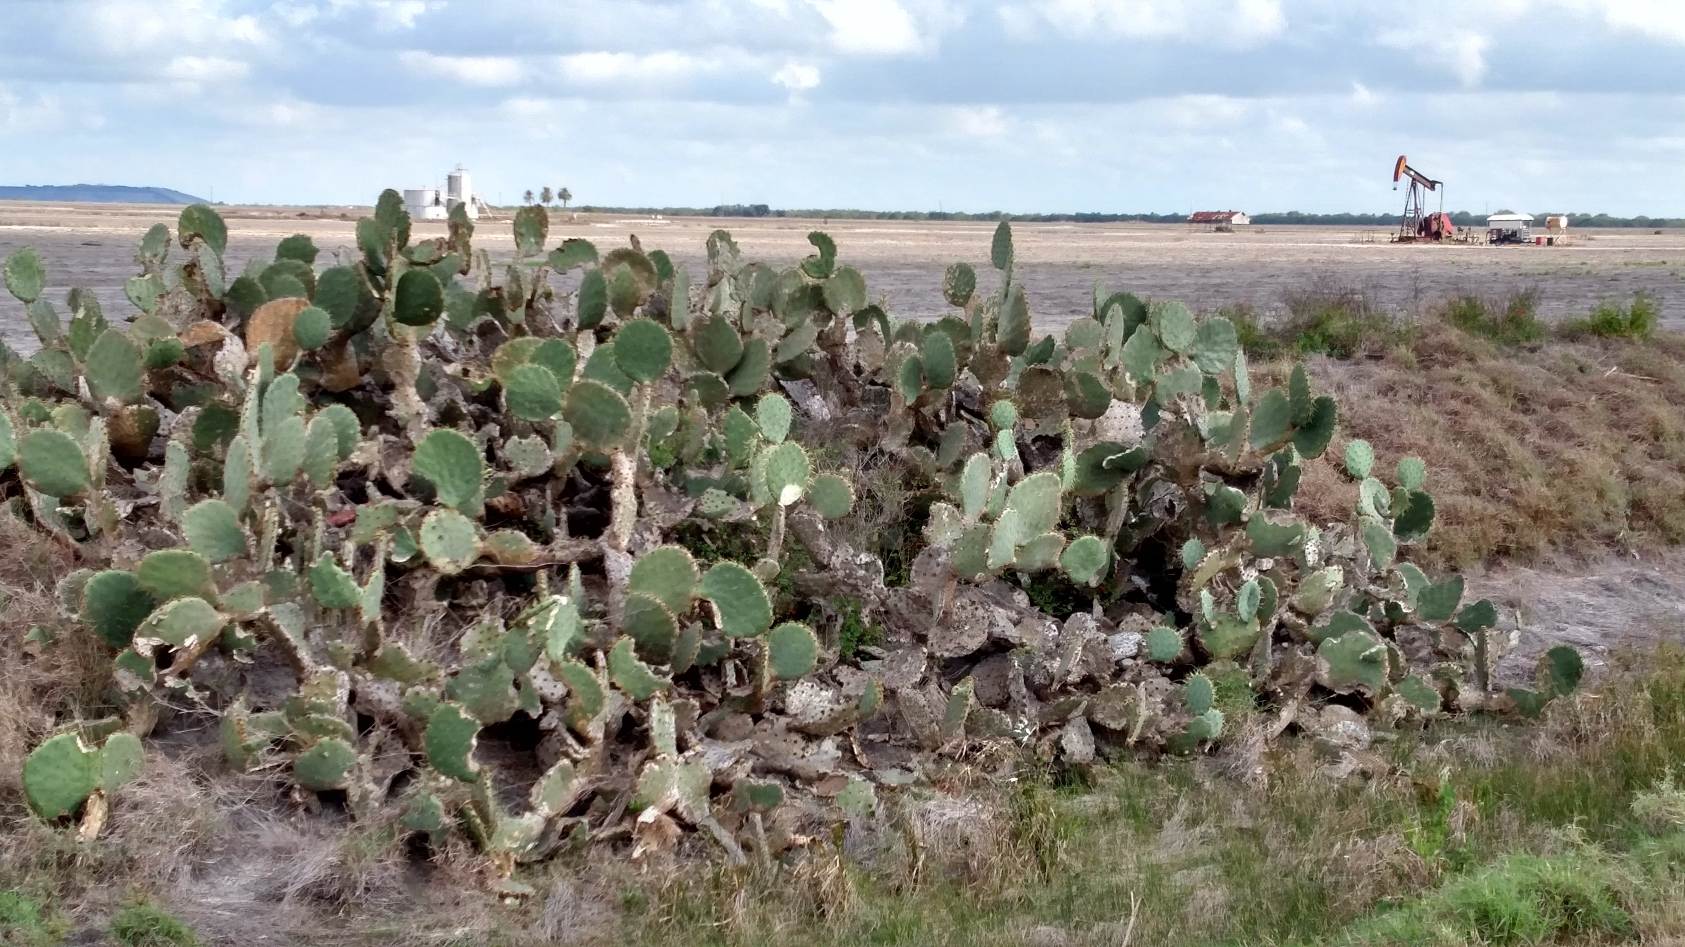
Challenges in Remote Data Collection
Uneven/Uncertain coverage
FCC Investigation showed cellular carriers exaggerated rural 4Glte coverage
Power availability
Harsh environments

Slide 5
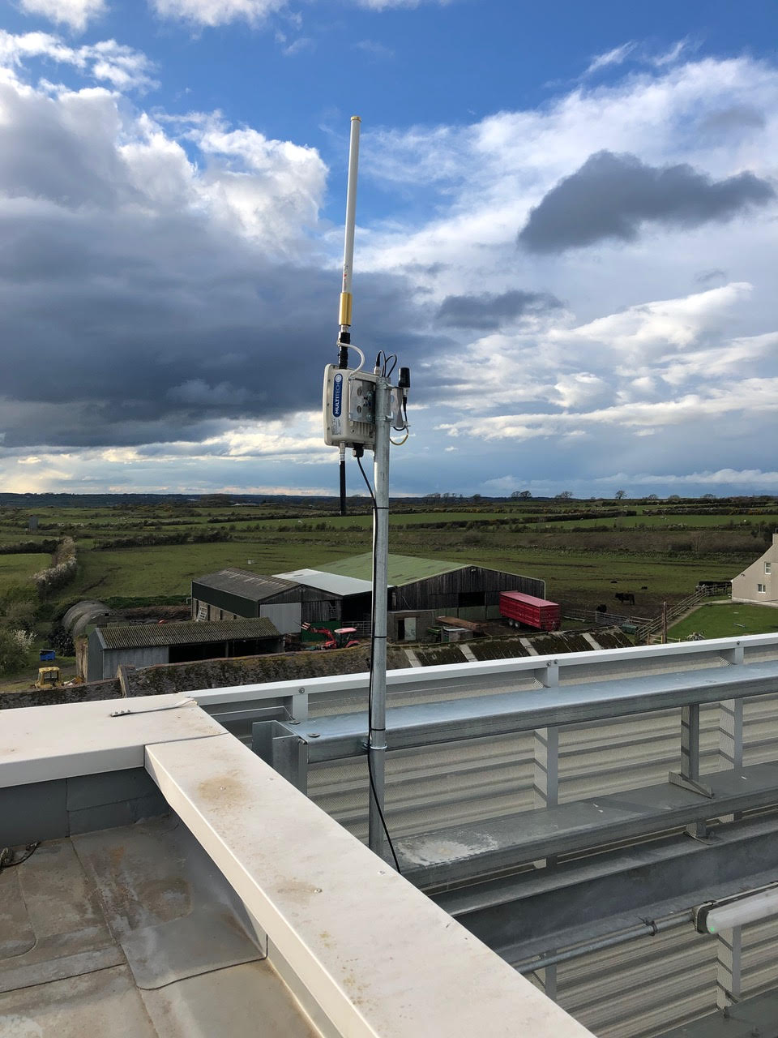
Why LoraWAN - Pluses
Long range
Extremely low power ( 5-10 years on battery power)
Unlicensed bandwidth (
3. Scaling and clustering proven and built in
  Cassandra/Newts Time Series database

Slide 6
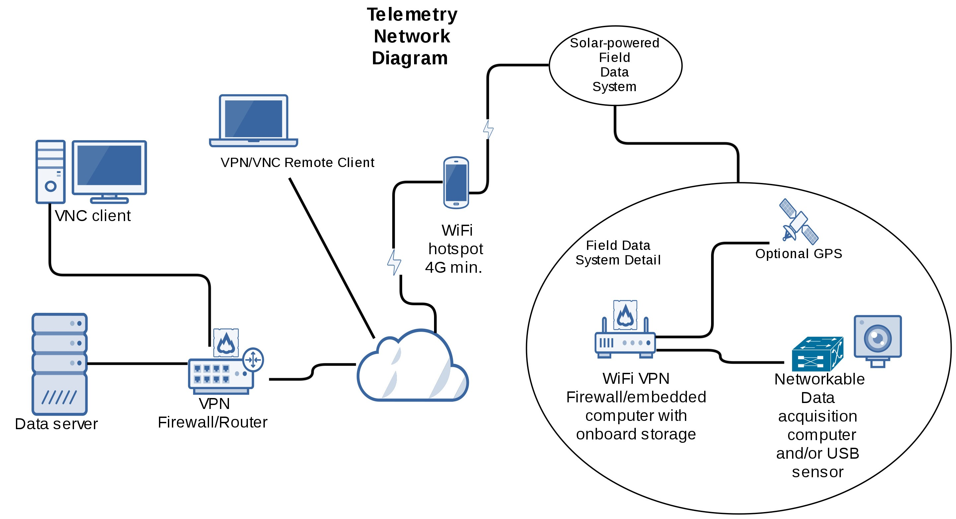
An Early Remote Data System

Slide 7
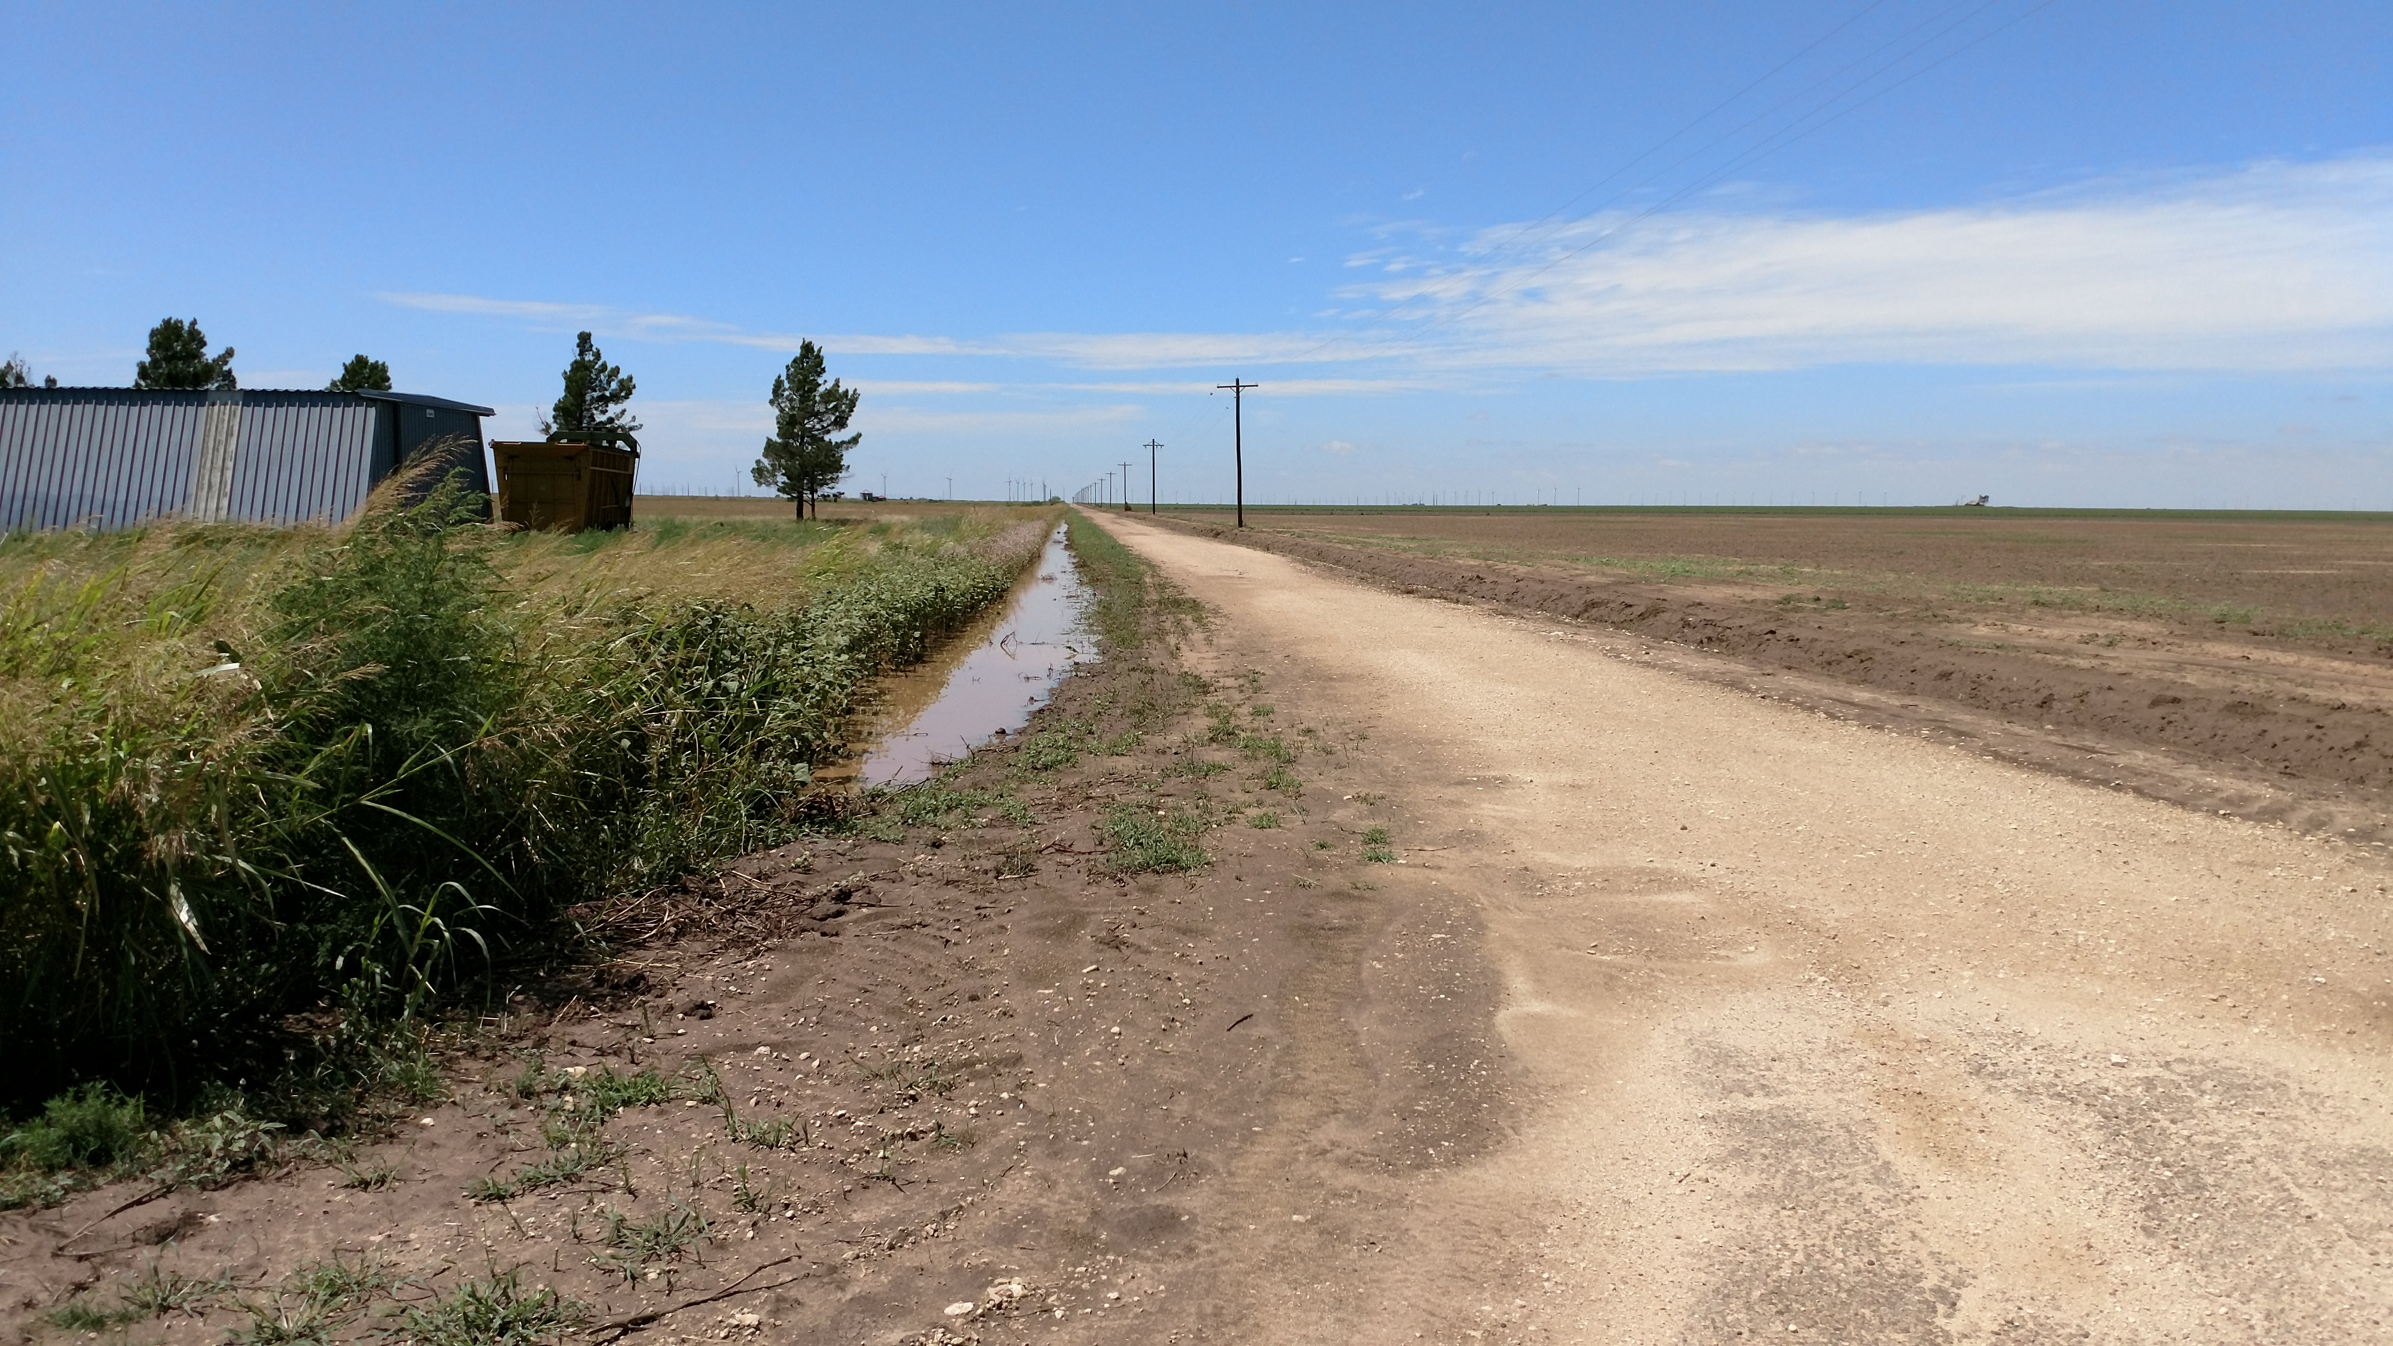
Contents
Challenges in remote data collection
LoraWAN Description
OpenNMS Description
Use Cases

Slide 8
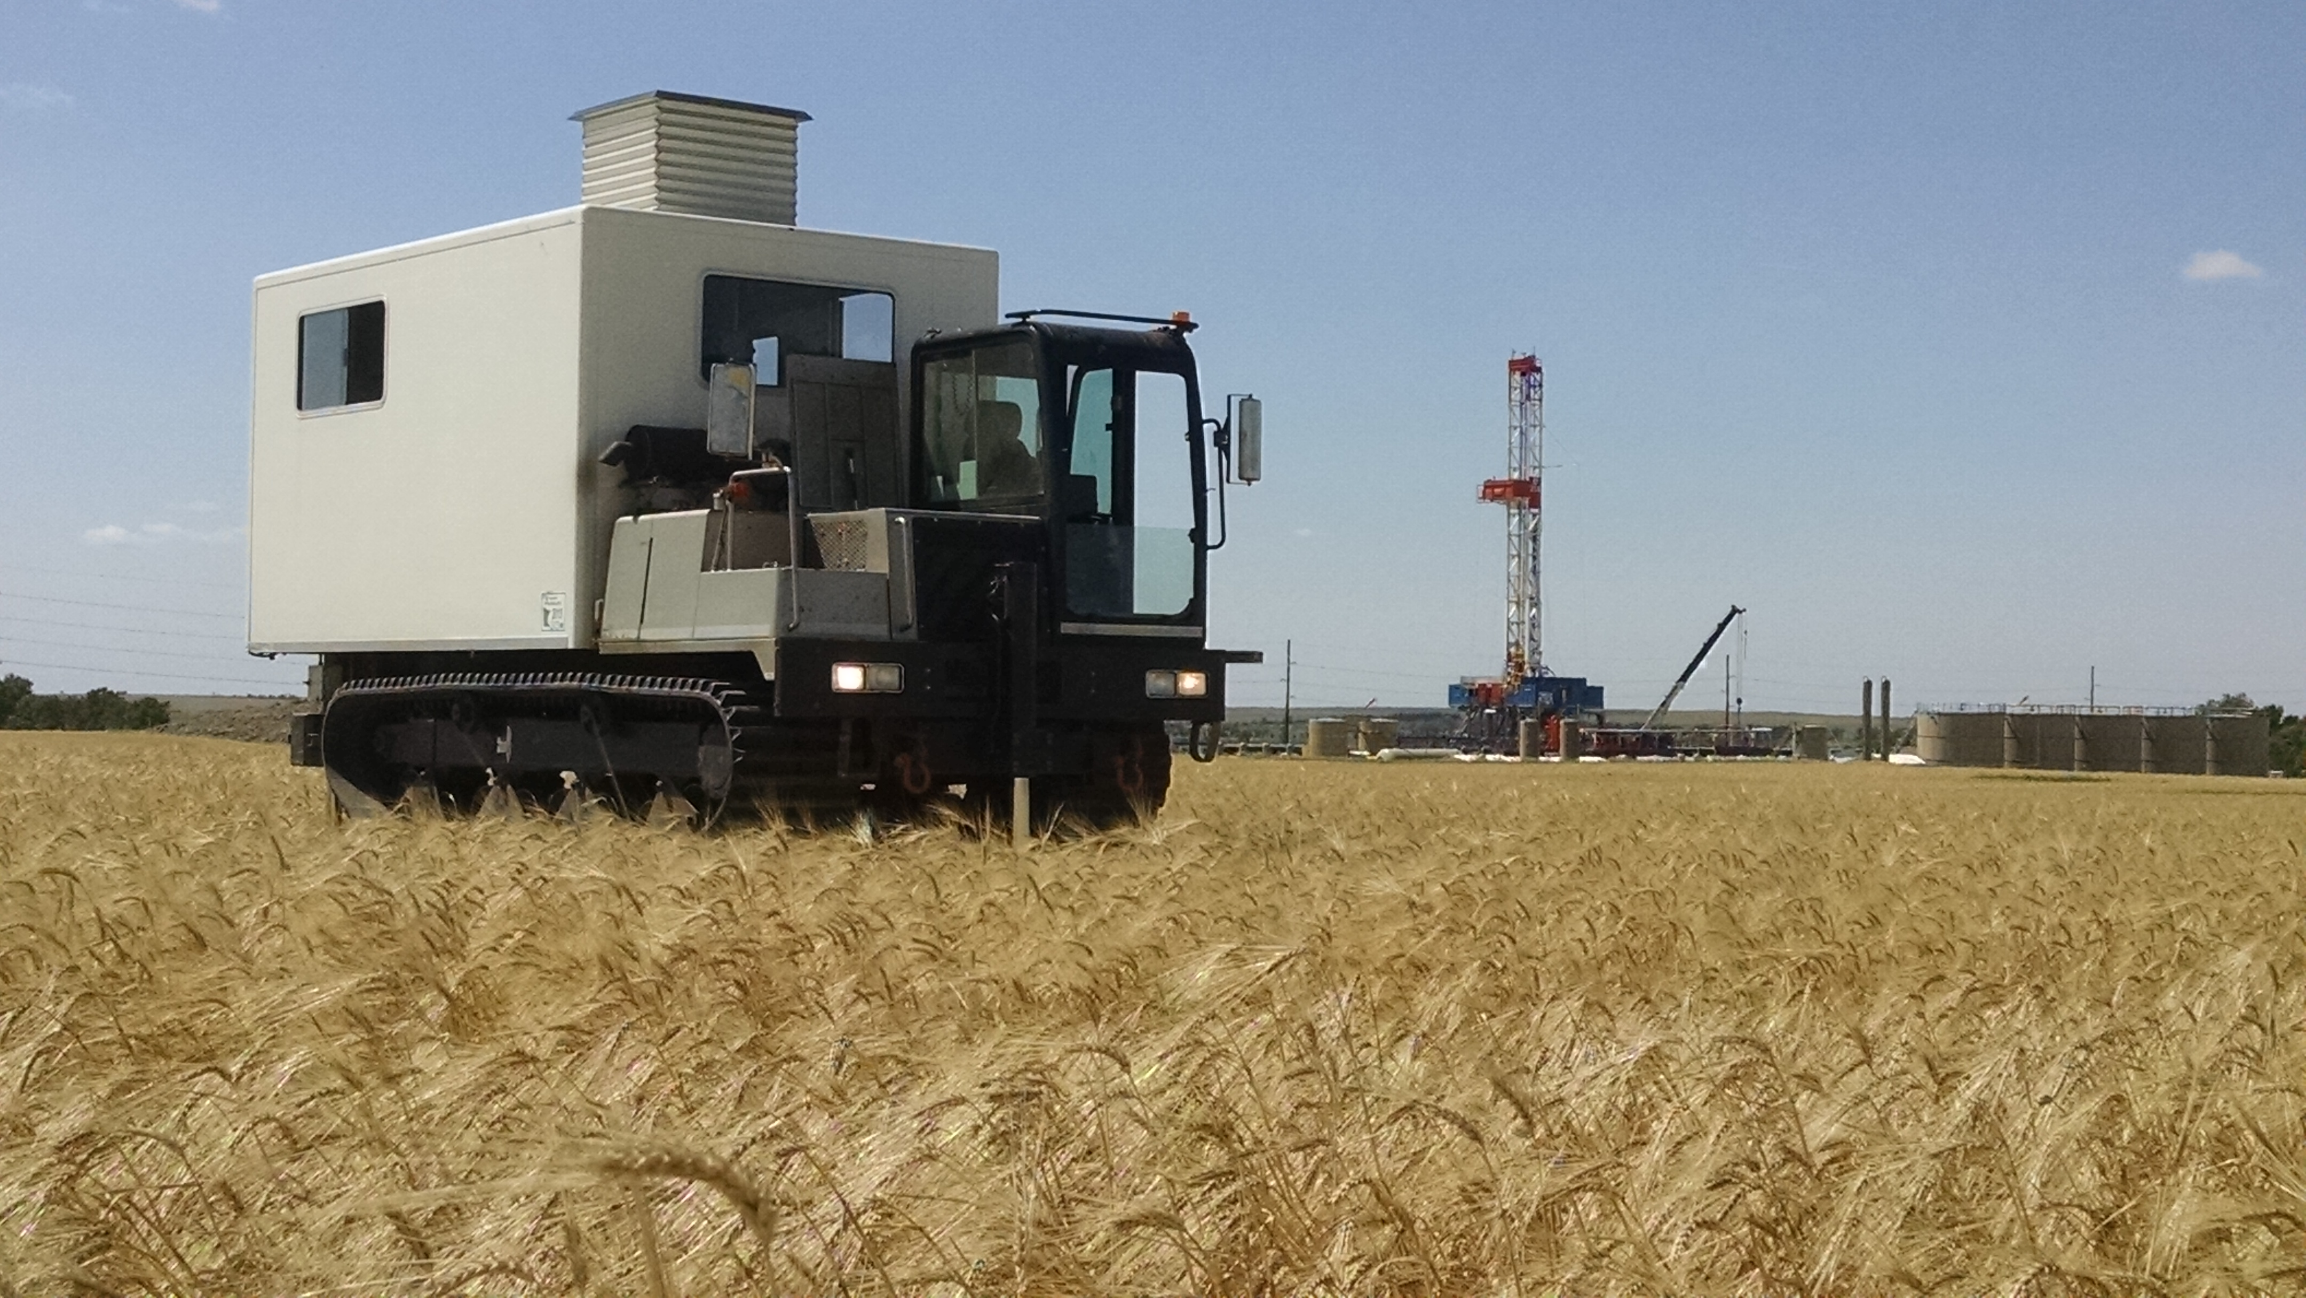
Why OpenNMS
1. Universal collection of data in one application
2. Already has nearly every needed tool for IoT data acquisition and visualization including
  Sensor and device provisioning via spreadsheet, database or dev ice discovery
  Close integration with Grafana for data visualization, heatmaps, and trend calculations
  Alerts, user groups, and scheduling
  An Android/IOS app
  Geographical/topology mapping of devices
3. Scaling and clustering proven and built in
  Cassandra/Newts Time Series database

Slide 9
Why OpenNMS - continued
4. Multiple methods of data acquisition including
  SNMP
  HTML
  Customized XML files
  MQTT
  CANBUS next?
4. Other
  Also capable of monitoring the system infrastructure, servers, switches, network
  Strong existing international developer community
  Open Source means FREE!!!!!!

Slide 10



The IoT protocol MQTT
MQTT (Message Queuing Telemetry Transport)
    Andy Stanford-Clark of IBM and Arlen Nipper of Cirrus Link authored the first version of the protocol in 1999
OASIS Standard MQTT v3.1.1
  http://docs.oasis-open.org/mqtt/mqtt/v3.1.1/os/mqtt-v3.1.1-os.html
  ISO standard (ISO/IEC PRF 20922)
Design criteria
  It is designed for connections with remote locations where a "small code footprint" is required or the network bandwidth is limited.
  Can work on top of LaRaWan, Zigbee, Wifi etc
Details
  A publish-subscribe-based messaging protocol requiring a broker
  Built on TCP/IP and can use TLS (secure sockets).
  Application Message : Topic, Qos, Payload
Client
Client
Client
mqtt
Mqtt
Broker
IoT
device
IoT
device
IoT
device
mqtt
IoT
device

Slide 11
MQTT Message
MQTT Message contains <Client Id>< Topic >< QoS (0,1,2) >< Payload >
MQTT QoS
  QoS 0: At most once delivery
    The message is delivered according to the capabilities of the underlying network. No response is sent by the receiver and no retry is performed by the sender. The message arrives at the receiver either once or not at all.
  QoS 1: At least once delivery
    This quality of service ensures that the message arrives at the receiver at least once. ( But may receive duplicates)
  QoS 2: Exactly once delivery
    This is the highest quality of service, for use when neither loss nor duplication of messages are acceptable
Client Identification and authentication
  MQTT Client id
  Username, Password and / or Certificate (e.g. Amazon IoT)

Slide 12
MQTT Topic
Topic Name:
  The label attached to an Application Message which is matched against the Subscriptions known to the Server. The Server sends a copy of the Application Message to each Client that has a matching Subscription.
  Topics follow a hierarchy defined by a Topic level separator ‘/’ e.g GW1/device1/sensorA etc
Topic Filter:
  An expression contained in a Subscription, to indicate an interest in one or more topics. A Topic Filter can include wildcard characters.
    Multi-level wildcard #
    Single level wildcard +
  Examples
    GW2/# selects all messages from GW2
    GW1/device1/+/ selects all messages from any sensor under device 1
    GW1/+/sensorA selects all sensorA messages from any device under GW1
GW1
device1
sensorA
sensorB
sensorC
device2
sensorA
GW2

Slide 13

OpenNMS MQTT Plugin
Stand alone OSGi plugin which drops into OpenNMS 22
Code : https://github.com/gallenc/opennms-mqtt-plugin
Installation
  mvn clean install
  drop opennms-mqtt-plugin/kar-package/target//opennms-mqtt-plugin.kar into <OpenNMS>/deploy
  Add <opennms>/etc/mqtt-interface-config.xml
    Example config file
    https://github.com/gallenc/opennms-mqtt-plugin/blob/master/main-module/mqtt-interface-config.xml
    Example configurations for message parsing in unit tests
    https://github.com/gallenc/opennms-mqtt-plugin/tree/master/main-module/src/test/resources
  There is a docker compose project with complete configuration opennms, cassandra, helm and mqtt plugin
Can connect to multiple clients
Mqtt device
Mqtt broker
Mqtt device
OpenNMS
Mqtt device
Mqtt Plugin
Mqtt device
Mqtt device
Mqtt broker
Mqtt device
Mqtt device
Mqtt device

Slide 14
Summary – OpenNMS MQTT
Simple to install plugin – just drop into <deploy> directory and add config file
Can connect (and reconnect) to multiple MQTT Brokers
  Username / Password, TLS authentication
Can automatically add Nodes discovered through MQTT
  With foreign source and foreign id from Topic path or payload data
  Add GIS coordinates to inventory
Can subscribe to filtered topics
  PMc178e3c2.6637eiot-2/type/mosquitto/id/00-08-00-4A-4F-F6/evt/datapoint/fmt/json
  PMc178e3c2.6637eiot-2/type/mosquitto/id/#
Can choose how to handle filtered topics with different configurations
  Events or Data or Both
  PMc178e3c2.6637eiot-2/type/mosquitto/id/+/evt/datapoint/fmt/jso
  PMc178e3c2.6637eiot-2/type/mosquitto/id/+/evt/events/fmt/jso
Can parse multiple payloads
  Compressed, uncompressed, JSON / XML / CSV (Future Protobuf)

Slide 15
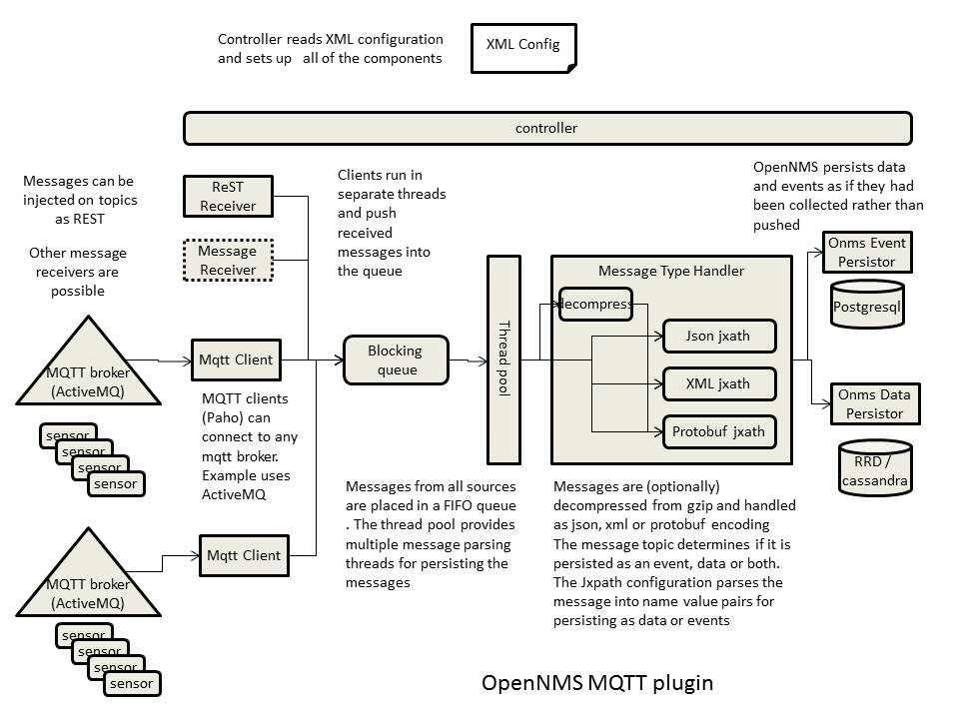
How it works

Slide 16
Basic Structure of Configuration
<opennms>/etc/ mqtt-interface-config.xml
<mqtt-receiver >
<createMissingNodes>true</createMissingNodes>
<createDummyInterfaces>true</createDummyInterfaces>
<createNodeAssetData>true</createNodeAssetData>
<messageDataParsers>
<messageDataParser>
….
<messageDataParser>
</messageDataParsers>
<messageEventParsers>
…..
</messageEventParsers>
<mqttClients>
….
</mqttClients>
</mqtt-receiver>
See https://github.com/gallenc/opennms-mqtt-plugin/blob/ba2138bf8aa9d731dbbb5ede7bed440b0ee0256f/mqtt-docker-compose/etc-overlay/mqtt-interface-config.xml
if true new nodes will be created for messages referencing an unknown node
if true a dummy interface will also be created when the node is created
if true asset information will be copied to the node asset table when the node is created. this particularly applies to latitude and longitude if defined in the message
configuration for data parsers – many parsers can be defined for different topic filters
configuration for event parsers – many parsers can be defined for different topic filters
configuration for clients. Many clients can be defined which connect to multiple topic filters

Slide 17
Setting up the connection
Mqtt broker
Can connect to multiple clients
Mqtt device
The clientinstanceId identifies the client in OpenMS and must be unique
the clientid must be unique for a given mqtt broker
  the clientConnectionMaxWait tetermins the time the client will wait for the broker to respond before abandoning a connection attempt
  the connectionRetryInterval is the interval before the client will try again to connect after failing to connect previously
the topic list determines which topics the client will subscribe to once it has established a connection
The subscribed topic can also be a filter e.g. topic="/+/foo/#
If you are using TLS you must provide both certificate and key files. If both are omitted from the configuration TLS will not be used
with AMAZON IoT, the certificate and key files can be generated for you . These are tied to a specific client id and IoT end point
Mqtt device
OpenNMS
Mqtt device
Mqtt Plugin
Mqtt device
Mqtt device
Mqtt broker
Mqtt device
Mqtt device
Mqtt device
<mqttClients>
<client clientInstanceId="client1">
<brokerUrl>tcp://localhost:1883</brokerUrl>
<clientId>opennms</clientId>
<connectionRetryInterval>3000</connectionRetryInterval>
<clientConnectionMaxWait>20000</clientConnectionMaxWait>
<topicList>
<topic qos="0" topic="mqtt-events/#" />
<topic qos="0" topic="mqtt-data" />
</topicList>
<userName>mqtt-user</userName>
<password>mqtt-password</password>
<certificateFile>put absolute path to certificate.pem file here</certificateFile>
<privateKeyFile>put absolute path to private.key file here</privateKeyFile>
<brokerUrl>ssl://{iot end point}:8883</brokerUrl>
</client>
</mqttClients>

Slide 18
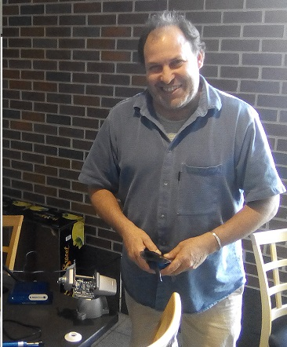
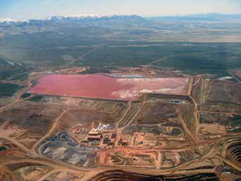
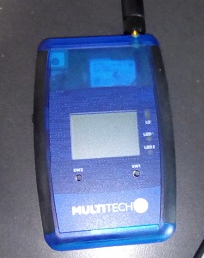
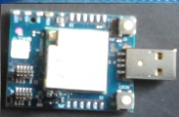
Case Study – Monitoring Tailings
Herb Garcia Insitu Systems, Inc.
www.insitusys.com
Mine tailings
  are the ore waste of mines, and are typically a mud-like material. Worldwide, the storage and handling of tailings is a major environmental issue. Many tailings are toxic and must be kept perpetually isolated from the environment.
  https://www.nps.gov/articles/aps-v13-i2-c8.htm
  Series: Alaska Park Science - Volume 13 Issue 2: Mineral and Energy Development Long-term Risk of Tailings Dam Failure

Slide 19
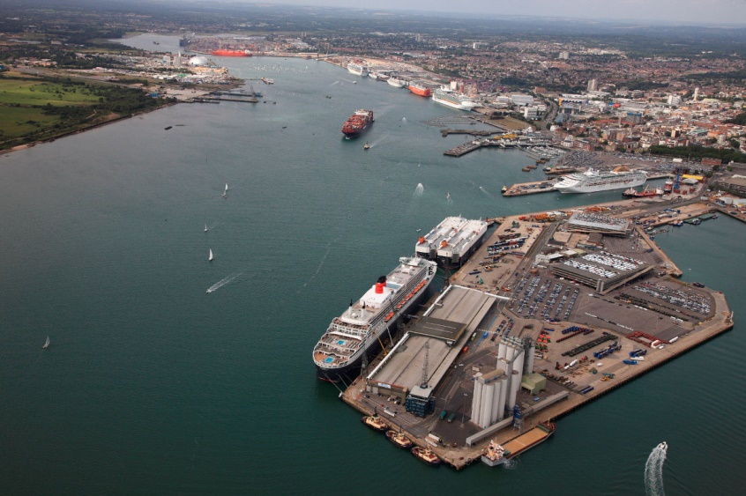

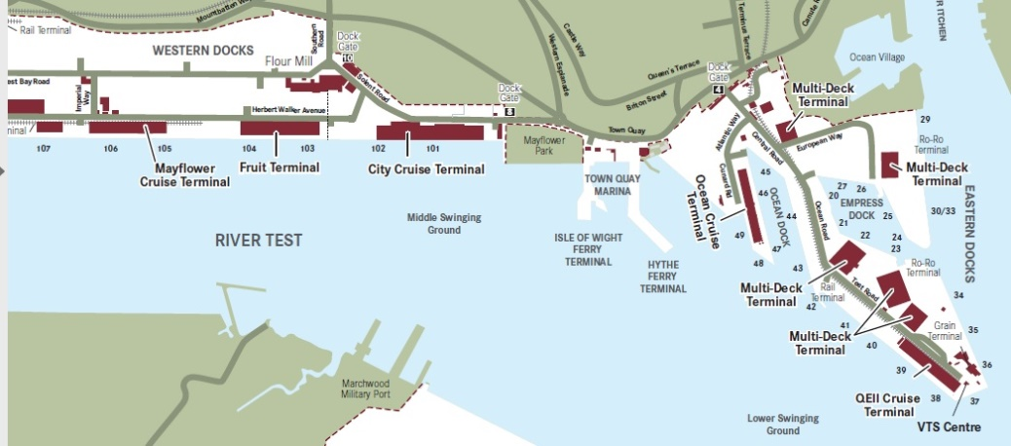
Case Study
Southampton Air Pollution Monitoring
The UK’s number one cruise port, which welcomes 1.7m passengers
Each ship up to 6000 passenger and crew
Ship turn around 1-2 days
Increasing problem of air pollution due to generators running while ships in port
http://www.solentairwatch.co.uk/
  Community air monitoring project
  Not for profit charity run by Southampton volunteers
  Monitor Sniffy – version 1
    https://github.com/SolentAirWatch/sniffy
    Raspberry Pi Zero
    Low cost laser Smoke detector
    Ruggedized container
  Founder Dr Joshua Taylor

Slide 20
Summary
OpenNMS now has a very credible IoT story
  Data collection – Cassandra and Elastic Search
  Drift – streaming protocols
  Minions
  New - MQTT plugin
MQTT plugin - still a prototype but appears to work well
  There is a docker compose project ☺
Please spread the word
Try the plugin yourself
Give us feedback as to what to do next

Slide 21
Thanks for listening
Questions?
With great thanks to Dr. Craig Gallen – University of Southampton!

Slide 22
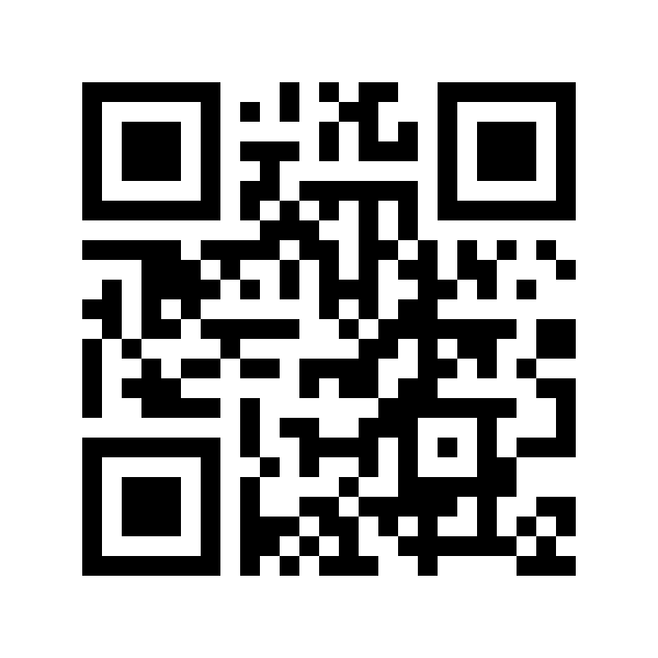
And now a Demonstration!

