Slide 1
DATABASE DEVELOPMENT STRATEGIES
TOP DOWN
  Large scale application driven by strategic objectives
  General → Specific
  Organization-wide (“data management philosophy”)
  “Industrial strength” DBMS required (e.g., Oracle, DB2, SQL Server)
  Done well, captures global view and integrates data
  Danger: “paralysis analysis”
BOTTOM UP
  Application-centric
  Produces useful systems more quickly
  Smaller DBMS such as M/S Access
  Less risky, more user involvement
  Danger: “stovepipes”

Slide 2
DATABASE DEVELOPMENT STRATEGIES
PROTOTYPING
Version 0
Adapt
Test
Improve

Slide 3
TOP DOWN DATABASE DEVELOPMENT
Requirements
Analysis
Design
Database
Administration
Implementation

Slide 4
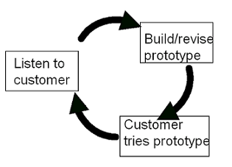
EXTREME PROGRAMMING
High speed waterfall approach
Component-based construction
Build off “proof of concept”

Slide 5
EP MANIFESTO
Individuals and interactions over processes and tools.
Working software over comprehensive documentation.
Customer collaboration over contract negotiation.
Responding to change over following a plan.
While there is value in the items on the right, EP values the items on the left more.

Slide 6
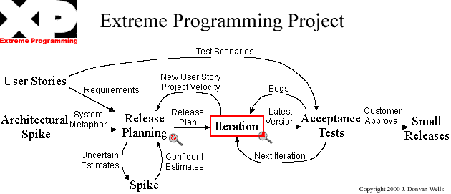
OVERVIEW OF EP PROJECT
User stories: written by stakeholders
Release planning meeting: which user stories will be implemented and when
Iteration: code the stories (days, weeks vice months)
Acceptance test: user accepts changes

Slide 7
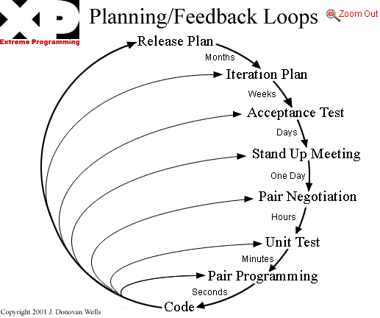
EP FEEDBACK LOOPS

Slide 8
DATABASE REQUIREMENTS
Identify Strategic Planning Factors
  Goals, critical success factors, risk analysis
Identify Corporate Planning Objects
  Organizational stakeholders (Actors), business functions (Processes), entities (Objects)
Requirements Statements
  Inputs and outputs from existing systems (manual and computer)
  INTERVIEW END USERS FOR FORMS, REPORTS AND QUERIES

Slide 9
DB REQUIREMENTS ANALYSIS
Develop conceptual data model (logical database design)
  Entity-Relationship
  Semantic Object Model (SOM)
  UML
Develop process models
  Old way: data flow diagrams, process decomposition
  UML way: actor diagrams, use cases

Slide 10
ENTITY-RELATIONSHIP DIAGRAM

CUSTOMER

Places
Bills
ORDER

INVOICE
Fulfills
Requests
PRODUCT
Ships

RAW
MATERIAL
Uses
Builds
WORK
ORDER
Supplies
Schedules
VENDOR
WORK
CENTER

EMPLOYEE
Works
Assigned
EQUIPMENT

Slide 11
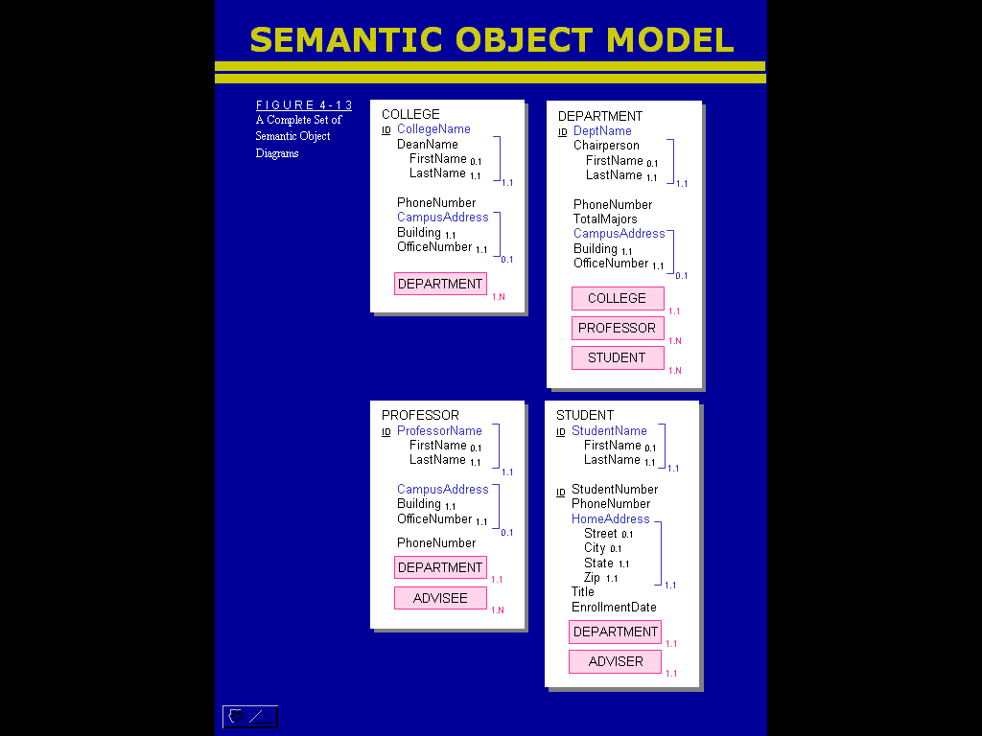

Slide 12
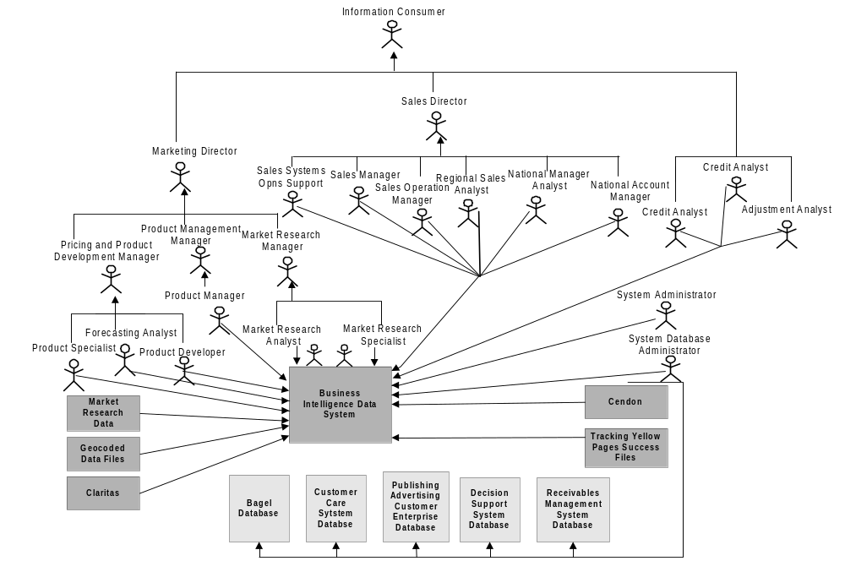
ACTOR DIAGRAM

Slide 13
DATABASE DESIGN
Logical design
  Convert conceptual data model into a database schema of normalized relations (tables)
Physical design
  Map normalized relations into actual tables
  Establish indexes, keys, and file access methods
  Implement referential integrity
  Specify security, recovery and backup parameters
Process design
  User interfaces: menus, screens, reports
  Functional design: detailed logic for each process

Slide 14
DB IMPLEMENTATION AND TESTING
Data
  Populate database with data
  Data cleansing
Procedures
  Program code
  Implement user interfaces
  Implement stored procedures

Slide 15
DATABASE ADMINISTRATION
Maintain data integrity through execution of security, backup/recovery, and transaction procedures
Monitor performance of database
Establish procedures for identifying and ranking new requirements

Slide 16
DB PROJECT DEVELOPMENT PROCESS
Project Definition:
Queries and Reports
Data Model using
E-R, SOM, or UML
Convert Data Model
to M/S Access DB
REQUIREMENTS
ANALYSIS
Build Forms, Queries
and Reports in M/S
Access
Populate with Data
DESIGN
Thesis…..?
Test and Present
MAINTENANCE
IMPLEMENT AND TEST

