Slide 1

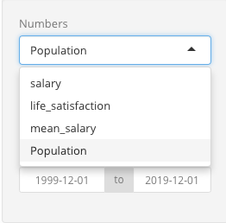
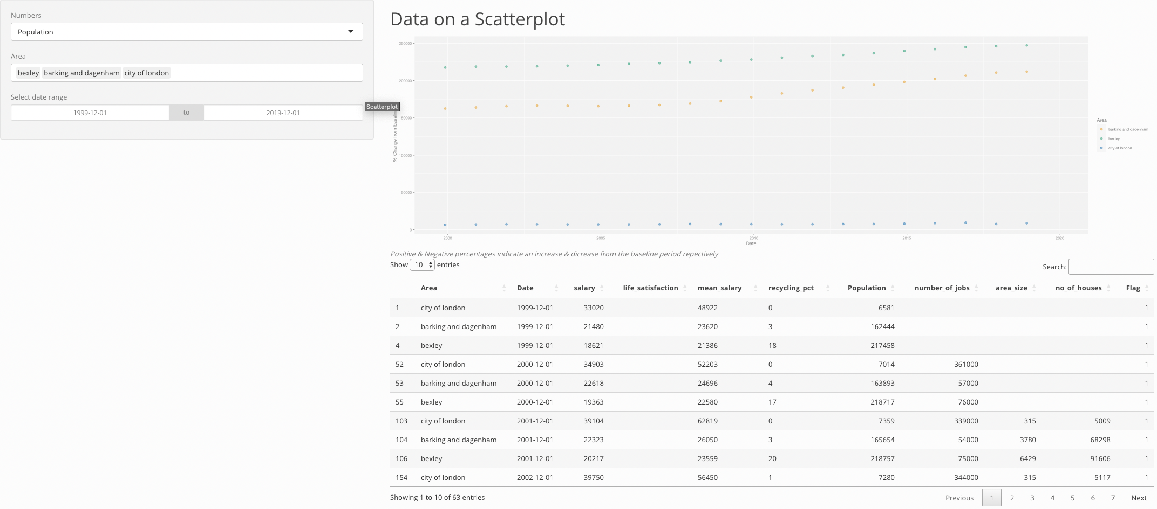
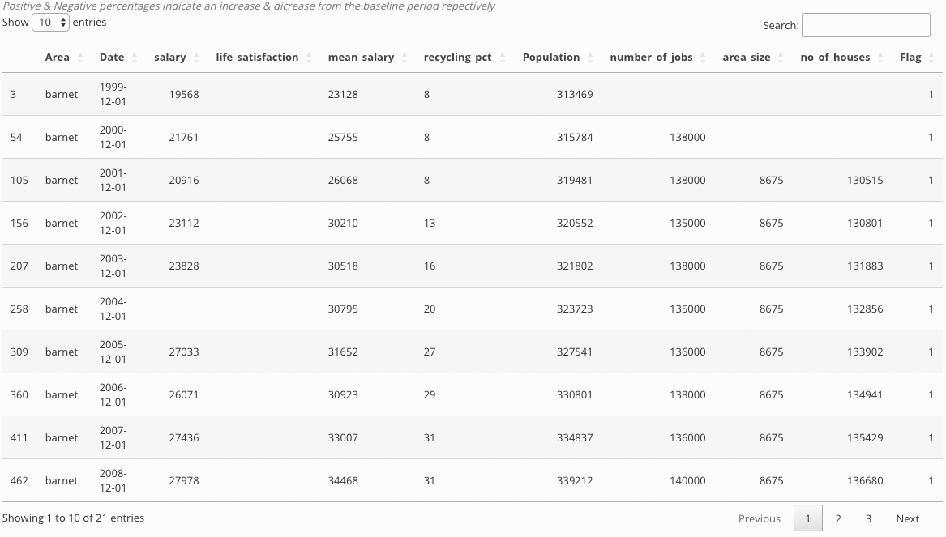
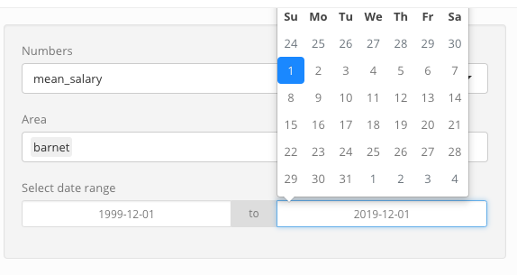
Lot of different details In different parts of london
30051220/Balazs Krajcsirik
This Shiny app dashboard shows data with plot and data table. There’s option to filter it by:
Population ( default value)
Life_satisfaction
Mean_salary
There’s a plot
The plot working if we 1 values for example Population and at least one of the parts of London. The plot shows the record with coloured dots. Every different part of the city got a different colour, to make it easier to read the plot.
The Data table
Simple and easy to read style . There’s many function built in:
Filter and/ or sort by date or other attribute
It can show data of more then 1 part of the city at the time
Page function is working well
There’s a search tab to find the wanted data even quicker
It can be filtered already before the plot shows up:
Simple , by clicking on the left ( set the time we looking from ) and/or the right date panel ( to set the time we looking until ) , It will search for data between those dates .
References:
Dataset is from : https://www.kaggle.com/datasets
Git hub link : https://github.com/30051220/Shiny-app/blob/main/30051220.R

