Slide 1
Project 1: Protinex
Market Opportunity Analysis
Segmenting, Positioning and Branding

Slide 2
Segmentation | Geographic: In India, protein deficiency is a major concern with 80% Indian diet deficits in protein. It was necessary to inform and educate the masses about the protein deficiency. Protinex can move from not only a doctor’s prescription brand but to a direct to consumer root brand. Demographic: Protinex can segment the customers on the basis of age and income. As the protinex ‘Original’ product is for adult age group with protein deficiency. And its price is not affordable for middle income and lower income segment. Psychographic: Protinex can segment the customers on the basis of their lifestyle. Person who lives a tiring, stressful life. And don’t have time to look after their health. Protinex can be a great product as it contains Acti-Pro5 to provide a protein rich nutrition for everyday nutritional needs. Protinex original has nutrients that supports immune system, also help in reduce tiredness and fatigue, and help in build stamina. Behavioral: Protinex can segment the customers on their purchasing, usage behavior and customer satisfaction.
Targeting | For Protinex ‘Original’ product, Protinex can use niche marketing strategy. It is a product for all age group but especially for customers with protein deficiency.
Positioning | Protinex ‘Original’ can position it self as a healthy, and full of nutrition source in customers mind.
Answer 1

Slide 3
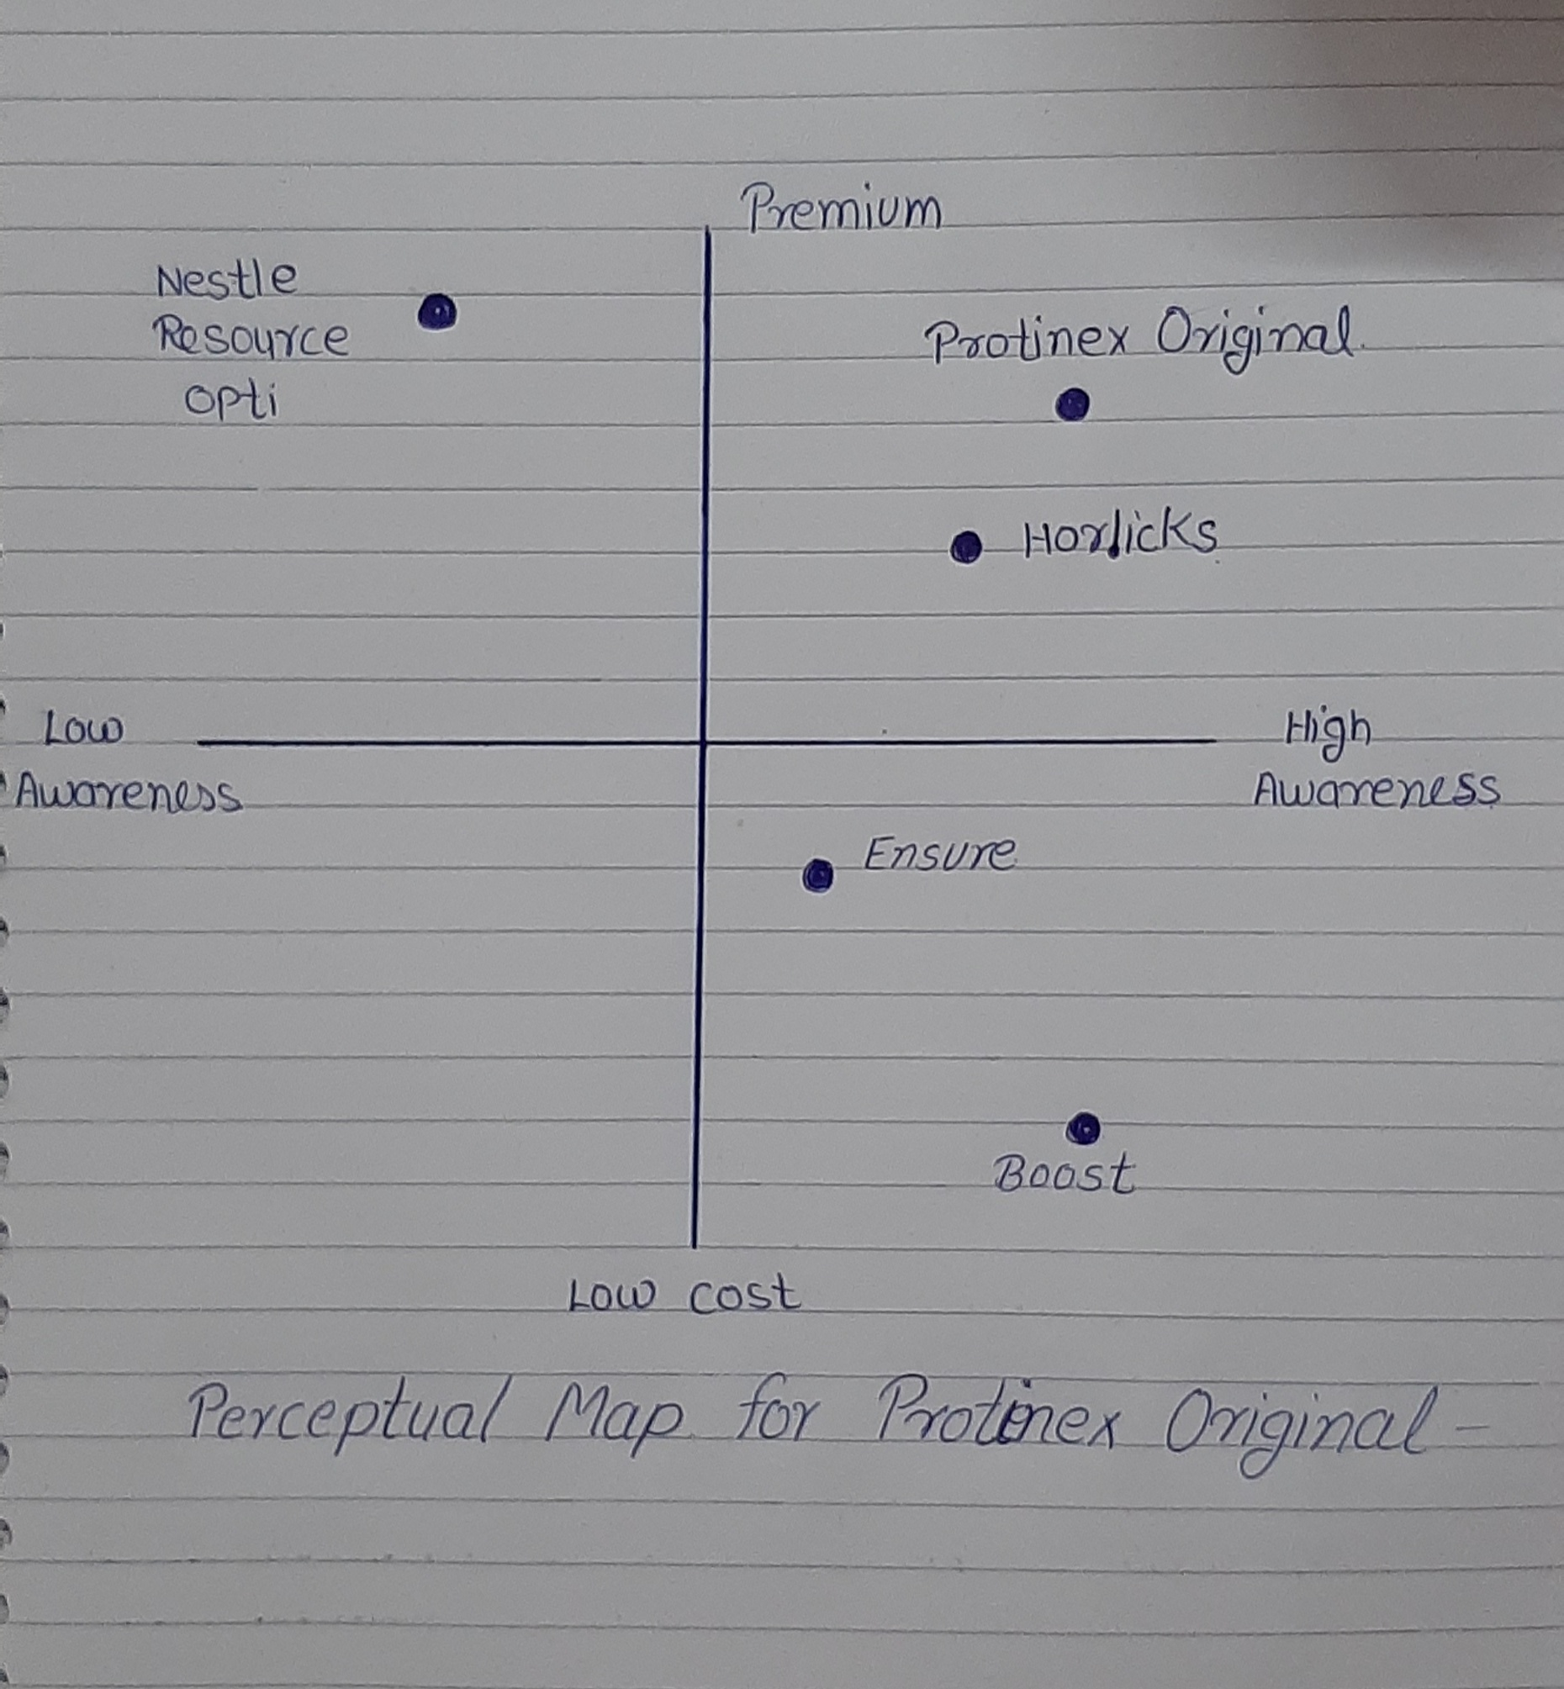
Answer 2
India is a developing country but aside that India's population in also increasing rapidly. A few year’s back , there were not many people who understood protein deficiency, they don’t even realise that they also could have protein deficiency. There were many myths and misinformation about protein consumption in Indian households like protein is only for body-builders or it is expensive to obtain. But in recent years, health consciousness among Indians is growing . Consumers are getting aware of how they are not consuming enough protein to stay healthy. Consumers in India are getting conscious about how deficiency of protein in body effects their health. Which leads them to the protein supplements available in market.
Y axis- premium to low cost
X axis- high awareness to low awareness

Slide 4
Answer 3
Protinex journey started with Dumex(1957),Pfizer(1972) and wockhardt (2006). In year 2012, Protinex is acquired by Danone in order to enter indian market, with it’s mission to,‘ Bringing health through food to as many people as possible’. Indian diet are often unbalance from a nutritional stand point, around 80% Indians have a diet dificiency in protein. Protinex has to compeite with brands like Ensure and Horlics in the adult nutrition category. Protinex is a family brand with almost 60 years of heritage value and one of the most trusted brand by several generations of doctors and consumers. Protein content in Protinex Original is almost double than that in other competive brands, also it provides the right amount of carbohydrats,minerals and vitamins.

Slide 5
Answer 4
Product: Protinex is a trusted brand which offers an extensive range of tailored variants for all member of family and for consumers of all age group on basis of their needs and perspective towards health. For people who seek health product with intention driven by health condition or by recommendation for faster recovery or building immunity it provides Protinex Original, Mama Protinex, Protinex Diabetics. Protinex Original is the only supplement in India which consist Hydrolysed protein which fulfill daily nutritional need.
Price: As Protinex is almost three times more expensive in comparison to other health food drinks. Protinex is a family nutrition brand with almost 60 years of trust. Protinex is also one of the most trusted brand by several generations of doctors and consumers. A single spoon of Protinex Original provides almost double amount of protein in comparison to other brands. Protinex Original also provides a good amount of carbohydrates, minerals and vitamins which gives a complete nourishment. Brands also have has volume pricing policy. Protinex Original is available in different size of packing like 250gm , 400gm, 750 gm, and 1 kg. Even the price for it box and refill pack of same quantity is different. It helps customers to choose this brand as it provides better nourishment in comparison to other brands.
Place: Protinex is one unique brand with a heritage, credible doctors recommended equity. But in past consumer believe system positions this brand as a problem solution brand. To over come this problem, since 2015 the brand has been acting as the nexus point for health nutrition and creating mass consumer health awareness. Danone also decided to move Protinex from not only a prescription brand but to a direct to consumer root rand. So now the availability of Protinex have become more accessible to consumer via the retail stores and online stores.
Promotion: Protinex launched a marketing campaign in 2016 “#SOMETHINGMISSING” with a question “ could their be SOMETHINGMISSING in your daily diet’. They uses the lunch box/ Tiffin box as the campaign visual. The campaign was focused on creating awareness of protein deficiency in Indian diet and also in breaking the myths and misinformation about protein consumption.

Slide 6
Answer 5
Digital Content: Protinex Original uses owned ( website, blog post) and paid media channel (display ads) to reach to its potential customers. By the help of content of blog post, display ads and social media Protinex was able to create awareness in its potential consumers about protein deficiency thus resulting in converting those potential consumers into future customers. For digital content, Protinex Original used “ #DontMissOut ” by visualizing the triggers led by protein deficiency like tiredness, weakness & weight gain and used this as an emotional aspect to not miss out joyful moments with your loved ones.
Digital Devices: Protinex uses mobile phones, computers and tablets for as digital device for it Digital Marketing Framework. As users uses all the devices so both mobile marketing and desktop marketing are can be used in digital marketing framework of Protinex Original.
Digital Channels: As Digital channels, Protinex Original uses Social Media Marketing channels like Facebook, Instagram, LinkedIn and Twitter. They also uses Search Engine Optimization and Online Public Relation as digital channel.
Digital metrics: Protinex Original can use Performance Metrics and Revenue Metrics for each stage of consumer funnel. BY using performance metrics for different stage they can use no of impression, Reach, Its Impression share, CPM, No. of website visits, Bounce rate, Engagement rate, Click-through-rate also the CPA and Conversion rate. They can use Referrals, Social mentions and Reviews to calculate the satisfaction of their customers. For measure channel performance at different stages of the consumer funnel they can use Revenue Metrics. With the help of this metrics they can calculate the Customer Acquisition Cost and Customer Lifetime Value . These metrics gives an idea of the ROI for marketing efforts and campaign.

