Slide 1

University Institute Of Technology RGPV, Bhopal
DEPARTMETN OF MASTERS IN COMPUTER APPLICATION
SESSION (2020-21)
A Minor Project Report
Submitted In Partial Fulfillment for Award Of Degree Of
MASTERS OF COMPUTER APPLICATION
“E-Complain WEB Based Project”
Submitted By
Mohammad Ajmal Prashu jain Ayush Chorasiya
(0101CA193D13) (0101CA193D14) (0101CA193D06)

Slide 2
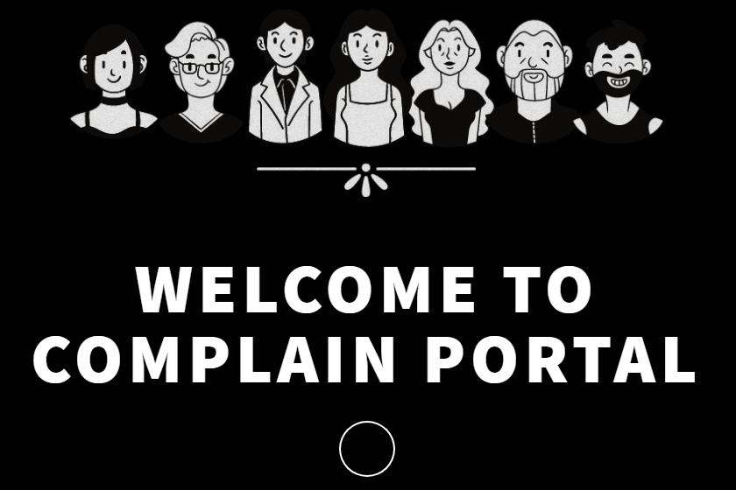

Slide 3
E-Complain
E-Complain is a web based System that takes the Complain of the user and process it.
This website is design with the purpose for promoting the Online Awareness among the people to Complain thier issues regarding to the any of the cases, in case of emergency and the this great Pandemic Corona Virus.

Slide 4
Requirement for this site
Some peoples with the issues are not very comfortable opening with the human directly. They are comfortable filing their issues anonymously and with less human interaction .
Main focus of this site are these people. So they can share and not feel cornered.
This system provide that infrastructure by requiring very less interaction with the human being.

Slide 5
Technology used in this project
Front End Development
HTML
CSS
JavaScript
JQuery
Back End Development
PHP
phpMyAdmin
MySql

Slide 6
Functionality
Awareness
This site Encourage people to open up in the society
This site contain various types of form of complains.
These forms takes the user details and their complain.
Process the complain
And store it into database.

Slide 7
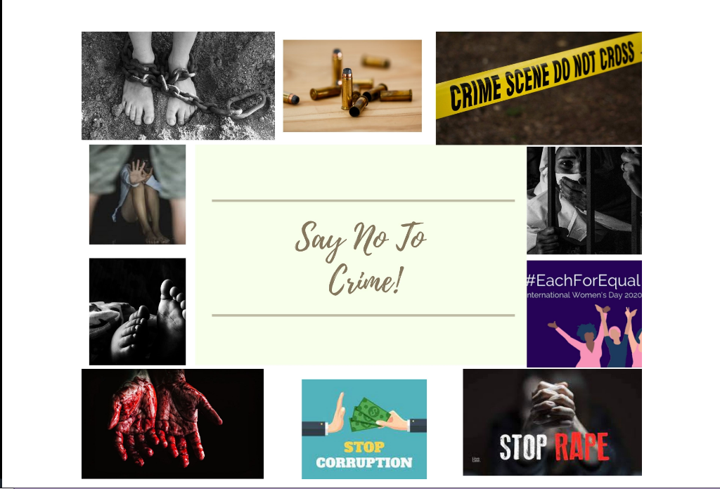

Slide 8
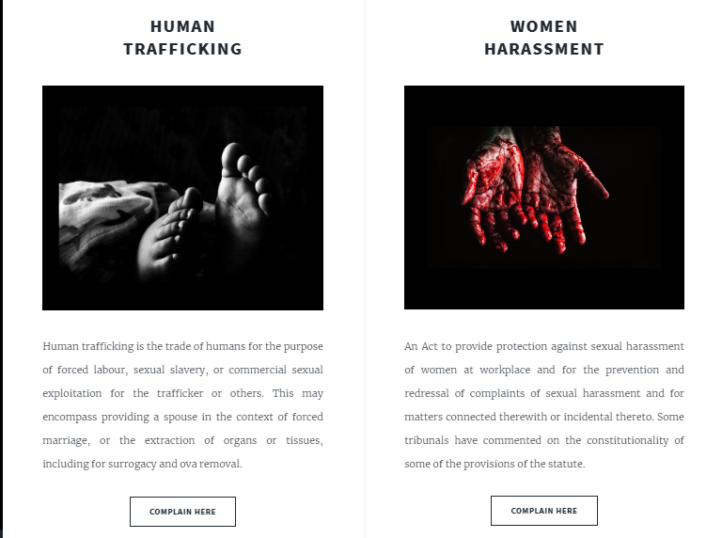

Slide 9
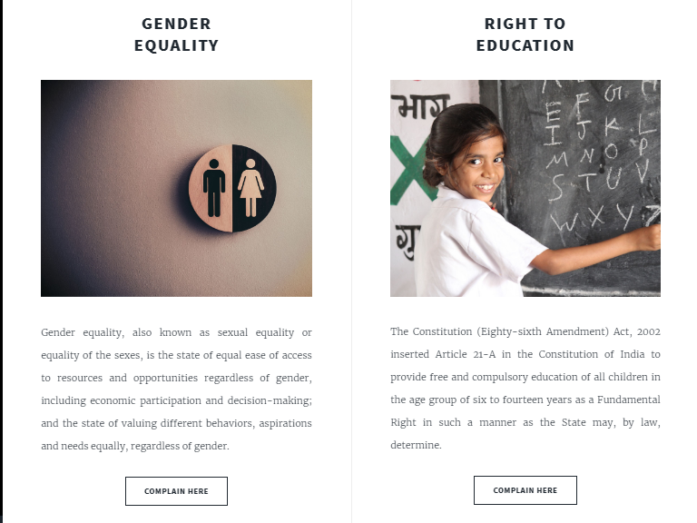

Slide 10
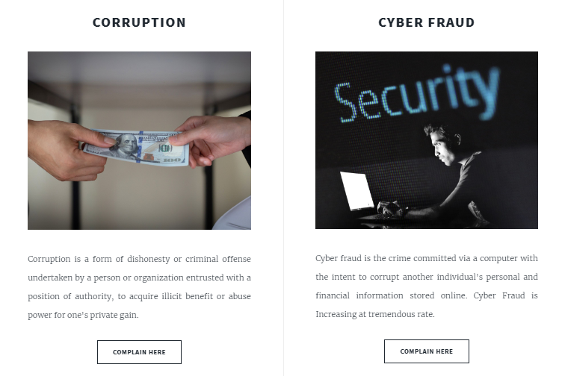

Slide 11
Result Analysis
To conclude, it is a simple application basically suitable for small organization. It has every basic items which are used for the small organization. Our team is successful in making the application where we can update, insert and delete the item as per the requirement.
Through it has few limitations, our team strongly believes that the implementation of this system will surely benefit the organization.

