Slide 1
Object Comparison
Major Project
{ }
A Module Project
in Wordline Website
of ZEST Softech Private LTD.

Slide 2
Developed by:
Mohammad Ajmal Siddiqui
(Project Lead and Developer)
Under the guidance of Shikhar Mall
(Mentor and Chief Executive, ZSPL)
Submitted to:
Mr. Jay Narayan Takhare
(Teacher InCharge)

Slide 3
Zest Softech Private LTD.
ZSPL offers me the role of Software Trainee and provide me the real world experience that is guiding me to grow in the field of Software Engineering.
Founded by a group of technocrats and management experts.
ZSPL have been committed to the cause of providing high quality networking solutions, educational tools, software solutions, project management and consultancy in India and overseas.
I had learned so much in last 4 months in ZSPL that isn’t comparable to what I learned in my graduation and post graduation combined.

Slide 4

Wordline is a revolutionary educational tool provided by ZSPL.
Wordline pushes the boundaries of Online Education System.
Wordline provides an infrastructure that let any Institution to manage and organise their whole business from just a computer machine.
By Wordline, the tedious and hard job of teaching can be done just like using a social media
And Students can focus on their studies without getting distracted. Wordline promotes targeted studies.
Wordline uses artificial intelligence to get the education on next level.

Slide 5
Today Educational Institutes are facing a very big challenge of delivering education to the students doorsteps.
Teachers have to run towards video conferencing platforms for conducting classes, and run towards whatsapp or any messengers for discussion, sharing study materials and resources, and run towards any third party platforms for conducting online exams.
This hustle of Teachers and Instructors are letting down their courage and affecting the quality of education.

Slide 6
The Solution to this Problem is Wordline.
You can conduct classes in wordline,
conduct online exams in wordline,
share unlimited organized study materials,
create whole course structures,
practice sample paper/ mock tests,
create study groups, etc.
Name any tools and technology of educational field. Wordline contains all of them under a hood.
And the process of adding new features and tools are not going to stop.

Slide 7
Object Comparison
Object Comparison is a module in the Wordline.
This module compares all the objects present in the Wordline, like: Institutions, Instructors, Students, Course Structure, etc.

Slide 8
Functionality:
Object Comparison allow students to select best option by comparing Institutes, Course Structures and Teachers .
Object Comparison allows Institutions and teachers to track performance of Studenrs and track the progress.
Lists Trending Course Structures.
Lists Top Performing Institutes.
Lists Best Teachers and Instructures.
Student can Track their Performance and compare with their class or locallity.

Slide 9
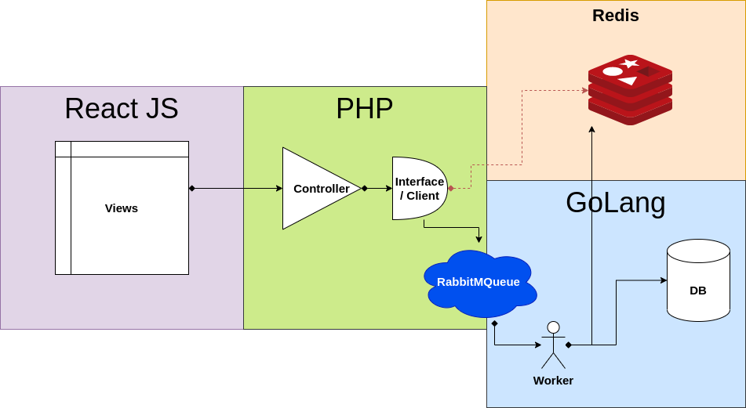
Flow Diagram
Process of Object Comparison >>

Slide 10
Components:
Views
Comparison Client
RabbitMQ
Worker
DataBase
Caches

Slide 11
Process:
Views requests the data from the Comparison Clients through Ajax call
Comparison client and controllers get the request and validate the request.
Comparion client process the request by looking up data into redis caches. If data is present in the cache then client response with the data.
If data is not found in the cache, client response with the error message to the view and communicate with the worker through RabbitMQ.
Worker get the message of client and start working on processing the request of client
Worker runs complicate queries and access the data from the database.
Worker generates Caches into redis.

Slide 12
Views
There are three Different views in this project:
1. Comparison View
2. Top Chart View / Ranking View
3. Specification on Object’s Profile
Views are developed using React JS, HTML, CSS, JavaScript, Bootstrap, JQuery. Ajax

Slide 13
Comparison Client
Comparion Client consists of Controllers and Client Interface.
Controllers get the request from views, validate it and pass it to the Client Interface.
Client Interface is a class containing functionalities that are responsible of managing whole module.
Client access the data from redis cache and response back If data is present .
Otherwise leaves a message into RabbitMQ .
Comparison Client is developed into PHP and its FrameWork Laravel.

Slide 14
Caching (Redis)
Why Needed Caching in this Project:
To avoid repeated computation
To reduce database load
Redis is used to implement caching in this project.
Redis
Redis is an open source, in memory data structure.
Redis can be used as a database or a cache and message broker
Redis is a NoSQL Key/Value store
Redis supports different kinds of abstract data structures:
• Strings • Bitmaps
• Lists • Hyper Logs
• Sets • Geospatial Indexes
• Sorted Sets
• Hashes

Slide 15
RabbitMQ
Communication Between Clients and Worker using RabbitMQ.
RabbitMQ is an open-source message-broker software that originally implemented the Advanced Message Queuing Protocol
RabbitMQ is a message broker: it accepts and forwards messages..
In this Project
• Comparisons Client is the Producers. They contains some functionalities that put message into queue to ask for cache generation and modification.
• Worker is the Consumer. Worker receives the message and process the message by generating the cache that client ask for.

Slide 16
Worker
Back-end application for Data Comparison.
Set of functions that will be used to run complex queries to extract data from database and maintain cache based on that data.
Types of functions Worker contains:
Query Runners
Cache Mantainers
Go Language is used to develop the Worker.
Reason for Using Go:
Static typing and run-time efficiency (like C),
readability and usability (like Python or JavaScript),
high-performance networking and multiprocessing.

Slide 17
Technologies used:
Front End :
Back End :
Development tools :
HTML
CSS
Bootstrap
Java Script
JQuery
React JS
PHP
GoLang
Laravel
JSON
AJAX
RabbitMQ
Redis
MySQL
Git / GitLab
Docker
phpMyAdmin

