Slide 1
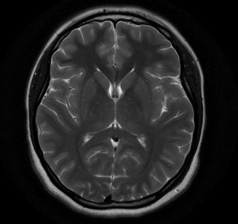
Brain Tumor Classification using SVM and Logistic Regression and QueryBot.
Amutha Yalini E
211501008

Slide 2
Classification using SVM and Logistic Regression
Support Vector Machine (SVM):
Definition: SVM is a supervised learning algorithm used for classification and regression tasks. It works by finding the hyperplane that best separates the classes in the feature space.
Key Features:
Versatility: SVM is effective in high-dimensional spaces and is often used in scenarios with many features.
Performance: SVM performs well with limited data, especially when there's a clear margin of separation between classes.
Logistic Regression:
Definition: Logistic Regression is a statistical model that is primarily used for binary classification tasks. It models the probability of a binary outcome based on one or more predictor variables.
Key Features:
Simplicity: Logistic Regression is easy to implement and interpret, making it ideal for both binary and multiclass classification tasks.
Probabilistic Interpretation: The output of Logistic Regression can be interpreted as the probability of a certain class.
Objective: To classify brain tumors into four categories using machine learning models.
Tumor Classes:
Glioma Tumor
Meningioma Tumor
No Tumor
Pituitary Tumor
Approach: Utilize SVM and Logistic Regression with PCA for dimensionality reduction.

Slide 3
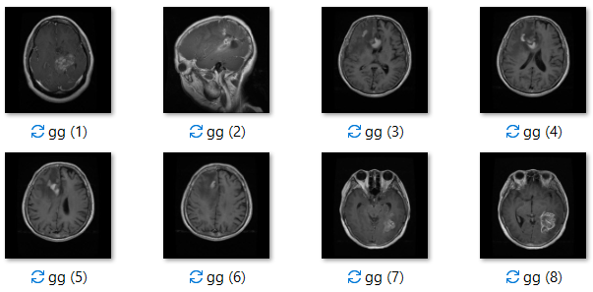
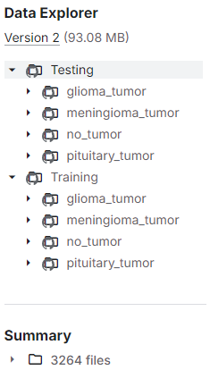
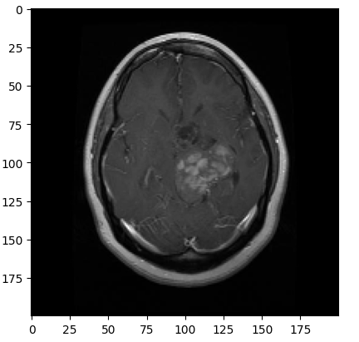
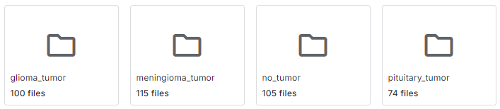
About dataset
Data Overview
Dataset Source: Brain Tumor Classification MRI dataset from Kaggle.
Classes: Glioma, Meningioma, No Tumor, Pituitary Tumor.
Data Preparation:
Images resized to 200x200 pixels.
Grayscale conversion.
Flattened to 1D arrays.
Preprocessing
Data Splitting:
Train/Test split: 80% train, 20% test.
Normalization:
Feature scaling: Dividing pixel values by 255.
PCA Application:
Dimensionality reduction retaining 98% variance.

Slide 4
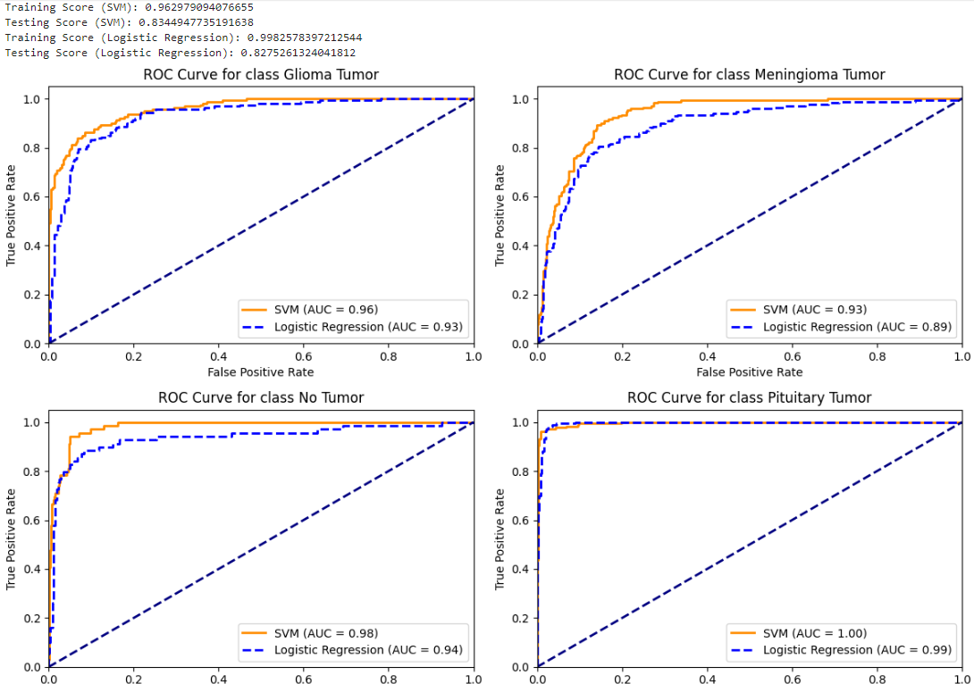
Evaluation
Training Score (SVM): 0.962979094076655
Testing Score (SVM): 0.8344947735191638
Training Score (Logistic Regression): 0.9982578397212544
Testing Score (Logistic Regression): 0.8275261324041812

Slide 5
Metrics
SVM
Logistic Regression
Mean Average Precision: 0.7752727847507274
Recall: 0.7485769264876706
MAP: 0.792381680933852
Mean Average Precision: 0.7791010806490843
Logistic Regression Recall: 0.7507633131222178
Logistic Regression MAP: 0.7755651505625953

Slide 6
Features
lg = LogisticRegression(C=0.1) lg.fit(pca_train, ytrain). The default penalty in LogisticRegression is L2 regularization. L2 regularization penalizes large coefficients by adding a term to the loss function that is proportional to the sum of the squared coefficients. Logistic Regression with L2 regularization assigns weights to features and includes a penalty proportional to the square of the weights to prevent overfitting, which helps the model generalize better and perform well on unseen data by discouraging excessively large coefficients. | SVC() Probability Estimates: Not included in the base SVM model (only used in the first version with probability=True). Kernel: Default is a radial basis function (RBF) kernel. Hyperparameters: C: Regularization parameter. Default is 1.0.

Slide 7
Dimensionality Reduction: PCA transforms high-dimensional data into a lower-dimensional space, retaining 98% of the variance (`PCA(0.98)`).
Application: Both SVM and Logistic Regression are trained and tested on the PCA-transformed data (`pca_train` and `pca_test`).
Benefits:
Simplifies the dataset, reducing computational complexity.
Helps prevent overfitting by focusing on the most significant features.
Improves model efficiency and generalization.
SVM:
sv.fit(pca_train, ytrain)
Logistic Regression:
lg.fit(pca_train, ytrain)
PCA in SVM and Logistic Regression

Slide 8
Challenges
Dataset: Brain Tumor MRI from Kaggle (Training: 3,264 Files, Testing: 394 Files)
# Preprocessing
img_flattened = cv2.resize(cv2.imread(image_path, cv2.IMREAD_GRAYSCALE), (200, 200)).flatten()
# Classification
svm = SVC(kernel='linear').fit(X_train, y_train)
y_pred_svm = svm.predict(X_test)
log_reg = LogisticRegression().fit(X_train, y_train)
y_pred_log_reg = log_reg.predict(X_test)
Disadvantages:
No Detection Capability: Only classifies, cannot localize tumors.
Scalability Issues: Requires extensive preprocessing and is less efficient with larger datasets.
# Model Initialization and Training
model = YOLOv5('yolov5s.pt', device='cuda')
model.train(data='yolo_data.yaml', epochs=100, batch_size=16)
# Prediction
results = model.predict('test_image.jpg')
Advantages:
Integrated Detection & Classification: Simultaneously detects and classifies tumors in real-time.
Scalable and Efficient: Handles large datasets with minimal preprocessing, optimized for performance.

Slide 9
Brain Tumor QueryBot
A chatbot that offers preliminary guidance and insights into terms related to brain tumor.
Provides prognosis and statistics.
Clears misconceptions of being affected by tumors.

Slide 10
Overview
Backend Setup:
Framework: Built using Flask, a web framework for Python.
Model: Utilizes GPT-2 from the Hugging Face Transformers library.
Key Features:
Flask Application:
Homepage (/): Displays the main interface.
Response Endpoint (/get_response): Processes user queries and returns answers.
Model Loading:
Tokenizer & Model: Converts text to tokens for GPT-2 and generates responses.
Padding Token: Ensures uniform sequence lengths.

Slide 11

Workflow
Response Generation:
Tokenization: Converts user input into model-readable tokens.
Text Generation: GPT-2 generates a response with settings like:
max_length (200 tokens)
temperature (0.7 for randomness)
top_k and top_p (sampling strategies)
no_repeat_ngram_size (prevents repetition)
Processing:
Avoids Repetition: Removes repeated questions from responses.
Proper Ending: Ensures responses end with punctuation.
Workflow:
Request: User submits a query via the frontend.
Processing: Query is tokenized, and GPT-2 generates a response.
Delivery: Cleaned response is sent back to the frontend in JSON format.

Slide 12
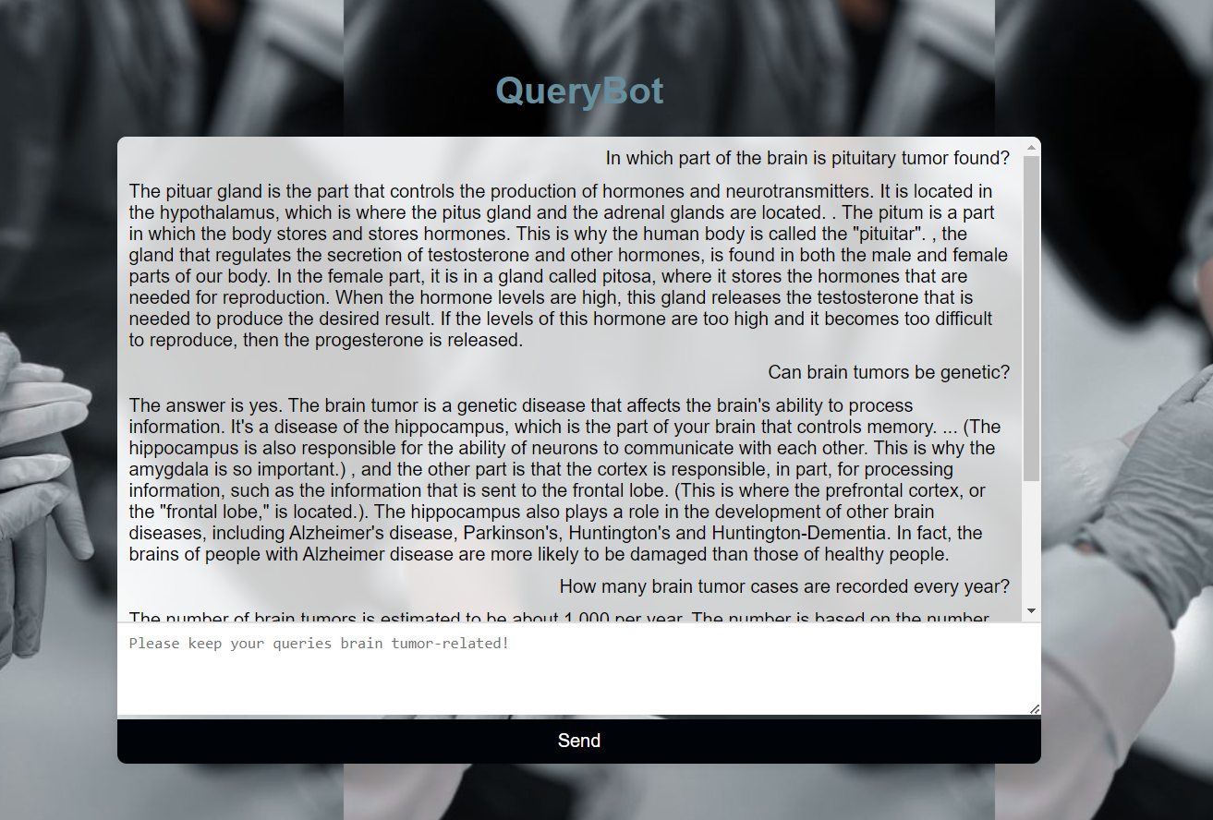
Result
and
Evaluation
Response Accuracy: 85%
Response Quality: 8.1/10
Response Time: 434 milliseconds
Repetition Handling: 90%

Slide 13
Thank you.

