Slide 1

EEG Emotion Recognition Using Dynamical Graph Convolutional Neural Networks
2019/9/5

Slide 2
Abstract
The basic idea of the proposed EEG emotion recognition method is to use a graph to model the multichannel EEG features and then perform EEG emotion classification based on this model. Different from the traditional graph convolutional neural networks (GCNN) methods, however, the proposed DGCNN method can dynamically learn the intrinsic relationship between different electroencephalogram (EEG) channels, represented by an adjacency matrix, via training a neural network so as to benefit for more discriminative EEG feature extraction. Then, the learned adjacency matrix is used for learning more discriminative features for improving the EEG emotion recognition. We conduct extensive experiments on the SJTU emotion EEG dataset (SEED) and DREAMER dataset. The experimental results demonstrate that the proposed method achieves better recognition performance than the state-of-the-art methods, in which the average recognition accuracy of 90.4% is achieved for subject dependent experiment while 79.95% for subject independent cross-validation one on the SEED database, and the average accuracies of 86.23%, 84.54% and 85.02% are respectively obtained for valence, arousal and dominance classifications on the DREAMER database.

Slide 3
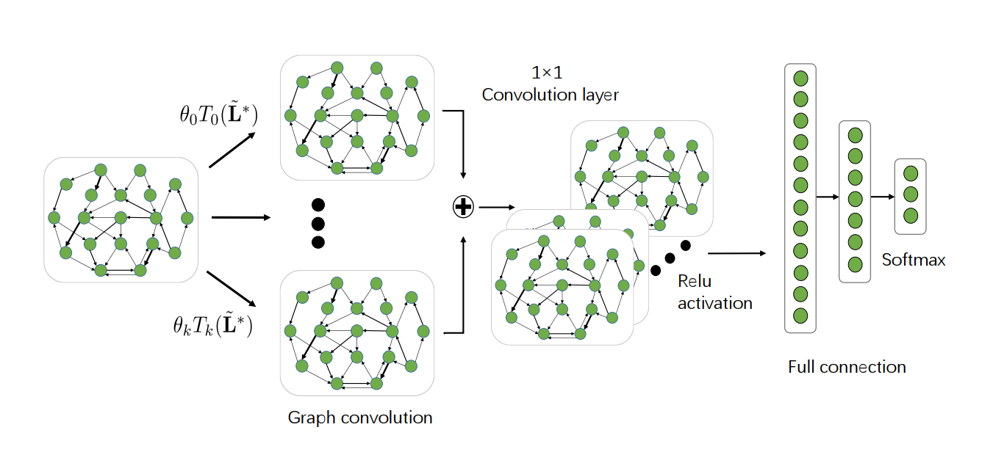
Algorithm

Slide 4
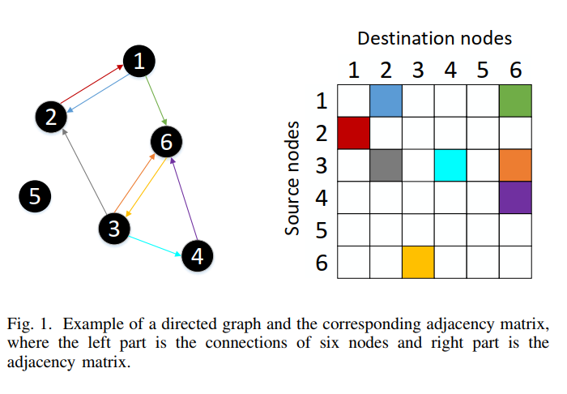
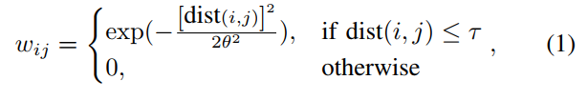
Introduction
τ and θ are two parameters to be fixed, dist(i; j) denotes the distance between the i-th node and the j-th one.

Slide 5
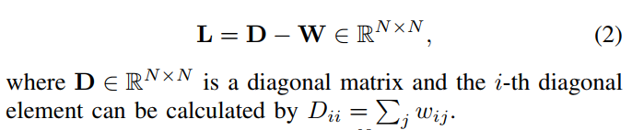
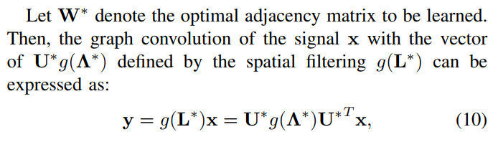
Introduction

Slide 6
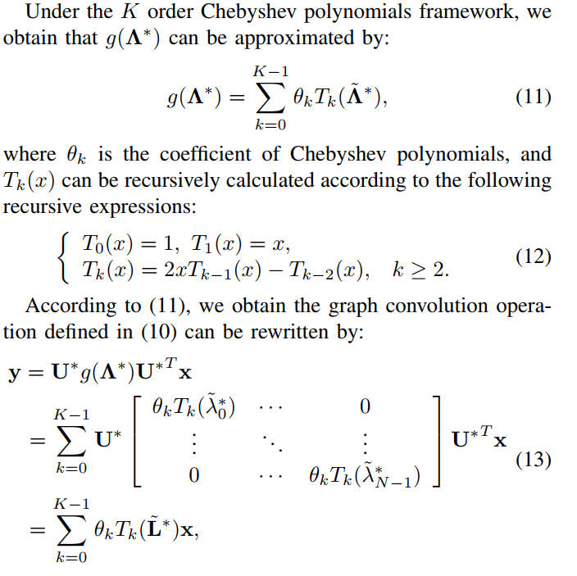
Introduction

Slide 7

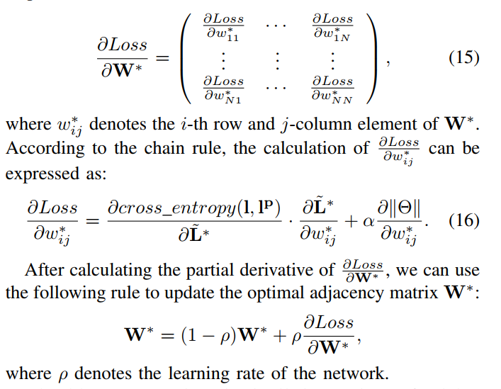
Introduction

Slide 8
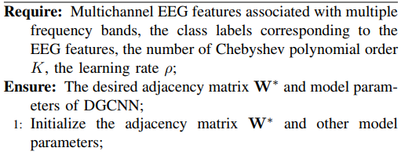
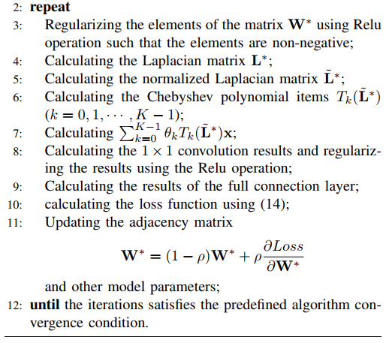
Algorithm

Slide 9
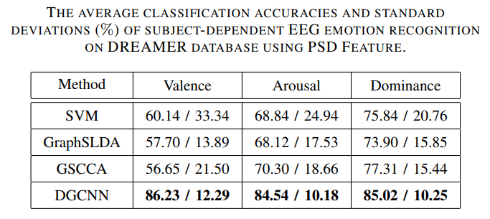
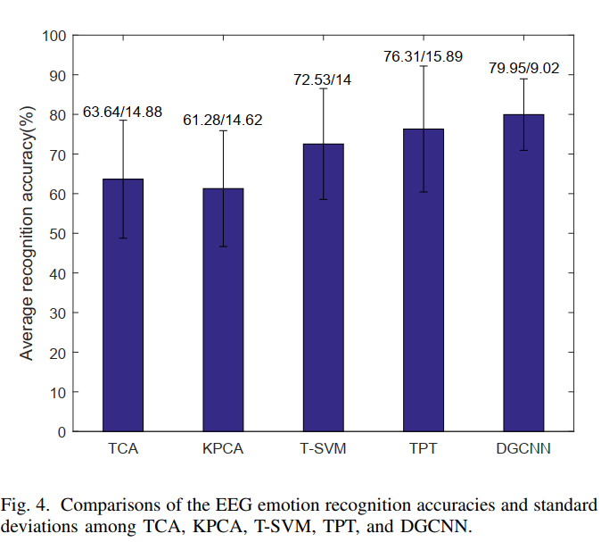
Result

Slide 10
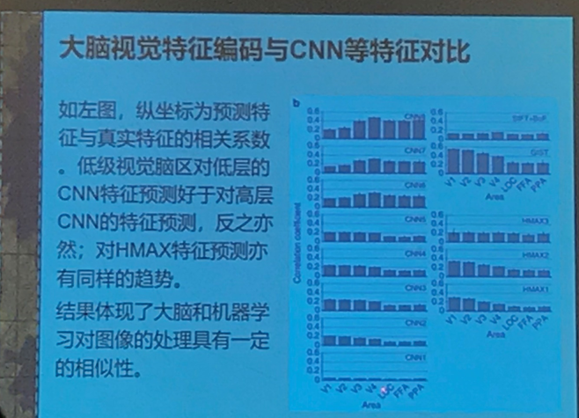
ISICDM

Slide 11
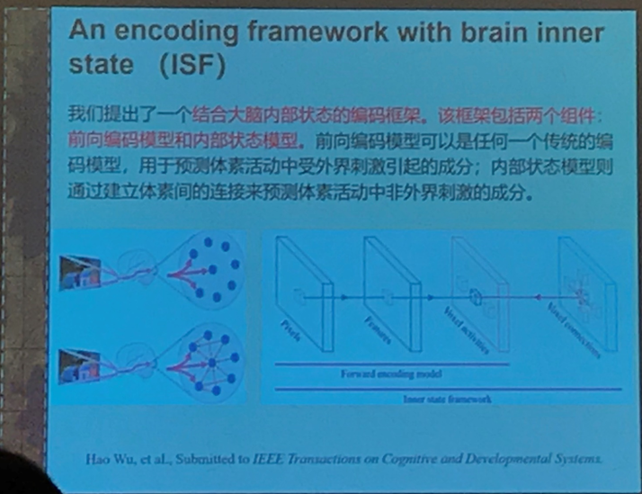
ISICDM

Slide 12
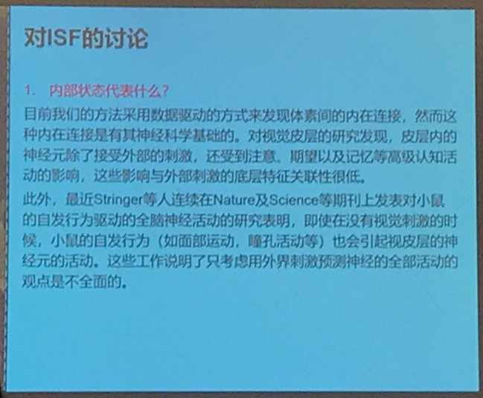
ISICDM

Slide 13
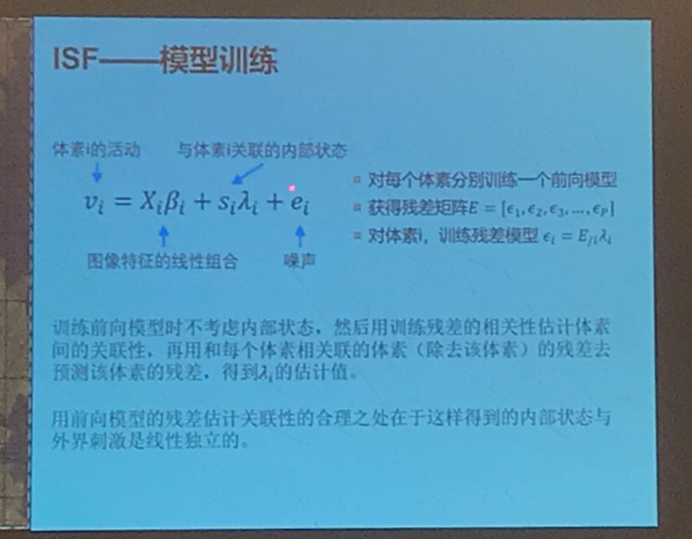
ISICDM

Slide 14
EEGnet实际结果
近期工作
Result
Batch size | Valid AUC | Valid Precision
1 | 0.99 | 1.00
2 | 0.99 | 0.90
3 | 1.00 | 0.95
4 | 0.98 | 0.95
5 | 0.99 | 1.00
Batch size | Test AUC | Test Precision
1 | 0.97 | 0.79
2 | 0.97 | 0.75
3 | 0.97 | 0.71
4 | 0.97 | 0.69
5 | 0.96 | 0.69

