Slide 1
Sentover ⎯ A sensor-based two-step verification method
鲍西雨
2018/7/3

Slide 2
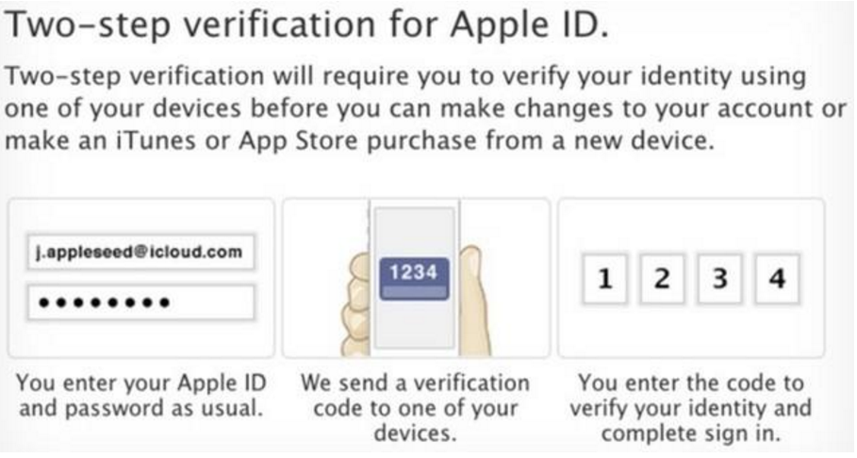
Background
Two-step verification

Slide 3
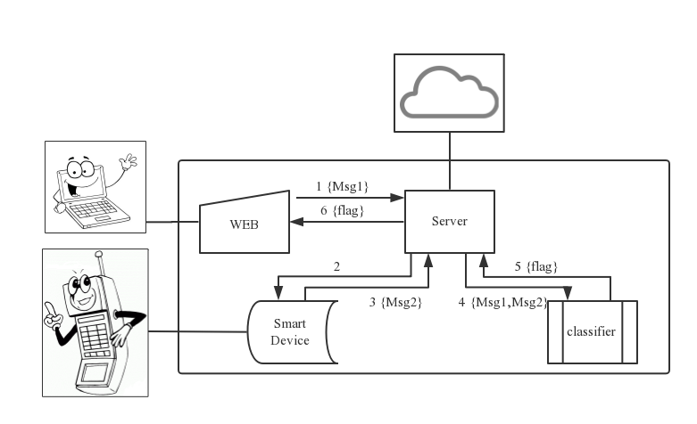
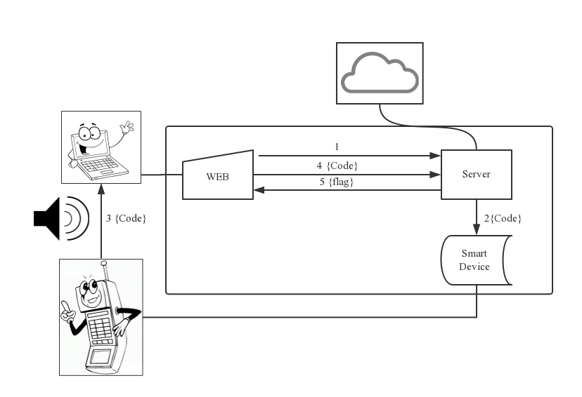

Solution

