Slide 1
Sentover ⎯ A sensor-based two-step verification method
鲍西雨
2018/7/3

Slide 2

Background
Two-step verification

Slide 3
Scenes
Private Scene
Phishing Website,
Protect Scene
Listener
Public Scene

Slide 4
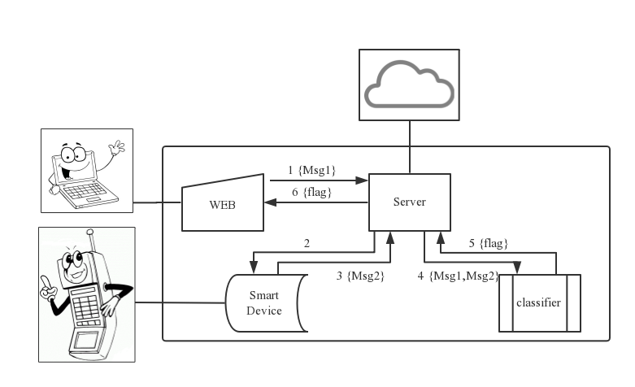

Layer 1

Slide 5
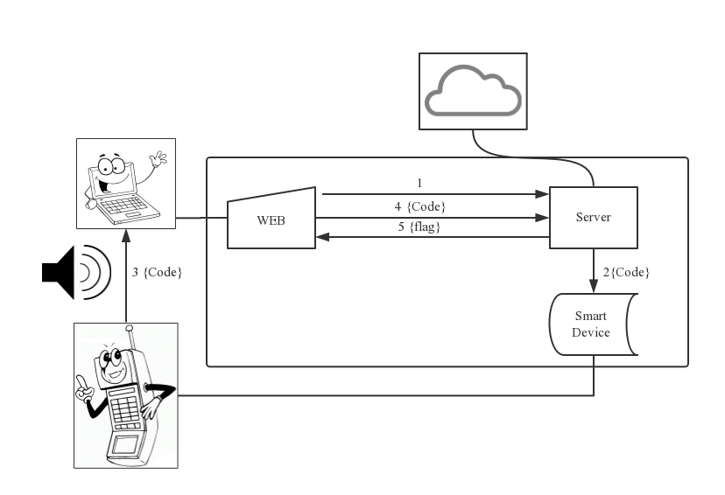
Layer 2

Slide 6
Sound layer

