Slide 1
Sentover ⎯ A sensor-based two-step verification method
Xiyu Bao
Yinhao Xiao
2018/7/20

Slide 2
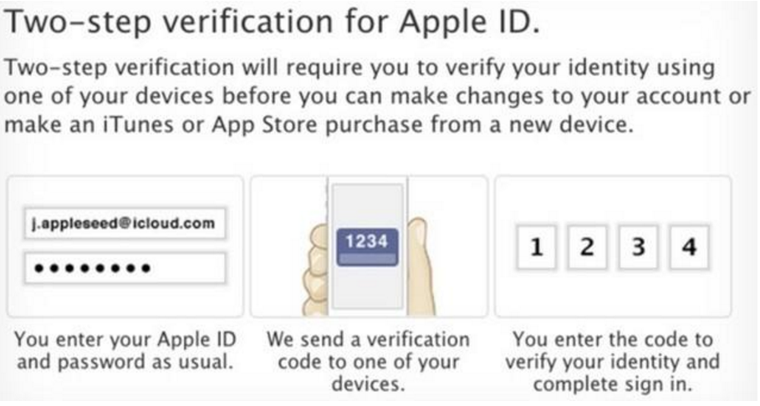
Background
Two-step verification

Slide 3
Scenes
Private Scene
Phishing Website, etc
Protect Scene
Listener, etc
Public Scene

Slide 4
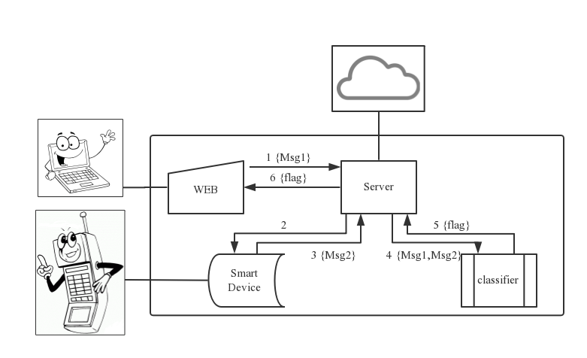

Layer 1

Slide 5
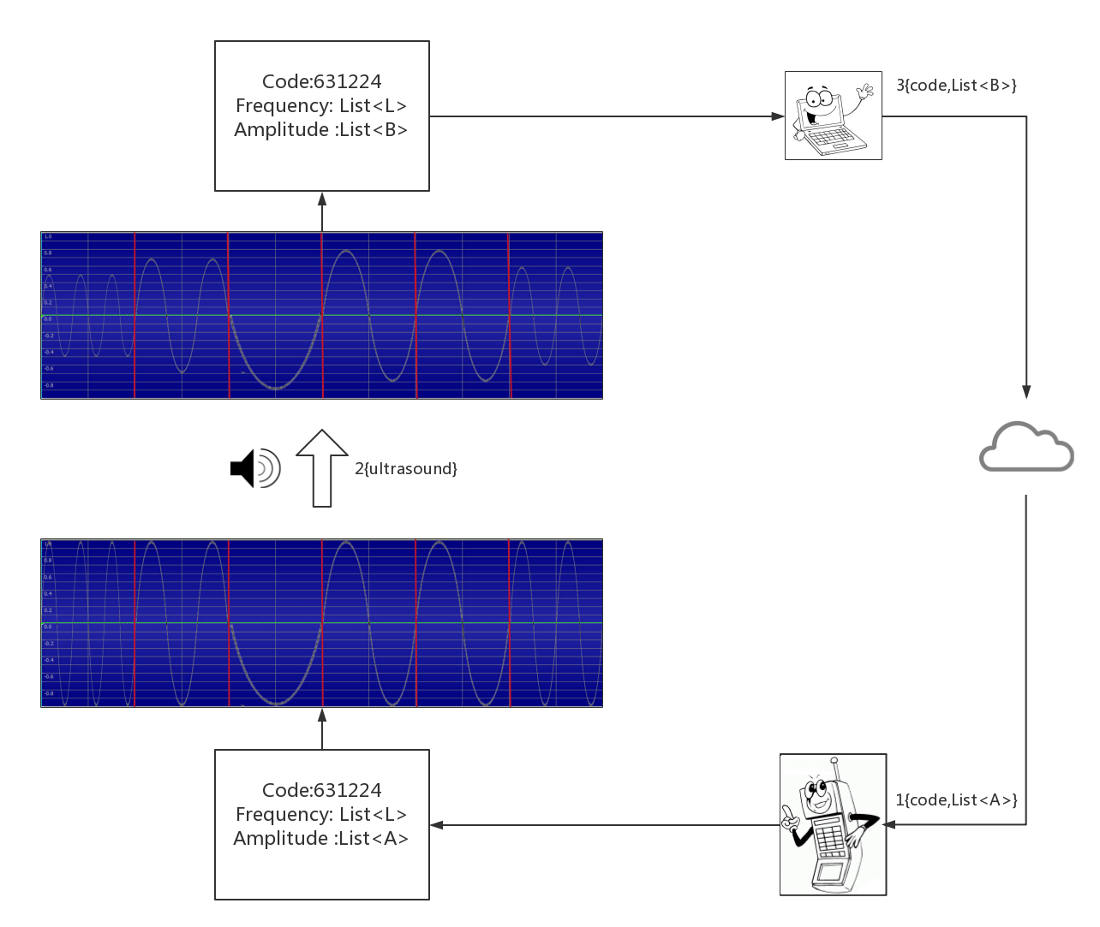
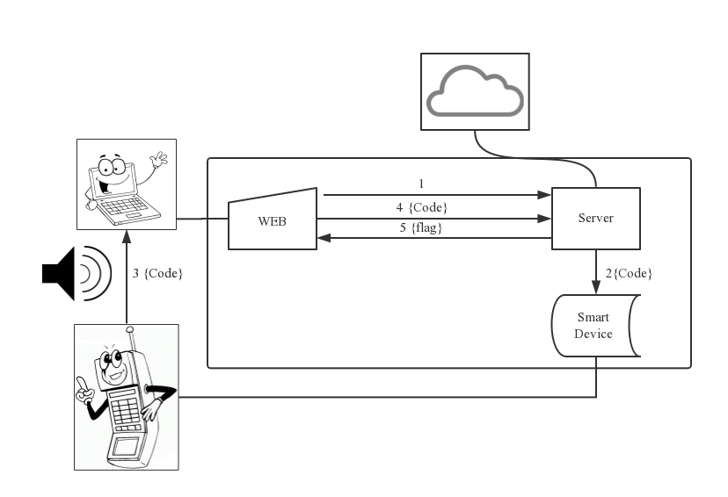
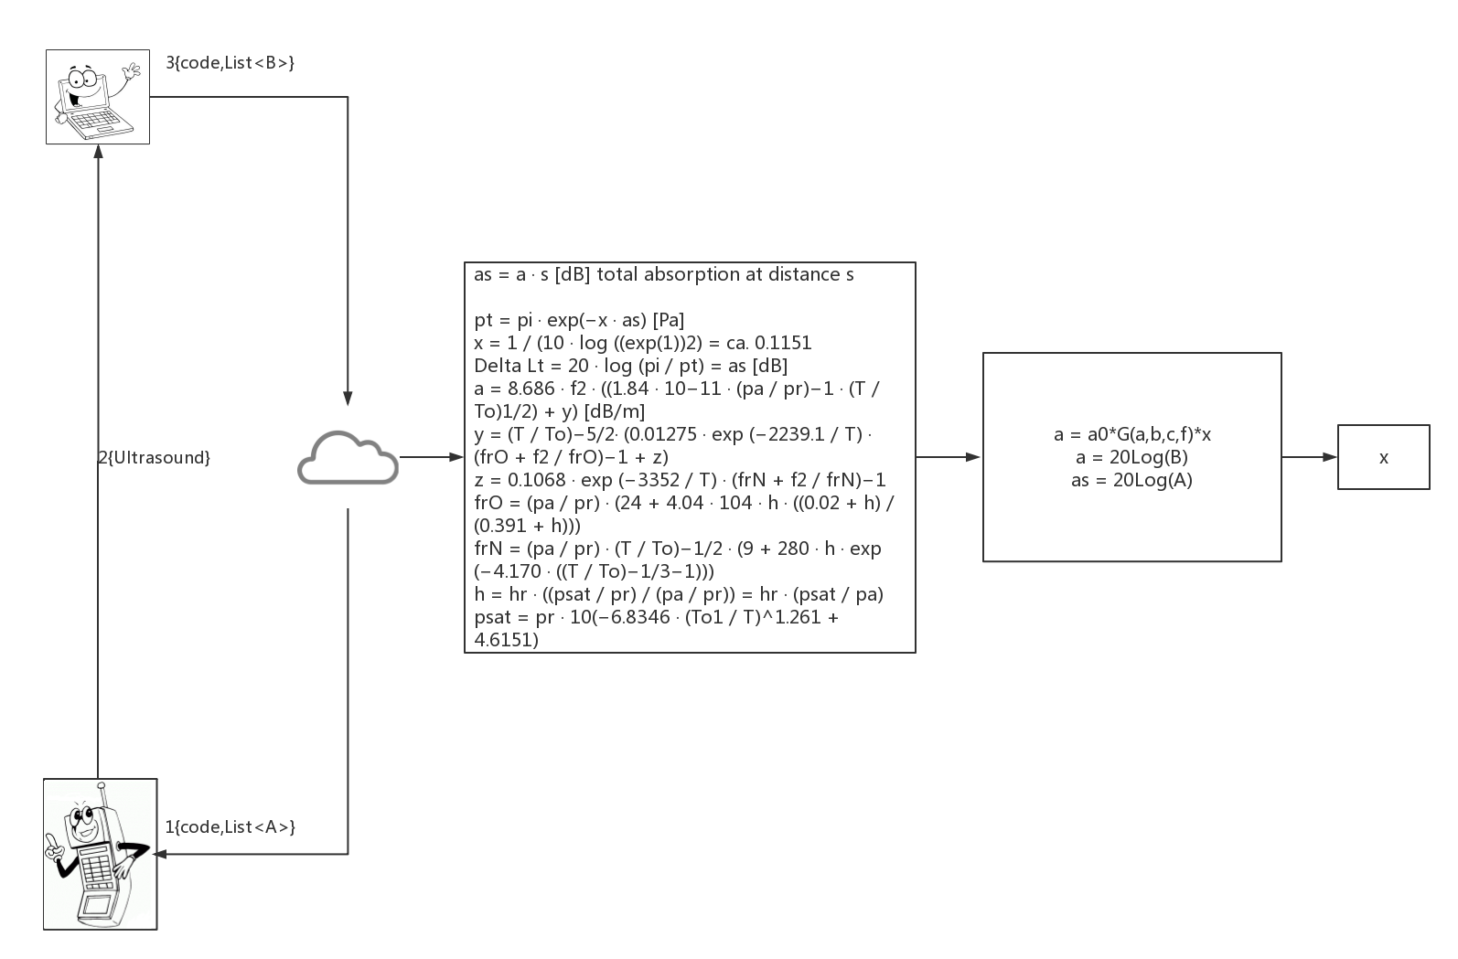
Layer 2

Slide 6
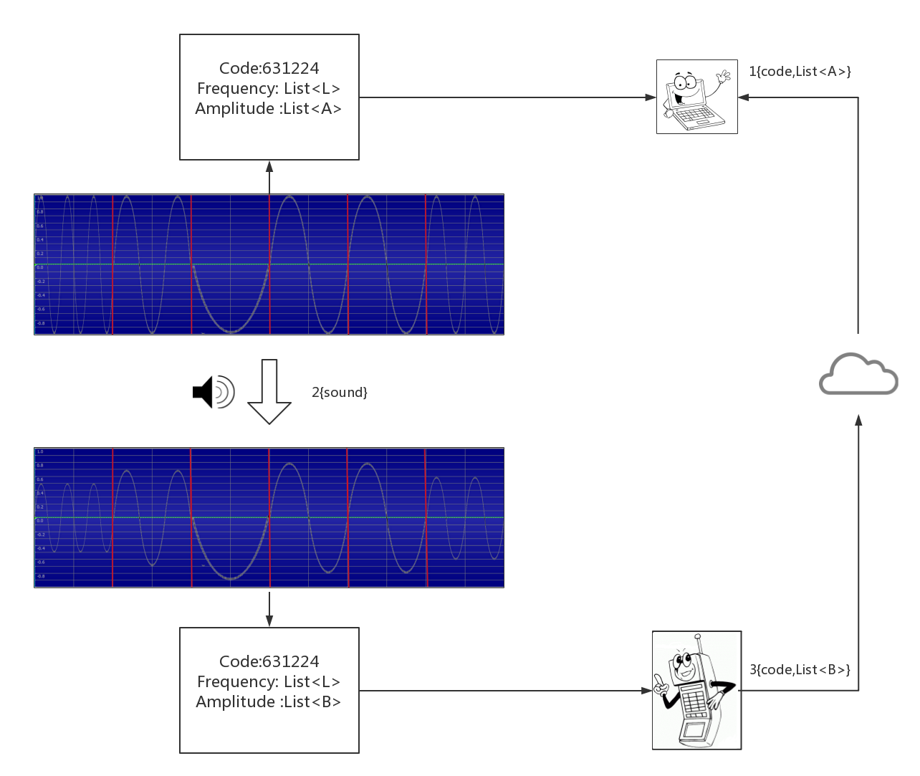
Layer 3

Slide 7
Thanks

