Slide 1
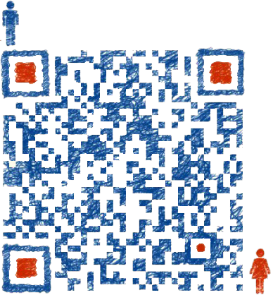
B
E
E
I
zigbee 自主网的定位模型
主讲：张心泽
Institute of Enterprise Business Intelligence Engineering, School of Management, Huazhong University of Science & Technology

Slide 2



zigbee
Institute of Enterprise Business Intelligence Engineering, School of Management, Huazhong University of Science & Technology

Slide 3


概述
问题
方案
实例
需求
理论
应用
GPS的弱势
Zigbee的优势
根据Zigbee标签的强度确定相对距离
室内定位
物流配送
Institute of Enterprise Business Intelligence Engineering, School of Management, Huazhong University of Science & Technology

Slide 4


CONTENTS
问题与技术背景
方案
方案
实例
实例
问题
Social Media
Web Design
Institute of Enterprise Business Intelligence Engineering, School of Management, Huazhong University of Science & Technology

Slide 5
1
问题与技术背景
Institute of Enterprise Business Intelligence Engineering, School of Management, Huazhong University of Science & Technology

Slide 6
问题
Zigbee 定位系统
Zigbee定位系统是基于Zigbee标签的定位服务系统，与GPS或北斗是互补的系统。
Zigbee定位系统一般应用于确定监控对象的位置，并提供相应的服务。
Institute of Enterprise Business Intelligence Engineering, School of Management, Huazhong University of Science & Technology

Slide 7
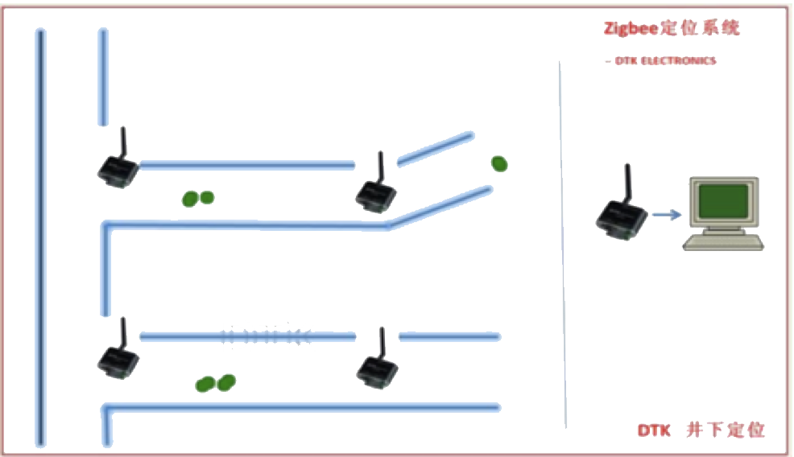
问题
传统的移动系统：
通过布设Zigbee定位系统，能知道被监控对象（定位卡）的区域（如煤矿的工作人员在巷道的哪个位置）
Institute of Enterprise Business Intelligence Engineering, School of Management, Huazhong University of Science & Technology

Slide 8
2
解决方案
Institute of Enterprise Business Intelligence Engineering, School of Management, Huazhong University of Science & Technology

Slide 9
解决方案
假设将三个位置参考点分别放在三个房间，定位系统会自动找出全部的定位卡在哪个房间（即，某个定位卡离哪个位置参考点最近）。
定位数据通过数据节点传输至后台电脑。
定位数据包内还包含：定位卡离得第二近、第三近的位置参考点数据，用户可做进一步的精确定位。
Institute of Enterprise Business Intelligence Engineering, School of Management, Huazhong University of Science & Technology

Slide 10
解决方案
网络结构
定位系统由定位卡、位置参考点、数据节点构成；
数据节点用网线连接，通过交换机或路由器连接至电脑；
位置参考点只需要供电，为定位卡提供位置参考；
每个数据节点可覆盖半径约20米的范围，在此范围内，至少布置一个位置参考点；
定位卡在系统覆盖范围内移动时，系统每隔3秒计算出定位卡的位置数据，并报告给上位机。
Institute of Enterprise Business Intelligence Engineering, School of Management, Huazhong University of Science & Technology

Slide 11
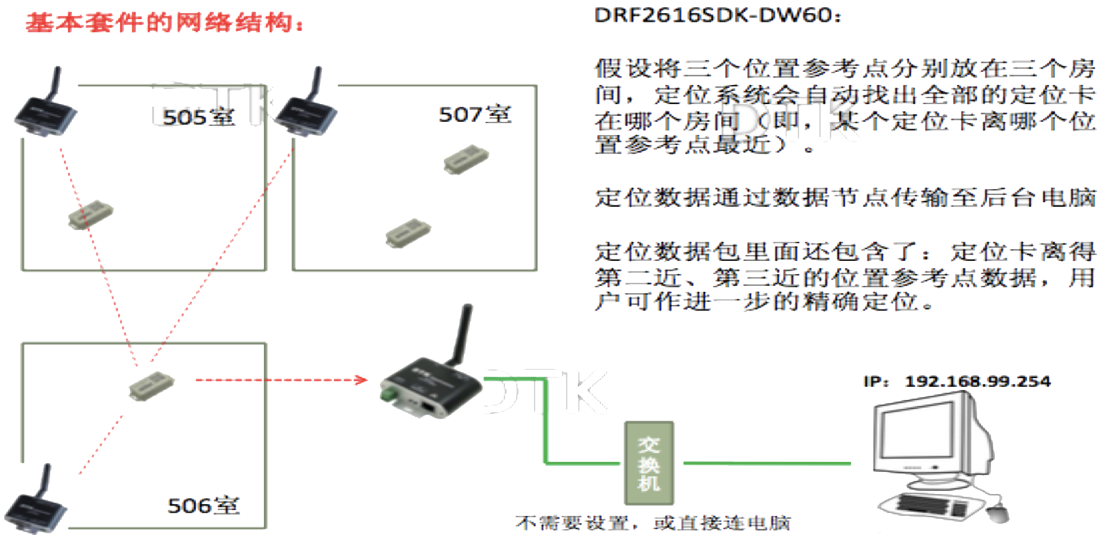
解决方案
Institute of Enterprise Business Intelligence Engineering, School of Management, Huazhong University of Science & Technology

Slide 12
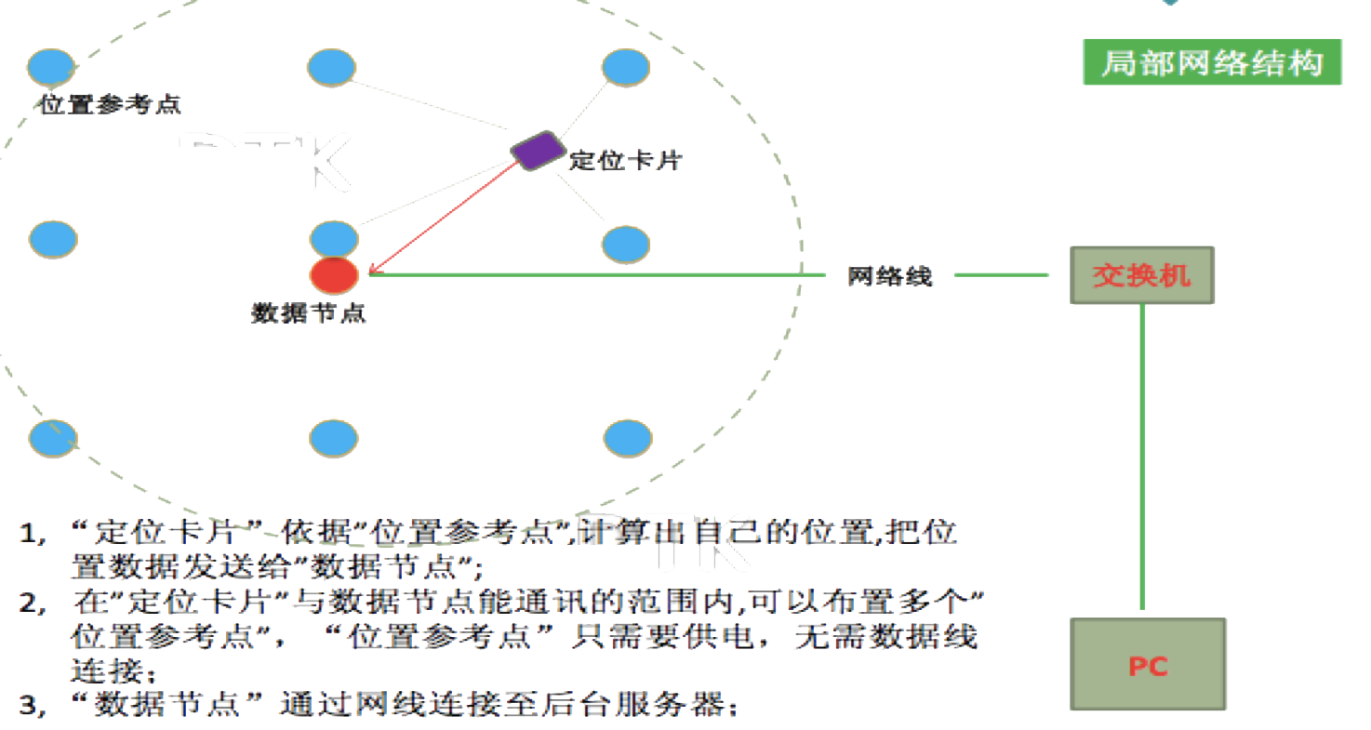
解决方案
Institute of Enterprise Business Intelligence Engineering, School of Management, Huazhong University of Science & Technology

Slide 13
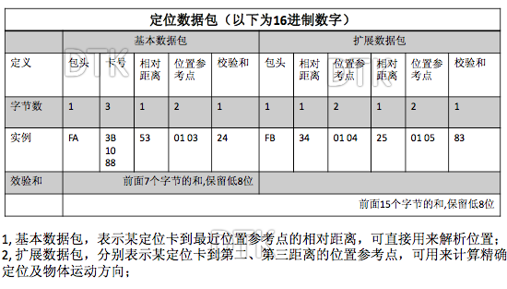
解决方案
定位数据包格式：
Institute of Enterprise Business Intelligence Engineering, School of Management, Huazhong University of Science & Technology

Slide 14
解决方案
实现定位：
通过基于节点之间通讯的信号强度综合计算得出定位卡到位置参考点的相对距离。
相对距离与实际距离没有明确的对应关系，在不同的空间，同样的相对距离可能对应不同的实际距离，在不同的应用现场，需要分别测量相对距离与实际距离的对应关系。
Institute of Enterprise Business Intelligence Engineering, School of Management, Huazhong University of Science & Technology

Slide 15
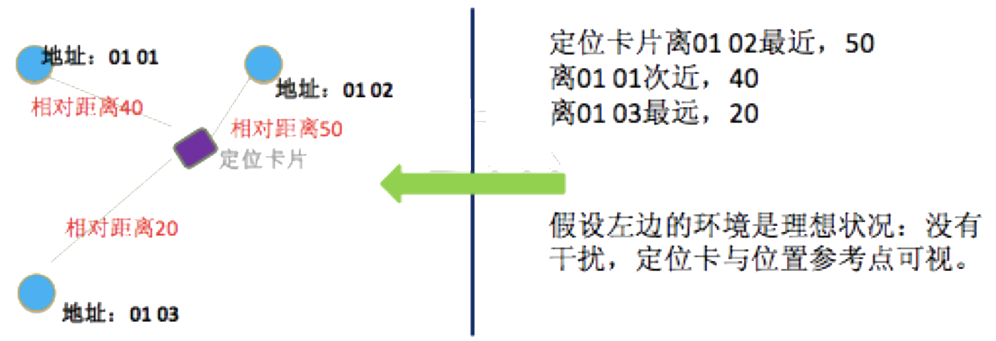
解决方案
实现定位：
Institute of Enterprise Business Intelligence Engineering, School of Management, Huazhong University of Science & Technology

Slide 16
3
实例
Institute of Enterprise Business Intelligence Engineering, School of Management, Huazhong University of Science & Technology

Slide 17
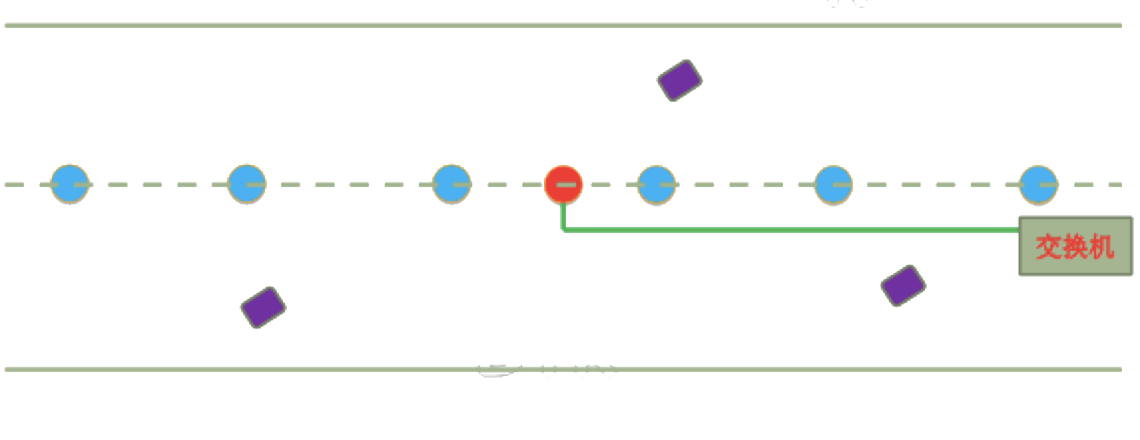
实例
基于道路运动的物流入厂配送：
Institute of Enterprise Business Intelligence Engineering, School of Management, Huazhong University of Science & Technology

Slide 18
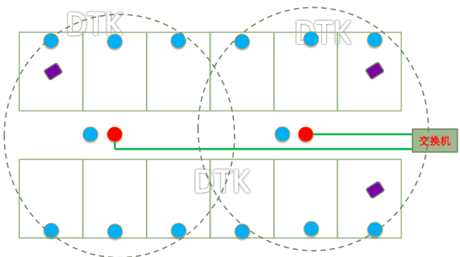
实例
医院类应用网络参考：
Institute of Enterprise Business Intelligence Engineering, School of Management, Huazhong University of Science & Technology

Slide 19
B
E
E
I
THANKS FOR YOUR TIME
Xinze Zhang Mail: xinze@hust.edu.cn
Institute of Enterprise Business Intelligence Engineering, School of Management, Huazhong University of Science & Technology

