Slide 1
Tera Chess Project
Names: Lovyck juteau-mercier, Dan bondarenko and patrick beland
Comp 307

Slide 2
Summary
Based on chess
But with a twist…
Chess with customizable pieces
Including RPG mechanics

Slide 3
Motivation
We all like strategy and RPG video games and Terra chess has these

Slide 4
Architecture
MVC
Views: HTML/ JS based
Model: MySQL
Controller: Django server with scripts

Slide 5
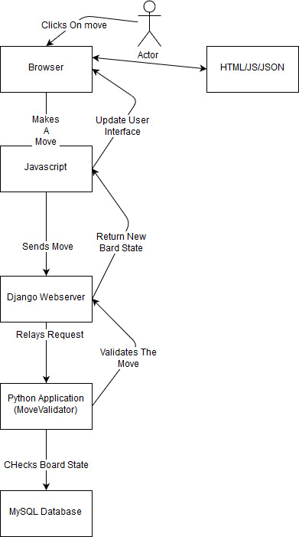
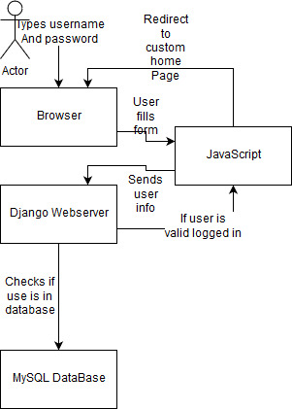
Flowcharts

Slide 6
Conclusion

