Slide 1
Parsing step

Slide 2
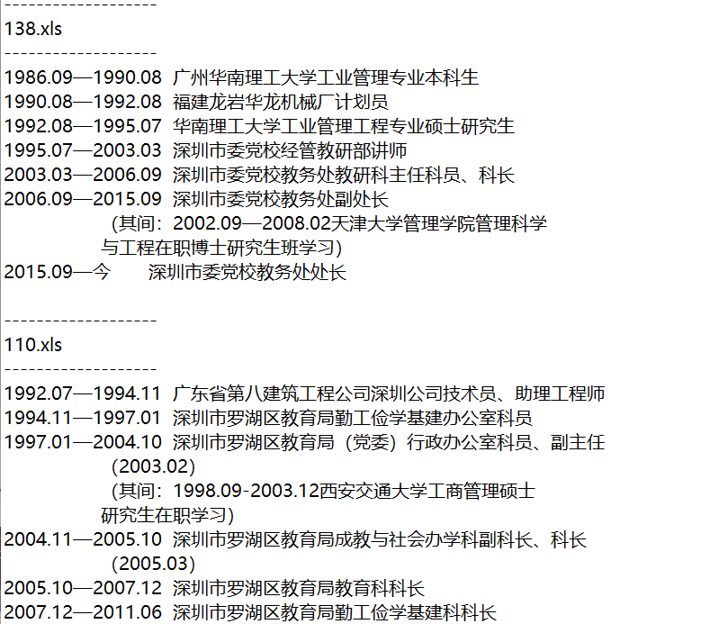
1，load out.txt

Slide 3
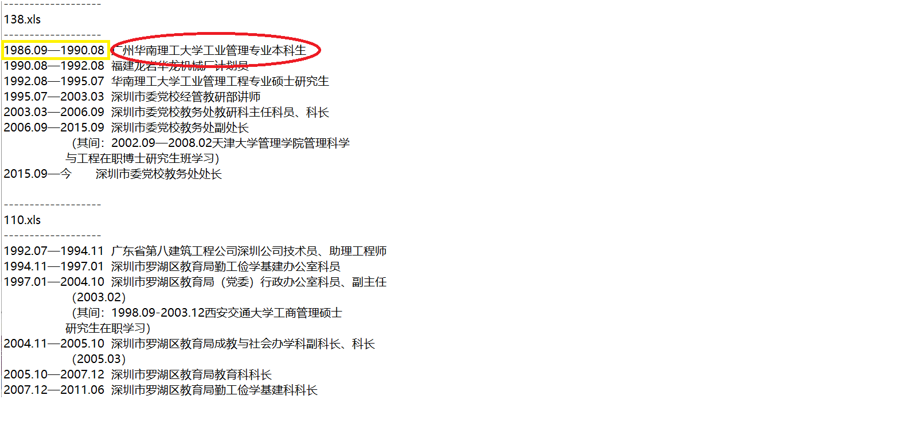
2,get target information by time-signal

Slide 4

3,Use hanlp to parse target

Slide 5



4, Get the last-n word in parsing result

Slide 6
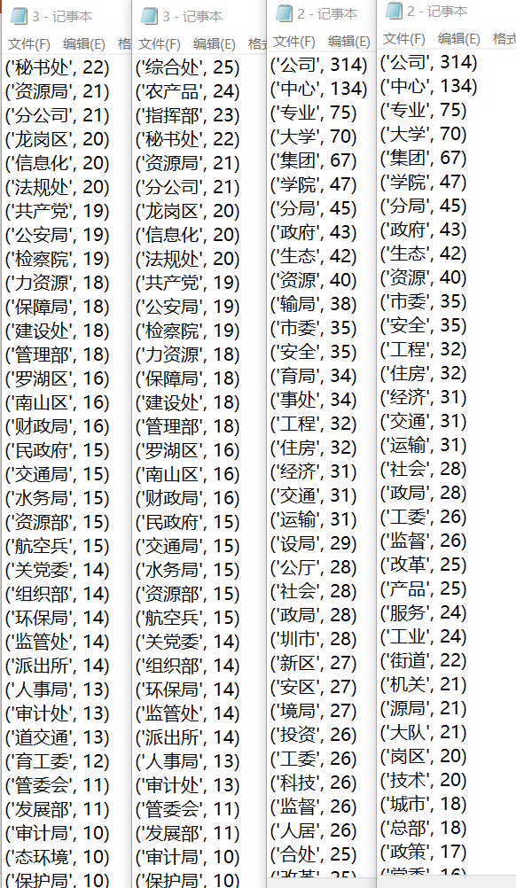
5, Record corresponding sequence and frequency
1, Delete the sequence which doesn't look like a suffix
2, Remove sequence with frequency less than 10
Tips:(left: unchanged)

Slide 7
6,Use the key-sequence we get to parse
Input: raw sentence, key-sequence(Ordered by frequency)
Output: parsing result(list2)
1,Use hanlp_parsing to process raw sentence, then we get a list result(list1)
2,Loop every element in list1. If hanlp_detect_institution is True or finding the same sequence both in the the last-n words in current element and key-sequence, define this element as FIRST_ELEMENT, add this element in list2 (Eg: ‘教务处’ ‘处’ we find the same word in these two sequences, then this element”教务处” will be added)
3,Continue to loop every element after FIRST_ELEMENT, if finding same sequence both in the the last-n words in current element and key-sequence, add this element in list2.

