Slide 1


Career Analysis by Spatial-Temporal Network
Shi Mao
Yuan Wang
Yanfeng Chen

Slide 2
Outline
Introduction
Data Crawling and Parsing
Spatial-Temporal Graph Construction & Visualization
Data Analysis
Result and Conclusion
Team Contribution

Slide 3
Introduction
Motivation
Trying our best by applying learning algorithm to help people to find their suitable job.
Problem
Conventional algorithms neglect the relationship of users' mentors, schoolmates and colleagues.

Slide 4
Data Crawling and Parsing
Data Crawling
From a public government website http://www.sz.gov.cn/cn/xxgk/zfxxgj/sldzc/sz_97404/crg/
All Shenzhen government officer resumes

Slide 5
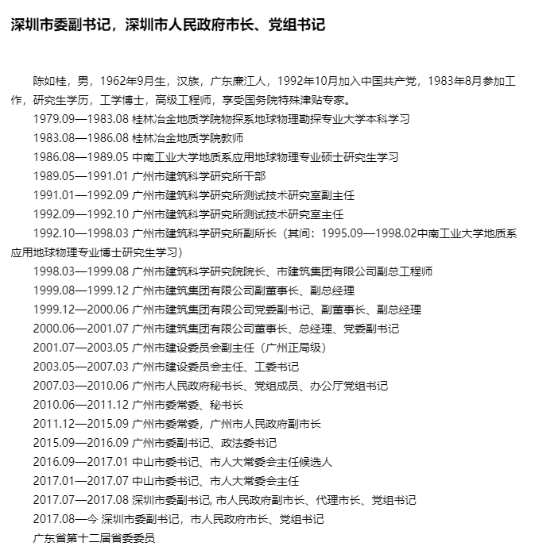
Data Crawling and Parsing

Slide 6
Data Crawling and Parsing
Data Parsing
Using a public Github repository https://github.com/hankcs/pyhanlp
Manual adjustment

Slide 7
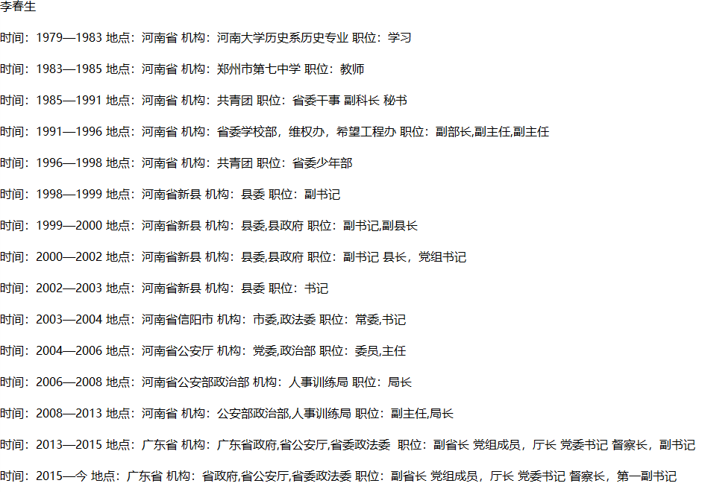
Notes:
1. Four components

Slide 8
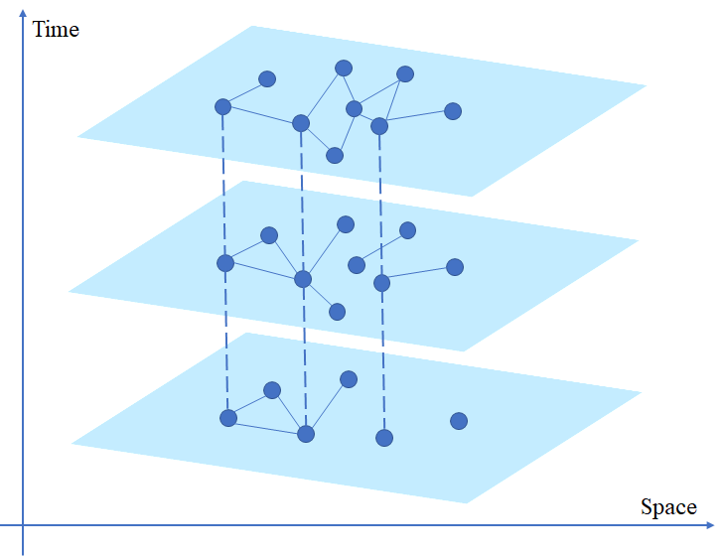
Spatial-Temporal Graph
Spatial-temporal networks are spatial networks whose topology and parameters change with time.
Specifically for Social Network, we consider the change of social connection through time
Construction considerations:
How to establish connection?
How to choose time step?
Labeling

Slide 9
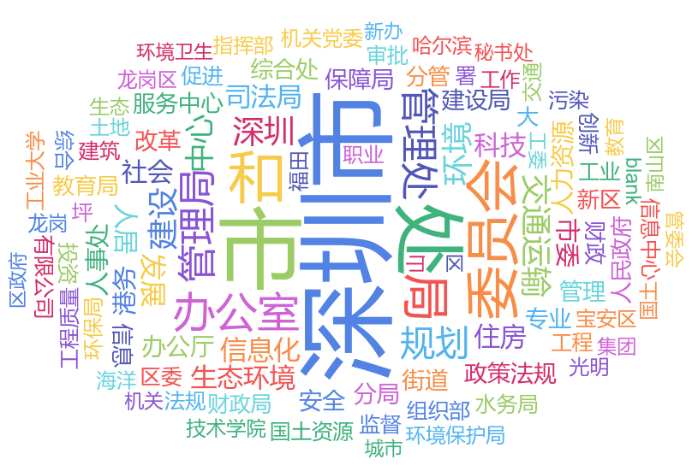
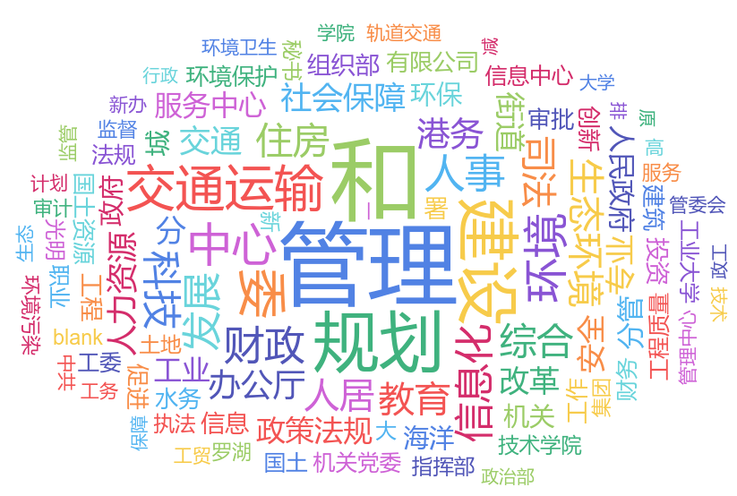
Spatial-Temporal Graph: Connection
Connected if serving the same institution?
too Sparse: 108 repeated in all 720 institutions
Measure the distance of nodes by the stem of their institution 'similarity'.
By fuzzy matching
institution
name | institution | institution stem
于宝明 Baoming Yu | 深圳市交通局 Shenzhen transportation Bureau | 交通 trasnportation
徐忠平 Zhongping Xu | 智慧交通处 Intel-transportation Division | 智慧交通 intel-transportation
张福通 Futong Zhang | 深圳市财政局 Shenzhen Finance Bureau | 财政 Finance
institution
stem
Fuzzy matching tools: Fuzzywuzzy. https://github.com/seatgeek/fuzzywuzzy. Accessed: 2019-12-30.

Slide 10
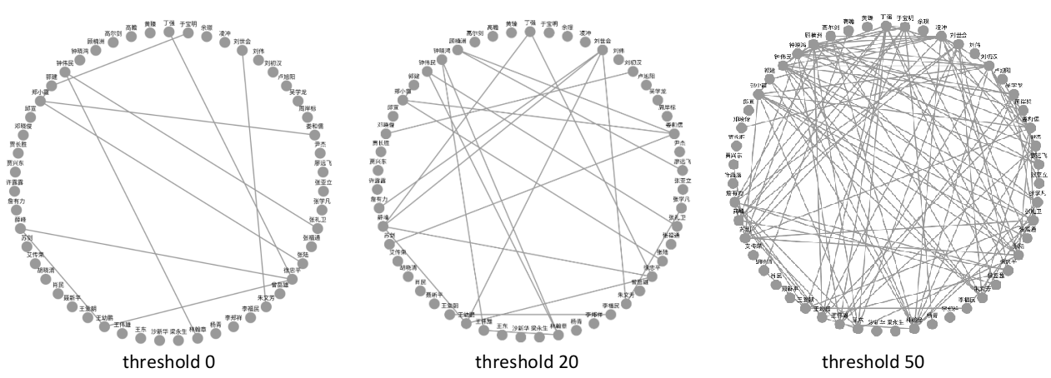
Spatial-Temporal Graph: Connection
Build the graph by epsilon-neighborhood
different people might have different number of neighbors
Fine-tune the epsilon by visualization

Slide 11
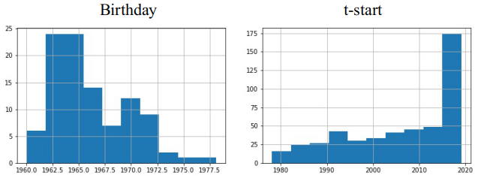
Spatial-Temporal Graph: time step
Choose smaller time step to observe the evolution clearly
Another observation here is the distribution of our dataset is concertrate on 50-60 years old senior officers

Slide 12
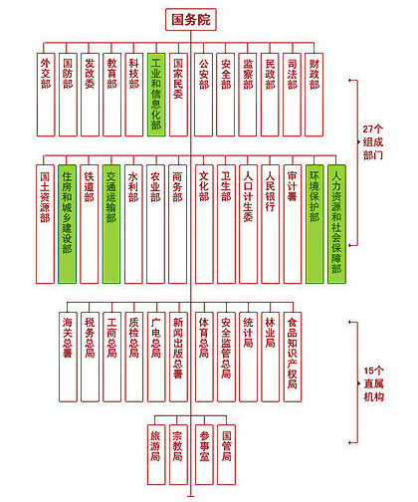
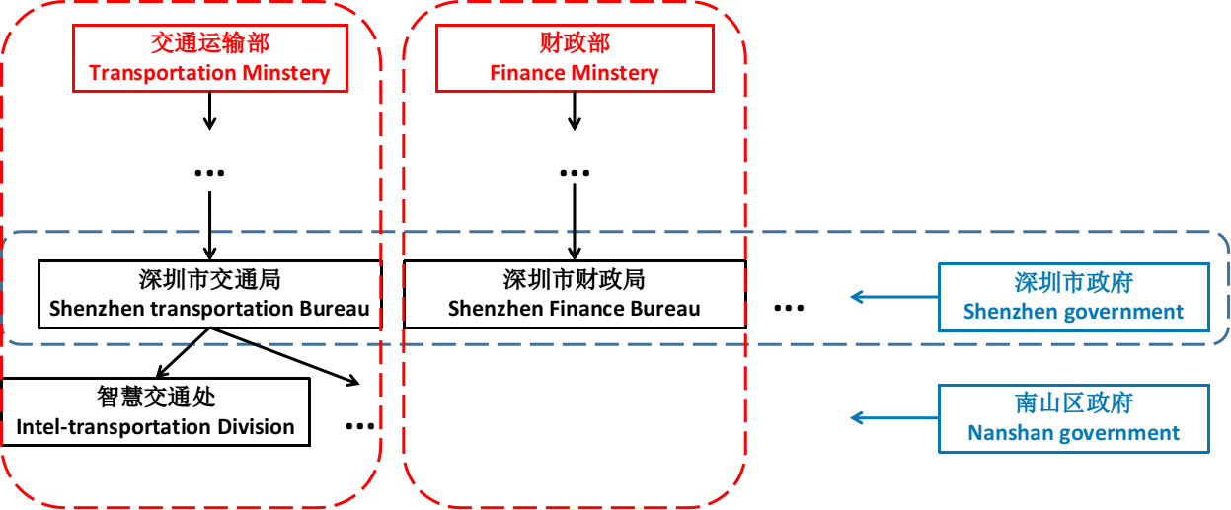
Spatial-Temporal Graph: Labeling
Institution have Large diversity
Share limited purview of authority (职能范围)vertically

Slide 13
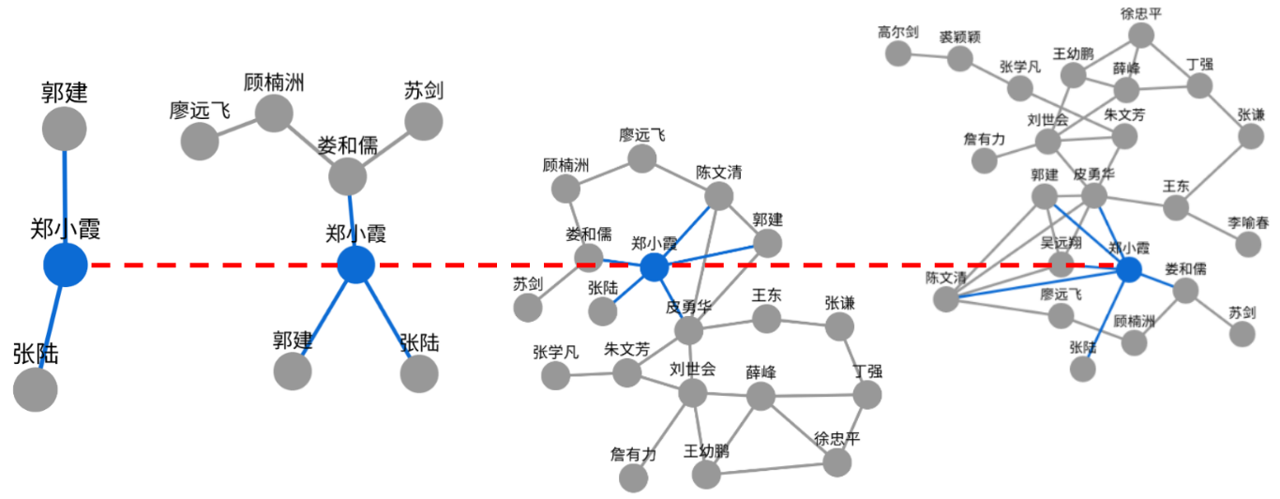
Spatial-Temporal Graph: Visualize
Visualization in temporal domain shows the evolving characteristic in data

Slide 14
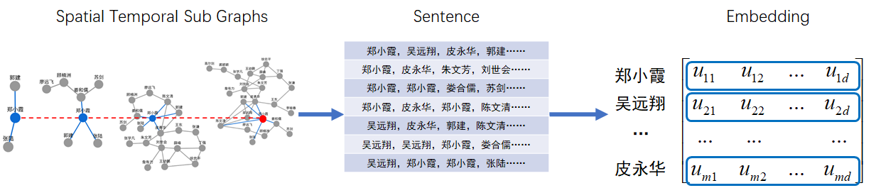
Data Analysis: STWalk
A structure embedding method
Two parts:
Random walk on the spatial-temporal network
SkipGram network to learn feature vector (NLP)
Supriya Pandhre, Himangi Mittal, Manish Gupta, and Vineeth N Balasubramanian. Stwalk: learning trajectory representations in temporal graphs. In Proceedings of the ACM India Joint International Conference on Data Science and Management of Data, pages 210–219. ACM, 2018.

Slide 15
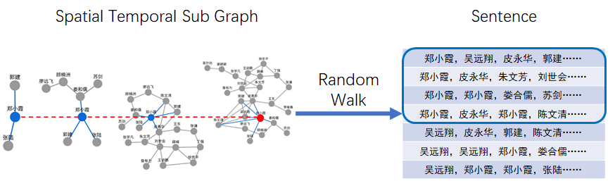
Data Analysis: STWalk
Random Walk in both spatial and temporal domain.
imporvement: weighted sampling
record the trajectory as 'sentence'

Slide 16
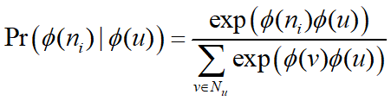
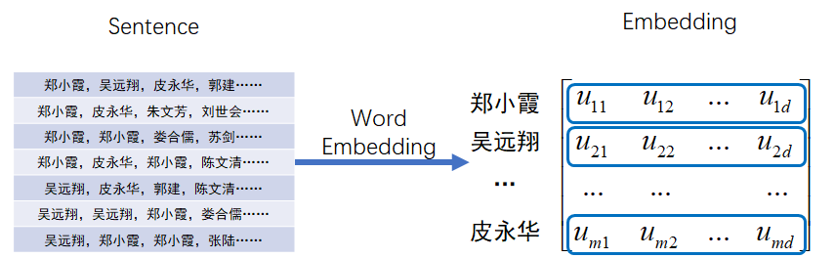
Data Analysis: STWalk
word embedding by SkipGram:
Maximizing the co-occurance probability
Tomas Mikolov, Kai Chen, Greg Corrado, and Jeﬀrey Dean. Eﬃcient estimation of word representations in vector space. arXiv preprint arXiv:1301.3781, 2013.

Slide 17
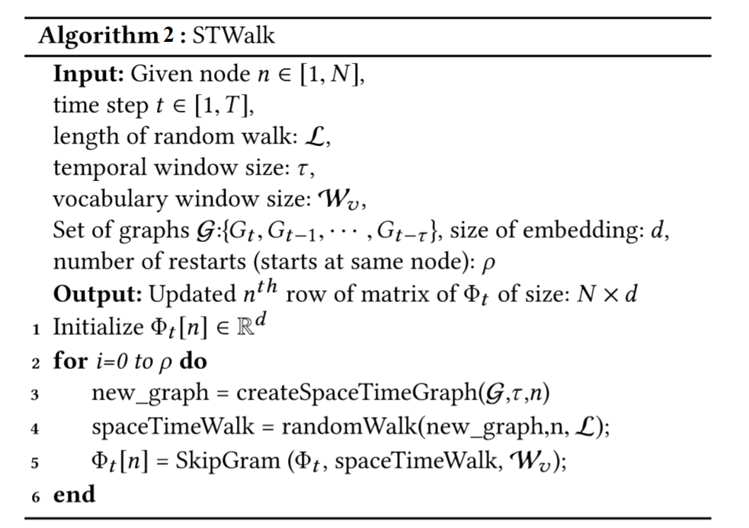
Data Analysis: STWalk

Slide 18
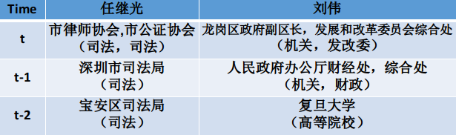
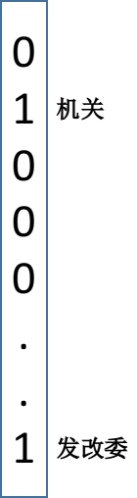
Data Analysis: Classiﬁcation
Mutilabel classiﬁcation problem
One-hot encoding to encode labels
One-Vs-The-Rest classiﬁcation problem
Multiple Binary SVM classifier

Slide 19
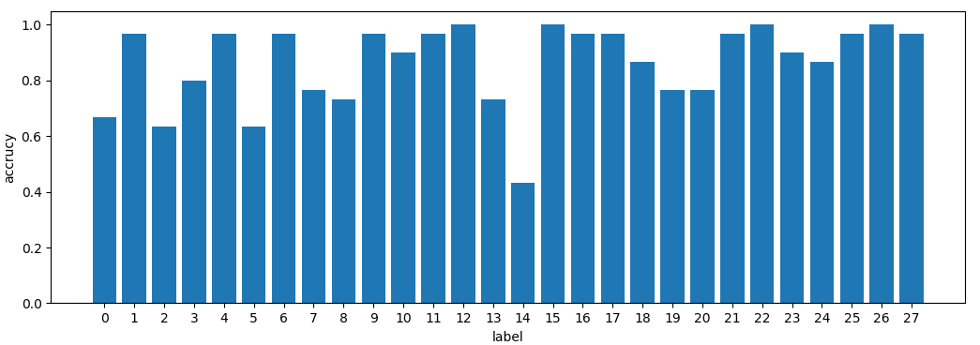
Result: Mutilabel classiﬁcation
In average, the accuracy of classiﬁcation is 86.19%
The accuracy of correctly predict at least one label for a node is 73.33%.
Label accuracy

Slide 20
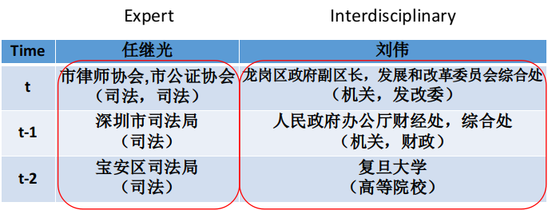
Data Analysis: Classiﬁcation
Interdisciplinary or expert problem:
Only one label Expert
More than one label Interdisciplinary
In average, the accuracy of classiﬁcation is 86.67%*

Slide 21
Future work
Extend the scope of dataset to over the country
Promotion analysis and prediction
Better embedding with node features

Slide 22
Team Contribution
陈彦锋 Yanfeng Chen | Data Crawling and Parsing
毛适 Shi Mao | Spatial-Temporal Graph Construction and Visualization
王远 Yuan Wang | Data Analysis

Slide 23

THANK YOU!

