Slide 1



Financial Text Sentiment Prediction & Fitbit Big Data Health Solutions
LIU Yuxuan, LIU Yuetong, WU Mengyun, LIU Yize, LIN Lixin
Lingnan University

Slide 2

Contents
System Design
Background
Data & Data Preprocessing
Word Embedding & Models Setting
Result
Case Study
Background
Idea & Solution

Slide 3
01. System Design

Slide 4
Project Background & Objectives
Financial Sentiment Analysis Overview:
Financial sentiment analysis involves analyzing the sentiment orientation in financial texts (such as news, reports, and social media) to help financial institutions identify market sentiment fluctuations.
Sentiment fluctuations directly impact stock markets, foreign exchange markets, and other financial trends, making sentiment analysis an important tool for supporting investment decisions.
Project Objectives:
The goal of this project is to develop a text classification decision support system, using sentiment analysis techniques to classify financial texts and help investors and financial institutions more accurately predict market sentiment changes..

Slide 5

System Development Goals & Key Features
System Development Goals:
The goal of this project is to create a decision support system based on financial sentiment analysis, helping financial institutions identify market sentiment fluctuations and make more accurate investment decisions.
Core functions of the system:
1. Sentiment analysis and classification: Through sentiment analysis models, identify the sentiment endencies (such as positive, negative, neutral) in financial texts, providing support for market sentiment classification.
2. Sentiment trend prediction: Based on the results of sentiment analysis, predict the changes in market sentiment, providing data support for investment decisions.
3. Decision support: Provide actionable suggestions based on sentiment analysis results to help financial institutions and investors optimize their strategies.

Slide 6
System Implementation Methods & Steps
1. Data loading & preprocessing:
Load the financial text data and conduct necessary data cleaning and preprocessing (such as tokenization, removal of stop words, punctuation, etc.).
2. Baseline model & training:
Use machine learning models to perform sentiment classification on the text and evaluate the performance of the models.
3. Application of word embedding models:
Use word embedding models for text feature extraction to enhance the accuracy of sentiment analysis.
4. Model evaluation and optimization:
Optimize the model performance through methods such as grid search and random search for hyperparameter tuning to ensure the best classification effect.
5. Performance Visualization
Use bar charts and word clouds to visualize the accuracy of different models and show the distribution of high-frequency sentiment words, helping decision-makers better understand sentiment data.

Slide 7
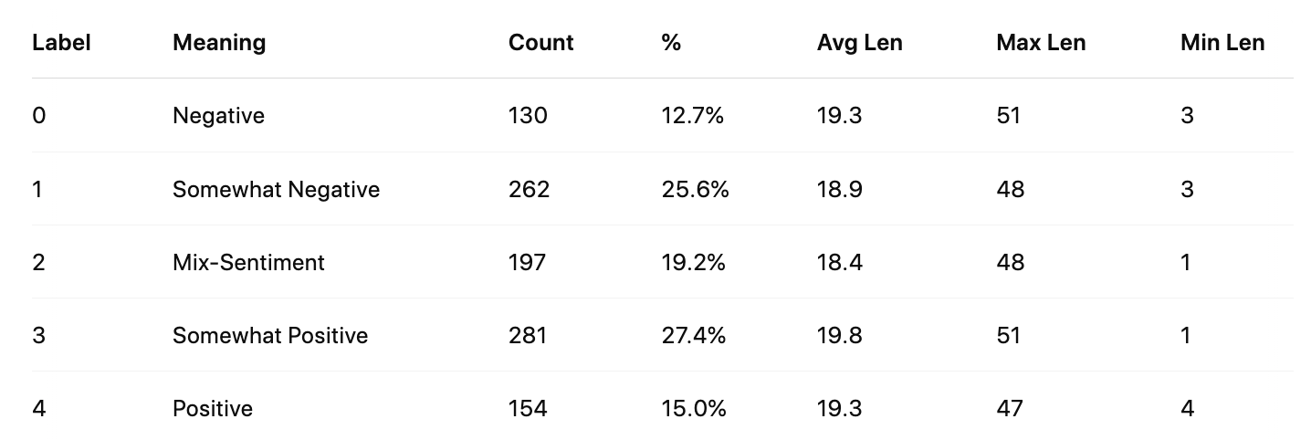
Sentiment Label Distribution
Balanced Distribution: Most labels have a similar number of samples, which helps with model training.
Consistent Sentence Length: The average sentence length is similar across all labels, making the data more uniform for analysis.

Slide 8
Text Preprocessing Flow
Tokenization
Used word_tokenize to split the text into individual words.
Lowercase
Converted all words to lowercase.
Remove Punctuation
Removed irrelevant characters such as , . ( ) ...
Remove Stopwords
Removed common English stop words using NLTK’s standard stopword list.
Extract
Sentiment Words

Slide 9

Extract Sentiment Words
Tokenization
Lowercase
Loughran-McDonald Master Dictionary
Remove Punctuation
A well-known dictionary designed specifically for financial texts
Categorizes words into various sentiments
Covers words from 1993 to 2024, with a total of 82,660 words
Remove Stopwords
Extract
Sentiment Words
Source: https://sraf.nd.edu/loughranmcdonald-master-dictionary/

Slide 10

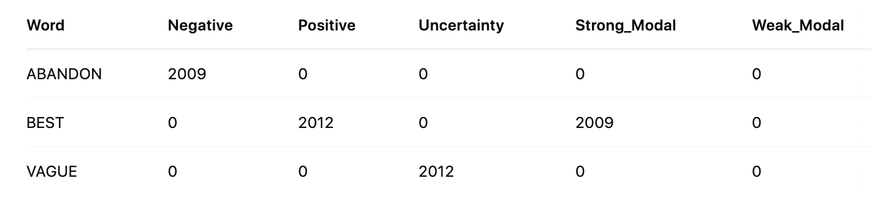
Extract Sentiment Words
match and extract financial sentiment words
Loughran-McDonald Master Dictionary
Our Dataset
(Record year)

Slide 11
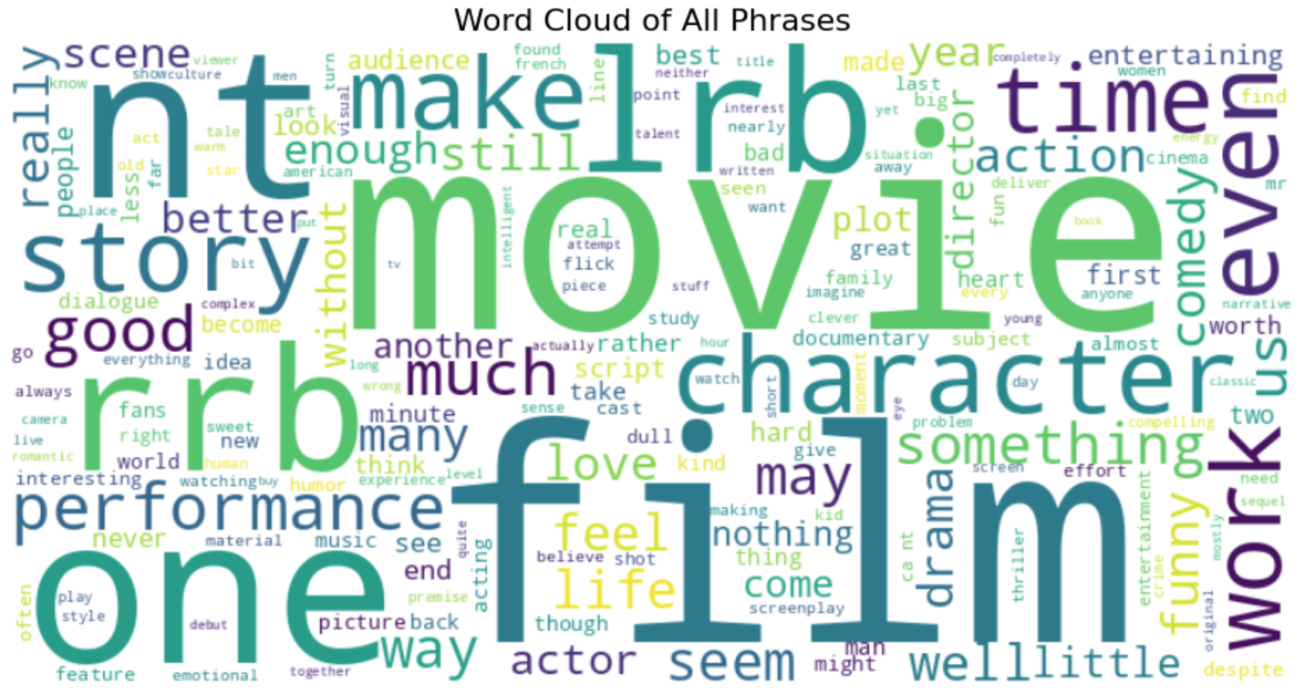
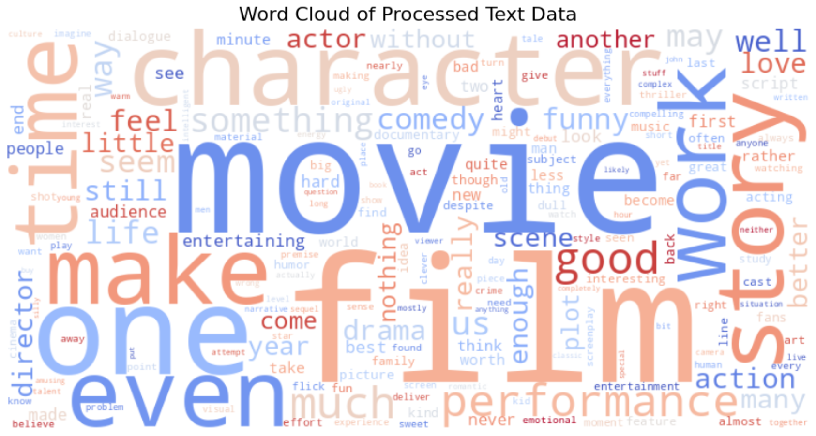
Text Preprocessing
The text quality has been effectively improved by removing noise and
retaining high-frequency, meaningful words.
Before
After

Slide 12
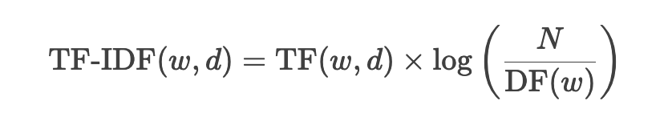
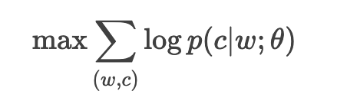
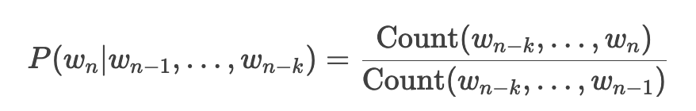
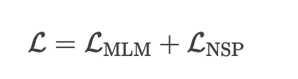
Word Embedding
TF-IDF ：
Word2Vec：
N-Gram：
BERT ：

Slide 13
Models Setting
Models
Logistic Regression
（ As baseline model）
Random Forest
XGBoost
SVM
Multi-Layer Perceptron
Word Embedding Methods
TF-IDF
Word2Vec
N-Gram
BERT
Data

Slide 14
Key parameter modification
Logistic Regression
Learning Rate、Epochs
N-Gram Range：(1, 2)
Random Forest
max_depth、learning_rate
XGBoost
numTrees、maxDepth
SVM
maxIter、regParam
Multi-Layer Perceptron
The number of neurons in each hidden layer

Slide 15
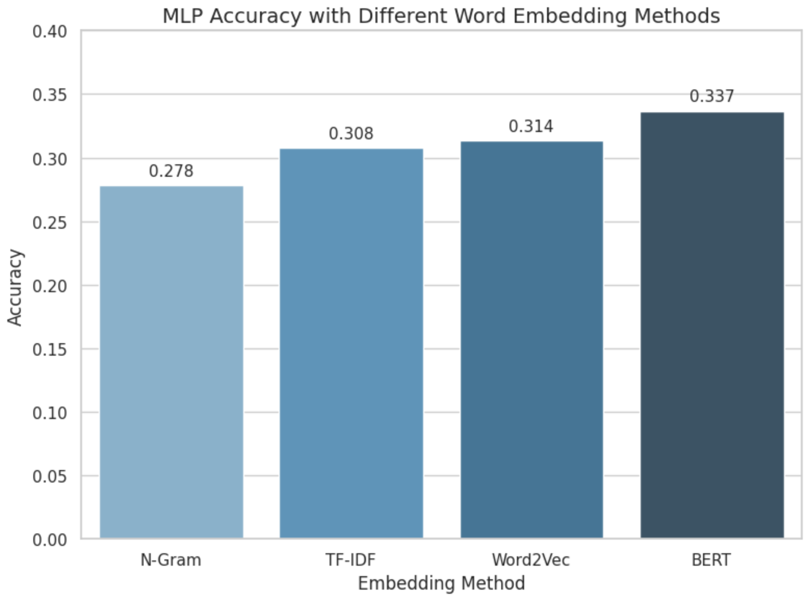
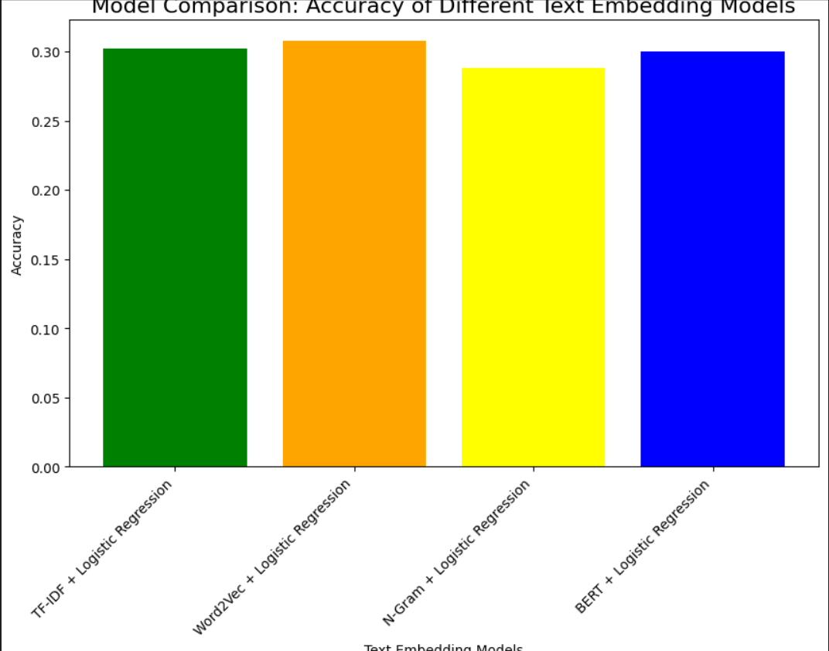
Result
MLP
Logistic Regression

Slide 16
Result
Accuracy Comparison
 | TF-IDF | Word2Vec | N-Gram | BERT
Logistic Regression | 0.3024 | 0.3073 | 0.2878 | 0.3024
XGBoost | 0.2485 | 0.2663 | 0.2130 | 0.3526
Random Forest | 0.2840 | 0.2722 | 0.2781 | 0.3579
MLP | 0.2781 | 0.3077 | 0.3136 | 0.3368
SVM | 0.3314 | 0.2485 | 0.2130 | 0.3964
After summarizing and comparing the results, we found that the results were not ideal, so we decided to optimize the model in two ways: Stacking and Grid Search + Cross Validation

Slide 17
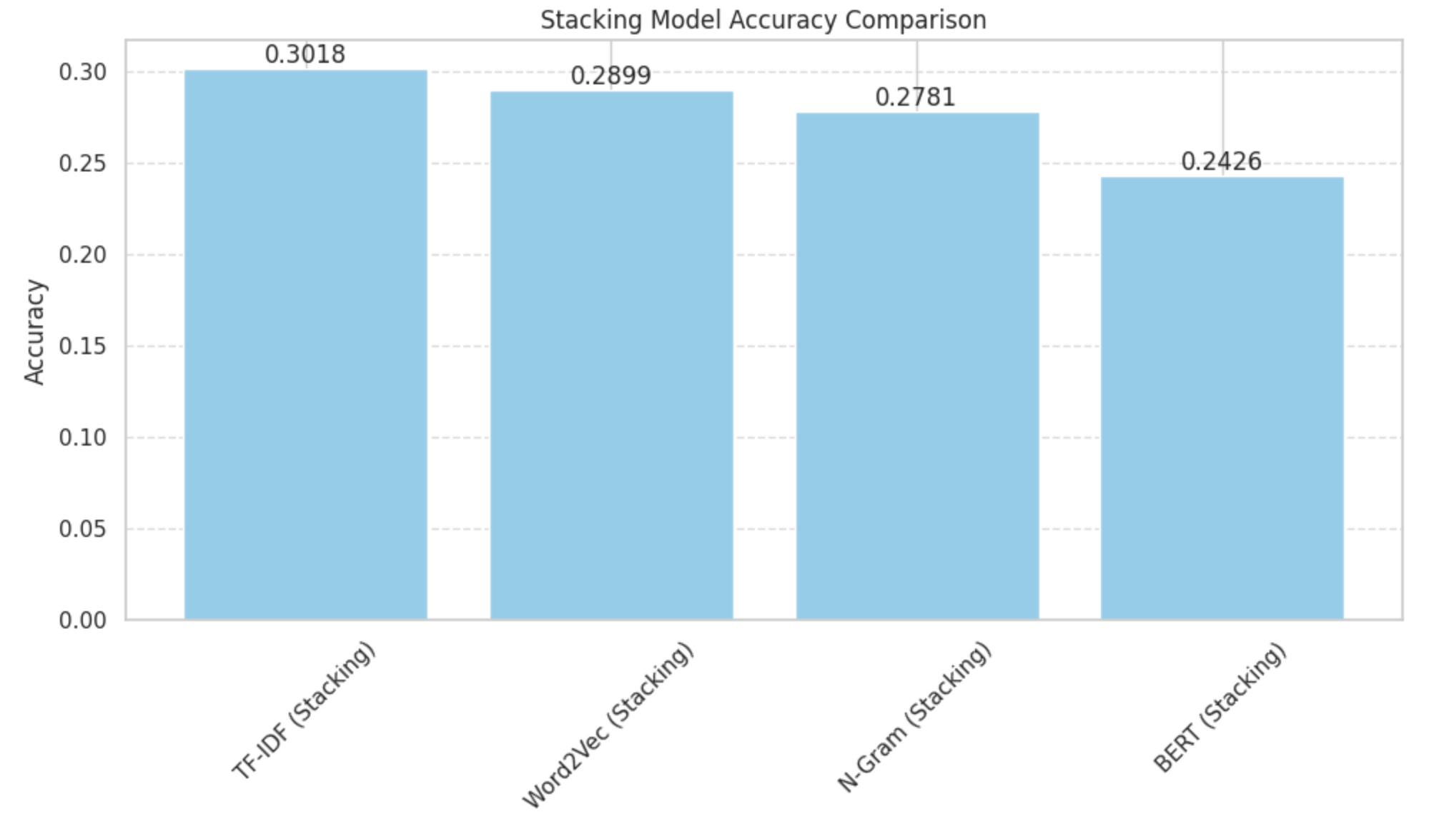
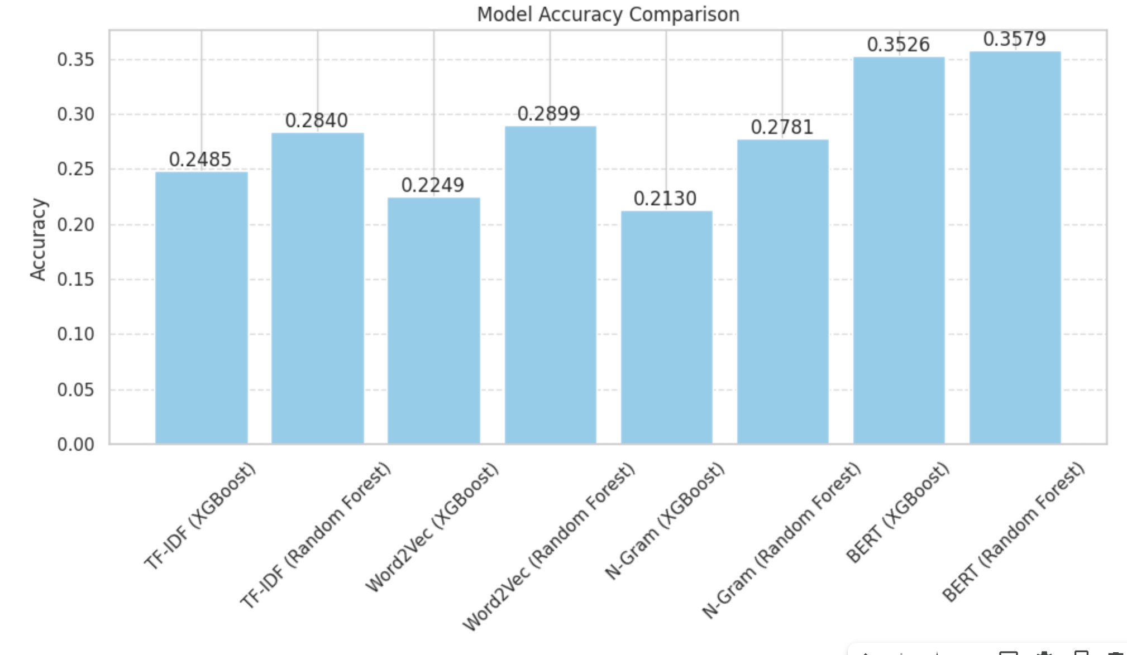
Result
Stacking works well on TF-TDF and Word2Vec

Slide 18
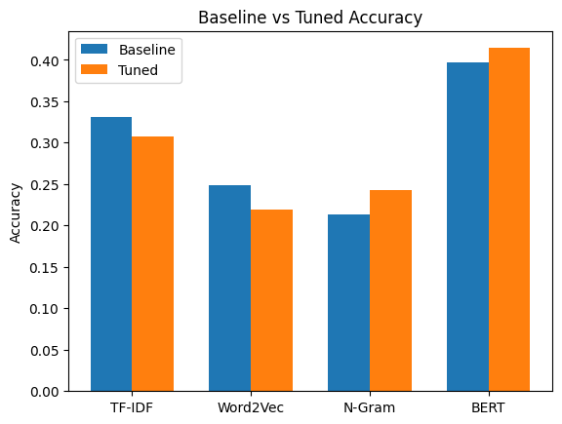
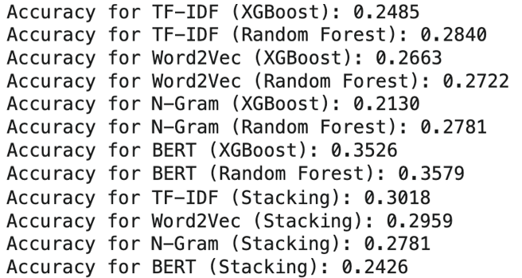
Result
Stacking works well on TF-TDF and Word2Vec
Grid Search and Cross Validation works well on N-Gram and BERT

Slide 19
02. Case Study

Slide 20

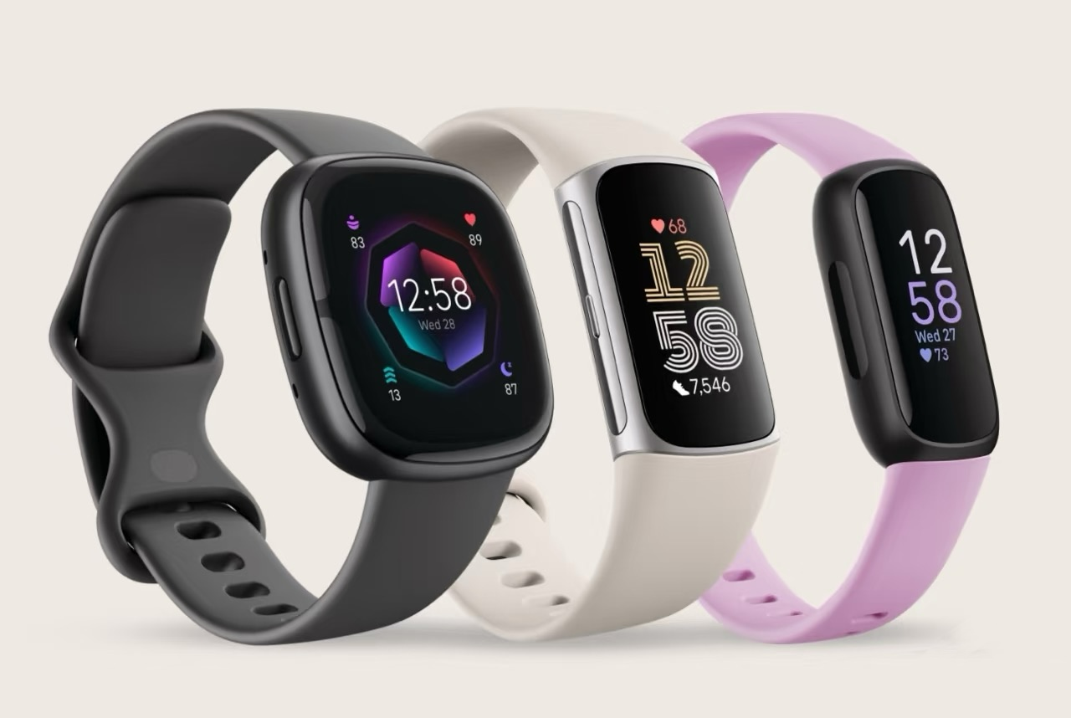
Case Study
Background——Fitbit&Wearable Devices
Fitbit——Markrt leader in wearable devices
San Francisco, 2007.
In 2014 alone, sold almost 11 million divices.
Wearable Divices
Fitness tracker.
Collect heart rate, sleep stages, step number, etc.

Slide 21
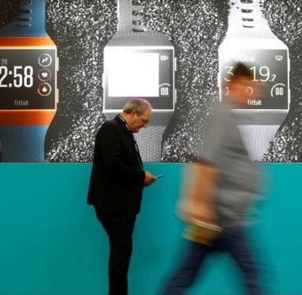
Case Study
Background——Problem Analysis
What is the relationship between indicators and the actual results of "health or not"?
Data value has not been fully released.
Is the data collected professional and reliable?
Data lacks of medical reliability.
Without useful insights, why should I keep using my wearable?
Decrease in user stickiness.

Slide 22
Case Study
Background——Research Value with 5Vs
Volume
Value
Veracity
Variety
Velocity
large data volume but no labels
unrelease value
unable to derive from data to causal relationship
not explicit
lack of medical verification
not trusted
difficulty in unifying and integrating multi-modal data
low credibility
real-time updates but no feedback
weak user stickiness

Slide 23
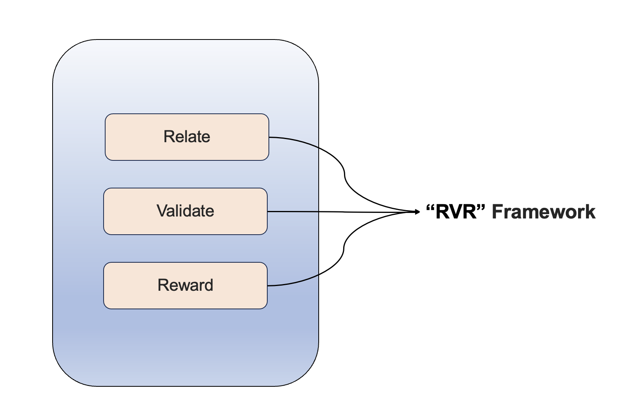
How to solve these problems?
Idea:

Slide 24
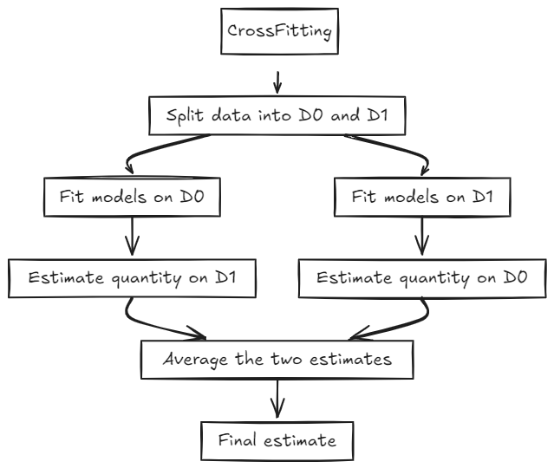
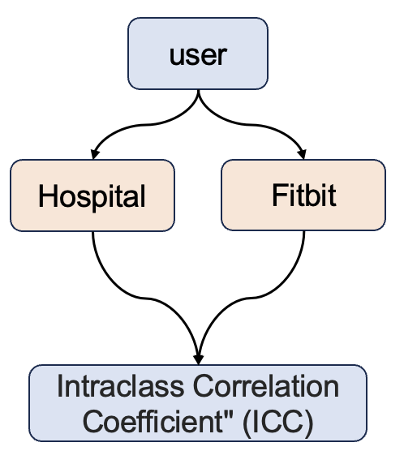
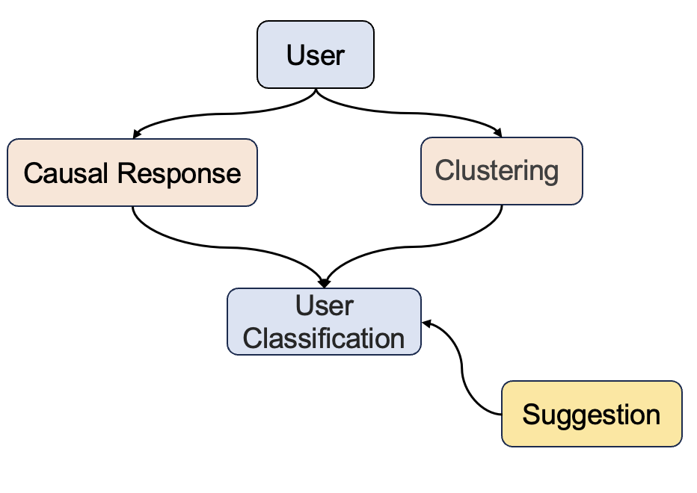
Solution
Relational Analysis
Medical Validation
User Engagement
Double ML

Slide 25
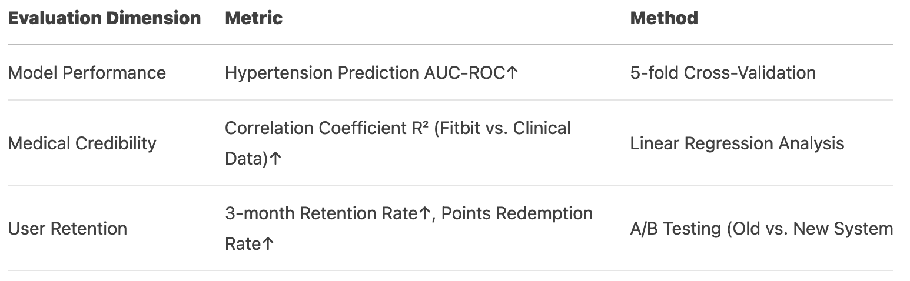
Evaluation
Fitbit Dataset

