Slide 1



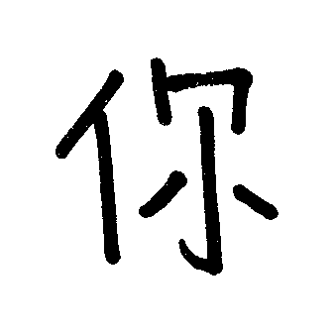






t=110
t=120
t=130
t=140
t=150
t=160
t=170
t=180
t=190
t=200

Slide 2






t=0
t=1
t=2
t=3
t=150
t=180
t=210
t=230

Slide 3




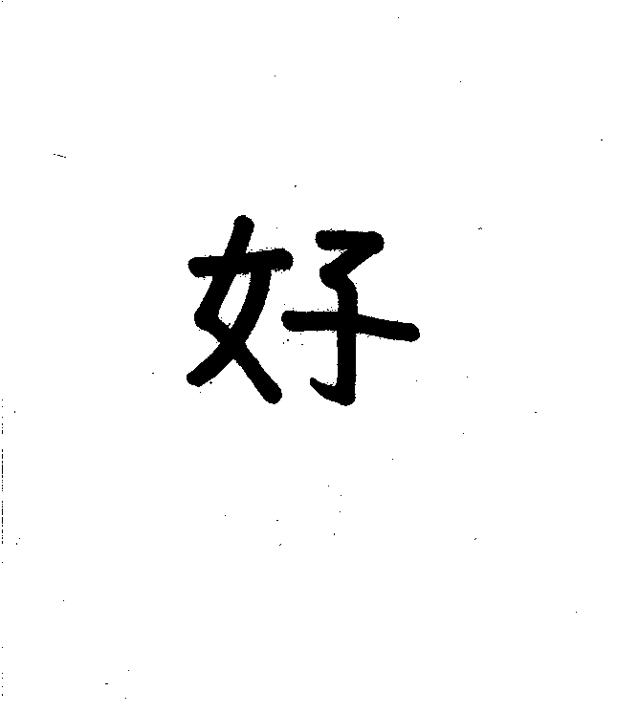


t=0
t=1
t=2
t=3
t=150
t=180
t=210
t=230

Slide 4






t=150
t=160
t=170
t=180
t=190
t=200

Slide 5






t=0
t=1
t=2
t=3
t=150
t=180
t=210
t=230

