Slide 1

Pig Yelping Out Review data

Slide 2

Pig Yelping Out Review data
Story –
Learning exercise in understanding how Hadoop and Pig can be used to extract, transform and load data.
Data – Yelp Dataset Challenge
https://www.yelp.com/dataset_challenge/dataset

Slide 3

The Challenge Dataset includes data from Phoenix, Las Vegas, Madison, Waterloo and Edinburgh:
42,153 businesses
320,002 business attributes
31,617 check-in sets
252,898 users
955,999 edge social graph
403,210 tips
1,125,458 reviews

Slide 4
Understanding and Preparing Data
Yelp’s dataset available for download is a single gzip-compressed file .
Each file is composed of a single object type like business, reviews, user, check-in and tips , one json-object per-line
Downloaded and decompressed the file on to an AWS EC2 instance.
Using AWS CLI copied JSON files to s3 bucket to be stored as input for AWS EMR.

Slide 5
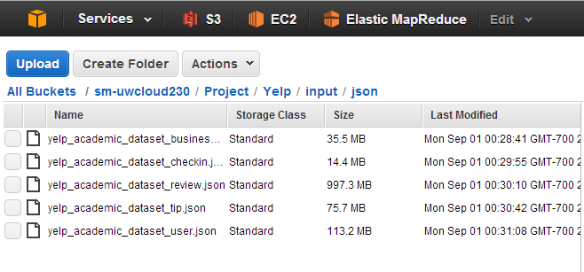

Slide 6
Processing the yelp reviews from yelp_academic_dataset_review.json .
Each json-object line in this file has a structure as below -
{
'type': 'review',
‘review_id’: (encrypted review_id)
'business_id': (encrypted business id),
'user_id': (encrypted user id),
'stars': (star rating),
'text': (review text),
'date': (date, formatted like '2012-03-14'),
'votes': {(vote type): (count)},
}

Slide 7
Yelp Reviews Description -
Each review is made by a user for a business and is made up of -
funny_vote, useful_vote, cool_vote, user_id, review_id, text, business_id, stars, review_date, type
Sample data :
{"votes": {"funny": 1, "useful": 1, "cool": 1}, "user_id": "k2u1F6spBGhgk2JtAe97QA", "review_id": "HeDqdFYkKaeDvPtiFy6Xmw", "stars": 5, "date": "2014-07-16", "text": "This event was my favorite event in a long time. Lindsey did a fabulous job of setting all of this up and keeping the movie to be played completely hush hush. I absolutely love FilmBar. They always have a great beer and wine selection, wonderful staff, and a wacky selection of art film. The movie for the night was Wayne's World, one of my all-time favorites. So naturally I was beyond thrilled to have been invited. Had a super \"Foxey\" date, (Can you say that about a guy?) and a delicious dog from Short Leash, and a fabulous time. \n\nThank you Lindsey, FilmBar, and Yelp for a fantastic evening! Party time, excellent!", "type": "review", "business_id": "nYer89hXYAoddMEKTxw7kA"}

Slide 8
Goal – Insights from the Yelp’s Review Dataset
Top businesses with most reviews
Top businesses with funny reviews
Top businesses with least reviews
Top reviewers in each of the review categories (funny, useful, cool)

Slide 9
Overview :
Tools : AWS EMR, S3 , Pig, Excel to visualize the data
Started a cluster on AWS EMR.
Ssh to log into the master node
Executed commands on Pig Grunt shell to extract, clean and flatten the nested review json file and output a comma separated file.
Merged the parts file using the hdfs getmerge command into a single file.
Copied the output into s3 output bucket folder . It has about one million records.
Loaded the new csv file into powerquery to understand the review trends.

Slide 10
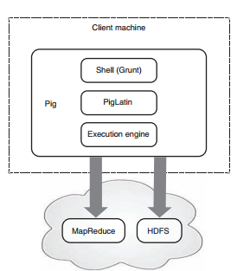
Details
Pig Architecture :

Slide 11
More Details –
Created test review json data file on EC2 instance and put it onto AWS EMR master node.
Using SSh logged into the AWS EMR master node.
Started Pig Grunt shell in local mode and executed Test data file.
[Hadoop@ip~]$ Pig –x local
Started Pig Grunt Shell in Hadoop mode
[Hadoop@ip~]$ Pig

Slide 12
######## Loading JSON Data with JsonLoader() and Providing Schema
Grunt>ReviewData = LOAD 's3://sm-uwcloud230/Project/Yelp/input/json/yelp_academic_dataset_review.json' USING JsonLoader('votes:tuple(funny_vote:int,useful_vote:int,cool_vote:int),user_id:chararray,review_id:chararray,stars:int,creation_date:datetime,text:chararray,type:chararray,business_id:chararray');
######### To remove nested structure and text column
Grunt> OutputReview = FOREACH ReviewData generate FLATTEN(votes), user_id, review_id,stars,creation_date,type,business_id
########## Storing data into aws S3
Grunt > STORE OutputReview into 's3://sm-uwcloud230/Project/Yelp/output/review';
##### Combining output parts file into a single file
[hadoop@ip-172-31-28-21 smitha]$ hadoop fs -getmerge s3://sm-uwcloud230/Project/Yelp/output/review/ yelp_review

Slide 13
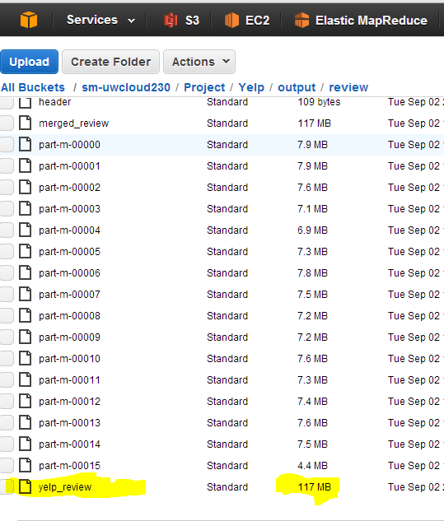

Slide 14
Viewing Yelp Review Data in Excel
Loaded data into power query using the output web link from aws S3.
Used Group By feature to aggregate data by ‘users’ and ‘businesses’ to get Top businesses and Top Reviewers
Loaded the power query results into excel workbook.

Slide 15
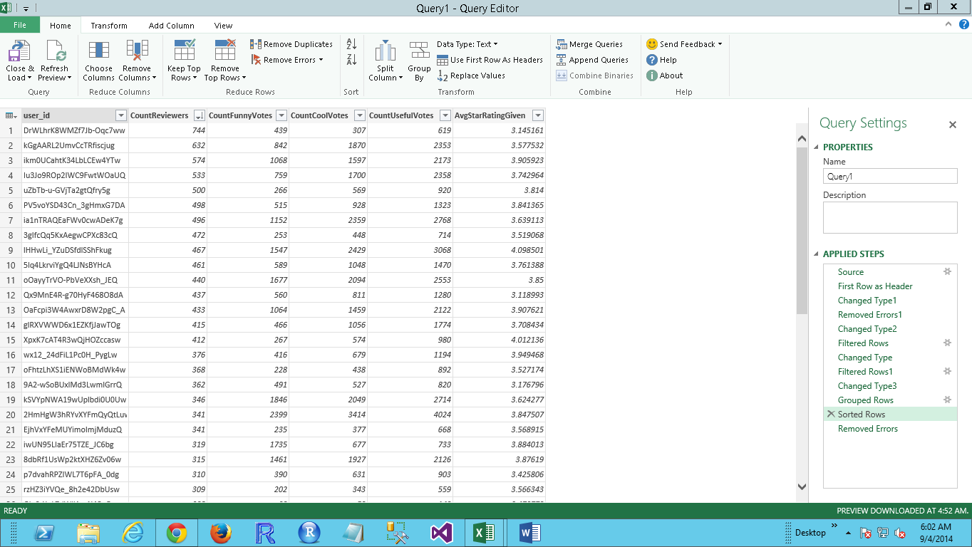

Slide 16
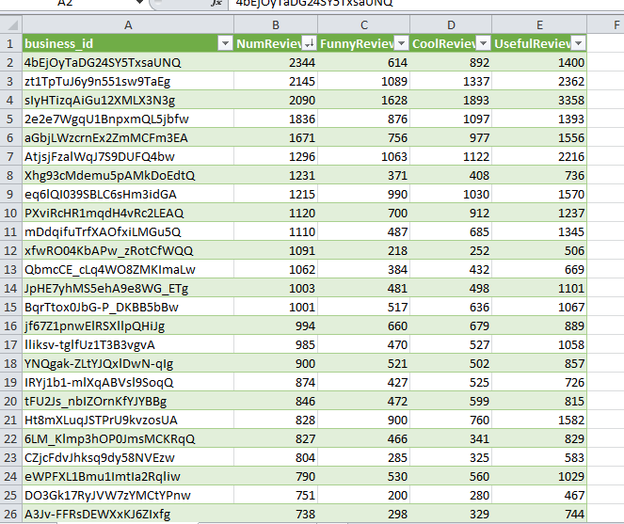
Top businesses reviewed for 2012-2014

Slide 17
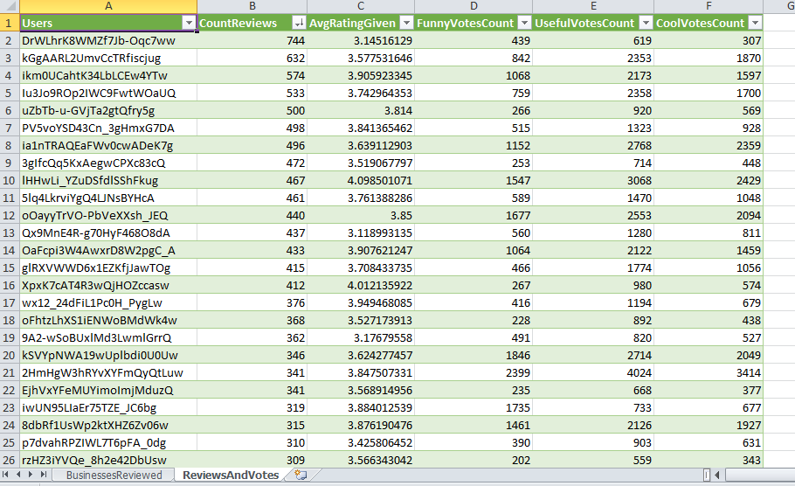
Top Reviewers and their Votes for 2012-2014

Slide 18
References :
https://www.yelp.com/dataset_challenge/dataset
http://pig.apache.org/docs/r0.10.0/func.html#jsonloadstore
http://hortonworks.com/hadoop-tutorial/how-to-use-basic-pig-commands/

Slide 19

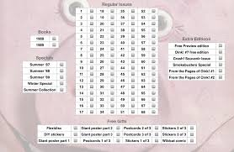
The End

