Slide 1
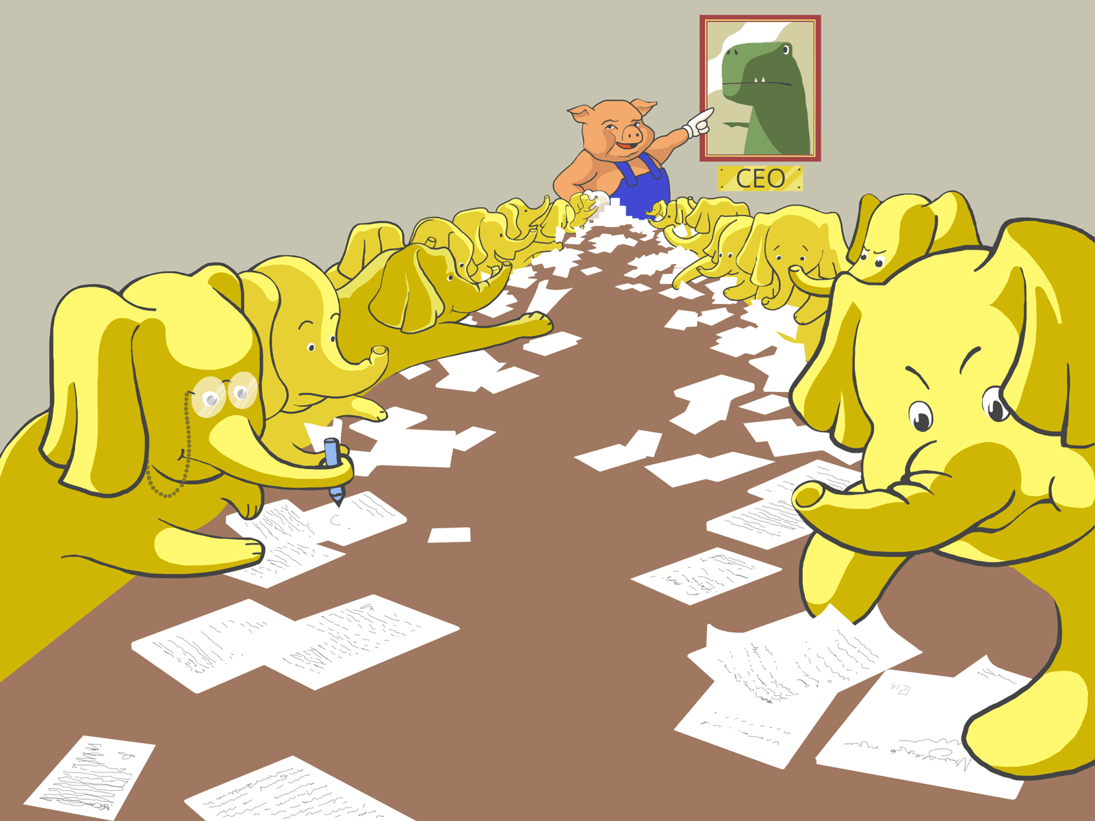
Pig Yelping Out Review data

