Slide 1
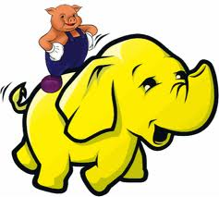
Pig Yelping Out Review data
Story –
Learning exercise in understanding how Hadoop and Pig can be used to extract, transform and load data.
Data – Yelp Dataset Challenge
https://www.yelp.com/dataset_challenge/dataset

