Slide 1
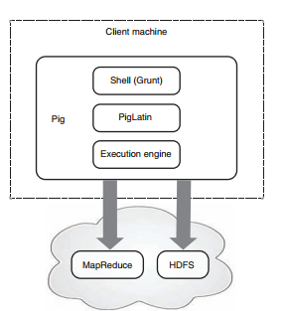
Details
Pig Architecture :

