Slide 1
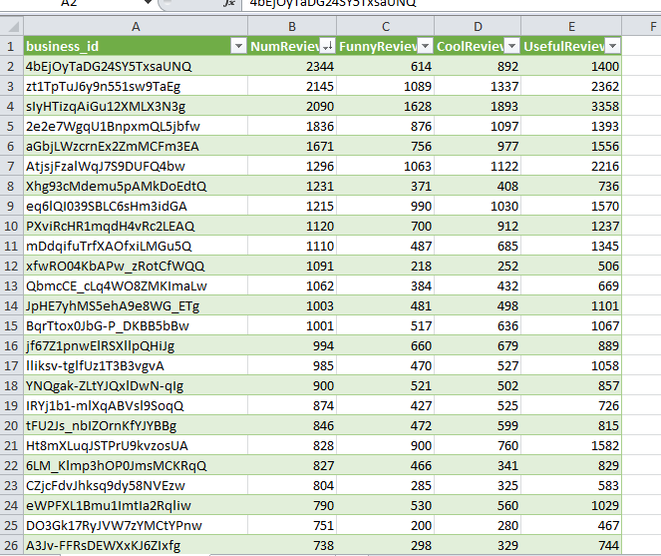
Top businesses reviewed for 2012-2014

