Slide 1
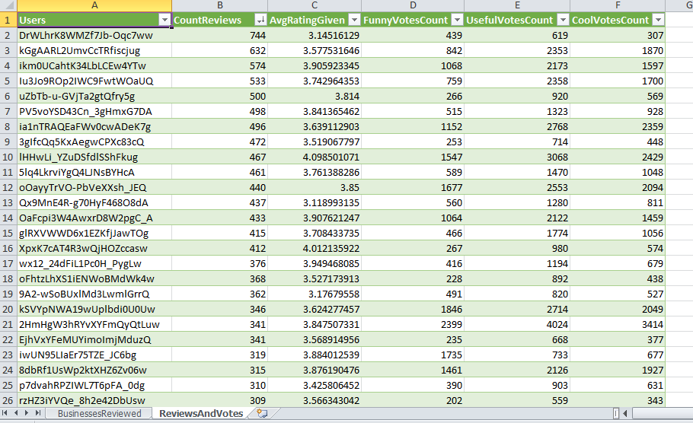
Top Reviewers and their Votes for 2012-2014

