Slide 1
IBM University Engagement Project Submission
AI Mock Interview Trainer Agent

Slide 2

Project Title - AI Mock Interview Trainer Agent
Domain of Project - Education / Artificial Intelligence
Student Name | Recent Passport Photo | Email ID | Mobile number [WhatsApp]
Student Name: Vaishnavi Nikam
Email ID: [add email]
Mobile / WhatsApp: [add number]
Target Role: AI Engineer / Machine Learning Engineer

Slide 3
Problem Statement: AI Mock Interview Trainer
The Challenge
Candidates often lack access to realistic, personalized interview practice. Generic question lists do not understand a candidate's resume, projects, target role, or answer quality. This makes it difficult to identify knowledge gaps, improve communication, and build confidence before a real interview.
The Objective
Build an AI-powered interview trainer that analyzes a resume, generates role-specific questions, supports text and voice answers, evaluates responses, and maintains interview history.
Key needs
- Resume-aware and personalized questions
- Technical, project, HR, and coding practice
- Retrieval-Augmented Generation using an interview knowledge base
- Instant feedback on submitted answers
- A simple interface for repeated practice

Slide 4
Proposed Solution: AI Mock Interview Trainer
The proposed solution is a Streamlit-based AI interview practice platform powered by IBM watsonx.ai and Granite models.
The workflow begins with resume upload and parsing. The candidate profile is then used with the selected role, difficulty, question count, and answer style to generate a structured mock interview.
A RAG pipeline retrieves relevant interview concepts from the local knowledge base. Granite generates questions, evaluates answers, and powers resume-aware chat practice. Candidates can answer by typing or recording voice, and completed sessions can be saved for later review.
Core modules
- Resume Intelligence: extracts skills, projects, and profile text
- Interview Generator: creates structured role-specific questions
- Answer Evaluator: returns actionable feedback
- Chat Trainer: provides interactive preparation support
- Voice Module: converts spoken answers to text
- History Module: stores completed interviews

Slide 5
Technology Used
IBM watsonx.ai / Granite Models
- Question generation, answer evaluation, and conversational coaching
IBM Cloud
- Secure access to hosted foundation models through IBM watsonx.ai
Python
- Core application and AI orchestration language
Streamlit
- Interactive web interface for resume analysis and mock interviews
RAG
- Retrieves relevant interview knowledge before generation
ChromaDB
- Vector storage for knowledge-base retrieval
LangChain and Hugging Face
- Retrieval and embedding ecosystem
PyPDF2 and python-docx
- PDF and DOCX resume extraction
SpeechRecognition
- Voice answer transcription

Slide 6
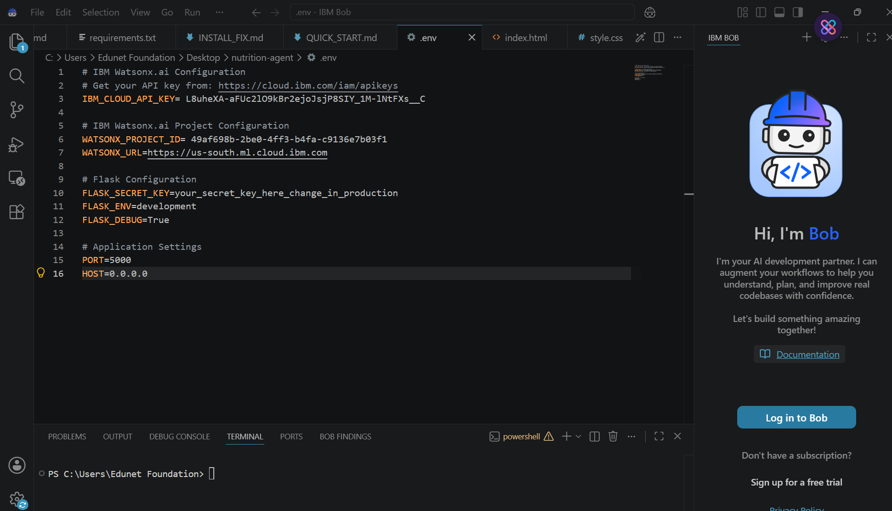
Required Files Created for the Project
app_ui.py - Streamlit application interface
agent.py - IBM Granite generation, evaluation, and chat functions
resume_parser.py - Resume extraction and profile analysis
rag.py / rag_agent.py - Retrieval-Augmented Generation logic
vector_store.py - Vector database operations
history.py - Interview history persistence
voice.py - Speech-to-text support
knowledge_base/ - Interview preparation documents
requirements.txt - Python dependencies
README.md - Setup and usage instructions
.env - Local credentials only; excluded from Git

Slide 7
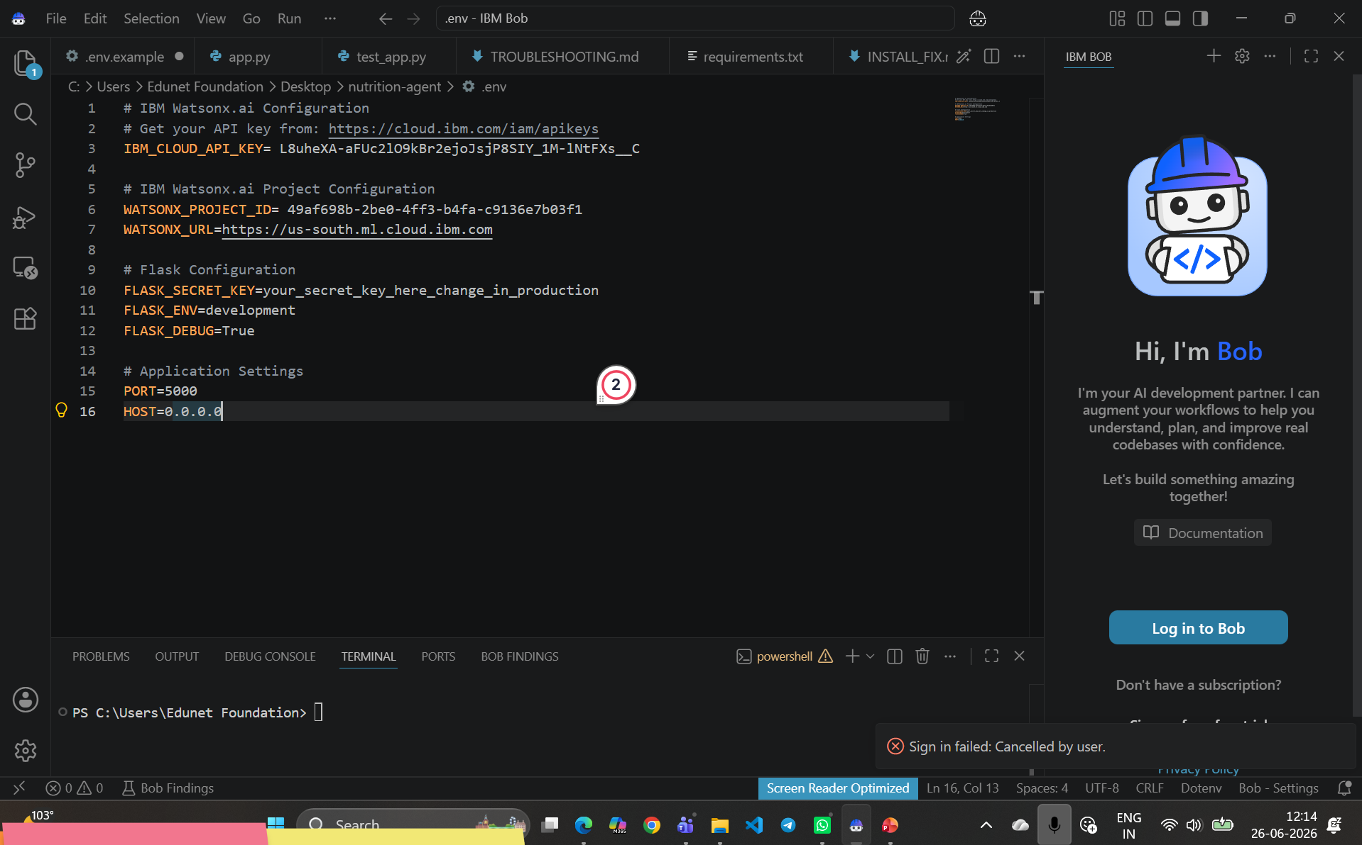
Application Screens and User Flow
1. Home: access the interview trainer modules
2. Resume: upload a PDF or DOCX and review the extracted profile
3. Chat Trainer: ask resume-aware preparation questions
4. Mock Interview: choose role, difficulty, style, and question count
5. Answer: respond using text or voice transcription
6. Feedback: receive AI evaluation after each response
7. History: save completed interview sessions for later review
The interface is implemented in app_ui.py with Streamlit session state coordinating the active profile, questions, answers, and interview progress.

Slide 8
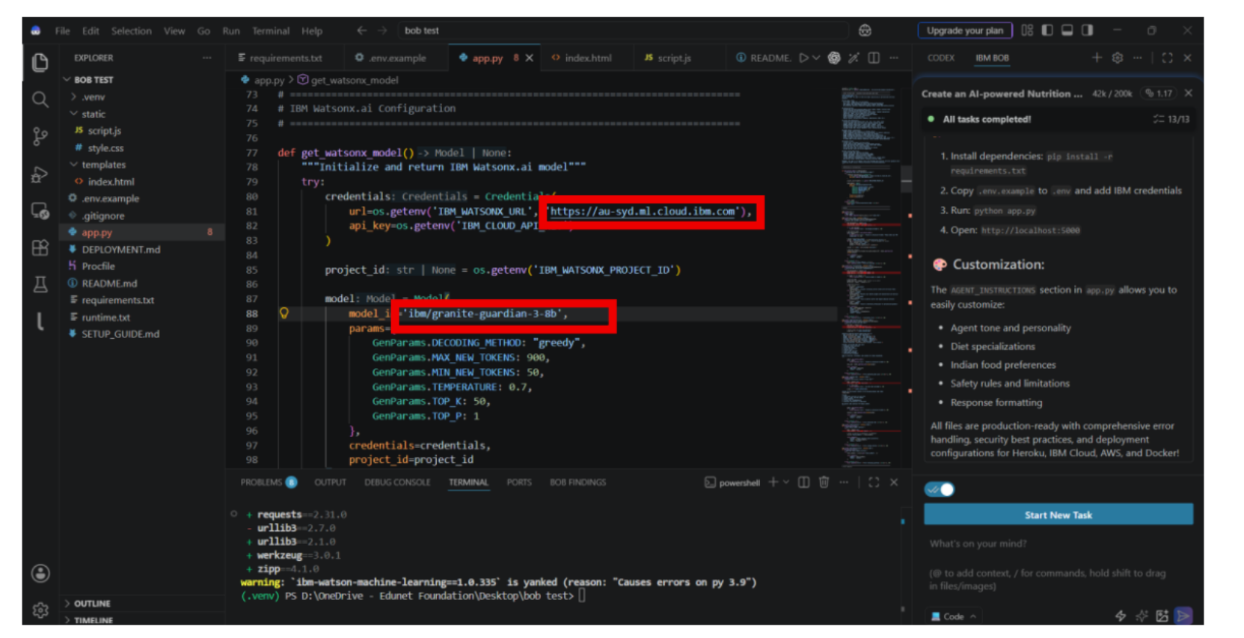
Architecture Blueprint
Candidate
|
v
Streamlit UI (app_ui.py)
|
+--> Resume Parser --> Candidate Profile
|
+--> Interview Agent --> Granite Model
| ^
+--> Answer Evaluator ---+
|
+--> RAG Agent --> ChromaDB Vector Store --> Knowledge Base
|
+--> Voice Module --> Transcribed Answer
|
+--> History Module --> Local SQLite Database
IBM watsonx.ai provides the hosted Granite model inference layer. The local modules manage parsing, retrieval, interaction, and persistence.

Slide 9
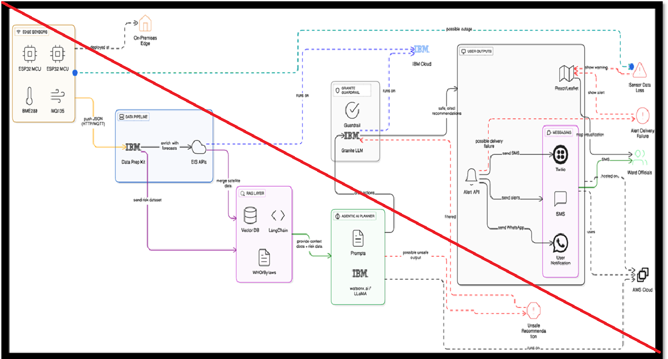
Role of Agentic AI in the Solution
Agentic AI enables the trainer to coordinate several focused capabilities instead of behaving like a single static question generator.
- Resume agent: understands the candidate's background
- Interview agent: creates the next relevant question
- Retrieval agent: finds supporting interview knowledge
- Evaluation agent: analyzes the submitted answer
- Chat agent: responds to preparation requests
- Voice capability: converts spoken answers into usable text
Together, these components create a context-aware and goal-driven practice loop. The system adapts questions and feedback to the candidate profile, target role, selected difficulty, and current answer.

Slide 10

Token Usage and Prompt Design
Prompt inputs include:
- Target role and interview difficulty
- Candidate skills, projects, and resume text
- Question type and answer style
- Retrieved knowledge-base context
- Candidate's submitted answer
Output includes:
- Structured interview questions
- Evaluation feedback and improvement guidance
- Resume-aware coaching responses
Token usage depends on resume length, retrieved context, number of questions, and answer size. Keeping prompts focused and requesting structured JSON helps control cost and makes the Streamlit interface reliable.

Slide 11


Project Output: Resume Intelligence
Expected application output
Resume upload
-> PDF / DOCX text extraction
-> Skills and projects identified
-> Candidate profile displayed
-> Profile can be edited and saved
The Resume page gives the interview generator and chat trainer a consistent candidate context. This allows the system to ask questions about the candidate's actual projects instead of relying only on generic prompts.

Slide 12
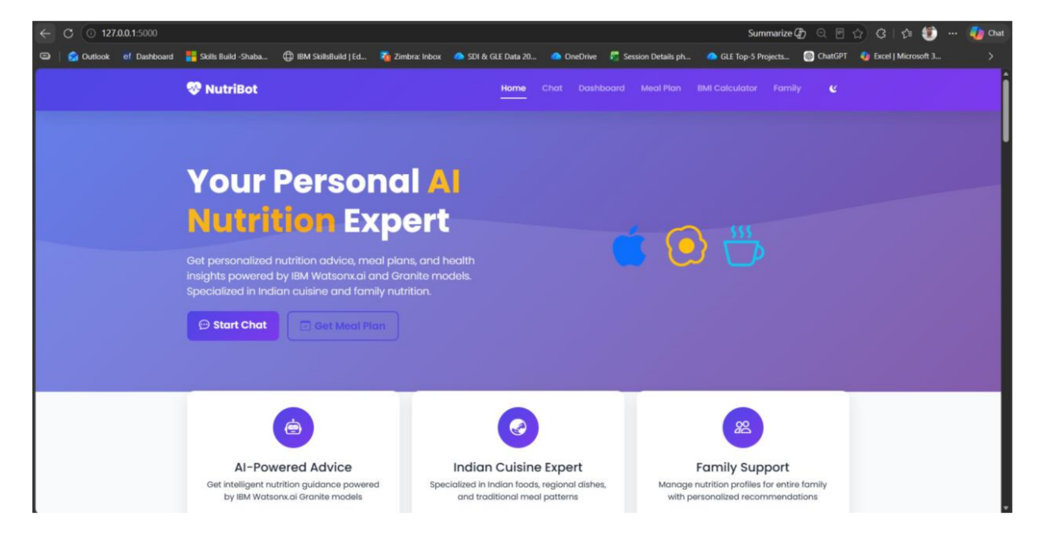
Project Output: Mock Interview Setup
The Mock Interview page allows the candidate to configure:
- Target role: AI Engineer, ML Engineer, Data Analyst, Software Developer, or Data Scientist
- Question count: 1 to 10
- Difficulty: Easy, Medium, or Hard
- Answer style: Short, Medium, or Detailed
- Answer method: Text or Voice
After starting, the interface displays one question at a time with progress tracking and Submit / Skip controls.

Slide 13
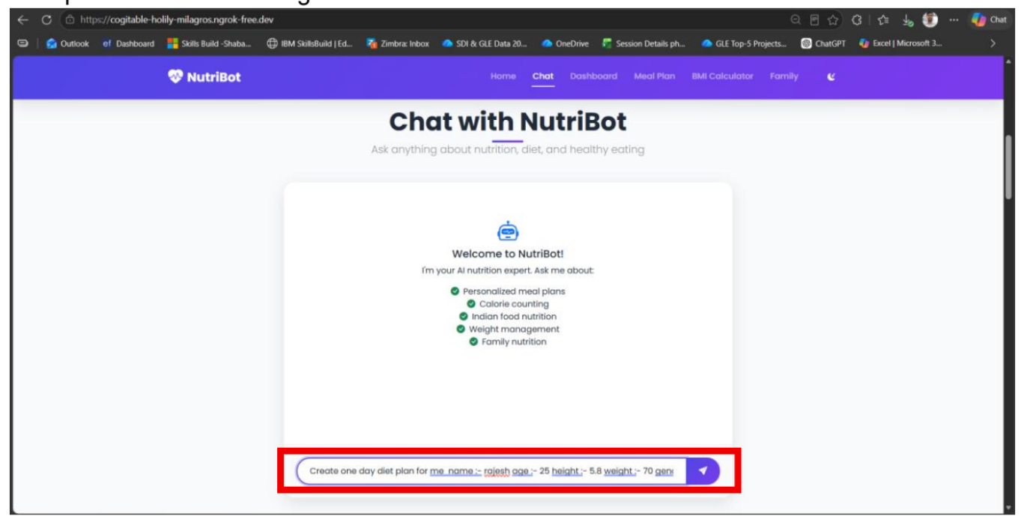
Project Output: Answer Evaluation
For each submitted answer, the system sends the question and answer to the IBM Granite evaluator.
Feedback can identify:
- What the candidate explained well
- Missing technical concepts
- Clarity and relevance issues
- Specific ways to improve the response
The result is stored with the question and answer so the candidate can review the full interview summary after completion.

Slide 14
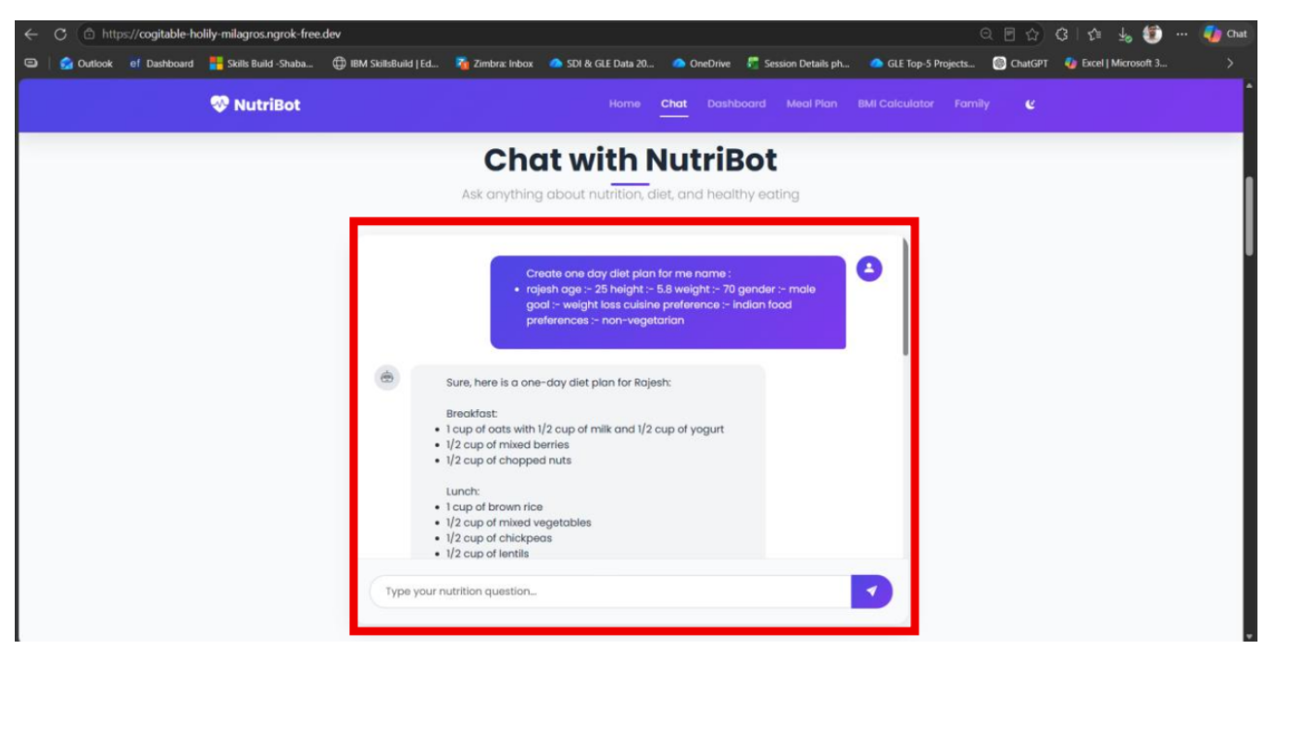
Project Output: Chat Trainer
The Chat Trainer provides resume-aware preparation through natural-language prompts.
Example prompts:
- Generate interview questions from my projects
- Review my resume for an AI Engineer role
- Ask difficult ML interview questions
- Improve my interview answers
- Prepare HR questions
Chat history remains available during the session, and the candidate can clear it when starting a new practice topic.

Slide 15
Novelty and Uniqueness
The project combines personalized resume intelligence, RAG, interactive practice, voice input, and answer evaluation in one workflow.
Resume-grounded personalization - questions are connected to the candidate's skills and projects.
Multi-modal practice - candidates can type or speak their answers.
Continuous feedback loop - every response produces guidance for improvement.
Retrieval-supported generation - the knowledge base supplies relevant interview concepts.
Session continuity - completed interviews can be saved and reviewed.
The result is a practical interview companion rather than a static collection of questions.

Slide 16
GitHub Repository
Public repository:
https://github.com/30nikamvaishnavi/AI-Mock-Interview-Trainer-Agent
The repository contains:
- Application source files
- Knowledge-base documents
- requirements.txt
- README.md with setup instructions
- Test files
Sensitive credentials in .env, local virtual environments, generated databases, uploaded resumes, audio files, and reports are excluded from the repository.
· Please create public github repository (Enable Add README button while creating repository) with format –
Please test and Paste the working Github URL –
Make sure you have Uploaded following three files into your github repository
1) All Agent relevant files of IBM Cloud , 2) yourproblemstatement.pdf file 3) your projectpresntation.pptx file 4)any other files

Slide 17
Future Scope
1. Cloud deployment
Deploy the Streamlit application with managed secrets and a hosted vector database.
2. Analytics dashboard
Track scores, topic-level weaknesses, progress over time, and repeated-question performance.
3. Better voice experience
Add browser-native recording, confidence signals, pronunciation analysis, and multilingual support.
4. More input formats
Support webcam interview practice, coding editor input, and richer resume formats.
5. Adaptive interviews
Use previous feedback to change the next question difficulty and focus areas automatically.
1.Integration with Wearables & Health Devices –
The system can be integrated with smartwatches and fitness trackers to collect real-time data such as steps, calories burned, heart rate, and sleep patterns. This will enable the Nutrition Agent to provide more accurate and dynamic diet recommendations based on actual user activity and health metrics.
2.AI-Powered Voice Assistant & Multilingual Support –
Enhancing the system with a voice-enabled assistant and support for multiple languages will improve accessibility. Users can interact naturally in their preferred language, making the solution more inclusive and suitable for diverse populations, especially in regions with varied linguistic backgrounds.

Slide 18
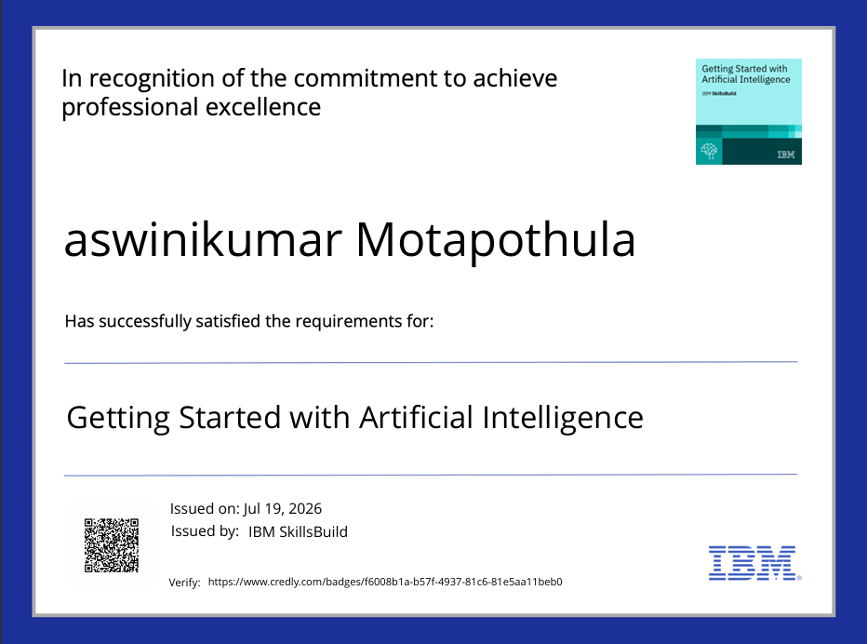
Certificates and Learning
Relevant learning areas demonstrated by the project:
- IBM watsonx.ai and Granite model integration
- Retrieval-Augmented Generation
- LangChain and vector databases
- Streamlit application development
- Resume parsing and document processing
- Speech-to-text interaction
Add verified Credly, IBM, or program certificates here before final submission.

Slide 19

Project Demonstration
The completed project can be demonstrated through the following workflow:
1. Launch the Streamlit app
2. Upload and analyze a resume
3. Open Chat Trainer and ask a preparation question
4. Start a mock interview
5. Submit a text or voice answer
6. Review AI feedback
7. Save the completed interview
Add screenshots from the running application here for the final submission version.

Slide 20

Thank You
AI Mock Interview Trainer Agent

