Slide 1
IT507 – Advanced Image Processing | DA-IICT, Gandhinagar
Frequency-Aware Pureformer
Transformer-Based Image Denoising with Learnable
Frequency Domain Feature Enhancement
Krishna Prajapati (202518024)
Manasi Patil (202518034)
Mentor: Dr. Srimanta Mandal
+0.51 dB
+0.051
+2.18 dB
PSNR Gain
SSIM Gain
LAN on S&P

Slide 2
Problem Statement
What is image denoising and why is it hard?
Observation Model: y(i, j) = x(i, j) + η(i, j) where η ~ N(0, σ²)
Why it's hard
What we want
How we measure
Every pixel has noise mixed into it. You cannot tell which part is noise without knowing the original image. The problem is fundamentally ill-posed.
Recover clean image x from noisy y — without ever seeing x during inference. Suppress noise while keeping sharp edges and fine textures.
PSNR = 10·log₁₀(1/MSE) — higher is better. 14 dB = noisy input. 24 dB = good result.
SSIM measures structural similarity (0 to 1).
Five noise types studied in this project:
Gaussian η~N(0,σ²)
Salt & Pepper impulse at 0 or 1
Poisson low-light
Speckle multiplicative
Uniform η~U[-a,a]

Slide 3
Reference Papers
Two papers we studied and implemented
Paper 1 — LAN (CVPR 2024)
Paper 2— Pureformer (CVPRW 2025)
Problem Statement: Traditional denoising models fail on unseen real-world noise from different cameras and environments.
Dataset Used: Training: SIDD dataset
Testing: PolyU and Nam datasets
Solution Proposed: LAN keeps the denoising network frozen and adapts the noisy image itself using a learnable noise offset.
Key Contribution: Improves denoising performance without retraining the entire model.
Limitation: Requires optimization during testing and gives moderate improvement for some noise conditions.
Problem Statement: CNN-based denoising methods remove noise but also lose important image details and textures.
Dataset Used: NTIRE 2025 Image Denoising Dataset, BSD68, Urban100
Solution Proposed: Pureformer uses a Transformer-based encoder-decoder architecture with feature enhancement blocks for better denoising.
Key Contribution: Removes heavy noise while preserving textures and fine image details.
Limitation: Transformer models are computationally expensive and require large datasets for training.
Our contribution: We extended Pureformer with a Frequency Branch (FFT-based filter) and applied LAN adaptation for unseen noise.

Slide 4
Datasets Used for Training and Evaluation
BSD400 (Berkeley Segmentation Dataset)— Training Set
BSD68(Berkeley Segmentation Dataset) — Test/Evaluation Set
400 natural grayscale images — everyday scenes
Cut into 48×48 patches with stride 24
This gives about 14,400 training samples
Noise added fresh every epoch — y(x,y)=f(x,y)+η(x,y)
σ = 50 Gaussian noise
68 images — completely held out, never trained on
Standard benchmark used by DnCNN, Restormer, Pureformer
Allows direct comparison with published numbers
We report PSNR (dB) and SSIM
σ = 50 Gaussian noise applied at test time
Fresh noise is generated every epoch so the model observes different noisy realizations of the same image, improving robustness and acting as implicit data augmentation
LAN adaptation performed on 5 BSD68 images using unseen noise types (Salt & Pepper, Speckle, Uniform) with frozen backbone and only 20 adaptation iterations.
.

Slide 5
Architecture & Our Contribution
How Pureformer works and what we added
Noisy
Input
Head
Conv 3×3
Encoder
3 Levels
Feature
Enhancer
★ OURS
Decoder
3 Levels
Clean
Output
Skip connections from each encoder level to matching decoder level
Baseline Feature Enhancer (original Pureformer)
Our Extended Feature Enhancer (added Frequency Branch)
FE_base(x) = τ [ Conv 3×3(x), Conv 5×5(x) ]
FE_ours(x) = τ [ Conv 3×3(x), Conv 5×5(x), FreqBranch(x) ]
Frequency Branch — 3 simple steps
Step 1
Step 2
Step 3
F(u,v) = FFT( W_pre · x )
F_φ = F(u,v) ⊙ W(u,v)
x_freq = Re( iFFT( F_φ ) )
Apply 2D Fourier Transform — convert to frequency domain
Multiply by learnable complex weights — suppresses noise frequencies
Inverse FFT — convert back to pixel domain
Key insight: Gaussian noise = flat white-noise spectrum in FFT — learnable W(u,v) directly suppresses it.

Slide 6
Frequency Branch Improvement Over Baseline
How our model compares to others
Method
PSNR (dB)
SSIM
Type
Our Gains
Noisy Input
14.15
0.201
—
+0.51 dB
NL-Means [classical]
19.98
0.497
Classical
vs. Baseline
PSNR
+0.051
BM3D [classical]
27.36
0.763
Classical
vs. Baseline
SSIM
DnCNN [CNN]
27.92
0.789
CNN
24.63 dB
Restormer [Transformer]
28.41
0.810
Transformer
Our best
PSNR
Pureformer Baseline (our impl.)
24.12
0.5648
Transformer
Our contribution focuses on validating learnable frequency enhancement under constrained training conditions.
Freq-Pureformer (ours)
24.63
0.6154
Transformer + FFT
† Published models used 87,000 images and 2× A100 GPUs. We used 400 images on Google Colab. The +0.51 dB gain over our own baseline under identical conditions is the scientific contribution.

Slide 7
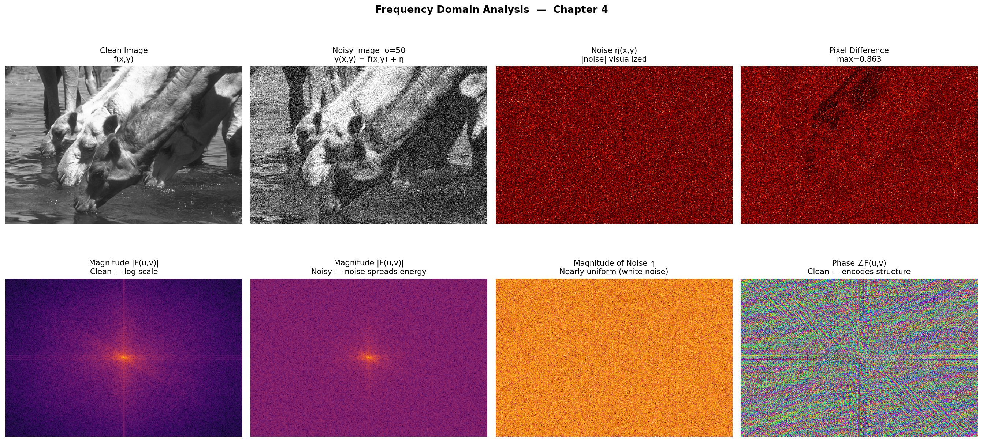
Result1: Why Frequency-Domain Processing Helps Denoising
Chapter 4
What this shows:
Top Row
• Clean image → original image
• Noisy image → Gaussian noise added
• Noise image → extracted noise pattern
• Difference image → shows corruption caused by noise
Bottom Row
• Clean FFT magnitude → structured spectrum near center
• Noisy FFT → noise spreads energy everywhere
• Noise-only spectrum → almost flat white-noise spectrum
• Phase spectrum → preserves image edges and structure
Clean images have structured frequency spectra, while Gaussian noise spreads uniformly like white noise. This motivated our learnable FFT filtering branch.
Chapter 4 formula: F(u,v) = ΣΣ f(x,y)·e^(−j2π(ux/M+vy/N)). Gaussian noise has flat spectrum = white noise. Our learnable W(u,v) learns to suppress it directly.

Slide 8
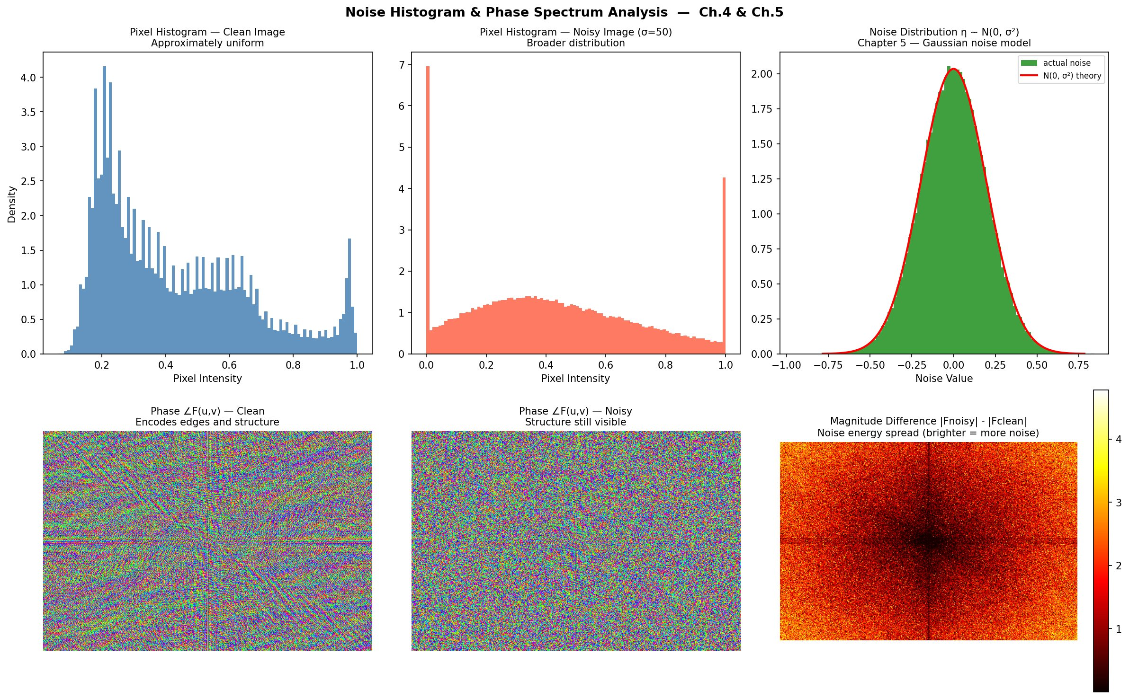

Result 2: Histogram & Phase Analysis
Chapter 4 & 5
What this shows:
Histogram Analysis
• Clean image histogram → natural pixel distribution
• Noisy histogram → wider distribution due to added noise
• Noise PDF → follows Gaussian bell curve $N\left(0 , σ^{2}\right)$
Phase Spectrum Analysis
• Clean phase spectrum → contains edges and structure
• Noisy phase spectrum → structure still mostly preserved
• Magnitude difference → noise energy spreads across frequencies
Main Observation:
Noise damages magnitude but phase stays mostly intact — this is why denoising can work without destroying image structure.
Validates our model: noise broadens histograms and flattens the FFT magnitude, but the phase (which encodes edges and structure) is preserved. This is why our frequency filter can separate noise from signal.

Slide 9
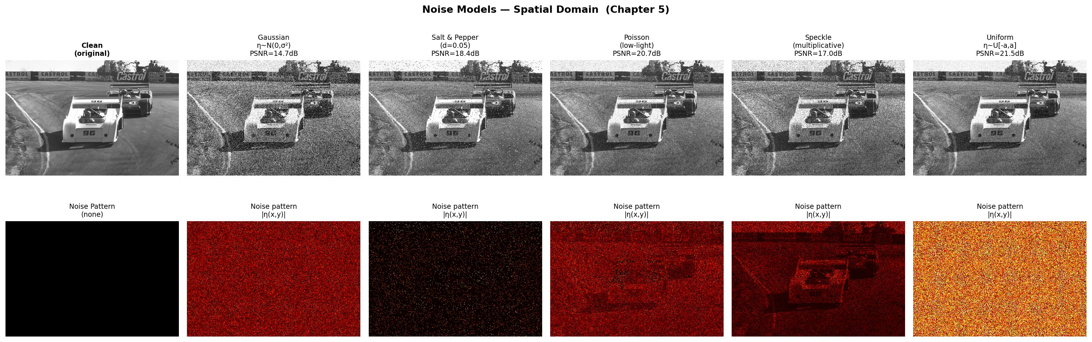
Result 3 : Noise Models — Spatial Domain
Chapter 5
What this shows:
Top Row
• Same image with different noise types
• Each noise affects image differently
• PSNR decreases when noise increases
Bottom Row
• Extracted noise patterns only
• Gaussian → fine grain everywhere
• Salt & Pepper → black and white dots
• Poisson → depends on brightness
• Speckle → multiplicative textured noise
• Uniform → evenly spread random noise
PSNR of noisy images:
Gaussian 14.7 → Uniform 21.5 dB
Our model denoises Gaussian (σ=50) → 24.63 dB
Each noise type has a different probability distribution. Gaussian is the most common in practice. Our model is trained specifically for Gaussian σ=50.

Slide 10
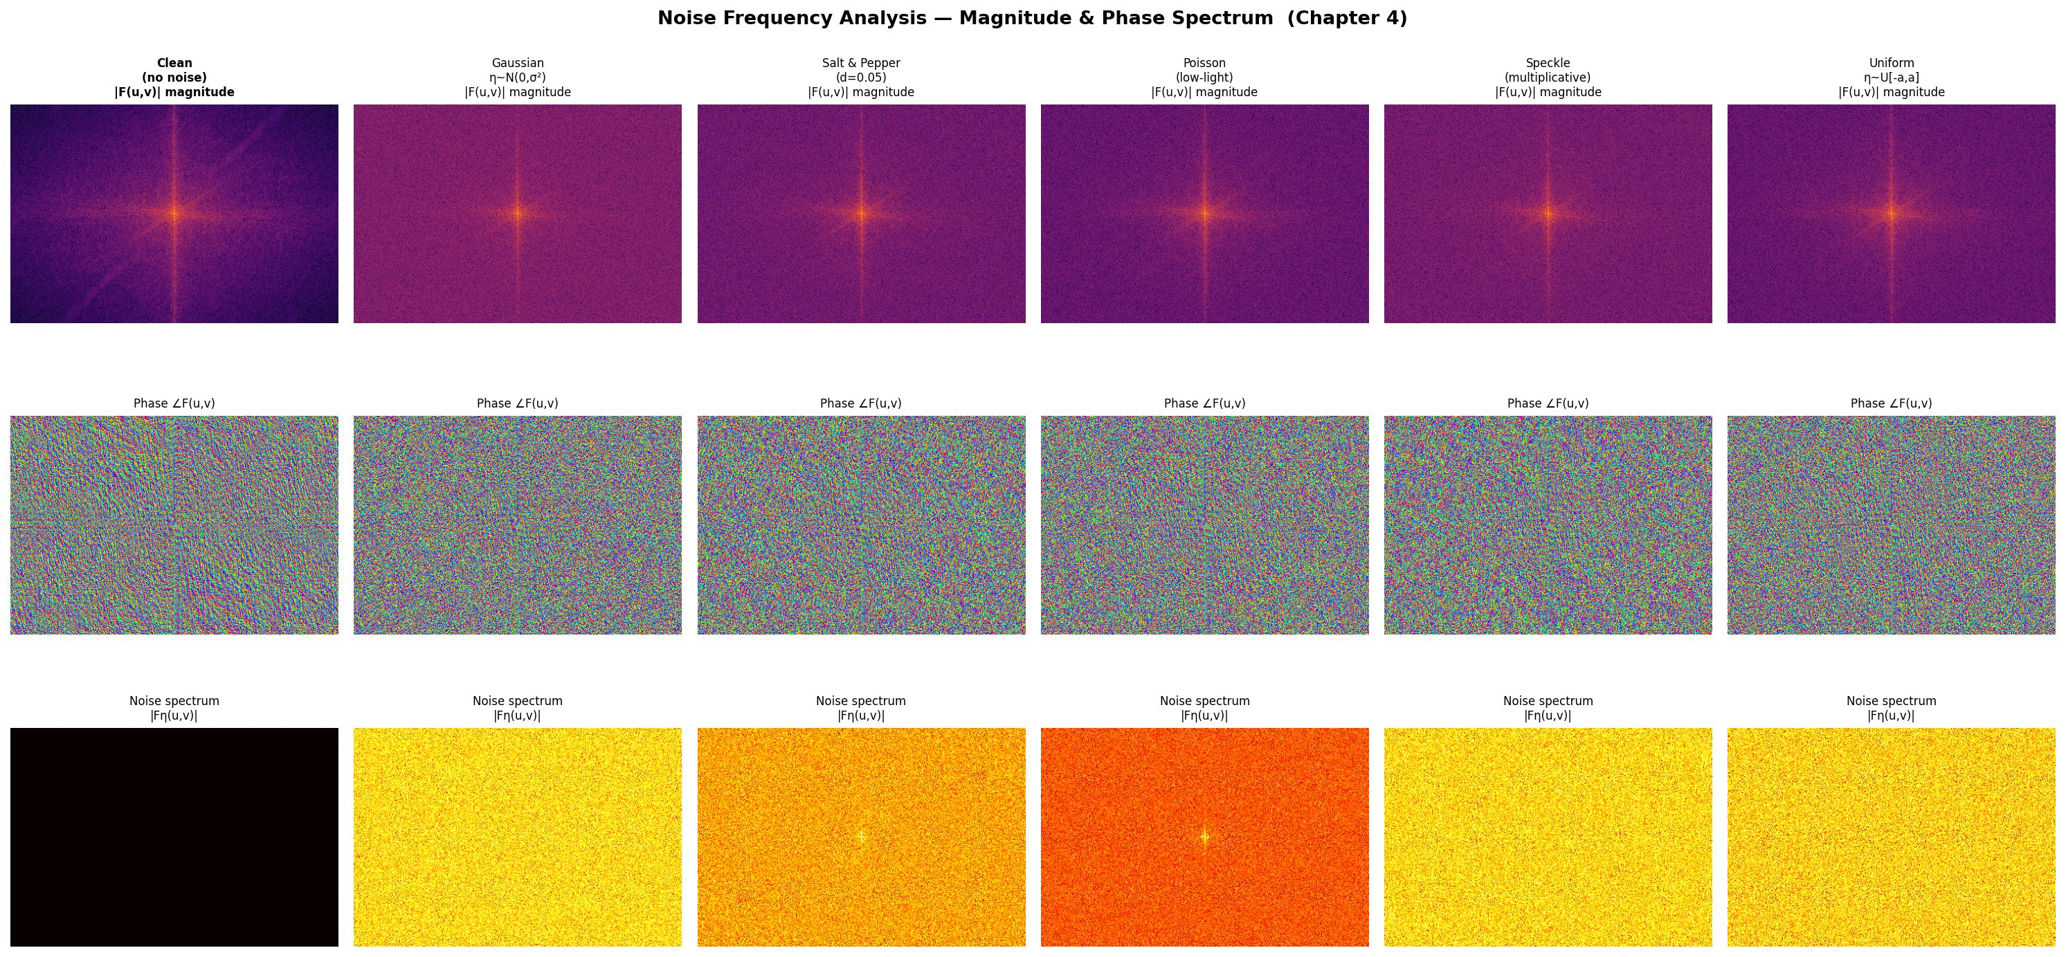
Result 5: Noise Frequency Spectra — All Noise Types
Chapter 4
What this shows:
Row 1 — Magnitude Spectrum |F(u,v)|
• FFT magnitude spectrum for different noise types
• Bright center = low-frequency image content
• Noise spreads energy across frequencies
Row 2 — Phase Spectrum ∠F(u,v)
• Phase stores image structure and edges
• Even with noise, structural information remains
Row 3 — Noise Spectrum |Fn(u,v)|
• Noise-only frequency spectrum
• Almost flat for all noise types
• Indicates white-noise behavior
Key Insight:
Most additive noises produce a nearly flat frequency spectrum.
Therefore, learnable FFT filtering becomes effective for denoising.
In frequency domain, noise energy spreads across frequencies while image structure remains in phase information. This motivates our learnable FFT-based frequency branch.

Slide 11
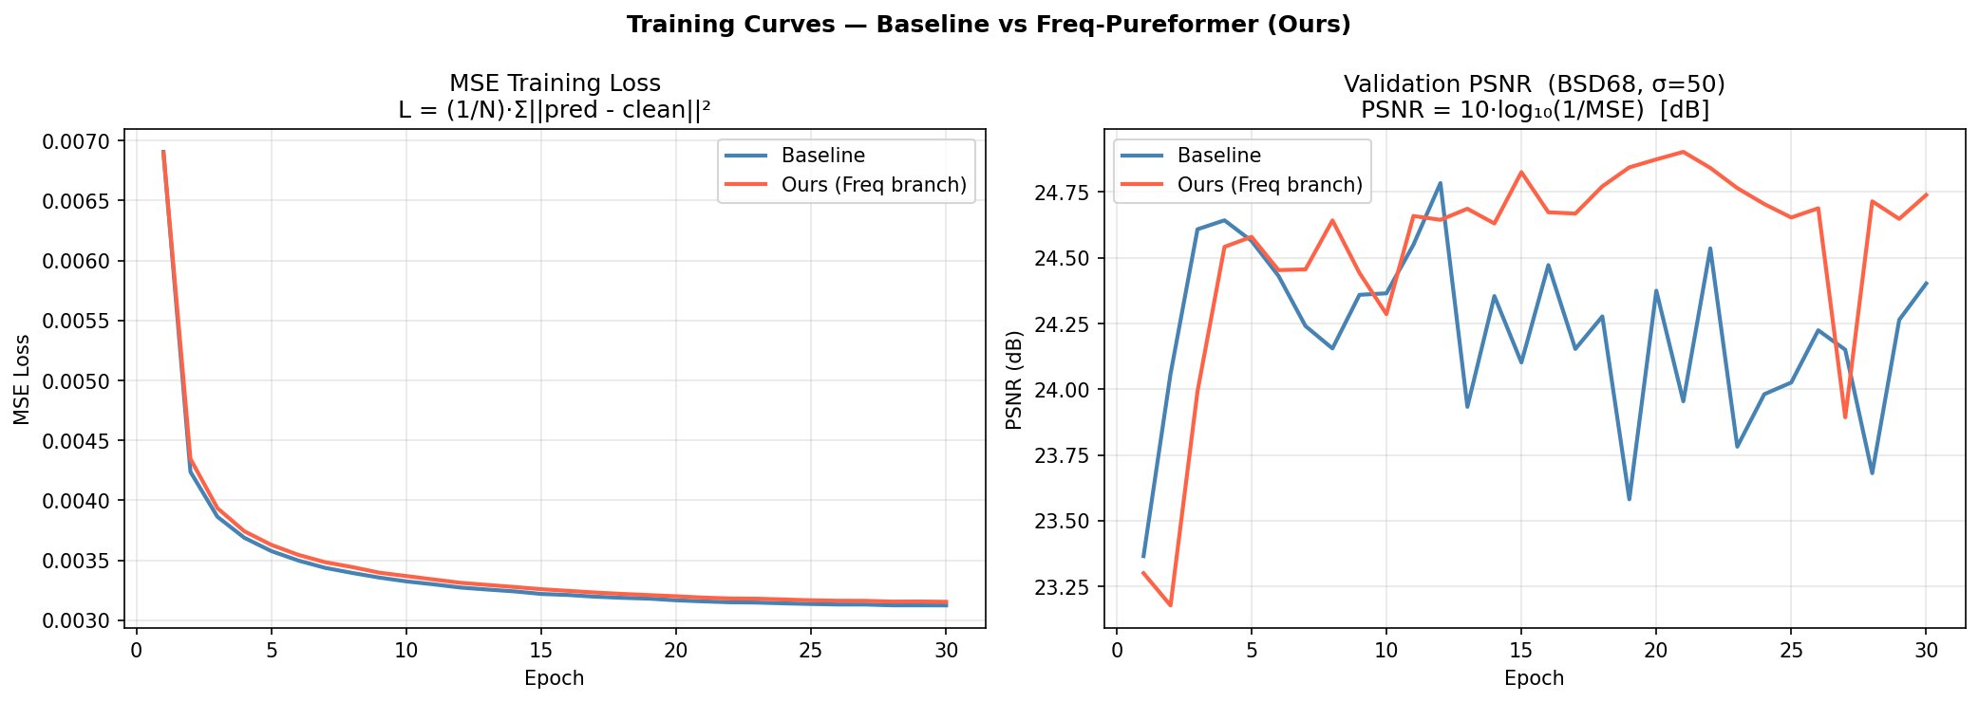
Result 6: Training Curves — 30 Epochs
Model Training
What this shows:
Left Graph — Training Loss
• MSE loss decreases over epochs
• Both models successfully learn
• Curves become stable after convergence
Right Graph — Validation PSNR
• PSNR evaluated on BSD68 test set
• Higher PSNR = better denoising quality
• Red curve (ours) stays above baseline most of the time
Key Insight:
Similar training loss but higher validation PSNR shows that the frequency branch improves reconstruction quality rather than simply memorizing training data.
Both models converge to similar MSE loss, but our model consistently achieves higher PSNR, proving the effectiveness of the learnable frequency branch.

Slide 12
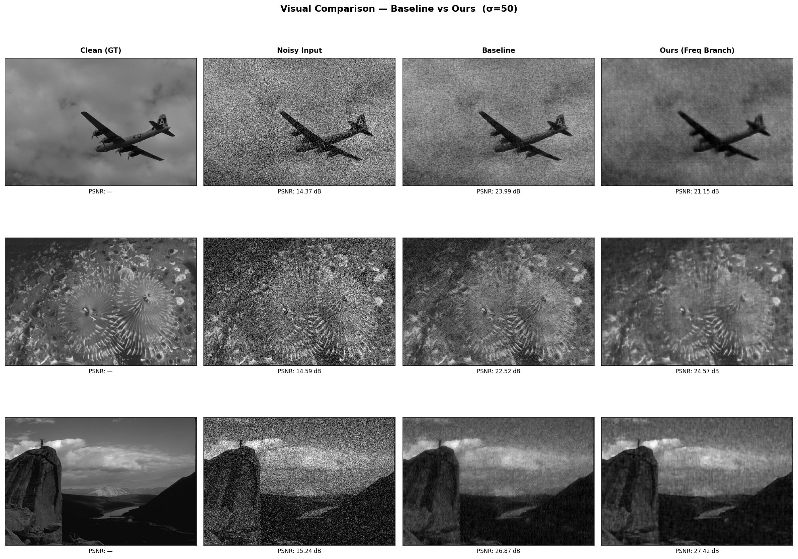
Result 7: Visual Comparison — Baseline vs Ours
BSD68, σ=50
What this shows:
Row 1 — Airplane
• Smooth regions and simple structure
• Baseline performs reasonably well
• Small improvement from frequency branch
Row 2 — Flower Texture
• Complex high-frequency details
• Our model preserves texture better
• Sharper reconstruction with fewer artifacts
Row 3 — Landscape
• Fine edges and structural regions
• Frequency branch recovers more details
• Better contrast and texture preservation
Key Insight:
The frequency-aware branch provides the biggest improvement on textured and high-frequency regions where spatial-only denoising loses detail.
.
Our model achieves better texture preservation and structural similarity, leading to higher PSNR and SSIM compared to the baseline Pureformer.

Slide 13
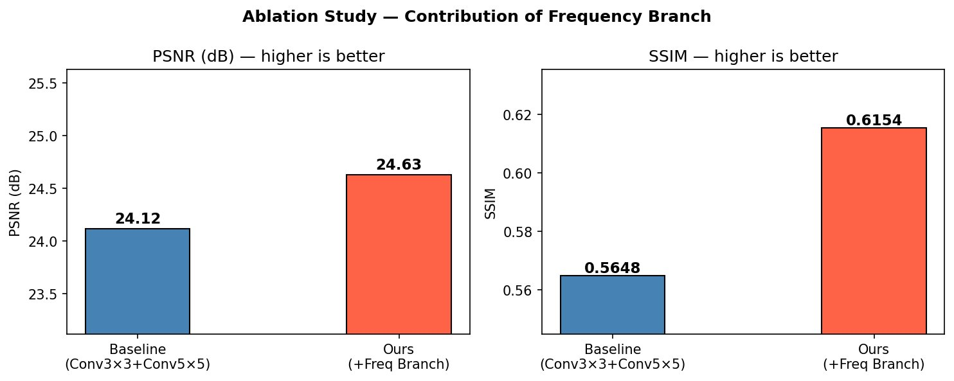
Result 8: Ablation Study — Does the Frequency Branch Actually Help?
Key Proof
What this shows:
Left Graph — PSNR
• Baseline: 24.12 dB
• Ours: 24.63 dB
• Improvement: +0.51 dB
Right Graph — SSIM
• Baseline: 0.5648
• Ours: 0.6154
• Better structural similarity
Config
PSNR
SSIM
Baseline (Conv3+Conv5)
24.12
0.5648
+ Freq Branch (ours)
24.63
0.6154
Key Proof: +0.51 dB PSNR and higher SSIM are achieved only by adding the learnable frequency branch.
This ablation study isolates the effect of the FFT frequency branch and confirms that it is the source of the performance improvement.

Slide 14
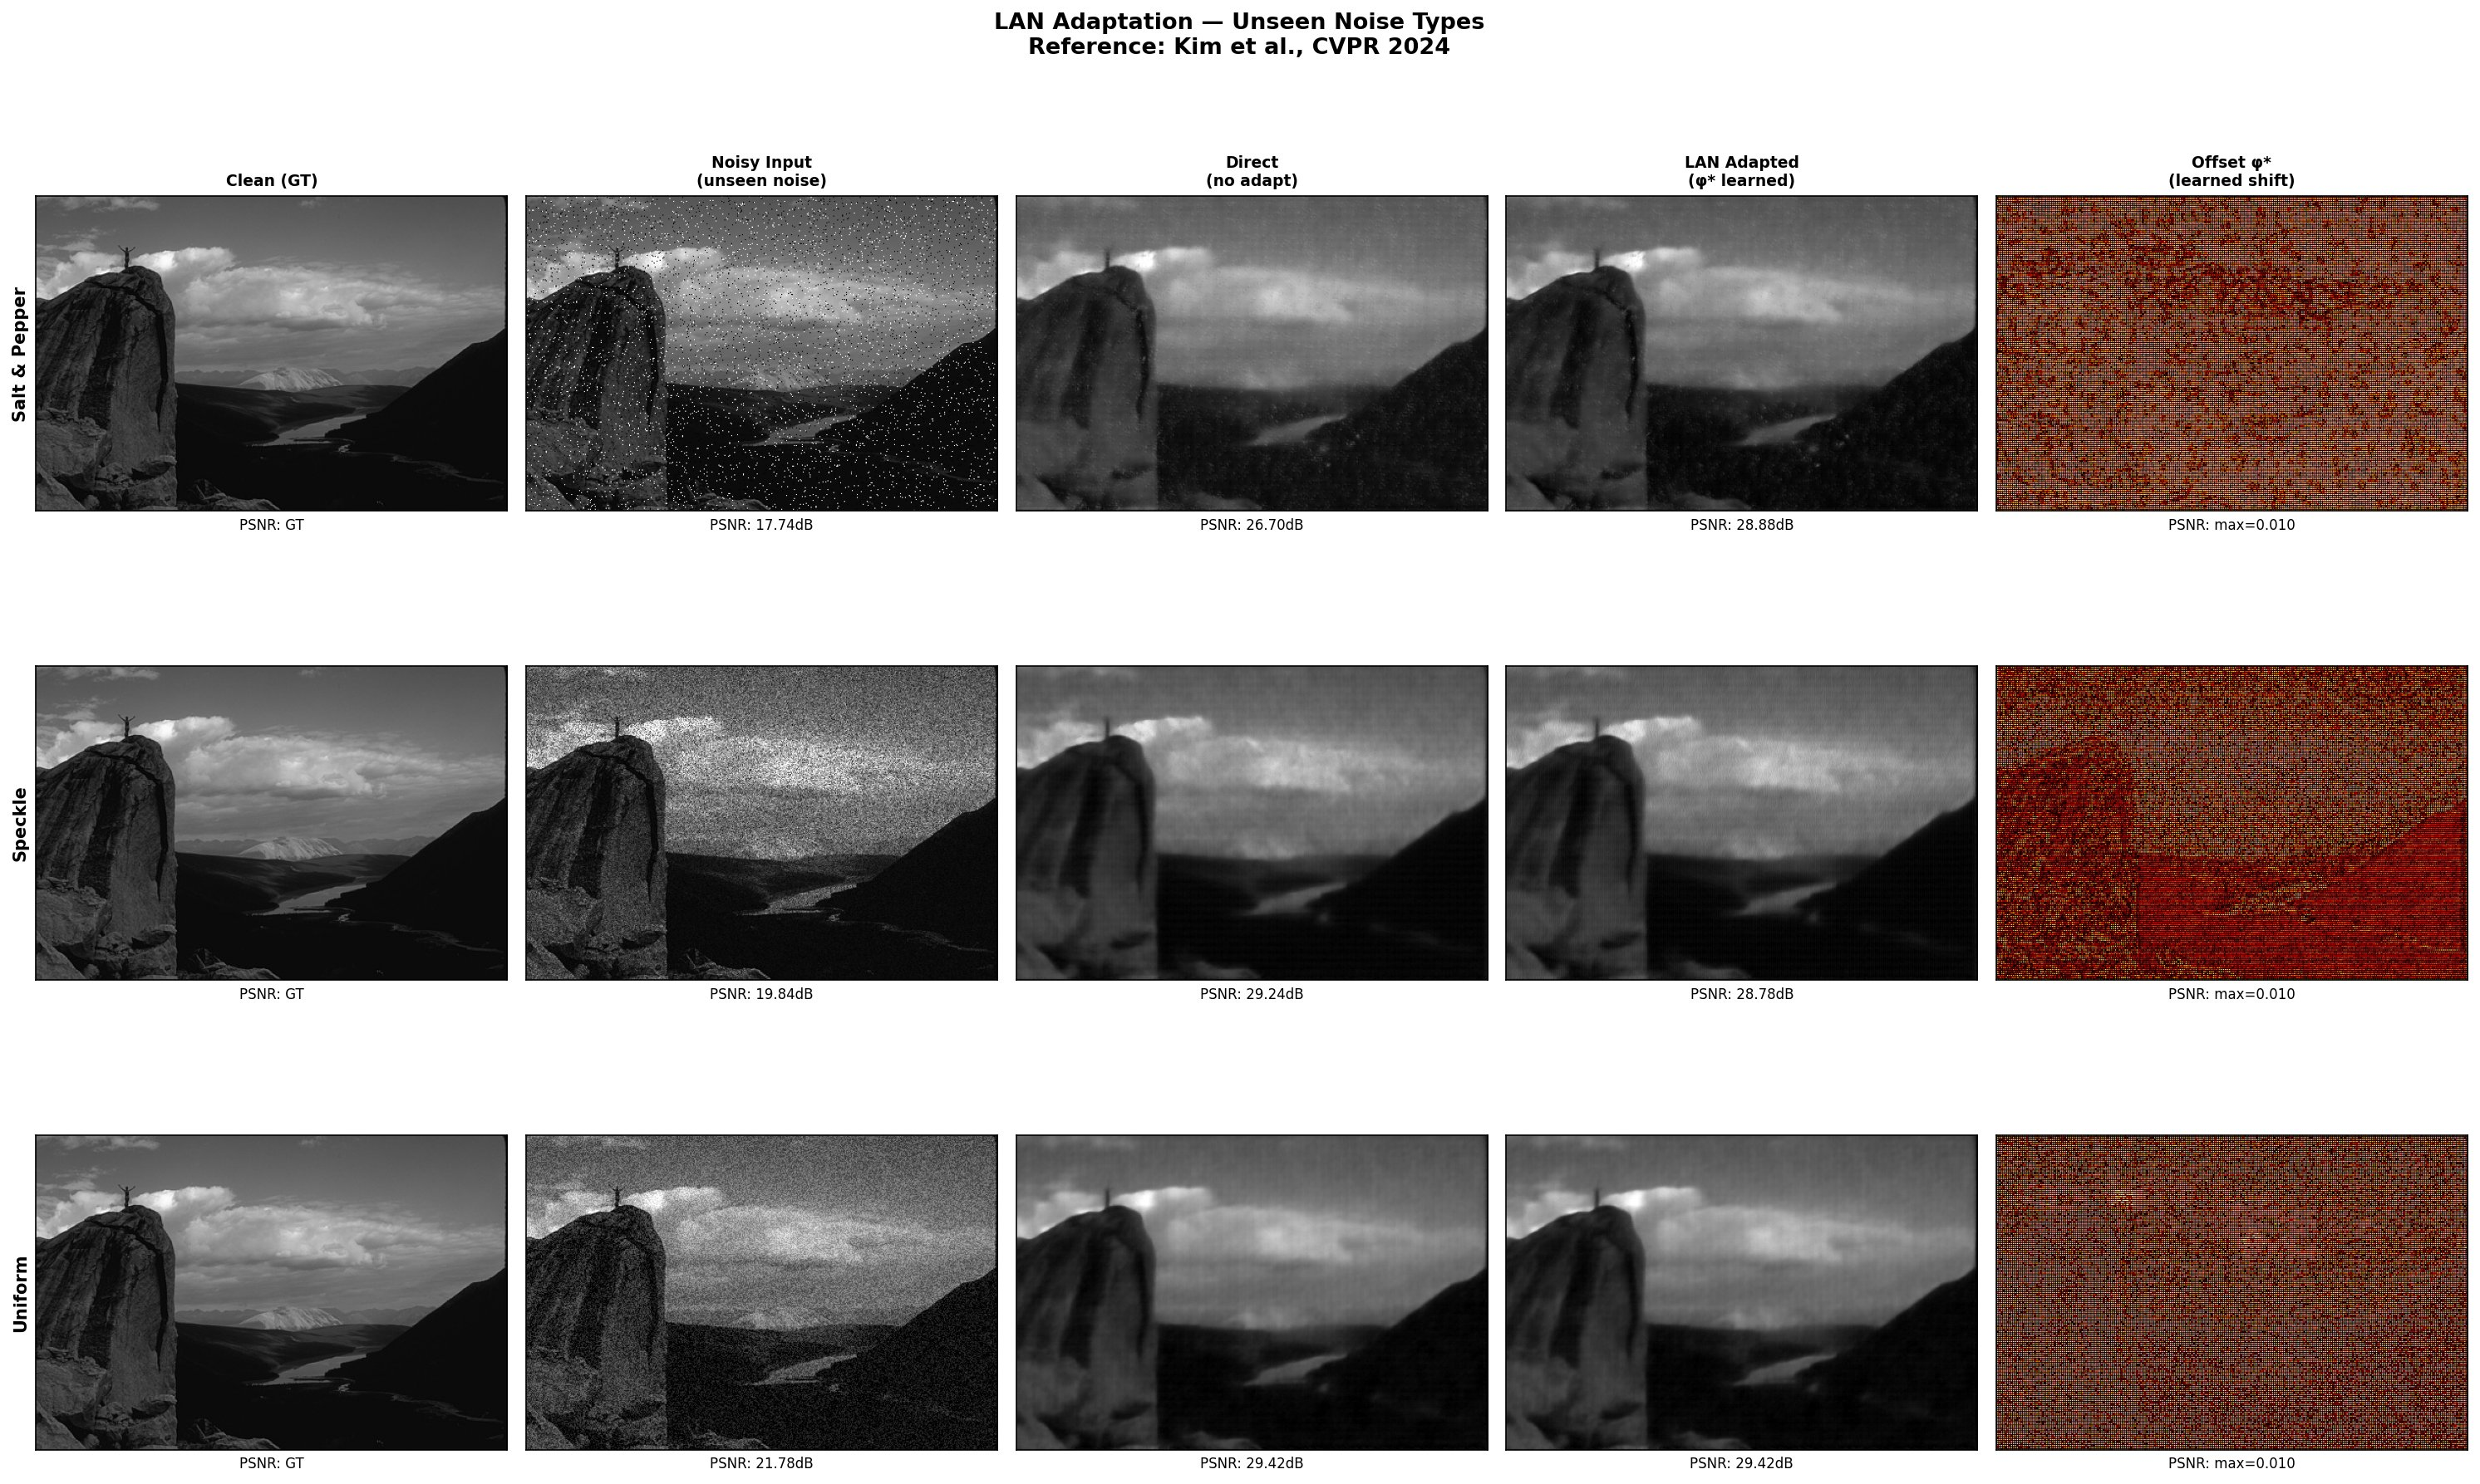
Result 9: LAN Adaptation — Unseen Noise Types
Test-Time Adaptation
What this shows:
Columns
• Clean ground truth image
• Noisy image with unseen noise
• Direct output without adaptation
• LAN-adapted output
• Learned offset visualization
Rows
• Row 1: Salt & Pepper noise
• Row 2: Speckle noise
• Row 3: Uniform noise
Noise
Direct
+ LAN
Gain
Key Results:
Salt & Pepper benefits the most
• Uniform noise already resembles Gaussian behavior
• Speckle is harder because it is multiplicative noise
LAN formula: φ* = argmin ||f_θ(D₁(y+φ)) − D₂(y+φ)||². LAN learns a small correction offset φ* so the noisy input becomes easier for the pretrained denoiser to process.

Slide 15
Conclusion
Frequency Branch
1
Result
• +0.51 dB PSNR
• +0.051 SSIM
• Added a learnable FFT frequency branch inside Pureformer
• Directly suppresses white-noise frequency components
• Improved denoising performance on BSD68
Key Idea
• Spatial branch → local textures
• Frequency branch → noise suppression
Frequency-Aware Architecture
2
• Combined spatial and frequency-domain learning
• Minimal architectural modification
• FFT branch integrated into Feature Enhancer block
LAN Adaptation
3
Result
• +2.18 dB improvement
• Tested on unseen noise types
• Adaptation works without retraining
• Significant gain on Salt & Pepper noise
Our work shows that combining spatial transformers with learnable frequency-domain filtering improves image denoising performance while keeping the architecture lightweight.

