Slide 1
ANALYSIS OF BIKE SHARING DATA

Slide 2
INTRODUCATION
Case study - How does a bike-share navigate speedy success?
Company - Cyclistic an fictional bike sharing company in Chicago
Dataset - Use Cyclistic’s historical trip data of 2019 & 2020(1st quarter)
Total data - 365069 ride data in 2019 and 426887 ride data in 2020
2019 - 341906(93.65%) member rides and 23164(6.34%) casual rides
2020 - 378404(88.64%) member rides and 48480(12.8%) casual rides
Tool - Excel is used for this case study
Question to answer - How different members and casuals use cyclistic

Slide 3
DATA CLEANING
Missing values :
2019 dataset have missing values in two columns gender and birth year.
2020 dataset have missing values in one row with start & end trip time with same datetime.
Duplicate values and Irrelevant values :
There is no duplicate entries and irrelevant values in both dataset.
Removed columns:
2019 bike_id, start and end station(name, Id), gender, birth year
2020 rideable_type, start and end station(name, Id, latitude, longitude)
To focus on import information that are relevant to business task.

Slide 4
ANALYSIS
Create new data for analysis
Create total trip duration using start and end trip time by subract end by start time in excel and format the cell to time(HH:MM:SS)
Create day of the week for each rides use start trip time in weekday() function and choose order of days (if criteria is 1 then 1 is Sunday and 7 is Saturday)
Use pivot table in excel
Use pivot table to calculate the total rides by user type for each day in a week.
Calculate total time of ride by user type for each days in a week.
Then create a clustered column chart to compare the frequency of rides by user type and total ride duration by user type for all days in a week.

Slide 5
PIVOT TABLE
2019
2020

Slide 6
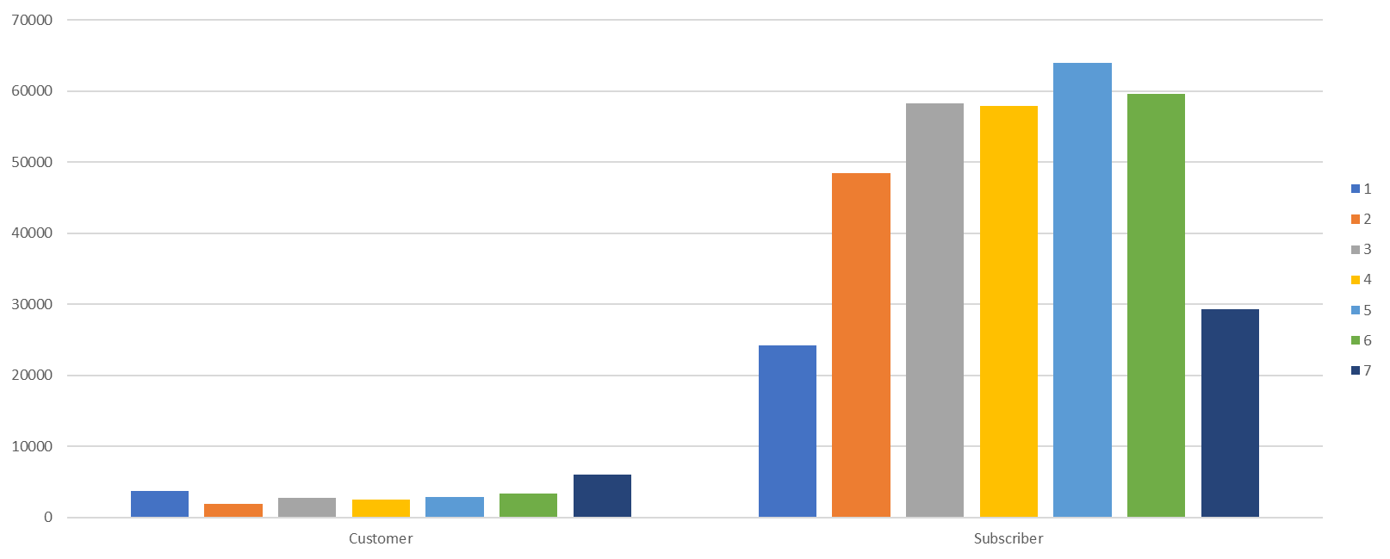
2019 - COUNT OF TRIPS BY USER TYPE
1-SUNDAY
2-MONDAY
3-TUESDAY
4-WEDNESDAY
5-THURSDAY
6-FRIDAY
7-SATURDAY
CUSTOMERS
SUBSCRIBERS

Slide 7
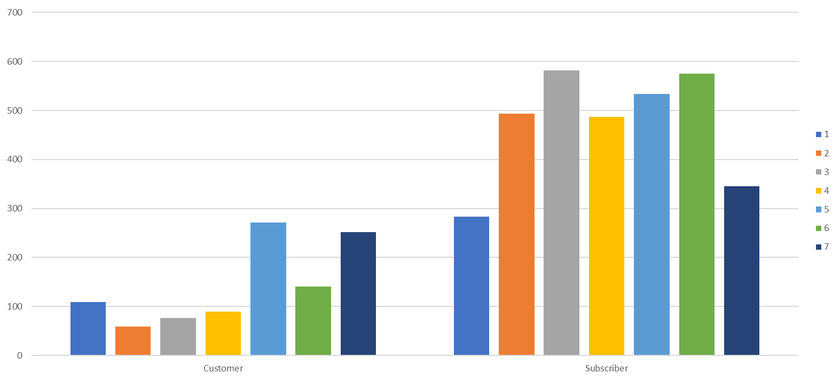
2019 - SUM OF TOTAL DURATION BY USER TYPE
1-SUNDAY
2-MONDAY
3-TUESDAY
4-WEDNESDAY
5-THURSDAY
6-FRIDAY
7-SATURDAY
CUSTOMERS
SUBSCRIBERS

Slide 8
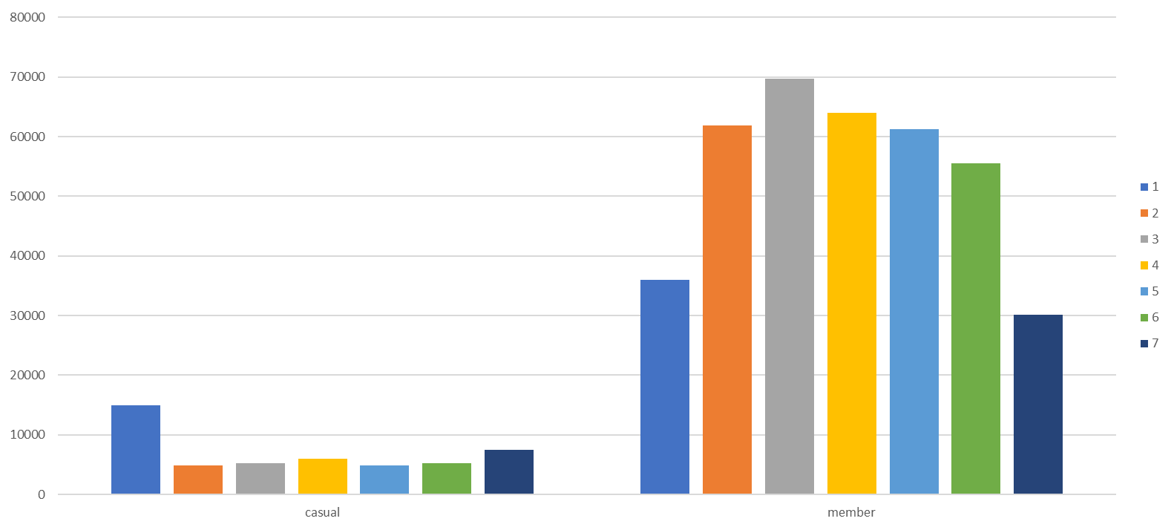
2020 - COUNT OF TRIPS BY USER TYPE
1-SUNDAY
2-MONDAY
3-TUESDAY
4-WEDNESDAY
5-THURSDAY
6-FRIDAY
7-SATURDAY
CUSTOMERS
SUBSCRIBERS

Slide 9
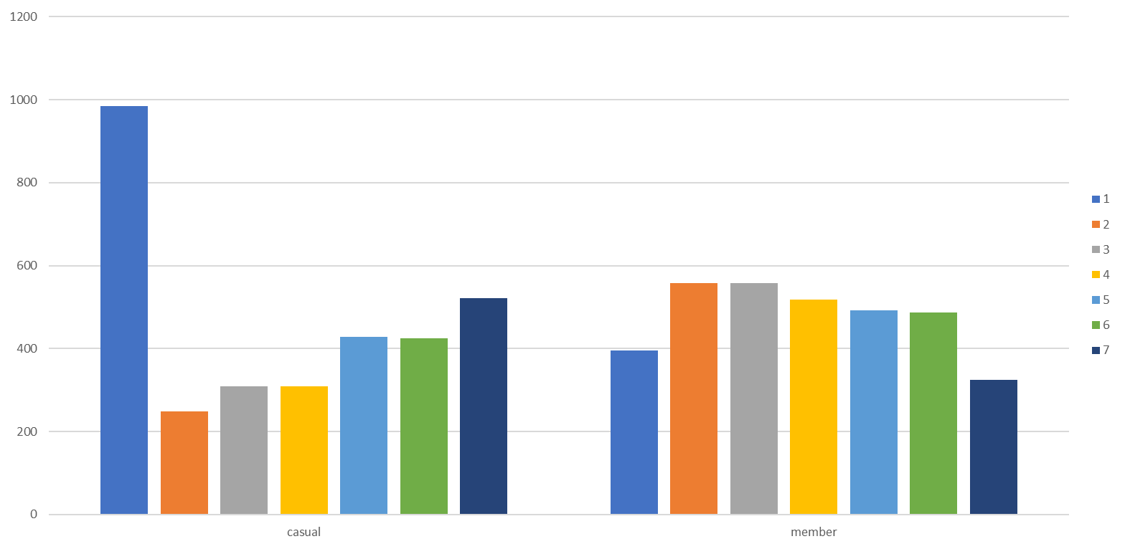
2020 - SUM OF TOTAL DURATION BY USER TYPE
1-SUNDAY
2-MONDAY
3-TUESDAY
4-WEDNESDAY
5-THURSDAY
6-FRIDAY
7-SATURDAY
CUSTOMERS
SUBCRIBERS

Slide 10
UNDERSTANDINGS FROM CLUSTERED BAR CHART
Casual riders are mostly ride in weekend and members are mostly ride in weekdays. Which means casual riders are occasional or leisure riders and members are mostly commute to works.

Slide 11
PIE CHART FOR CONTRIBUTION UNDERSTANDING
Use pivot table to understand the contributions of each user type in frequency of rides and total duration of rides.
Use pie chart to represent the each user type contribution in percentage for both years dataset
Which provides the depth understanding of members and casual riders contribution in total rides and find out which type of users trip duration is long.

Slide 12
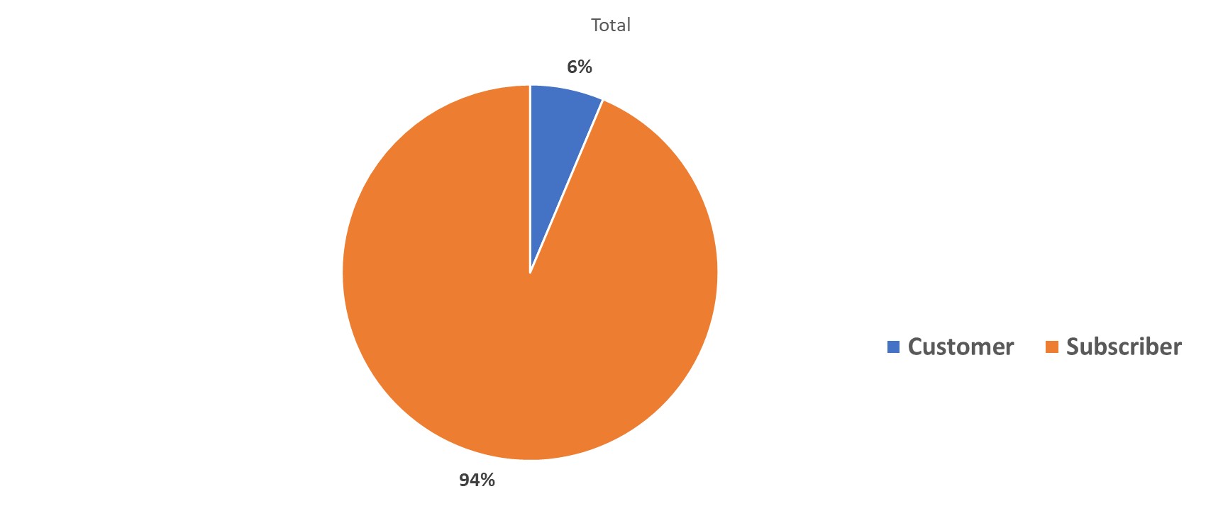
2019 – CUSTOMERS VS SUBSCRIBERS BY NUMBER OF RIDES

Slide 13
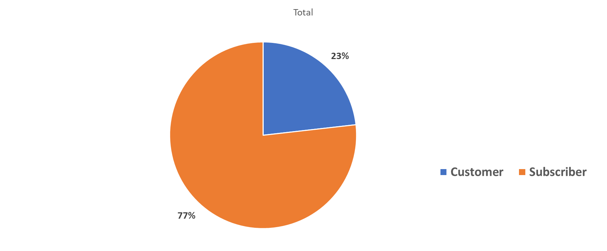
2019 – CUSTOMERS VS SUBSCRIBERS BY TOTAL DURATION OF TRIP

Slide 14
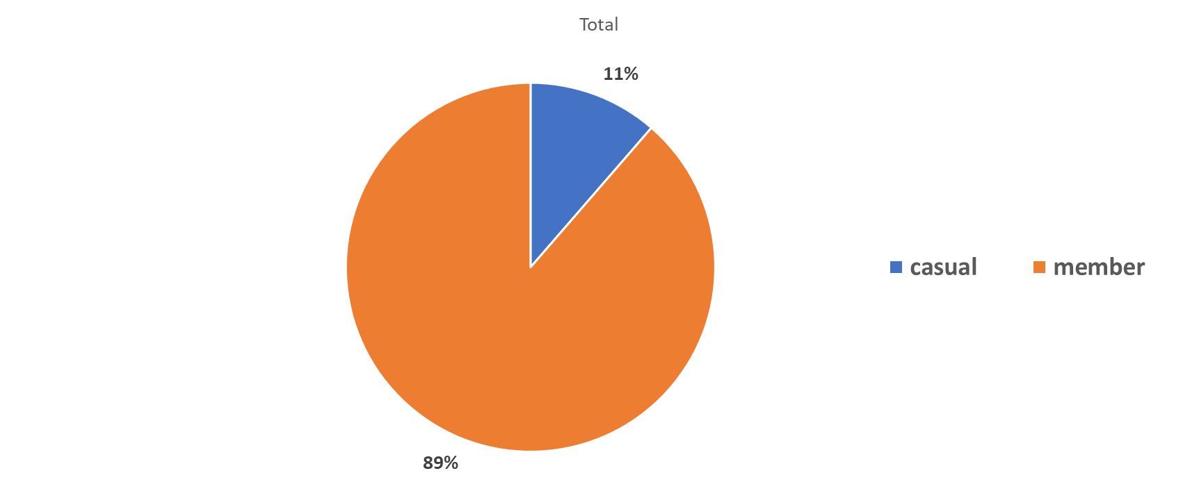
2020 – CUSTOMERS VS SUBSCRIBERS BY NUMBER OF RIDES

Slide 15
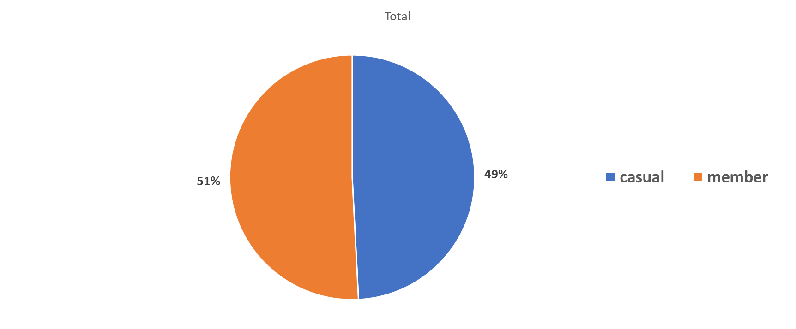
2020 – CUSTOMERS VS SUBSCRIBERS BY TOTAL DURATION OF TRIP

Slide 16
UNDERSTANDINGS FROM PIE CHART
2019-The frequency of casual ride is just 6% but their contribution is 23% in trip durations which shows casual riders ride for long durations.
2020-The frequency of casual riders 11% but their contribution is 49% in trip duration which shows the casual riders ride long durations and compare to 2019 both casual and members are increased
The frequency of members are high in both years but the average contribution in trip duration is low compare to casual riders

Slide 17
PIE CHART TO COMPARE USERS BY YEARS
Use a pivot table to create a pie chart using user type and frequency of rides .
Create separate pie charts for each user type and understand the contribution by years 2019 and 2020.
This helps to find the difference in years for each user type.

Slide 18
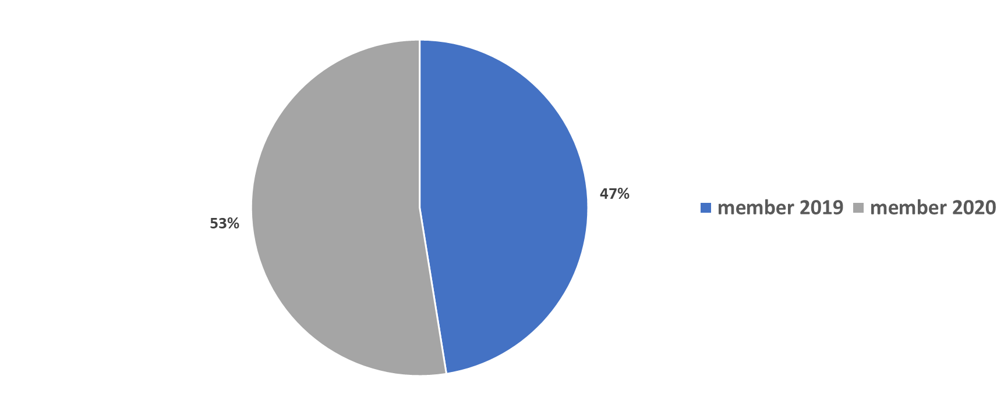
TOTAL MEMBER RIDES BY YEARS

Slide 19
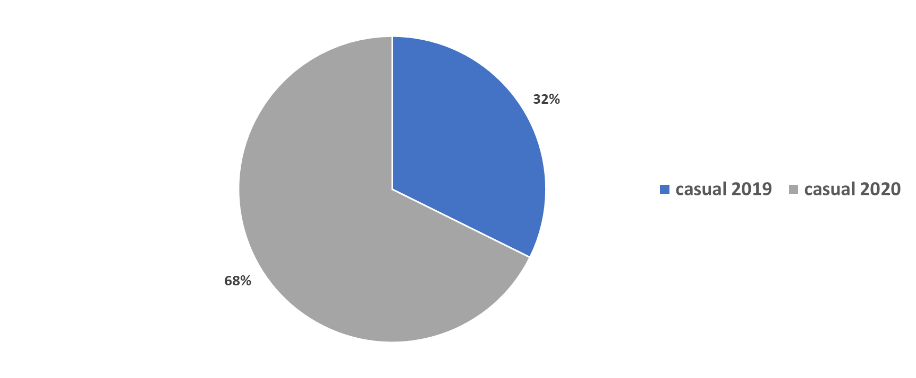
TOTAL CASUAL RIDES BY YEARS

Slide 20
UNDERSTANDINGS FROM YEAR WISE COTRIBUTIONS IN PIE CHART
2019 member rides are 341906 and casual rides are 23163
2020 member rides are 378407 and casual rides are 48480
This shows the increase of users in both user type.
In members, 6% increase ride compare to 2019.
In casuals, 36% increase ride compare to 2019.
From this, we understand the companies growth increased in 2020 compared to 2019 also most attractions in casual rides.

Slide 21
CONCLUSION AND SUGGESIONS
Capitalize on Casual Rider Growth
The significant 36% increase in casual rides suggests a growing pool of potential members. Cyclistic should focus on converting these casual riders into annual members through strategic initiatives. These could include personalized ride summaries, in-app recommendations, and cost-saving comparisons that highlight how much users could save with a membership.

Slide 22
Tailor Marketing by User Behaviour
Members show more consistent weekday usage, indicating they often use the service for commuting. In contrast, casual riders dominate on weekends, likely using the service for leisure. Marketing strategies should reflect these patterns—offering commuter incentives or loyalty rewards to members to promote long-term engagement and boost retention, and introducing recreational packages, weekend promotions, and trial discounts or benefits for frequent casual users to encourage them to switch to annual memberships
Optimize Operations with Data-Driven Planning
Cyclistic should adjust bike availability and station stocking using historical usage trends. This ensures bikes are reliably available during peak hours and popular days, improving the riding experience for both user types.

