Slide 1
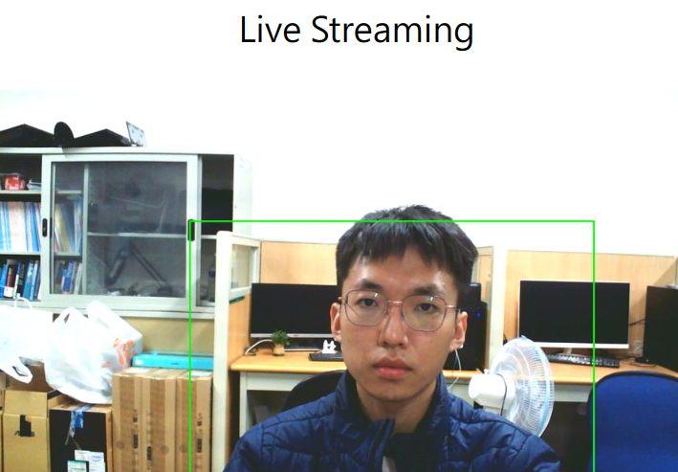
NYCU _ Video Streaming and Tracking 視訊串流與追蹤HW4 Report
Team1:
紀軒宇 詹恆瑜 周宗翰

Slide 2
How to combine tracking models with live streaming?
Capture video frames from the camera.
Identify people in the video using object detection models.
Perform real-time video processing and object tracking.
Process coordinate data sent from the frontend and update tracking objects.
Tracker
Coding
Resize and compress processed video frames.
Convert compressed video frames into JPEG format.
Stream the compressed video data back to the frontend.
Display live video stream.
Capture user clicks on the video.
Convert click positions to coordinates relative to the video.
Send coordinate data to the backend via AJAX
Interacte

