Slide 1
IF-Defense: 3D Adversarial Point Cloud Defense via Implicit Function based Restoration
Ziyi Wu*, Yueqi Duan*, He Wang, Qingnan Fan, Leo Guibas
2021.1.12

Slide 2
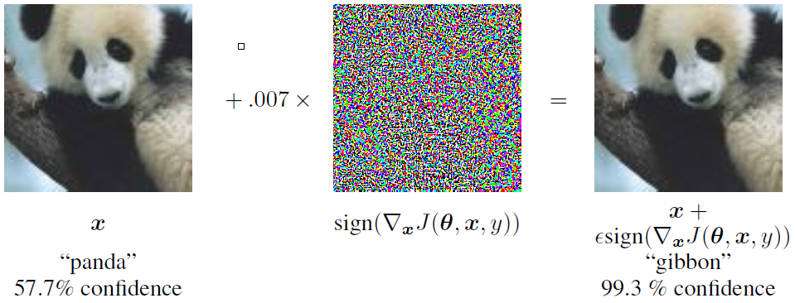
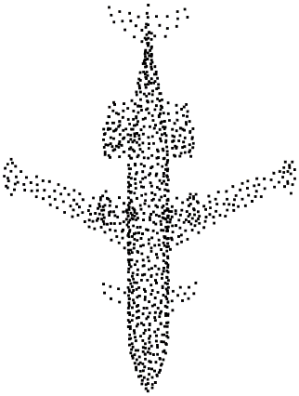
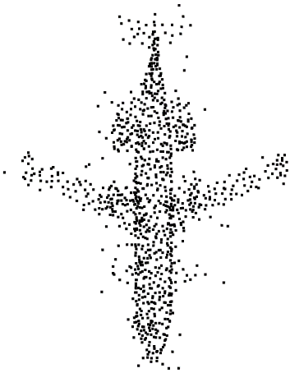
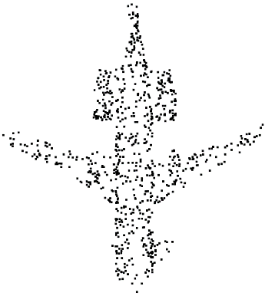
Adversarial Machine Learning (Adv ML)
What?
Adv data: fool the victim model while being visually similar to clean data
Why?
Improve safety in real world applications, e.g. self-driving cars
2D attacks and 3D attacks are different
Can perturb point coordinates & change number of points
Point clouds are unstructured and unordered
[1] Goodfellow, Ian J., Jonathon Shlens, and Christian Szegedy. "Explaining and harnessing adversarial examples." ICLR 2015.
[2] Xiang, Chong, Charles R. Qi, and Bo Li. "Generating 3d adversarial point clouds." CVPR 2019.
Notes:
So first what is adversarial ML? Previous work shows that, by adding some well-designed but imperceptible noise to the input data, the network will predict wrong answers with high confidence. By studying it, we can improve the robustness of models. While 2D attack and defense has been widely studied, 3D point cloud attacks are quite different from their 2D counterparts. They can not only perturb point coordinates, but also change the number of points by adding or dropping. This is because point clouds are unstructured, while 2D images have regular grid structures.

Slide 3
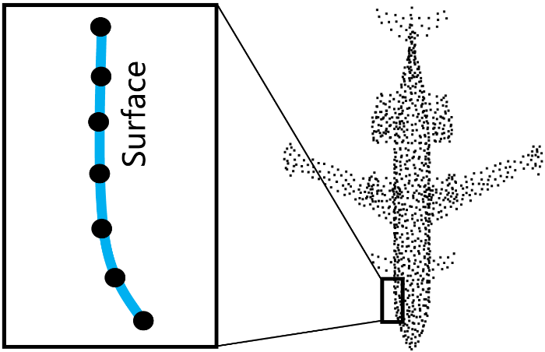
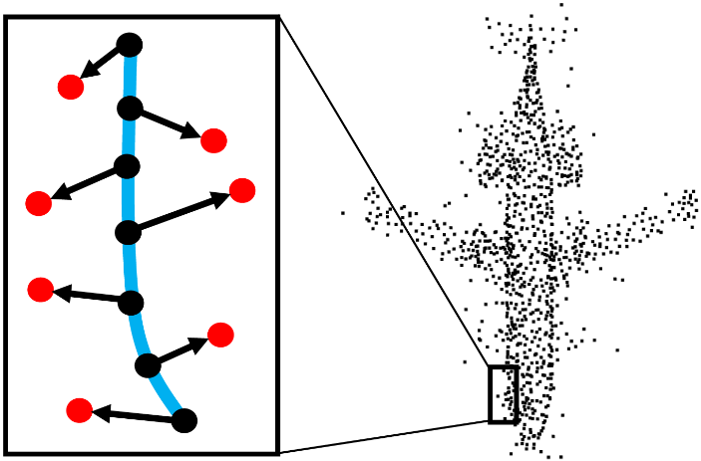
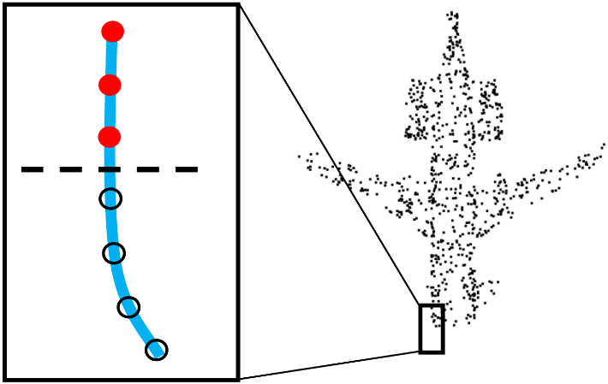
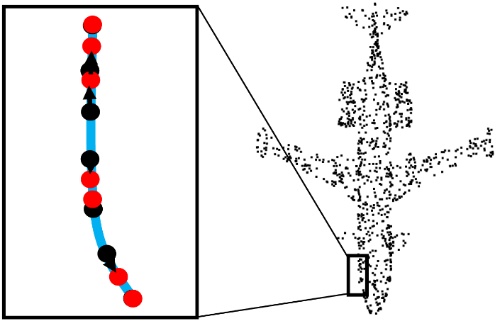
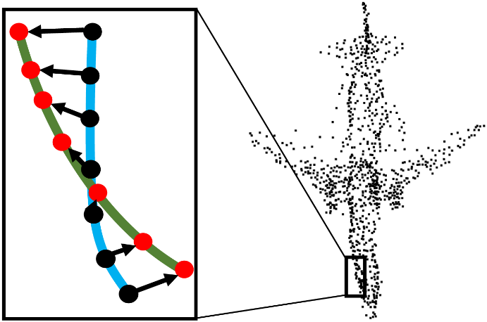
Different Attack Effects
clean
Point perturbation
Out-of-surface perturbation
On-surface perturbation
Surface distortion
Local part removal
Geometric Deformation
(a) out-of-surf. pert.
(c) Part Removal
(b) on-surf. pert.
(d) Geo. Deformation
Notes:
We first review existing attacks and summarize their effects into 2 aspects. Here are their visualizations. This is a clean airplane, and the black points distribute uniformly on the blue object surface. For point perturbation, the out-of-surface and on-surface perturbation either perturb the points to become outliers, or change the sampling pattern of the point cloud. For surface distortion, the attacks either remove the head and the tail of the airplane, or distort its normal shape.

Slide 4
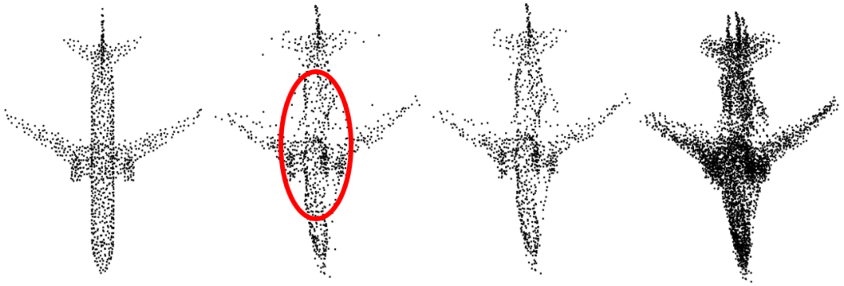
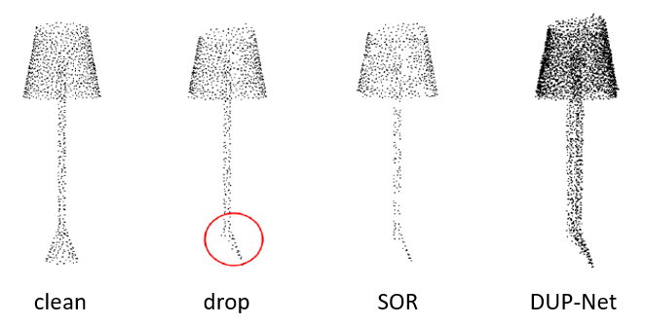
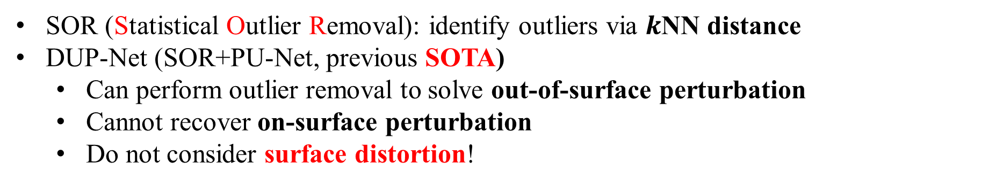
Existing Defense
SOR (Statistical Outlier Removal): identify outliers via $k$NN distance
DUP-Net (SOR+PU-Net, previous SOTA)
Can perform outlier removal to solve out-of-surface perturbation
Cannot recover on-surface perturbation
Do not consider surface distortion!
clean
adv
SOR
DUP-Net
clean
adv
SOR
DUP-Net
[1] Zhou, Hang, et al. "DUP-Net: Denoiser and upsampler network for 3D adversarial point clouds defense." ICCV 2019.
Notes:
We also review existing defenses. So far there are only two published methods, namely SOR and DUP-Net. Although they can perform outlier removal, they can’t recover point distribution change, as the output airplane here has messy point distribution. In addition, none of these methods consider surface distortion! Neither SOR nor DUP-Net can recover the complete base of this lamp.

Slide 5
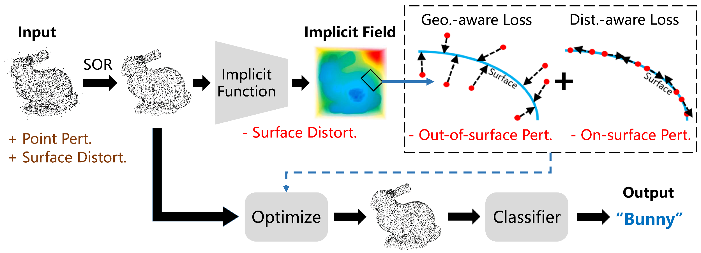
IF-Defense: Implicit Function based Restoration
Two key steps of our defense:
Surface recovery: recover the natural shape, via a deep implicit function
Point cloud restoration: re-generate points from implicit fields of shapes, via an optimization-based process
Notes:
In our work, we aim at proposing a defense framework that can simultaneously address both the attack effects. And we propose to do so in two key steps. Here is the pipeline of our IF-Defense. The input is an adv point cloud. In the surface recovery step, we employ an implicit function to recover the natural shape of the object. And in the point cloud restoration step, we adopt an optimization-based process to re-generate points from the implicit field guided by two loss.

Slide 6
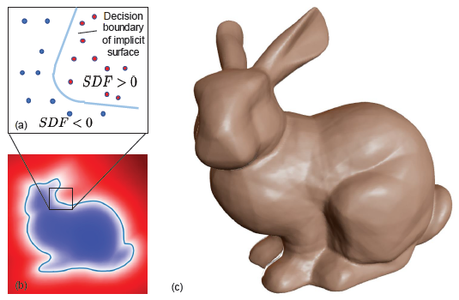
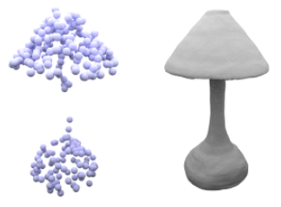
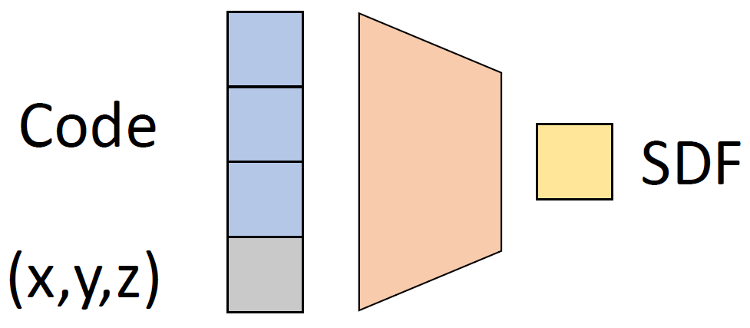
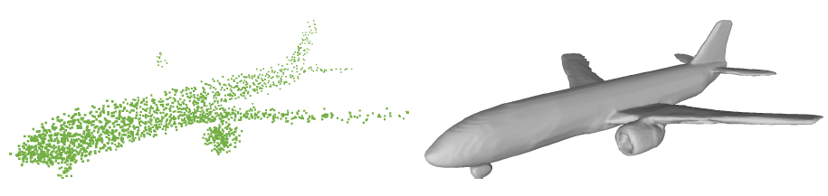
Surface Recovery
Implicit function (IF) network: trained on clean shapes in the reconstruction task
Encode shape priors: natural shape completion & recovery
Input the adv point cloud to an IF, get an implicit representation of the natural shape
DeepSDF
Occupancy Network
[1] Park, Jeong Joon, et al. "Deepsdf: Learning continuous signed distance functions for shape representation." CVPR 2019.
[2] Mescheder, Lars, et al. "Occupancy networks: Learning 3d reconstruction in function space." CVPR 2019.
Notes:
For the surface recovery step, the implicit function networks use deep neural networks to approximate the object shape as the zeroth level set. For example, the occupancy network output 1 for points inside the object boundary and 0 for outer points. They have many good properties. They are locally smooth thus free of noise, and can represent arbitrary complex geometry. More importantly, if we train an implicit function network to reconstruct clean shapes, they will encode shape priors in the model. In other words, they can project the input shapes back to the clean shape manifold. Previous works have leveraged this property to perform shape completion. So we input the adv point cloud to a pretrained implicit function network, and get an implicit representation of the recovered shape.

Slide 7
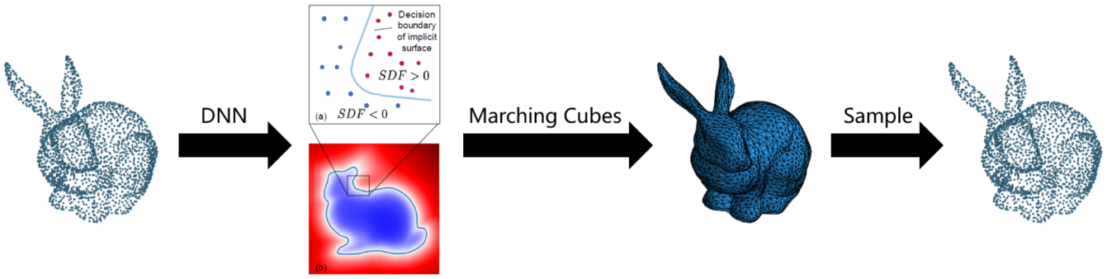
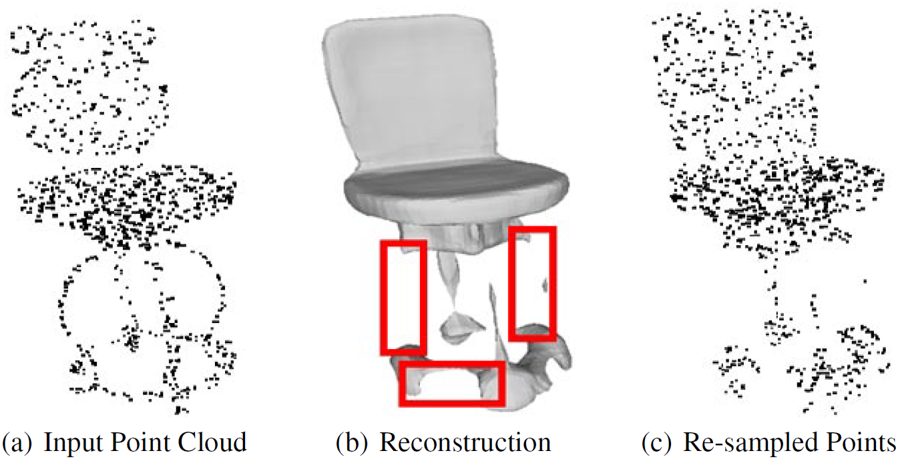
Point Cloud Restoration
How to re-generate a point cloud from the implicit representation?
An intuitive way: re-mesh & re-sample
Errors in the implicit field degrade the defense performance!
[1] Park, Jeong Joon, et al. "Deepsdf: Learning continuous signed distance functions for shape representation." CVPR 2019.
[2] Duan, Yueqi, et al. "Curriculum DeepSDF." ECCV 2020.
Notes:
OK so now the next step is to re-generate a point cloud from the implicit field. An intuitive way is to first use Marching Cubes algorithm to reconstruct a mesh, and then sample a point cloud from it. However, Marching Cubes completely replies on the predicted implicit field, which may contain certain errors. For example here, the ONet fails to reconstruct the legs of the chair, and the re-sampled point cloud is misclassified.

Slide 8
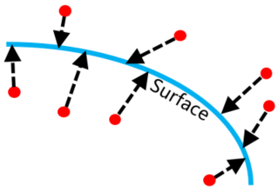
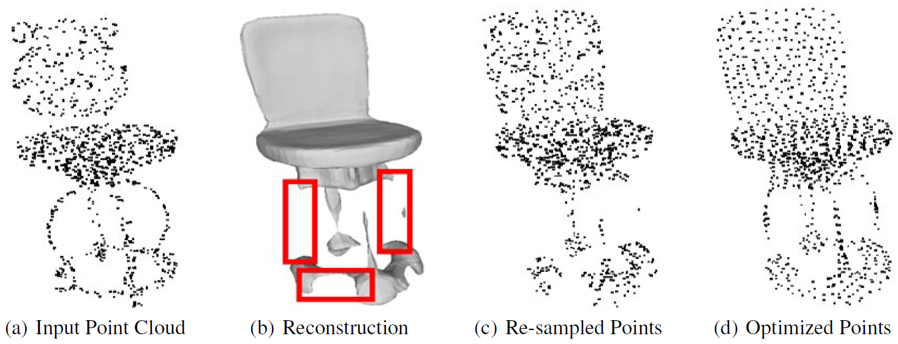
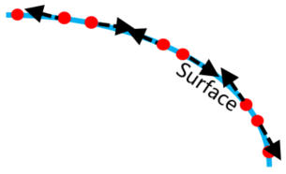
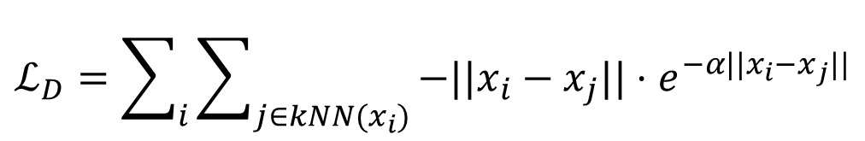
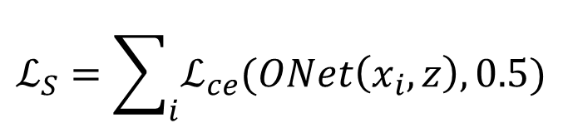
Optimization-based Restoration
0.5
Input points lying on missing parts, can compensate the errors in implicit field!
Initialize from input points, optimize their coordinates according to:
Geometry-aware loss: capture the surface
Distribution-aware loss: uniform distribution
Geo-aware loss
$$ℒ_{S}=\sum_{i}{ℒ_{ce}(ONet\left(x_{i}, z\right),0.5)}$$
Dist-aware loss
$$ℒ_{D}=\sum_{i}{\sum_{j∈kNN(x_{i})}{−||x_{i}−x_{j}||⋅e^{−α||x_{i}−x_{j}||}}}$$
Notes:
This is motivates us to propose an alternative way for restoration. Let’s have a closer look at the failure case, there are actually large number of points lying on the missing part, and we want to utilize them to compensate the reconstruction errors. Concretely, we directly initialize a point cloud from input points, and optimize their coordinates according to two loss.
The geometry-aware loss aims to capture the object surface. Suppose I adopt the Occupancy Network or ONet as the implicit function. Suppose this is the object boundary modeled by ONet, which outputs 0.5 for the surface. We input the red points which are the points to be optimized to ONet and get their predicted occupancy probabilities. Then we compute cross-entropy loss with GT equals to 0.5. So what’s the result of minimizing this loss? For points initialized near the surface, they will be pushed towards the boundary. But for points initialized at the missing part of the implicit field, the loss provides no gradient because ONet outputs nearly the same values among these regions. After all they’re considered not occupied so the occupancy values are all close to 0. It’s like doing gradient descent on a loss plateau, the points get stuck there and remain to form the missing parts.
The distribution-aware loss is straightforward, we maximize the distance between a point x_i to its kNN x_j, where the exponential term is a scaling factor that punishes greater for closer points. This loss leads to a uniform point distribution. This is the optimization result of the chair, where the legs are successfully retained and the point cloud is correctly classified by the victim model.

Slide 9
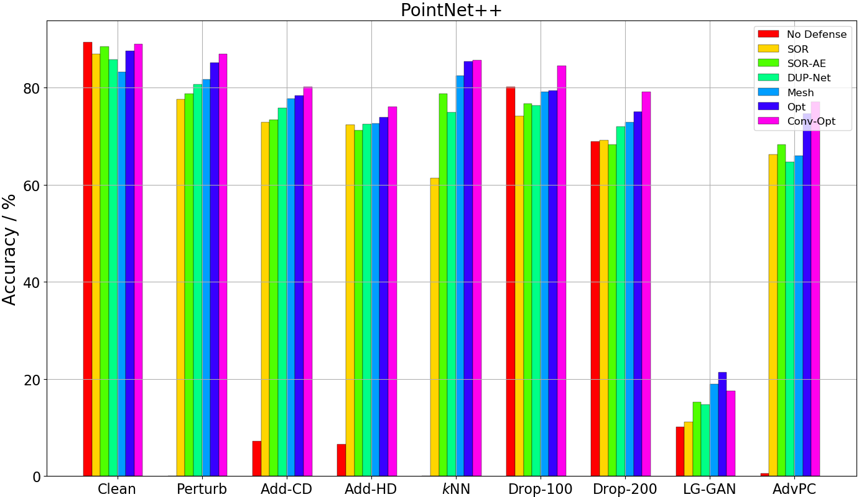
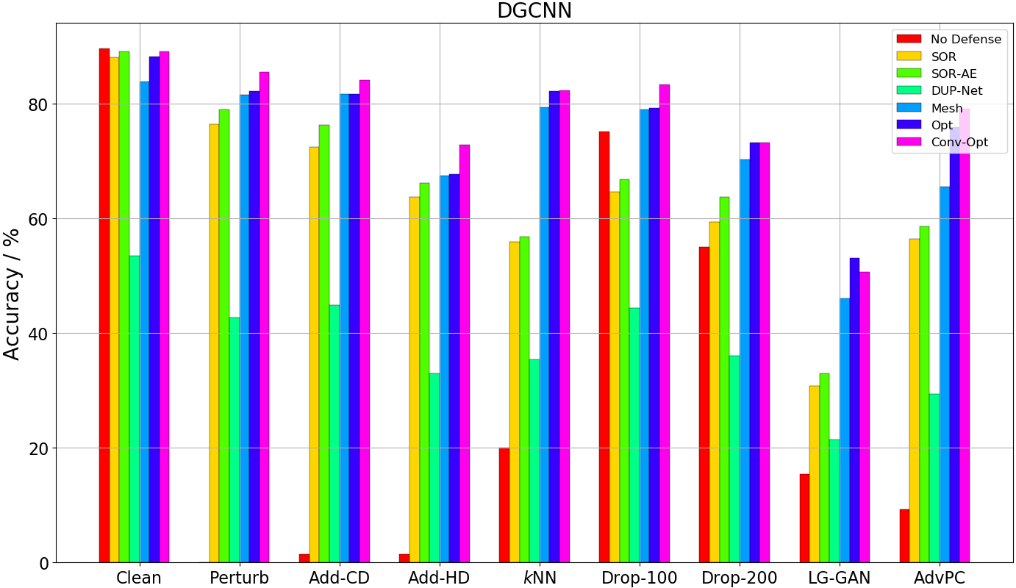

Experimental Results
Five victim models (PN, PN++, DGCNN, PointConv, RS-CNN), ModelNet40
Implicit function: ONet and ConvONet
Opt consistently outperforms Mesh, while Conv-Opt achieves new SOTA
Small improvement on perturb and adding attack
Significant increase on $k$NN, dropping, LG-GAN
8.77%
20.47%
6.89%
7.09%
25.55%
9.60%
20.12%
6.19%
[1] Peng, Songyou, et al. "Convolutional occupancy networks." ECCV 2020.
Notes:
Finally look at the experimental results. We adopt five victim models on the MN40 dataset. And we employ ONet and ConvONet as the implicit function network.
Here are two bar charts of the defense results for PN++ and DGCNN. The x-axis are different attacks and y-axis is accuracy, higher is better. The different color bars are no defense, three previous methods and three variants of IF-Defense. First, you can see that Opt consistently outperforms Mesh, indicating the effectiveness of our optimization based process. In addition, Conv-Opt achieves the highest accuracy against most of the attacks, proving that IF-Defense can be further enhanced if combined with stronger implicit function network. Overall, we achieve small improvement on perturbing and adding attack, but boost the accuracy significantly on kNN, dropping and LG-GAN attack, because they introduce surface distortion and point distribution change, which IF-Defense is designed to address.
We draw similar observations on other three networks so I don’t show them here.

Slide 10
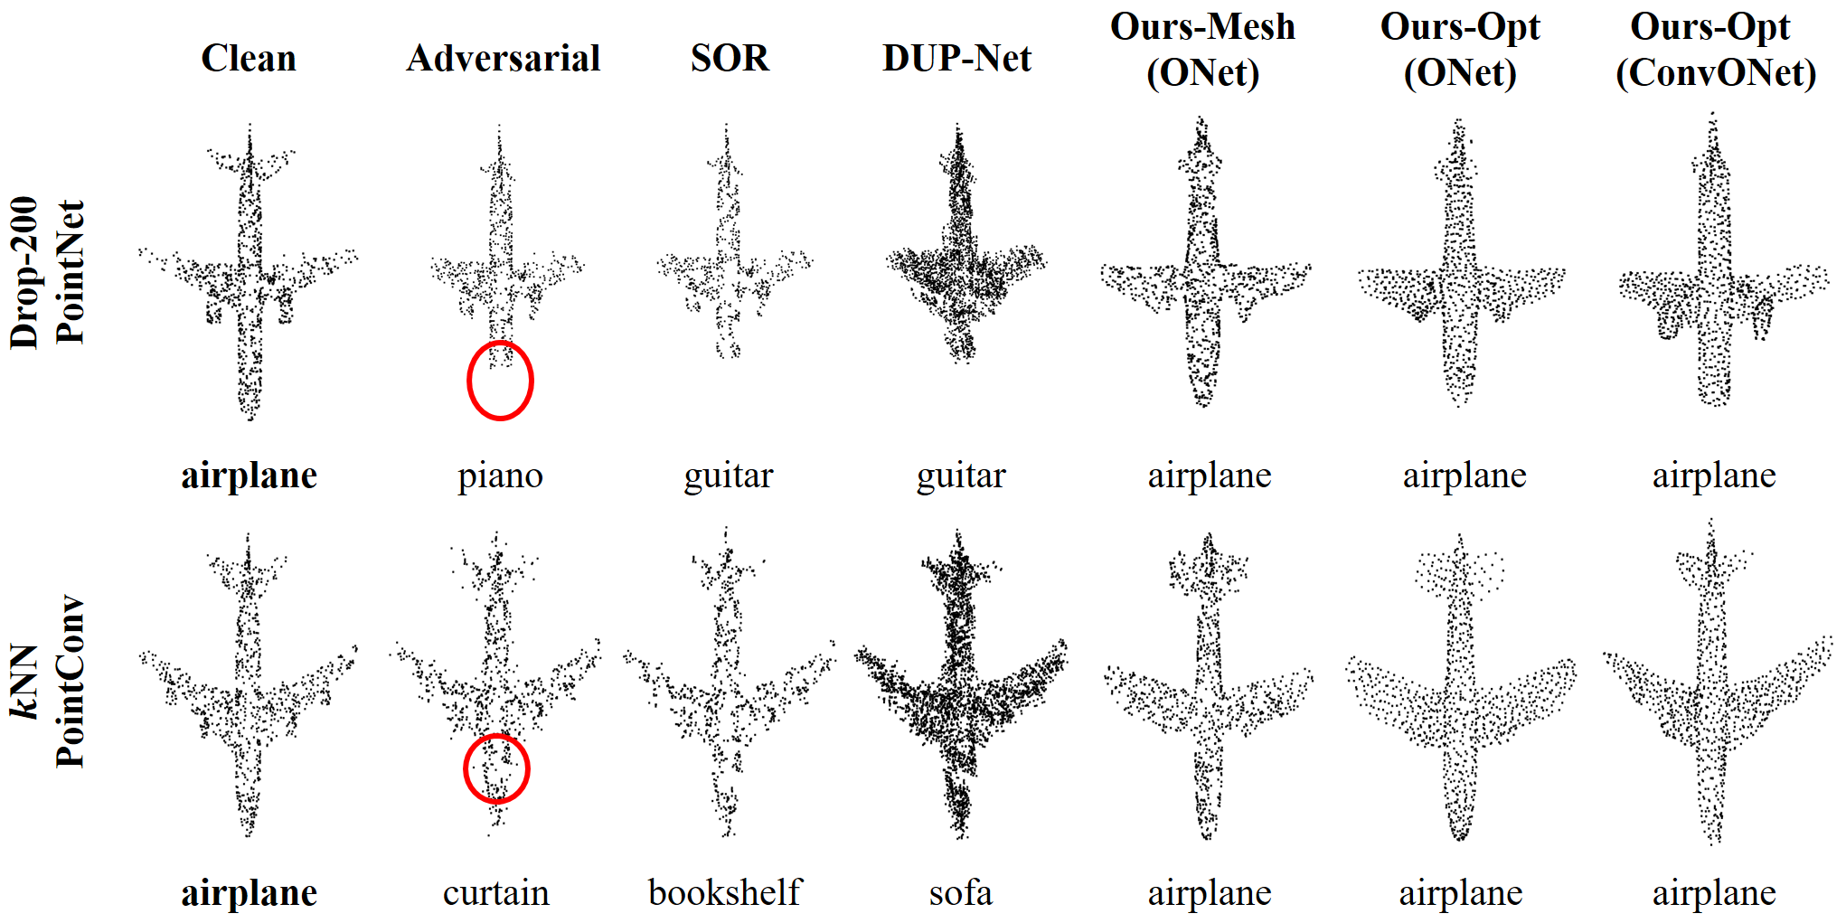
Qualitative Results
Notes:
And here are some qualitative results. Each row are results of one attack, each column is one defense method.
For point dropping attack, the head of the airplane is discarded, and all three variants of IF-Defense extend the front end trying to form a head.
For kNN attack, you can see that the SOR causes a hole here after removing outliers, and DUP-Net outputs a point cloud with messy distribution. In contrast, all three variants of our method retain clean shape and desired point distribution, thus being correctly classified by the model.

Slide 11
Summary
Comprehensive study of the effects of existing 3D adv attacks
Propose a general defense framework IF-Defense to address all attack effects
Introduce an optimization based method for point cloud restoration
Achieve SOTA defense performance against all 3D attacks on five typical point cloud networks
Notes:
It seems that I don’t have enough time for a summary. I will just put it here and thank you for listening! Are there any questions?

