Slide 1
House price- Prediction Model
Internship Batch-33
Created By : Rahul

Slide 2
Problem statement
A US-based housing company named Surprise Housing has decided to enter the Australian market. The company uses data analytics to purchase houses at a price below their actual values and flip them at a higher price.
The company is looking at prospective properties to buy houses to enter the market. It is required to build a model using Machine Learning in order to predict the actual value of the prospective properties and decide whether to invest in them or not
Model the price of houses with the available independent variables. This model will then be used by the management to understand how exactly the prices vary with the variables. They can accordingly manipulate the strategy of the firm and concentrate on areas that will yield high returns. Further, the model will be a good way for the management to understand the pricing dynamics of a new market.

Slide 3
EDA Steps and visualization
Imported libraries, loaded data and checked its shape. There were 1168 rows and 81 columns in total including label column.
Data types for all the dataset in checked and found one column which gives only unique type data to the dataset and has no impact to the outcome. Dropped those columns and all the data types are of int,float,object now.
Found missing values in the dataset, confirmed using heatmap. Missing values present in the dataset are corrected (mean,mode) and ensured count in all the columns are same.
Feature names were changed into categories and continuous for easy understanding and analyzing data.

Slide 4
EDA Steps and visualization
While checking for null values I found null values in most of the columns and I have used imputation method to replace those null values (mode for categorical column and mean for numerical columns).
In Id and Utilities column the unique counts were 1168 and 1 respectively, which means all the entries in Id column are unique and ID is the identity number given for perticular asset and all the entries in Utilities column were same so these two column will not help us in model building. So I decided to drop those columns.
Next as a part of feature extraction I converted all the year columns to there respective age. Thinking that age will help us more than year.
And all these steps were performed to both train and test datasets separately and simultaneously.

Slide 5
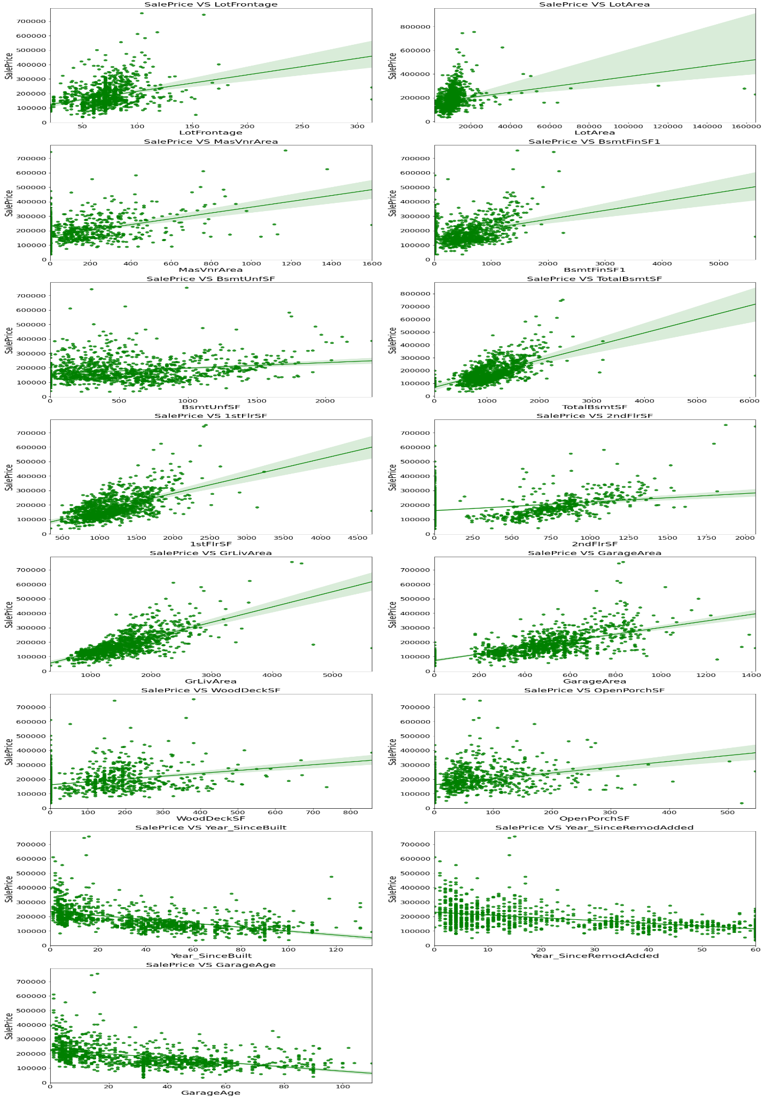
Visualization of numerical columns:

Slide 6
Observations:
As Linear feet of street connected to property(LotFrontage) is increasing sales is decreasing and the SalePrice is ranging between 0-3 lakhs.
As Lot size in square feet(LotArea) is increasing sales is decreasing and the SalePrice is in between 0-4 lakhs.
As Masonry veneer area in square feet (MasVnrArea) is increasing sales is decreasing and SalePrice is ranging between 0-4 lakhs.
As Type 1 finished square feet(BsmtFinSF1) is increasing sales is decreasing and the SalePrice is in between 0-4 lakhs.
As Unfinished square feet of basement area (BsmtUnfSF) is increasing sales is decreasing and the SalePrice is in between 0-4 lakhs. There are some outliers also.
As Total square feet of basement area (TotalBsmtSF) is increasing sales is decreasing and the SalePrice is in between 0-4 lakhs.
As First Floor square feet(1stFlrSF) is increasing sales is decreasing and the SalePrice is in between 0-4 lakhs.
As Second floor square feet(2ndFlrSF) is increasing sales is increasing in the range 500-1000 and the SalePrice is in between 0-4 lakhs.

Slide 7
Visualization of numerical columns:

Slide 8
Observations:
As Above grade (ground) living area square feet (GrLivArea) is increasing sales is decreasing and the SalePrice is in between 0-4 lakhs.
As Size of garage in square feet(GarageArea) is increasing sales is increasing and the SalePrice is in between 0-4 lakhs.
As Wood deck area in square feet(WoodDeckSF) is increasing sales is decreasing and the SalePrice is in between 0-4 lakhs.
As Open porch area in square feet (OpenPorchSF) is increasing sales is decreasing and the SalePrice is in between 0-4 lakhs.
As Year_SinceBuilt is increasing sales is decreasing and the SalePrice is high for newly built building and the sales price is in between 0-4 lakhs.
As Since Remodel date (same as construction date if no remodeling or additions)(Year_SinceRemodAdded) is increasing sales is decreasing and the SalePrice is in between 1-4 lakhs.
As Since Year garage was built(GarageAge) is increasing sales is decreasing and the SalePrice is in between 0-4 lakhs.

Slide 9
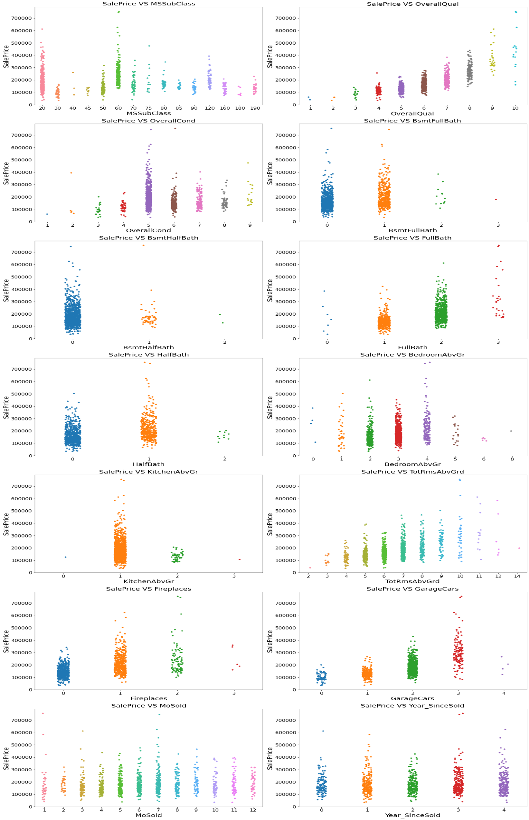
Visualization of numerical columns:

Slide 10
Observations:
For 1-STORY 1946 & NEWER ALL STYLES (20) and 2-STORY 1946 & NEWER (60) types of dwelling (MSSuubClass) the sales is good and SalePrice is also high.
As Rates the overall material and finish of the house (OverallQual) is increasing linearly sales is also increasing And SalePrice is also increasing linearly.
For 5(Average) overall condition of the house (OverallCond) the sales is high and SalePrice is also high.
For 0 and 1 Basement full bathrooms (BsmtFullBath) the sales as well as SalePrice is high.
For 0 Basement half bathrooms (BsmtHalfBath) the sales as well as SalePrice is high.
For 1 and 2 Full bathrooms above grade (FullBath) the sales as well as SalePrice is high.

Slide 11
Visualization of numerical columns:

Slide 12
Observations:
For 0 and 1 Half baths above grade (HalfBath) the sales as well as SalePrice is high.
For 2, 3 and 4 Bedrooms above grade (does NOT include basement bedrooms) (BedroomAbvGr) the sales as well as SalePrice is high.
For 1 Kitchens above grade (KitchenAbvGr) the sales as well as SalePrice is high.
For 4-9 Total rooms above grade (does not include bathrooms) (TotRmsAbvGrd) the sales as well as SalePrice is high.
For 0 and 1 Number of fireplaces (Fireplaces) the sales as well as SalePrice is high.
For 1 and 2 Size of garage in car capacity (GarageCars) the sales is high and for 3 Size of garage in car capacity (GarageCars) the SalePrice is high.
In between april to august for Month Sold (MoSold) the sales is good with SalePrice.
For all the Year_SinceSold the SalePrice and sales both are same.

Slide 13
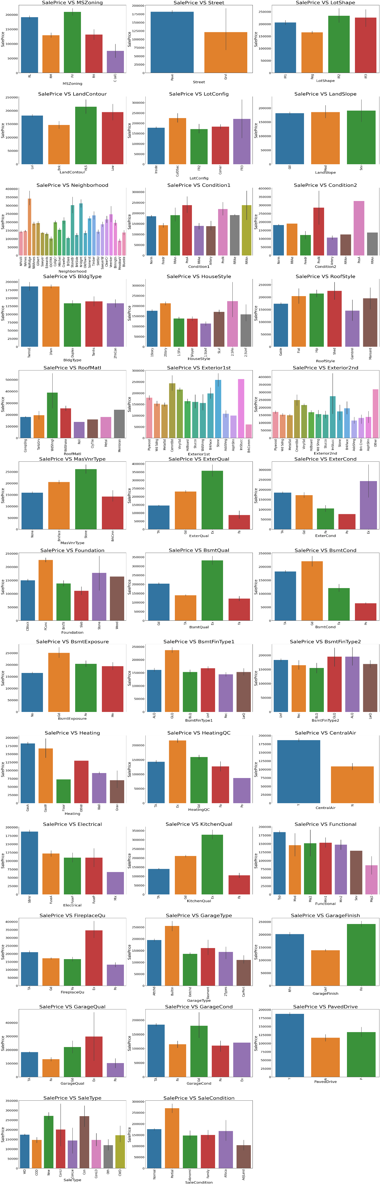
Vizualization of categorical columns:

Slide 14
Observations:
For Floating Village Residential (FV) and Residential Low Density(RL) zoning classification of the sale(MSZoning) the SalePrice is high.
For paved type of road access to property (Street) the SalePrice is high.
For Slightly irregular (IR1), Moderately Irregular (IR2) and Irregular (IR3) shape of property (LotShape) the SalePrice is high.
For Hillside - Significant slope from side to side (HLS) Flatness of the property (LandContour) the SalePrice is High.
For Cul-de-sac (CulDSac) Lot configuration (LotConfig) the SalePrice is High.
For all types of Slope of property (LandSlope) i.e., Gentle slope (Gtl), Moderate Slope (Mod) and Severe Slope (Sev) the SalePrice is High.
For Northridge (NoRidge) locations within Ames city limits (Neighborhood) the SalePrice is High.
For Within 200' of North-South Railroad (RRNn), Adjacent to postive off-site feature (PosA) and Near positive off-site feature--park, greenbelt, etc. (PosN) Proximity to various conditions(Condition1) has the maximum SalePrice.
For Adjacent to positive off-site feature (PosA) and Near positive off-site feature--park, greenbelt, etc.(PosN) Proximity to various conditions (if more than one is present) (Condition2) has maximum SalePrice.

Slide 15
Vizualization of categorical columns:

Slide 16
Observations:
For Single-family Detached(1Fam) and Townhouse End Unit (TwnhsE) type of dwelling (BldgType) the SalePrice is high.
For 2Story and Two and one-half story: 2nd level finished(2.5Fin) Style of dwelling (HouseStyle) the SalePrice is high.
For Shed Type of roof (RoofStyle) the SalePrice is high.
For Wood Shingles (WdShngl) Roof material (RoofMat1) the SalePrice is high.
For Cement Board (CemntBd), Imitation Stucco (ImStucc) and Stone type of Exterior covering on house(Exterior1st) the SalePrice is high.
For Cement Board (CemntBd), Imitation Stucco (ImStucc) and other Exterior covering on house (if more than one material) (Exterior2) has maximum SalePrice.
For Stone Masonry veneer type (MasvnrType) the SalePrice is high.
For Excellent (Ex) quality of the material on the exterior(ExterQual) the SalePrice is high.
For Excellent (Ex) present condition of the material on the exterior (ExterCond) the SalePrice is high.

Slide 17

Vizualization of categorical columns:

Slide 18
Observations:
For Poured Contrete (PConc) Type of foundation (Foundation) the SalePrice is high.
For Excellent (100+ inches) (Ex) height of the basement (BsmtQual) the SalePrice is high.
For Good (Gd) general condition of the basement (BsmtCond) the SalePrice is high.
For Good Exposure (Gd) of walkout or garden level walls (BsmtExposure) has maximum SalePrice.
For Good Living Quarters (GLQ) of basement finished area (BsmtFinType1) has maximum SalePrice.
For Good Living Quarters (GLQ) and Average Living Quarters (ALQ) of basement finished area (if multiple types) (BsmtFinType2) has maximum SalePrice.
For Gas forced warm air furnace (GasA) and Gas hot water or steam heat (GasW) Type of heating(Heating) has high SalePrice.
For Excellent (Ex) Heating quality and condition (HeatingQC) the SalePriceis high.
For building having Central air conditioning (CentralAir) the SalePrice is high.

Slide 19
Vizualization of categorical columns:

Slide 20
Observations:
For Standard Circuit Breakers & Romex (Sbrkr) of Electrical system (Electrical) the SalePrice is Maximum.
For Excellent (Ex) Kitchen quality (KitchenQual) the SalePrice is high.
For Typical Functionality (Typ) type of Home functionality (Assume typical unless deductions are warranted) (Functional) the SalePrice is high.
For Excellent - Exceptional Masonry Fireplace (Ex) of Fireplace quality (FireplaceQual) has highest SalePrice.
For Built-In (Garage part of house - typically has room above garage) (BuiltIn) Garage location (GarageType) the SalePrice is maximum.
For Completely finished (Fin) Interior of the garage (GarageFinish) the SalePrice is high.
For Excellent (Ex) Garage quality (GarageQual) the SalePrice is high.
For Typical/Average (TA) and Good (Gd) Garage condition (GarageCond) the SalePrice is high.
For having Paved driveway (PavedDrive) the SalePriceis high.

Slide 21
Observations:
For Home just constructed and sold (New) and Contract 15% Down payment regular terms (Con) of type of sale (SaleType) as highest SalePrice.
For Home was not completed when last assessed (associated with New Homes) (Partial) Condition of sale (SalesCondition) the SalePrice is maximum.

Slide 22
Analysis:
I have used box plot for each pair of categorical features that shows the relation with the median sale price for all the sub categories in each categorical feature.
And also for continuous numerical variables I have used reg plot to show the relationship between continuous numerical variable and target variable.
I found that there is a linear relationship between continuous numerical variable and SalePrice.

Slide 23
Data Cleaning Steps:
In my datasets I found null values, outliers and also skewness.
I have used imputation method to replace null values. To remove outliers I have used percentile method. And to remove skewness I have used yeo-johnson method.
To encode the categorical columns I have use Ordinal Encoding.
Use of Pearson’s correlation coefficient to check the correlation between dependent and independent features.
Also I have used standardization. Then followed by model building with all regression algorithms.

Slide 24
Model Building:
Since SalePrice was my target and it was a continuous column so this perticular problem was regression problem. And I have used all regression algorithms to build my model. By looking into the difference of r2 score and cross validation score I found ExtraTreesRegressor as a best model with least difference. Also to get the best model we have to run through multiple models and to avoid the confusion of overfitting we have go through cross validation. Below are the list of regression algorithms I have used in my project.
RandomForestRegressor
XGBRegressor
ExtraTreesRegressor
GradientBoostingRegressor
DecisionTreeRegressor

Slide 25
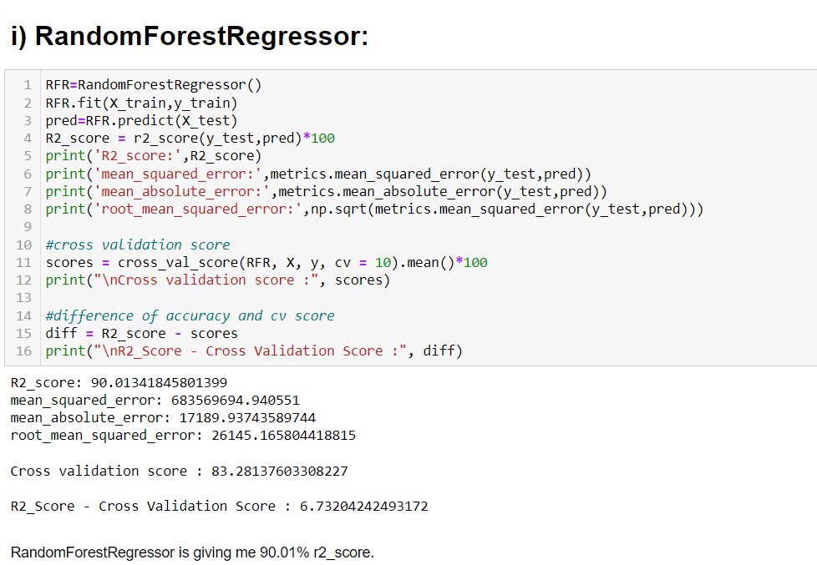
RandomForestRegressor has given me 90.01% accuracy

Slide 26
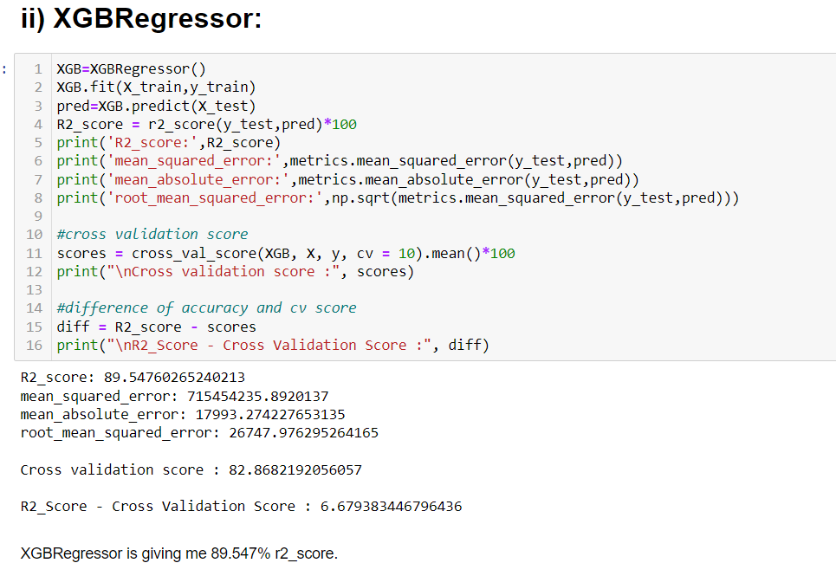
XGBRegressor is giving me 89.54% accuracy.

Slide 27
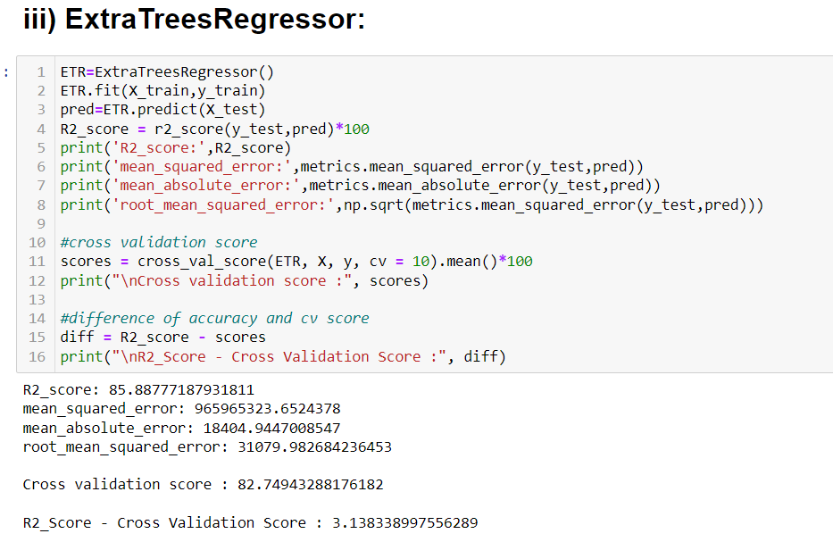
ExtraTreeRegressor is giving me 85.88% accuracy.

Slide 28
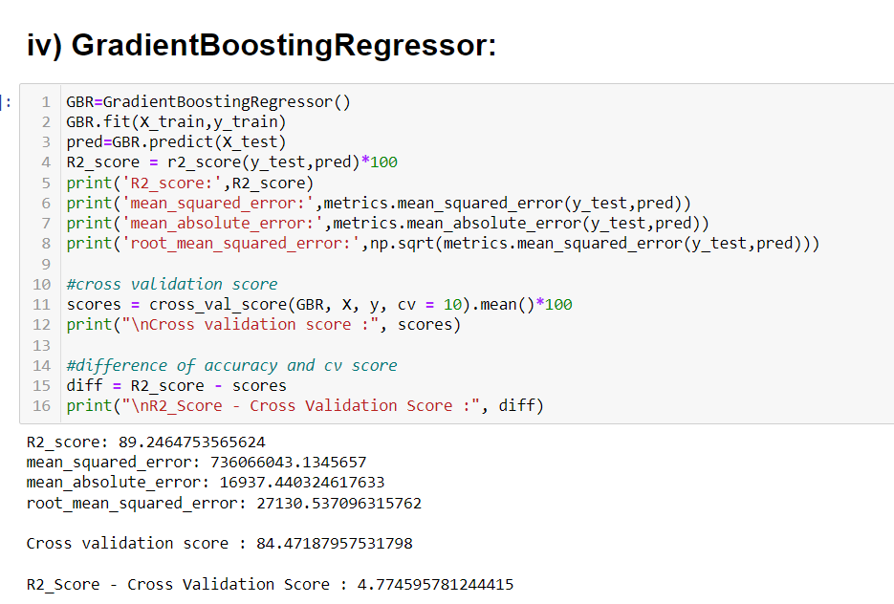
GradientBoostingRegressor is giving me 89.24% accuracy.

Slide 29
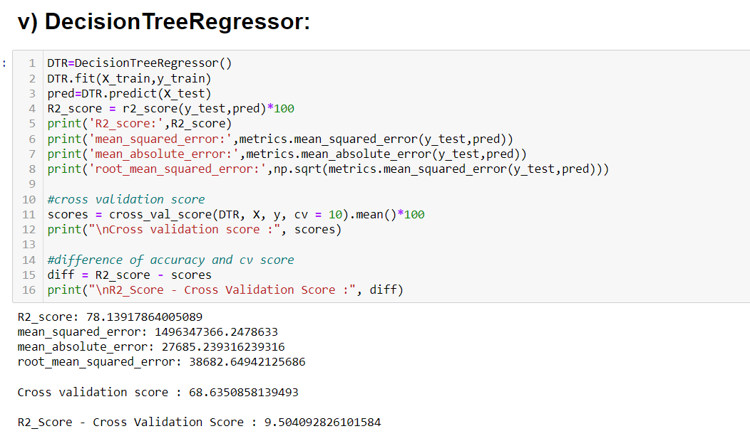
DecisionTreeRegressor is giving me 78.13 % accuracy.

Slide 30
Hyper Parameter Tunning:
I have choosed all parameters of ExtraTreesRegressor, after tunning the model with best parameters the accuracy is not increasing So selected the Model with out hypertuning as the final model.

Slide 31
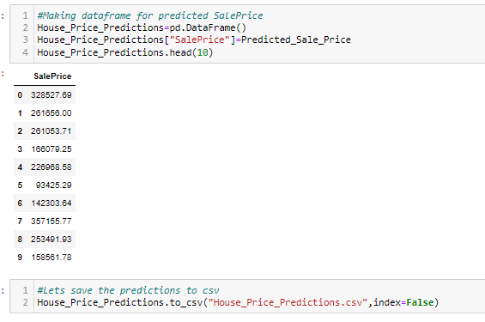
Saving the model and predictions using saved model:
I have saved my best model using .pkl as follows.
Now after saving the best model, loading my saved model and predicting the test values.

Slide 32
CONCLUSION
After Training and Testing five algorithm model. The best accuracy model was determined as random forest Regressor with almost 91% true accuracy after all the data cleaning, pre-processing, training and prediction as well as evaluation phase.

Slide 33
Thank you

