Slide 1
集合上
主讲人：任亮

Slide 2
今日内容
集合的体系
集合的常用方法
集合的遍历
List接口
ArrayList
Vector
LinkedList

Slide 3
数组回顾
需求：把一个你班级的学生存储起来，使用数组。
数组的长度是固定的，无法满足动态的数据添加。
面试题：数组和集合的区别？
数组：长度固定，
可以存储基本数据类型，也能存储对象
集合：长度可变
只能存储对象类型（由于有包装类的存在，集合可以存储任何类型）。
集合提供了丰富的API，让我们操作集合更简单，功能更强大。

Slide 4
集合体系
集合的体系结构
集合也叫容器用于存储对象。
我们根据不同的需求和不同的数据结构来对集合做了不同的抽象。
Collection
List
Set
ArrayList
LinkedList
Vector
HashSet
TreeSet
LinkedHashSet

Slide 5
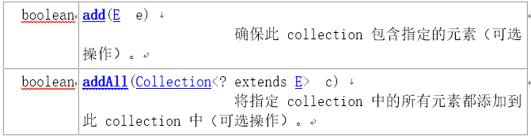
集合的方法
添加：
Notes:
package com.rl.coll;
import java.util.ArrayList;
import java.util.Collection;
public class CollectionDemo {
public static void main(String[] args) {
//创建ArrayList集合
Collection c = new ArrayList();
System.out.println(c);
c.add("renliang");
c.add("lisi");
c.add("zhangsan");
System.out.println(c);
Collection c1 = new ArrayList();
c1.add("wangwu");
c1.add("xueliu");
//把c这个集合的内容加在c1中，并且在后面追加
c1.addAll(c);
System.out.println(c1);
Collection c2 = new ArrayList();
//对于基本类型的添加自动做了装箱，所以其实添加的是Integer
c2.add(1);
c2.add(2);
//集合中可以存储不同类型的数据，但是在实际项目中都是存储同一类型的数据。
c2.add("renliang");
System.out.println(c2);
System.out.println("---------------------------------");
//c2.clear();
//System.out.println(c2);
c2.remove("renliang");
System.out.println(c2);
c1.removeAll(c);
System.out.println(c1);
}
}

Slide 6
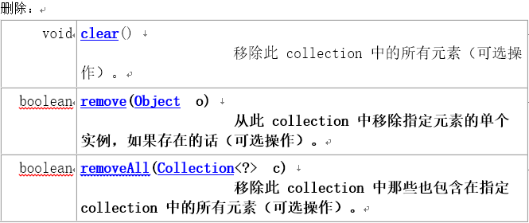
集合的方法

Slide 7
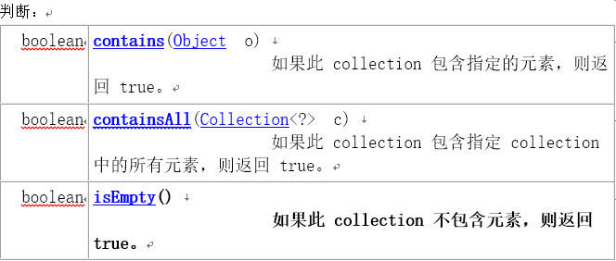
集合的方法
Notes:
package com.rl.coll;
import java.util.ArrayList;
import java.util.Collection;
public class CollectionDemo1 {
public static void main(String[] args) {
//创建ArrayList集合
Collection c = new ArrayList();
System.out.println(c);
c.add("renliang");
c.add("lisi");
c.add("zhangsan");
System.out.println(c);
Collection c1 = new ArrayList();
c1.add("wangwu");
c1.add("xueliu");
//把c这个集合的内容加在c1中，并且在后面追加
c1.addAll(c);
System.out.println(c1);
boolean isExist = c.contains("renliang");
System.out.println(isExist);
//c.add("aa");
//一个集合是否包含某个集合
boolean isExistColl = c1.containsAll(c);
System.out.println(isExistColl);
//c.clear();
//判断集合中是否有元素
boolean isEmpty = c.isEmpty();
System.out.println(isEmpty);
//把集合转换成数组
Object[] objArray = c.toArray();
for(int i = 0; i < objArray.length; i++){
System.out.println(objArray[i]);
}
}
}

Slide 8
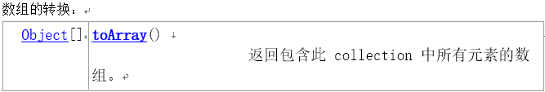
集合的方法

Slide 9
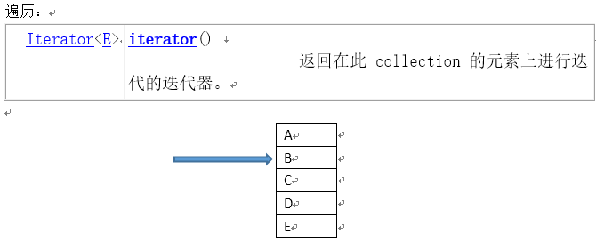
集合的遍历
Notes:
package com.rl.coll;
import java.util.ArrayList;
import java.util.Collection;
import java.util.Iterator;
public class CollectionDemo2 {
public static void main(String[] args) {
//创建ArrayList集合
Collection c = new ArrayList();
c.add("renliang");
c.add("lisi");
c.add("zhangsan");
//创建迭代器，迭代器是依赖于集合的，不能给别的集合使用
Iterator iter = c.iterator();
//判断是否有下一个元素
while(iter.hasNext()){
//区下一个元素
Object obj = iter.next();
System.out.println(obj);
}
//不能二次使用，迭代器的指针已经走到底部了
/*while(iter.hasNext()){
//区下一个元素
Object obj = iter.next();
System.out.println(obj);
}*/
}
}
package com.rl.coll;
import java.util.ArrayList;
import java.util.Collection;
import java.util.Iterator;
public class CollectionDemo3 {
public static void main(String[] args) {
//创建ArrayList集合
Collection c = new ArrayList();
Student s = new Student("林冲", 34);
Student s1 = new Student("武松", 30);
Student s2 = new Student("柴进", 40);
Student s3 = new Student("李逵", 28);
Student s4 = new Student("鲁智深", 30);
c.add(s);
c.add(s1);
c.add(s2);
c.add(s3);
c.add(s4);
Iterator it = c.iterator();
while(it.hasNext()){
//获得集合中一个元素
Object obj = it.next();
Student stu = (Student)obj;
System.out.println(stu);
/* 注意使用迭代器的时候一次取一个元素即可。
* java.util.NoSuchElementException
* Student stu1 = (Student)it.next();
System.out.println(stu1);*/
}
}
}

Slide 10
List
有序的 collection（也称为序列）。此接口的用户可以对列表中每个元素的插入位置进行精确地控制。用户可以根据元素的整数索引（在列表中的位置）访问元素，并搜索列表中的元素。
Notes:
package com.rl.coll;
import java.util.ArrayList;
import java.util.Collection;
import java.util.Iterator;
public class CollectionDemo2 {
public static void main(String[] args) {
//创建ArrayList集合
Collection c = new ArrayList();
c.add("renliang");
c.add("lisi");
c.add("zhangsan");
//创建迭代器，迭代器是依赖于集合的，不能给别的集合使用
Iterator iter = c.iterator();
//判断是否有下一个元素
while(iter.hasNext()){
//区下一个元素
Object obj = iter.next();
System.out.println(obj);
}
//不能二次使用，迭代器的指针已经走到底部了
/*while(iter.hasNext()){
//区下一个元素
Object obj = iter.next();
System.out.println(obj);
}*/
}
}

Slide 11
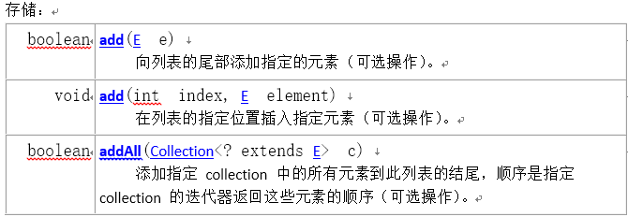
List
要掌握的方法
Notes:
package com.rl.list;
import java.util.ArrayList;
import java.util.List;
public class ListDemo {
public static void main(String[] args) {
//定义List的集合
List list = new ArrayList();
//添加
list.add("任亮");
list.add("吕布");
list.add("董卓");
System.out.println(list);
//[任亮, 吕布, 董卓]
// 0 1 2 List集合的索引号
//在指定的位置插入元素，后续的元素都向后顺移一位。
//在根据索引添加的时候，如果要添加的索引没有前一个值则不能添加,中间不允许有空位。
list.add(3, "貂蝉");
System.out.println(list);
//定义List的集合
List list1 = new ArrayList();
list1.add("王允");
//该方法继承与Collection
list1.addAll(list);
System.out.println(list1);
}
}

Slide 12
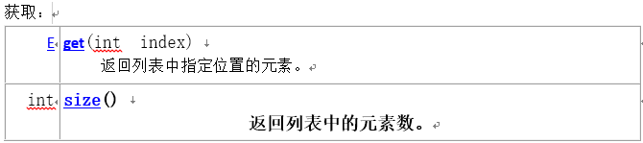
List
要掌握的方法
Notes:
package com.rl.list;
import java.util.ArrayList;
import java.util.List;
public class ListDemo1 {
public static void main(String[] args) {
//定义List的集合
List list = new ArrayList();
//添加
list.add("任亮");
list.add("吕布");
list.add("董卓");
System.out.println(list);
//[任亮, 吕布, 董卓]
// 0 1 2 List集合的索引号
//根据索引来获得list中的指定的元素
//注意java.lang.IndexOutOfBoundsException
Object obj = list.get(2);
String str = (String)obj;
System.out.println(str);
//获得list的元素的个数
Integer length = list.size();
System.out.println(length);
//使用for循环来遍历List
for(int i = 0; i < list.size(); i++){
String result = (String)list.get(i);
System.out.println(result);
}
}
}

Slide 13

List
要掌握的方法
Notes:
package com.rl.list;
import java.util.ArrayList;
import java.util.List;
public class ListDemo2 {
public static void main(String[] args) {
//定义List的集合
List list = new ArrayList();
//添加
list.add("任亮");
list.add("吕布");
list.add("董卓");
System.out.println(list);
//[任亮, 吕布, 董卓]
// 0 1 2 List集合的索引号
//根据索引删除list的元素,返回的结果是删除的元素
/*Object obj = list.remove(2);
System.out.println(obj);
System.out.println(list);
*/
/*boolean isDelete = list.remove("任亮");
System.out.println(isDelete);
System.out.println(list);*/
//定义List的集合
List list1 = new ArrayList();
//添加
list1.add("任亮");
list1.add("吕布");
//删除多个元素
list.removeAll(list1);
System.out.println(list);
//清空list
list.clear();
System.out.println(list);
}
}

Slide 14
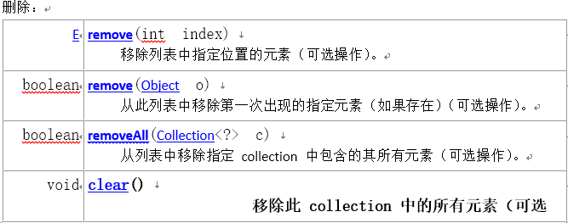
List
要掌握的方法
Notes:
package com.rl.list;
import java.util.ArrayList;
import java.util.List;
import java.util.ListIterator;
public class ListDemo3 {
public static void main(String[] args) {
//定义List的集合
List list = new ArrayList();
//添加
list.add("任亮");
list.add("吕布");
list.add("董卓");
//[任亮, 吕布, 董卓]
// 0 1 2 List集合的索引号
ListIterator iter = list.listIterator();
while(iter.hasNext()){
String result = (String) iter.next();
System.out.println(result);
}
System.out.println("------------------------");
//获得前一个元素
/*String str = (String) iter.previous();
Integer pIndex = iter.previousIndex();
System.out.println(str + " "+pIndex);
String str1 = (String) iter.previous();
Integer pIndex1 = iter.previousIndex();
System.out.println(str1 + " "+pIndex1);*/
while(iter.hasPrevious()){
String result = (String) iter.previous();
System.out.println(result);
}
}
}

Slide 15
ArrayList
List 接口的大小可变数组的实现。实现了所有可选列表操作，并允许包括 null 在内的所有元素。除了实现 List 接口外，此类还提供一些方法来操作内部用来存储列表的数组的大小。
特点：ArrayList中的元素和可以重复
是有序的集合，长度不固定。
不是线程安全的。
效率高。
Notes:
package com.rl.listson;
import java.util.ArrayList;
import java.util.Iterator;
import java.util.ListIterator;
public class ArrayListDemo {
public static void main(String[] args) {
//method1();
//curr();
currFor();
}
public static void method(){
ArrayList al = new ArrayList();
al.add("张三");
al.add("李四");
al.add("王五");
Iterator iter = al.iterator();
while(iter.hasNext()){
String result = (String) iter.next();
System.out.println(result);
}
}
public static void method1(){
ArrayList al = new ArrayList();
al.add(new Student("林冲",30));
al.add(new Student("鲁智深",32));
al.add(new Student("史文恭",35));
al.add(new Student("卢俊义",35));
Iterator iter = al.iterator();
while(iter.hasNext()){
Student result = (Student) iter.next();
System.out.println(result);
}
}
/**
* ListIterator当前的遍历不能输出变化后的集合
* @author renliang
*/
public static void curr(){
ArrayList al = new ArrayList();
al.add(new Student("林冲",30));
al.add(new Student("鲁智深",32));
al.add(new Student("史文恭",35));
al.add(new Student("卢俊义",35));
ListIterator iter = al.listIterator();
while(iter.hasNext()){
Student result = (Student) iter.next();
String stuName = result.getName();
if("史文恭".equals(stuName)){
iter.remove();
}
System.out.println(result);
}
System.out.println(al);
}
/**
* 在并发的时候for可以遍历变化后的集合
* @author renliang
*/
public static void currFor(){
ArrayList al = new ArrayList();
al.add(new Student("林冲",30));
al.add(new Student("鲁智深",32));
al.add(new Student("史文恭",35));
al.add(new Student("卢俊义",35));
for(int i = 0; i < al.size(); i++){
Student result = (Student) al.get(i);
String stuName = result.getName();
if("史文恭".equals(stuName)){
al.remove(i);
}
System.out.println(result);
}
}
}

Slide 16
LinkedList
List 接口的链接列表实现。实现所有可选的列表操作，并且允许所有元素（包括 null）。除了实现 List 接口外，LinkedList 类还为在列表的开头及结尾 get、remove 和 insert 元素提供了统一的命名方法。这些操作允许将链接列表用作堆栈、队列或双端队列。
不是线程安全的。
Notes:
package com.rl.listson;
import java.util.ArrayList;
import java.util.Iterator;
import java.util.ListIterator;
public class ArrayListDemo {
public static void main(String[] args) {
//method1();
//curr();
currFor();
}
public static void method(){
ArrayList al = new ArrayList();
al.add("张三");
al.add("李四");
al.add("王五");
Iterator iter = al.iterator();
while(iter.hasNext()){
String result = (String) iter.next();
System.out.println(result);
}
}
public static void method1(){
ArrayList al = new ArrayList();
al.add(new Student("林冲",30));
al.add(new Student("鲁智深",32));
al.add(new Student("史文恭",35));
al.add(new Student("卢俊义",35));
Iterator iter = al.iterator();
while(iter.hasNext()){
Student result = (Student) iter.next();
System.out.println(result);
}
}
/**
* ListIterator当前的遍历不能输出变化后的集合
* @author renliang
*/
public static void curr(){
ArrayList al = new ArrayList();
al.add(new Student("林冲",30));
al.add(new Student("鲁智深",32));
al.add(new Student("史文恭",35));
al.add(new Student("卢俊义",35));
ListIterator iter = al.listIterator();
while(iter.hasNext()){
Student result = (Student) iter.next();
String stuName = result.getName();
if("史文恭".equals(stuName)){
iter.remove();
}
System.out.println(result);
}
System.out.println(al);
}
/**
* 在并发的时候for可以遍历变化后的集合
* @author renliang
*/
public static void currFor(){
ArrayList al = new ArrayList();
al.add(new Student("林冲",30));
al.add(new Student("鲁智深",32));
al.add(new Student("史文恭",35));
al.add(new Student("卢俊义",35));
for(int i = 0; i < al.size(); i++){
Student result = (Student) al.get(i);
String stuName = result.getName();
if("史文恭".equals(stuName)){
al.remove(i);
}
System.out.println(result);
}
}
}

Slide 17
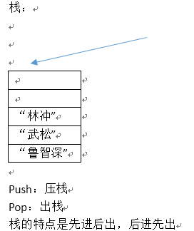
LinkedList
Notes:
package com.rl.listson;
import java.util.ArrayList;
import java.util.Iterator;
import java.util.ListIterator;
public class ArrayListDemo {
public static void main(String[] args) {
//method1();
//curr();
currFor();
}
public static void method(){
ArrayList al = new ArrayList();
al.add("张三");
al.add("李四");
al.add("王五");
Iterator iter = al.iterator();
while(iter.hasNext()){
String result = (String) iter.next();
System.out.println(result);
}
}
public static void method1(){
ArrayList al = new ArrayList();
al.add(new Student("林冲",30));
al.add(new Student("鲁智深",32));
al.add(new Student("史文恭",35));
al.add(new Student("卢俊义",35));
Iterator iter = al.iterator();
while(iter.hasNext()){
Student result = (Student) iter.next();
System.out.println(result);
}
}
/**
* ListIterator当前的遍历不能输出变化后的集合
* @author renliang
*/
public static void curr(){
ArrayList al = new ArrayList();
al.add(new Student("林冲",30));
al.add(new Student("鲁智深",32));
al.add(new Student("史文恭",35));
al.add(new Student("卢俊义",35));
ListIterator iter = al.listIterator();
while(iter.hasNext()){
Student result = (Student) iter.next();
String stuName = result.getName();
if("史文恭".equals(stuName)){
iter.remove();
}
System.out.println(result);
}
System.out.println(al);
}
/**
* 在并发的时候for可以遍历变化后的集合
* @author renliang
*/
public static void currFor(){
ArrayList al = new ArrayList();
al.add(new Student("林冲",30));
al.add(new Student("鲁智深",32));
al.add(new Student("史文恭",35));
al.add(new Student("卢俊义",35));
for(int i = 0; i < al.size(); i++){
Student result = (Student) al.get(i);
String stuName = result.getName();
if("史文恭".equals(stuName)){
al.remove(i);
}
System.out.println(result);
}
}
}

Slide 18
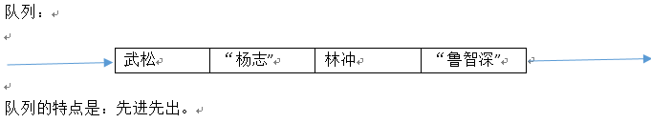
LinkedList
Notes:
package com.rl.listson;
import java.util.ArrayList;
import java.util.Iterator;
import java.util.ListIterator;
public class ArrayListDemo {
public static void main(String[] args) {
//method1();
//curr();
currFor();
}
public static void method(){
ArrayList al = new ArrayList();
al.add("张三");
al.add("李四");
al.add("王五");
Iterator iter = al.iterator();
while(iter.hasNext()){
String result = (String) iter.next();
System.out.println(result);
}
}
public static void method1(){
ArrayList al = new ArrayList();
al.add(new Student("林冲",30));
al.add(new Student("鲁智深",32));
al.add(new Student("史文恭",35));
al.add(new Student("卢俊义",35));
Iterator iter = al.iterator();
while(iter.hasNext()){
Student result = (Student) iter.next();
System.out.println(result);
}
}
/**
* ListIterator当前的遍历不能输出变化后的集合
* @author renliang
*/
public static void curr(){
ArrayList al = new ArrayList();
al.add(new Student("林冲",30));
al.add(new Student("鲁智深",32));
al.add(new Student("史文恭",35));
al.add(new Student("卢俊义",35));
ListIterator iter = al.listIterator();
while(iter.hasNext()){
Student result = (Student) iter.next();
String stuName = result.getName();
if("史文恭".equals(stuName)){
iter.remove();
}
System.out.println(result);
}
System.out.println(al);
}
/**
* 在并发的时候for可以遍历变化后的集合
* @author renliang
*/
public static void currFor(){
ArrayList al = new ArrayList();
al.add(new Student("林冲",30));
al.add(new Student("鲁智深",32));
al.add(new Student("史文恭",35));
al.add(new Student("卢俊义",35));
for(int i = 0; i < al.size(); i++){
Student result = (Student) al.get(i);
String stuName = result.getName();
if("史文恭".equals(stuName)){
al.remove(i);
}
System.out.println(result);
}
}
}

Slide 19
LinkedList
Notes:
package com.rl.listson;
import java.util.ArrayList;
import java.util.Iterator;
import java.util.ListIterator;
public class ArrayListDemo {
public static void main(String[] args) {
//method1();
//curr();
currFor();
}
public static void method(){
ArrayList al = new ArrayList();
al.add("张三");
al.add("李四");
al.add("王五");
Iterator iter = al.iterator();
while(iter.hasNext()){
String result = (String) iter.next();
System.out.println(result);
}
}
public static void method1(){
ArrayList al = new ArrayList();
al.add(new Student("林冲",30));
al.add(new Student("鲁智深",32));
al.add(new Student("史文恭",35));
al.add(new Student("卢俊义",35));
Iterator iter = al.iterator();
while(iter.hasNext()){
Student result = (Student) iter.next();
System.out.println(result);
}
}
/**
* ListIterator当前的遍历不能输出变化后的集合
* @author renliang
*/
public static void curr(){
ArrayList al = new ArrayList();
al.add(new Student("林冲",30));
al.add(new Student("鲁智深",32));
al.add(new Student("史文恭",35));
al.add(new Student("卢俊义",35));
ListIterator iter = al.listIterator();
while(iter.hasNext()){
Student result = (Student) iter.next();
String stuName = result.getName();
if("史文恭".equals(stuName)){
iter.remove();
}
System.out.println(result);
}
System.out.println(al);
}
/**
* 在并发的时候for可以遍历变化后的集合
* @author renliang
*/
public static void currFor(){
ArrayList al = new ArrayList();
al.add(new Student("林冲",30));
al.add(new Student("鲁智深",32));
al.add(new Student("史文恭",35));
al.add(new Student("卢俊义",35));
for(int i = 0; i < al.size(); i++){
Student result = (Student) al.get(i);
String stuName = result.getName();
if("史文恭".equals(stuName)){
al.remove(i);
}
System.out.println(result);
}
}
}

Slide 20

LinkedList
Notes:
package com.rl.listson;
import java.util.ArrayList;
import java.util.Iterator;
import java.util.ListIterator;
public class ArrayListDemo {
public static void main(String[] args) {
//method1();
//curr();
currFor();
}
public static void method(){
ArrayList al = new ArrayList();
al.add("张三");
al.add("李四");
al.add("王五");
Iterator iter = al.iterator();
while(iter.hasNext()){
String result = (String) iter.next();
System.out.println(result);
}
}
public static void method1(){
ArrayList al = new ArrayList();
al.add(new Student("林冲",30));
al.add(new Student("鲁智深",32));
al.add(new Student("史文恭",35));
al.add(new Student("卢俊义",35));
Iterator iter = al.iterator();
while(iter.hasNext()){
Student result = (Student) iter.next();
System.out.println(result);
}
}
/**
* ListIterator当前的遍历不能输出变化后的集合
* @author renliang
*/
public static void curr(){
ArrayList al = new ArrayList();
al.add(new Student("林冲",30));
al.add(new Student("鲁智深",32));
al.add(new Student("史文恭",35));
al.add(new Student("卢俊义",35));
ListIterator iter = al.listIterator();
while(iter.hasNext()){
Student result = (Student) iter.next();
String stuName = result.getName();
if("史文恭".equals(stuName)){
iter.remove();
}
System.out.println(result);
}
System.out.println(al);
}
/**
* 在并发的时候for可以遍历变化后的集合
* @author renliang
*/
public static void currFor(){
ArrayList al = new ArrayList();
al.add(new Student("林冲",30));
al.add(new Student("鲁智深",32));
al.add(new Student("史文恭",35));
al.add(new Student("卢俊义",35));
for(int i = 0; i < al.size(); i++){
Student result = (Student) al.get(i);
String stuName = result.getName();
if("史文恭".equals(stuName)){
al.remove(i);
}
System.out.println(result);
}
}
}

Slide 21
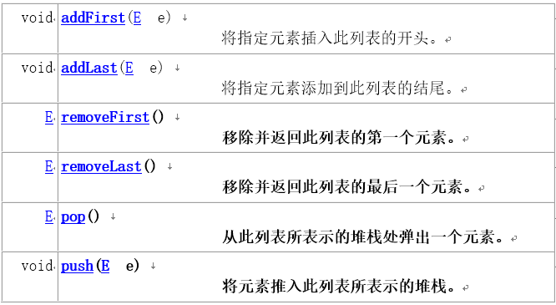
LinkedList
Notes:
package com.rl.listson;
import java.util.ArrayList;
import java.util.Iterator;
import java.util.ListIterator;
public class ArrayListDemo {
public static void main(String[] args) {
//method1();
//curr();
currFor();
}
public static void method(){
ArrayList al = new ArrayList();
al.add("张三");
al.add("李四");
al.add("王五");
Iterator iter = al.iterator();
while(iter.hasNext()){
String result = (String) iter.next();
System.out.println(result);
}
}
public static void method1(){
ArrayList al = new ArrayList();
al.add(new Student("林冲",30));
al.add(new Student("鲁智深",32));
al.add(new Student("史文恭",35));
al.add(new Student("卢俊义",35));
Iterator iter = al.iterator();
while(iter.hasNext()){
Student result = (Student) iter.next();
System.out.println(result);
}
}
/**
* ListIterator当前的遍历不能输出变化后的集合
* @author renliang
*/
public static void curr(){
ArrayList al = new ArrayList();
al.add(new Student("林冲",30));
al.add(new Student("鲁智深",32));
al.add(new Student("史文恭",35));
al.add(new Student("卢俊义",35));
ListIterator iter = al.listIterator();
while(iter.hasNext()){
Student result = (Student) iter.next();
String stuName = result.getName();
if("史文恭".equals(stuName)){
iter.remove();
}
System.out.println(result);
}
System.out.println(al);
}
/**
* 在并发的时候for可以遍历变化后的集合
* @author renliang
*/
public static void currFor(){
ArrayList al = new ArrayList();
al.add(new Student("林冲",30));
al.add(new Student("鲁智深",32));
al.add(new Student("史文恭",35));
al.add(new Student("卢俊义",35));
for(int i = 0; i < al.size(); i++){
Student result = (Student) al.get(i);
String stuName = result.getName();
if("史文恭".equals(stuName)){
al.remove(i);
}
System.out.println(result);
}
}
}

Slide 22
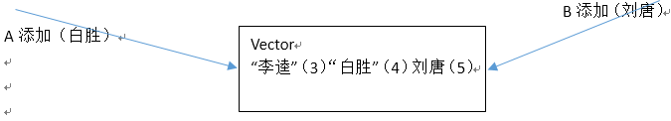
Vector
和ArrayList功能类似，最主要的区别就在于vector是线程并发安全的。但是缺点是效率比较低。
Notes:
package com.rl.listson;
import java.util.ArrayList;
import java.util.Iterator;
import java.util.ListIterator;
public class ArrayListDemo {
public static void main(String[] args) {
//method1();
//curr();
currFor();
}
public static void method(){
ArrayList al = new ArrayList();
al.add("张三");
al.add("李四");
al.add("王五");
Iterator iter = al.iterator();
while(iter.hasNext()){
String result = (String) iter.next();
System.out.println(result);
}
}
public static void method1(){
ArrayList al = new ArrayList();
al.add(new Student("林冲",30));
al.add(new Student("鲁智深",32));
al.add(new Student("史文恭",35));
al.add(new Student("卢俊义",35));
Iterator iter = al.iterator();
while(iter.hasNext()){
Student result = (Student) iter.next();
System.out.println(result);
}
}
/**
* ListIterator当前的遍历不能输出变化后的集合
* @author renliang
*/
public static void curr(){
ArrayList al = new ArrayList();
al.add(new Student("林冲",30));
al.add(new Student("鲁智深",32));
al.add(new Student("史文恭",35));
al.add(new Student("卢俊义",35));
ListIterator iter = al.listIterator();
while(iter.hasNext()){
Student result = (Student) iter.next();
String stuName = result.getName();
if("史文恭".equals(stuName)){
iter.remove();
}
System.out.println(result);
}
System.out.println(al);
}
/**
* 在并发的时候for可以遍历变化后的集合
* @author renliang
*/
public static void currFor(){
ArrayList al = new ArrayList();
al.add(new Student("林冲",30));
al.add(new Student("鲁智深",32));
al.add(new Student("史文恭",35));
al.add(new Student("卢俊义",35));
for(int i = 0; i < al.size(); i++){
Student result = (Student) al.get(i);
String stuName = result.getName();
if("史文恭".equals(stuName)){
al.remove(i);
}
System.out.println(result);
}
}
}

