Slide 1



Web Designer || UI Developer
SYLLABUS
DURATION – 3 . 5 MONTHS
MODE OF TRAINING – OFFLINE/ONLINE ()
ASSOCIATE WITH
For More Info Call :+91 – 9623922545

Slide 2




HTML -
Introduction to HTML
HTML Tags and Elements
HTML –Attributes
HTML -Formatting
HTML –Phrase Tags
HTML - Metatags
HTML –Comments
Image tags
HTMLTables
HTML –Lists
HTML -Iframes
HTML –Blocks
HTML –Backgrounds
HTML -Colors,Fonts
HTML -Forms

Slide 3
HTML 5 -
Introduction to HTML
HTML Tags and Elements
HTML –Attributes
HTML -Formatting
HTML –Phrase Tags
HTML - Metatags
HTML –Comments
Image tags
HTMLTables
HTML –Lists
HTML -Iframes
HTML –Blocks
HTML –Backgrounds
HTML -Colors,Fonts
HTML -Forms

Slide 4


CSS -
Introduction with CSS
The STYLE Element
Measurement Units
Colors,Backgrounds
Fonts,texts,images
Tables
Borders
Margins
Paddings

Slide 5
CSS 3 -
Introduction with CSS3
Rounded Corners
Border Image
Shadow
2dTransforms
3dTransforms
Animation
User Interface

Slide 6

Bootstrap is a powerful and popular mobile first front-end framework for building responsive mobile first sites on the web by using HTML, CSS and JS framework.
BOOTSTRAP -
Bootstrap is a free front-end framework for faster and easier web development.
Bootstrap includes HTML and CSS based design templates for typography, forms, buttons, tables, navigation, modals, image carousels and many other, as well as optional JavaScript plugins
Bootstrap also gives you the ability to easily create responsive designs

Slide 7
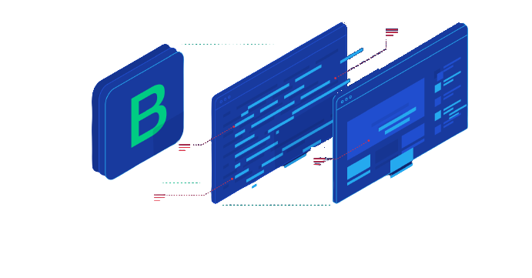
BOOTSTRAP 4
What We Learn In BOOTSTRAP 4 --
Installation Of Bootstrap 4
Bootstrap Forms
Bootstrap Containers
Bootstrap Colors
Bootstrap Buttons
Bootstrap Cards
Bootstrap Dropdowns
Bootstrap Navbar
Bootstrap Carousel
Bootstrap Components
Bootstrap Grid System
Responsive

Slide 8


Java Script --
JAVASCRIPT - VARIABLES
JavaScript - Operators
JavaScript -if. Else Statement
JavaScript –Switch Case
While, For And For. In Loops
JAVASCRIPT - OBJECTS
Number Object, Boolean
Strings Object And Arrays Object
Date Object And RegExpObject
Math Object
JavaScript -Document Object Model or DOM

Slide 9
Advance Java Script --
JavaScript -Errors & Exceptions Handling
JavaScript –Form Validation
JavaScript -Animation
JavaScript –Multimedia
JavaScript –Debugging
JavaScript –Image Map
JavaScript -Browsers Compatibility

Slide 10


JQuery --
Overview
Environment Setup
Using Your AdSense accountinterface
Draggable
Draggable
Resizable
Selectable
Accordion
Datepicker
Progress bar
Slider

Slide 11

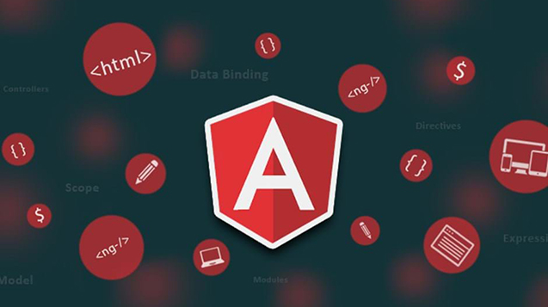
Angular JS --
Introduction to Angular JS
Directives
Modules
Data Binding
Scopes
Services
Events / Forms
Validation
Routing
Session /Cookies / Local
Storage
Folder Structure

Slide 12
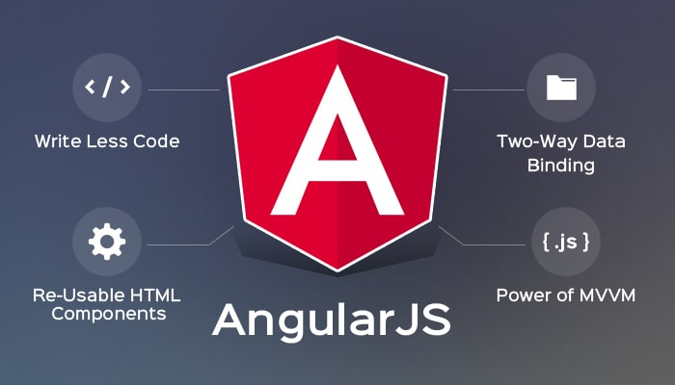
8
what we learn in Angular 8 --
Introduction to Angular 8
Development Setup of Angular
Introduction to TypeScript and ES6
Components in Angular
Data and Event Binding
Structural Directives
Template Driven Forms
Reactive Forms
Angular Modules
Services and Dependency Injection
HTTP Client

Slide 13


Key Feature
• Trainer with 12+ Years of Experience
• 200 hours of high-quality course
• Best Quality Training
• Live Project Experience
• Demo Lectures are available
• In-depth Course Contents
• Placement Support | Internship support

Slide 14

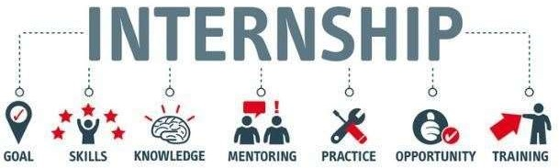







Slide 15




THANK YOU
408 4th Floor, Rajdhani Complex, Near Shankar Maharaj Math, Pune - Satara Road, Balajinagar, Pune 9975708774/9623922545
website - http://orangeitech.in http://empiretechs.in

