Slide 1

Computer Science
Department
Automobile Service Centre
System
(AutoRepair.com)
Mentor Name:
Ms. Deepa Basantani
Group Members:
Anchal Gupta
Ayushi Gupta
Divya Singh
Akansha Dhanker

Slide 2

INTRODUCTION:
The AutoRepair.com is intended to provide complete solutions for Automobile Repairing and Servicing for all type of Automobiles through an online Platform to bring the Local Automobile Service Providers and the Customers on one common platform. It will enable Customers to search for local as well as branded Service Providers, Customers to browse online and search for the various provided Services and book the service accordingly. The purpose of this document is to present a detailed description of the AutoRepair.com System. It will explain the purpose and features of the system, the interfaces of the system, what the system will do, the constraints under which it must operate and how the system will react to external stimuli.
Logo Of AutoRepair.com

Slide 3
PRODUCT FEATURES:
It is easy to use the product with all the information provided in the form of links.
The Service Providers and the Customers can access the portal with simple registration.
The product enables the Customers to choose which Service they want.
Customer can access all the Service provided by the Service Providers by paying some monetary value.
Customers can check the status of their automobiles time to time from there date of placing the order to the date of delivery on a regular basis.
Customers can discuss their problems with Service Providers via e-mail and Contact Number.
USER CLASSSES USED:
Automobile Owner/user
Service Provider/Mechanic
Customer Support

Slide 4

OPERATING ENVIRONMENT:
Programming Languages:
Tools And Development ENVIRONMENT
Eclipse IDE
Apache-Tomcat 9.0.22 Server
MySQL
JAVA
HTML
BOOTSTRAP
CSS
JAVASCRIPT

Slide 5
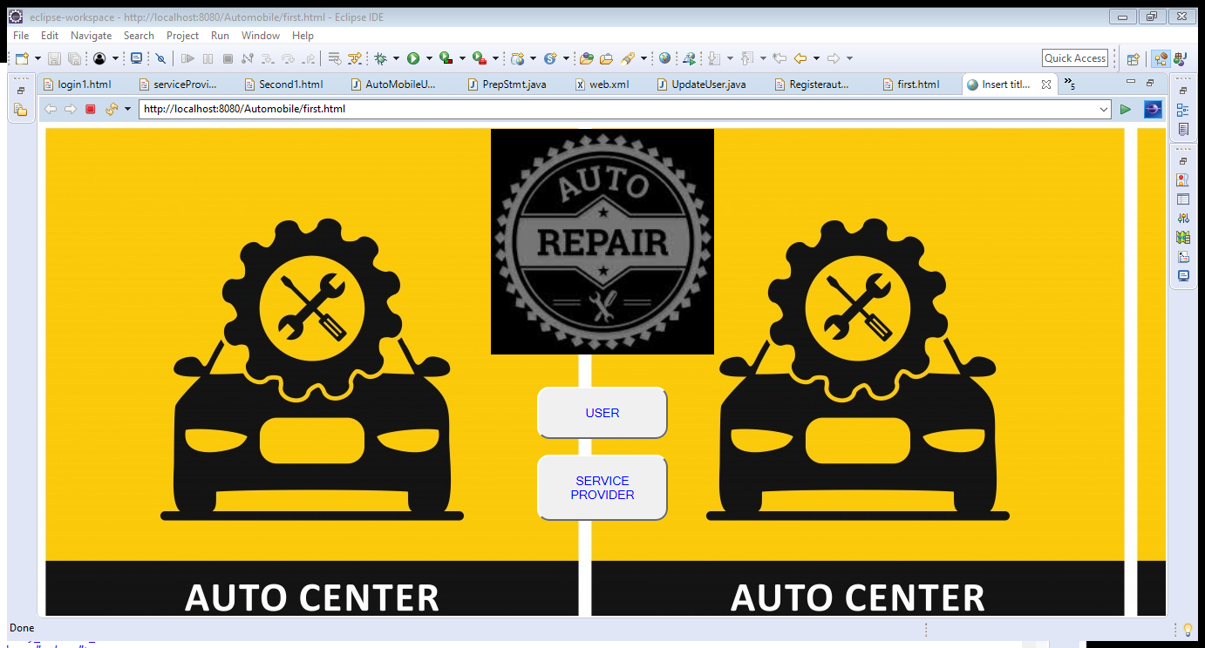
HOME PAGE:

Slide 6
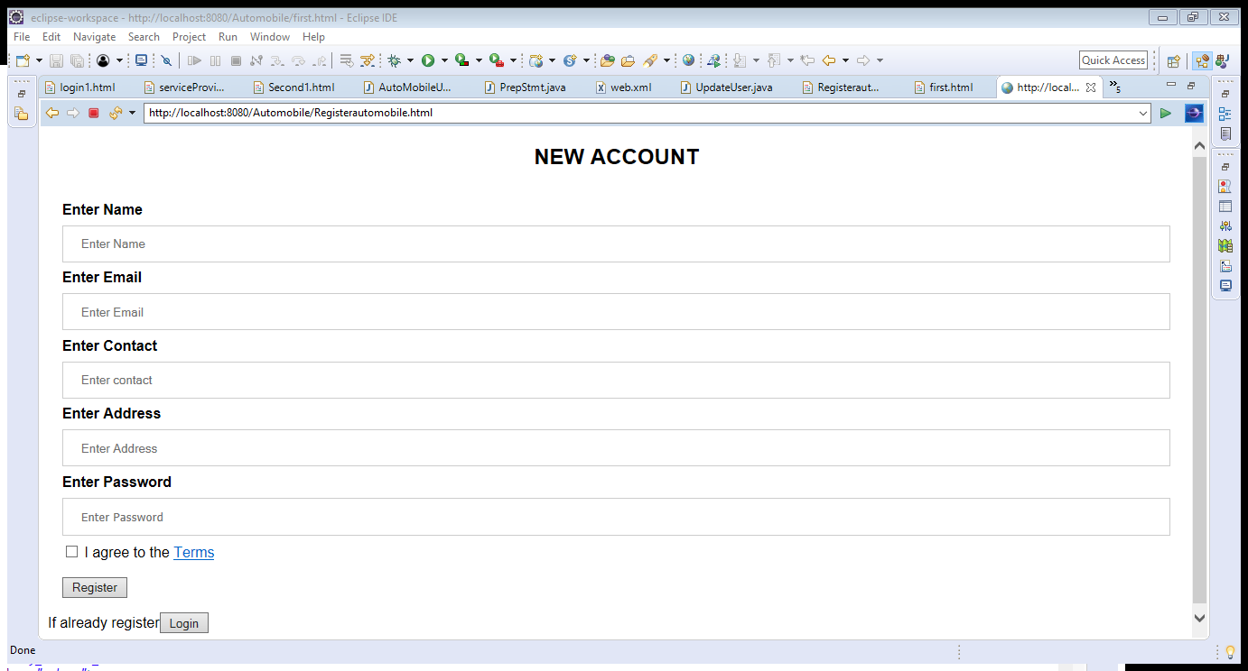
REGISTRATION PAGE:

Slide 7
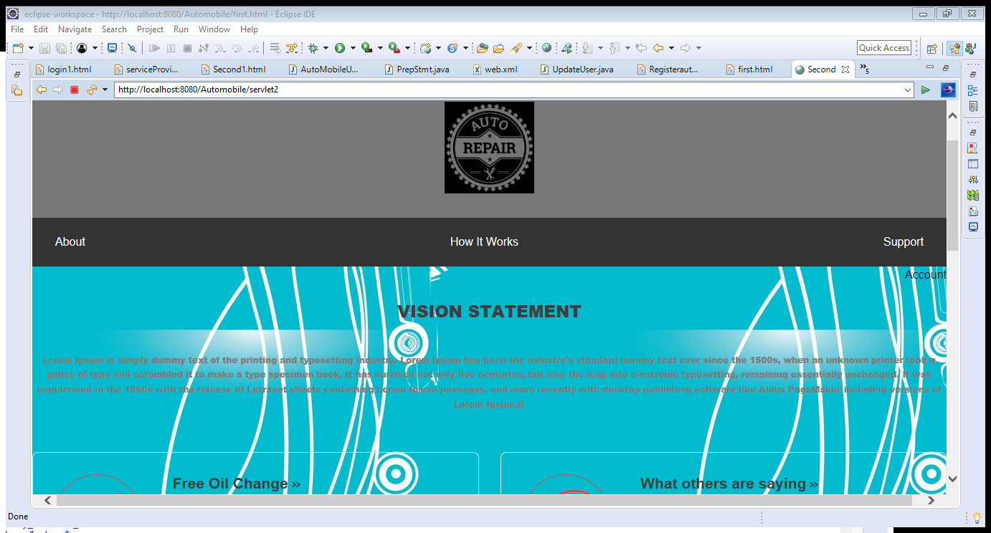
ABOUT PAGE:

Slide 8
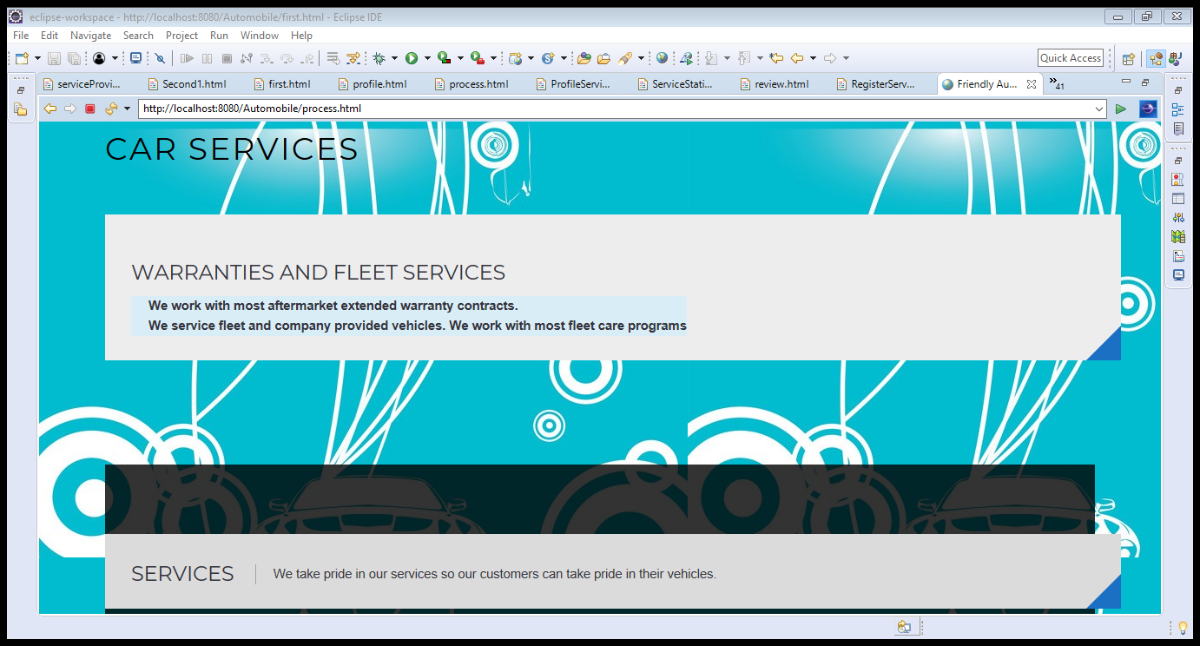
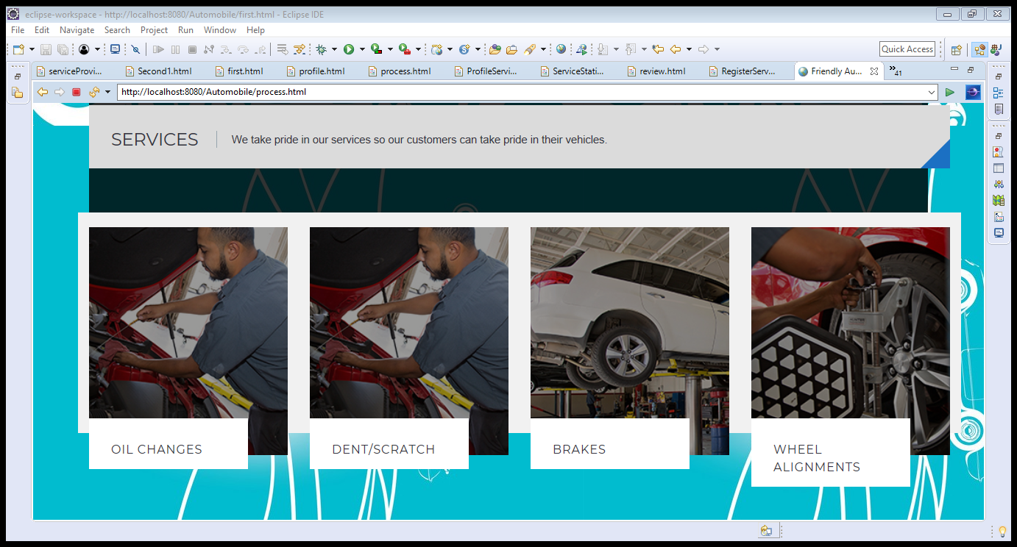
DESCRIPTION PAGE

Slide 9
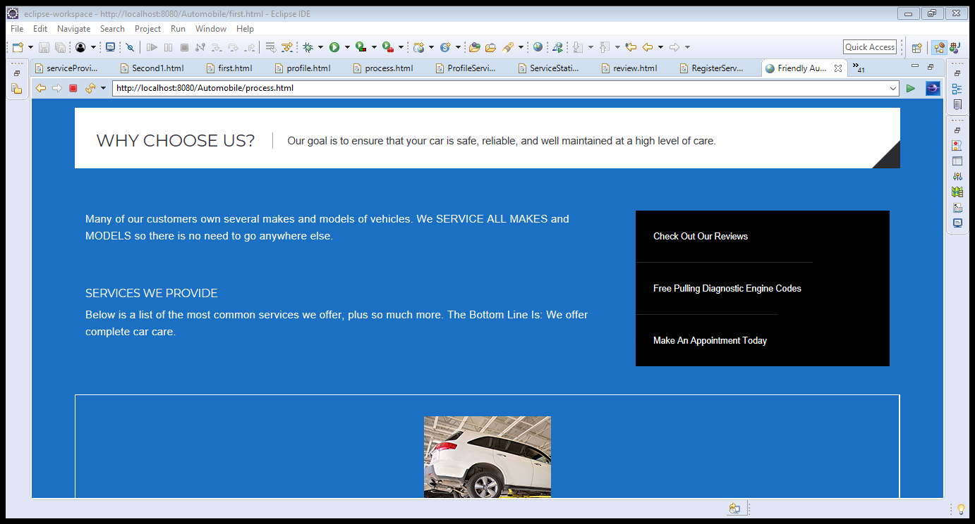
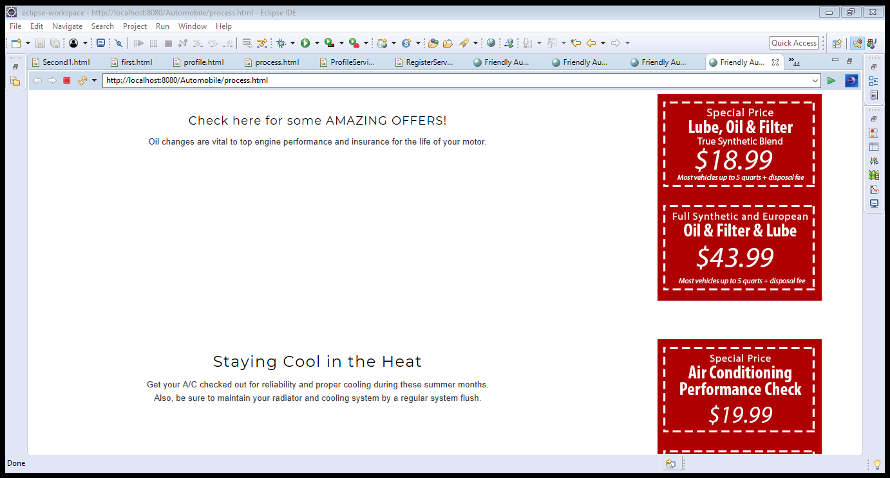
SPECIAL OFFERS

Slide 10
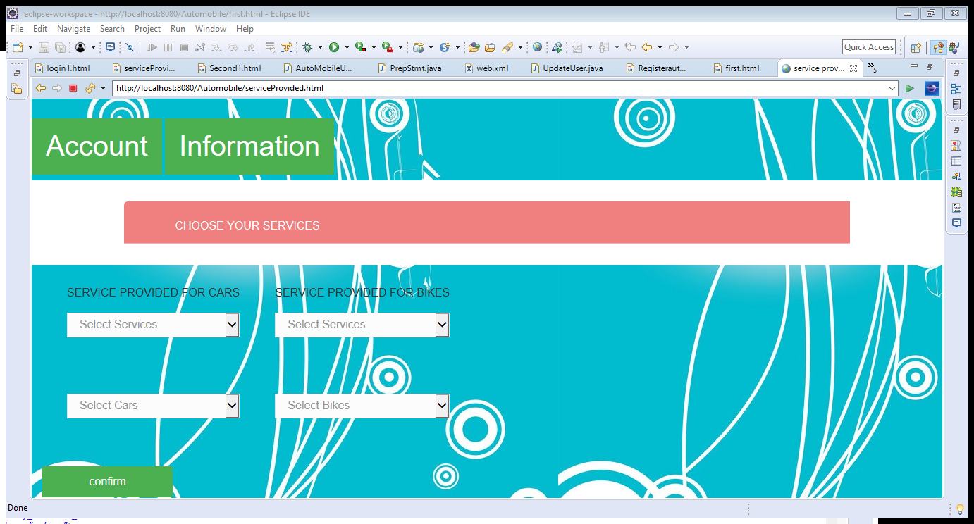
INFORMATION AND SELECTION PAGE OF SERVICES

Slide 11
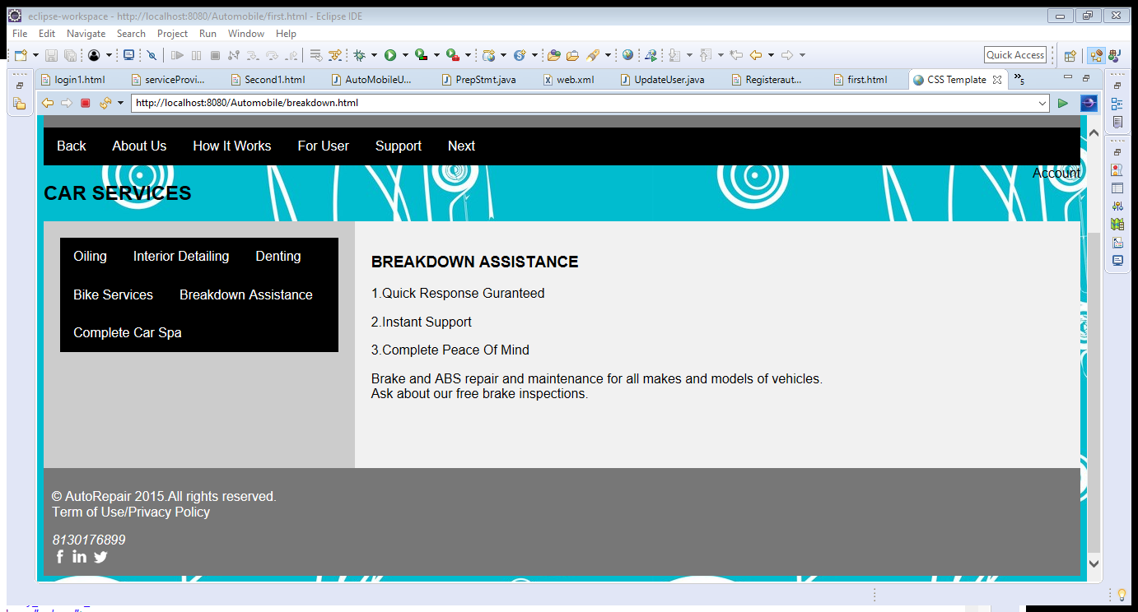
DETAILES OF SERVICES PAGE:

Slide 12
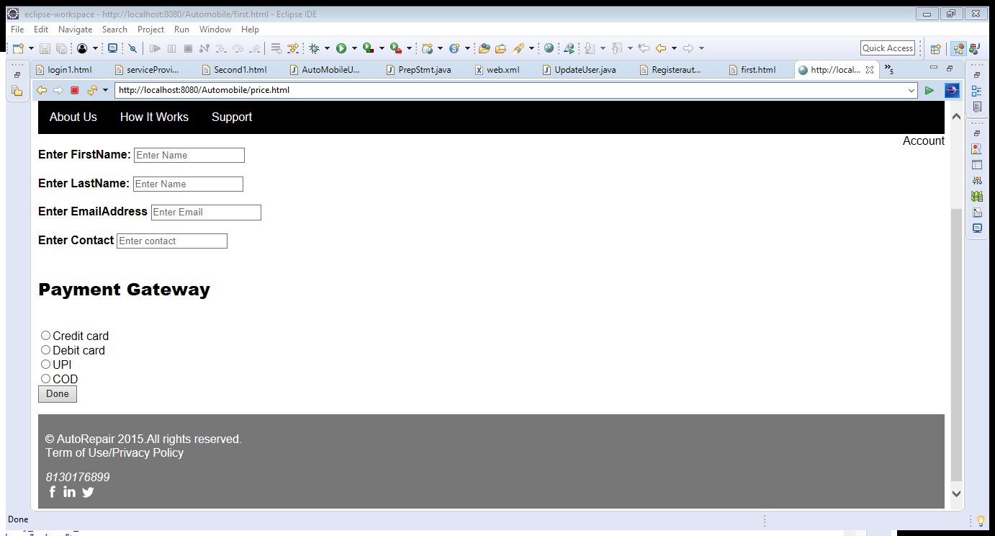
PAYMENT PAGE:

Slide 13
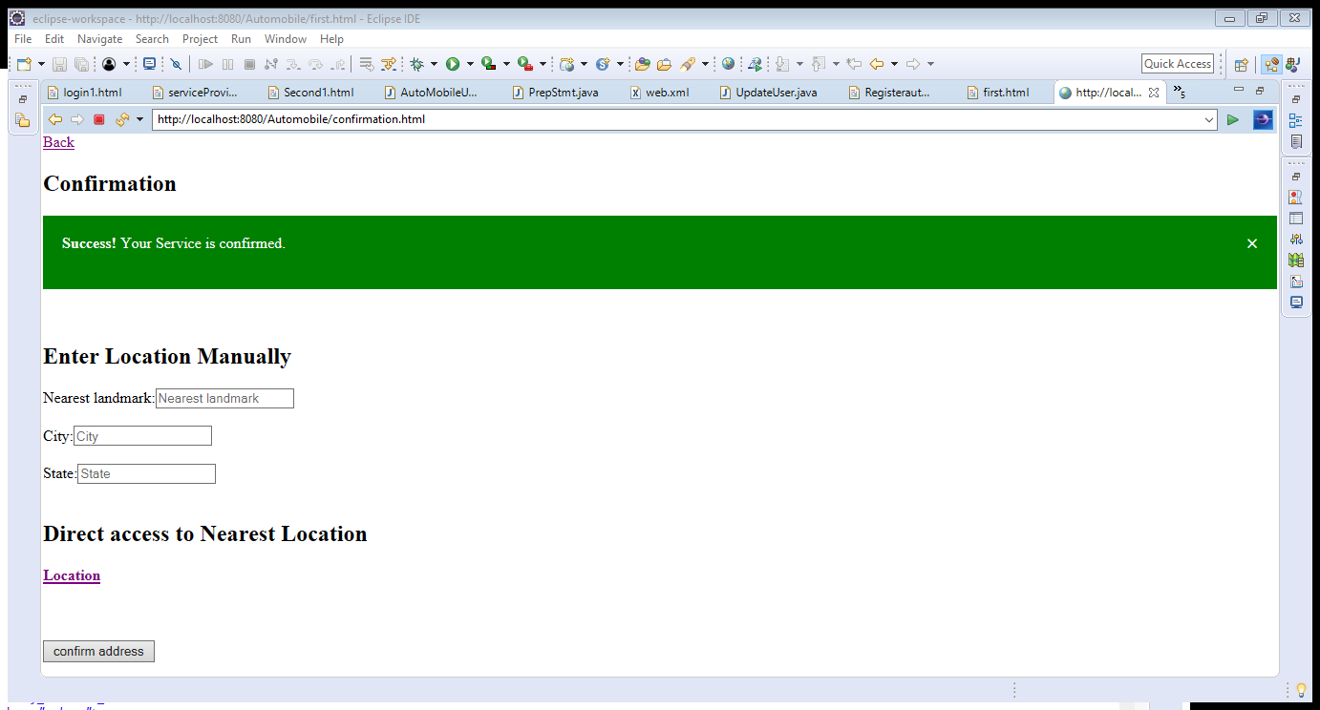
CONFIRMATION PAGE:

Slide 14
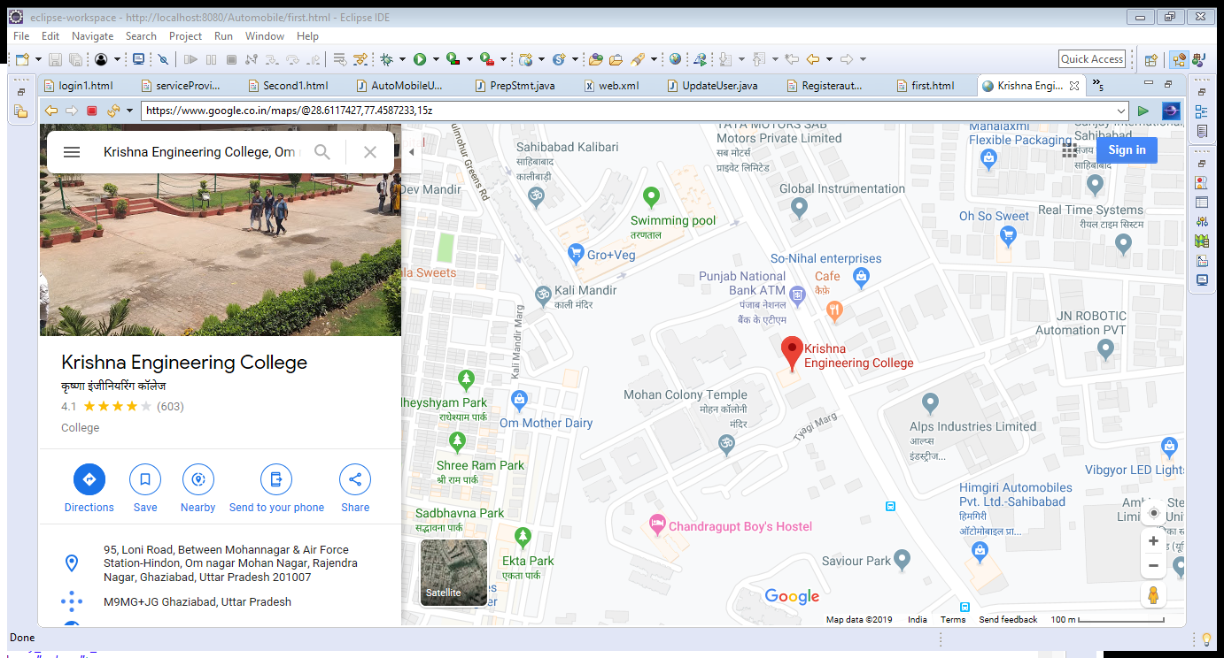
LOCATION :

Slide 15
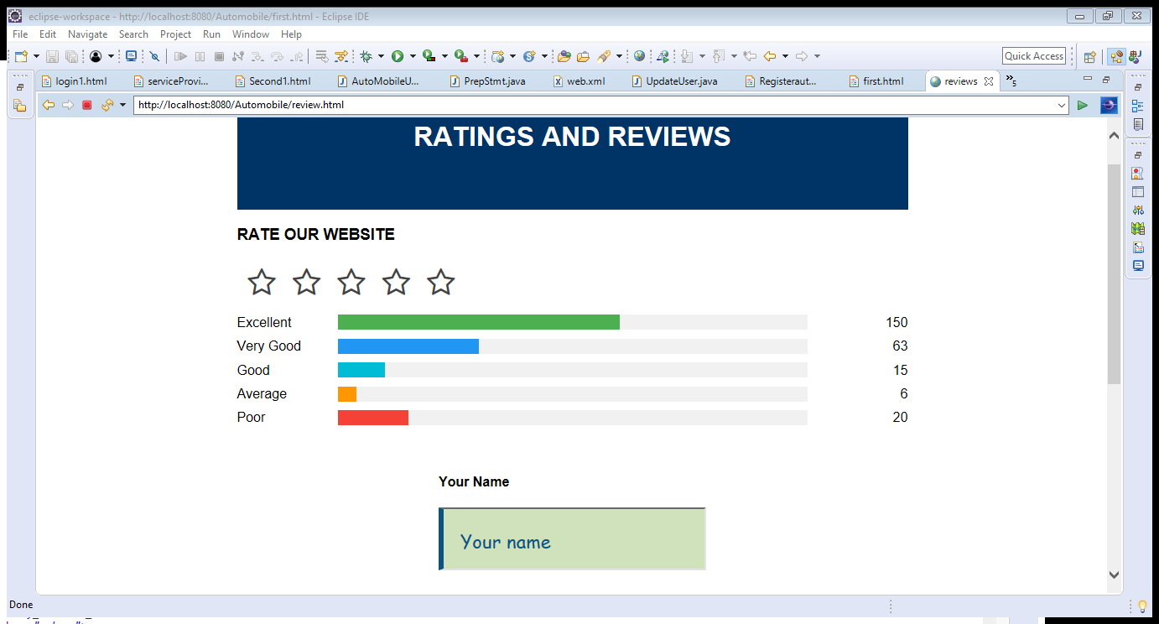
CUSTOMER REVIEW AND RATING:

Slide 16
Project Scope:
This software system will be an Automobile Service Centre System. This system will be designed to help Automobile Owners and Service Providers to find the suitable Service Providers to the customers according to their need and comfort. The software provides a simple navigation through the nearby Service providers and the services which are offered by them which will be beneficial to the customers to help them with the easiest and quick solutions. With a simple registration, new Customers and Service Providers can register to the portal and can find easy and more comfortable area of working which will be helpful economically as well as commercially.
More specifically, this system is designed to provide a list of available Service Providers to the searching Customers. It will facilitate communication between Automobile Owners and Automobile Service Providers via E-Mail and Contact Number.

Slide 17
THANK YOU

