Slide 1
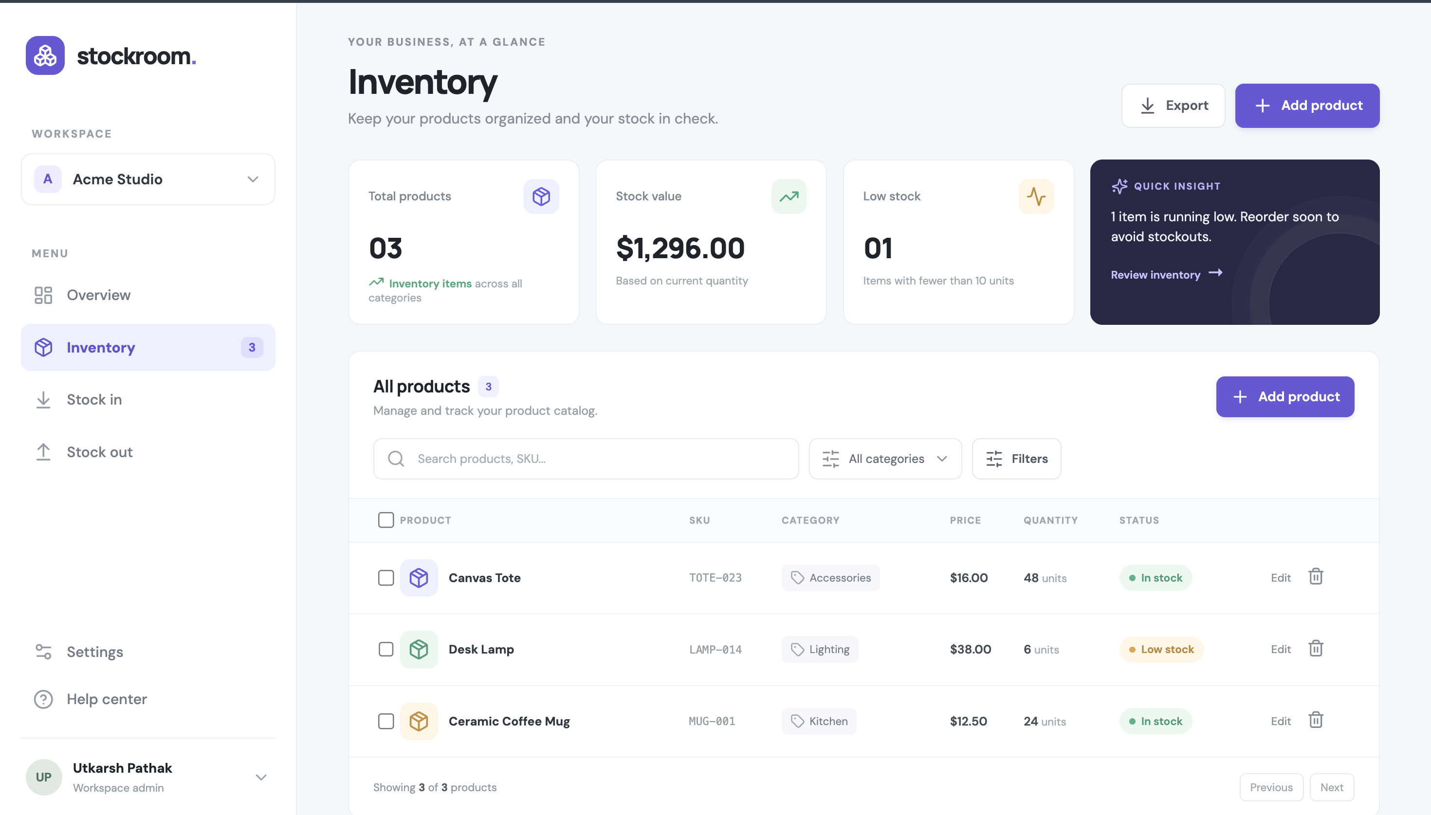
FINAL STUDENT PROJECT
Stockroom
Inventory management,
shipped with a DevOps pipeline.
A full-stack CRUD application with automated testing, secure image delivery, and local Kubernetes operations.
React
FastAPI
PostgreSQL
Kind + Helm
Built for teams that need a clear view of stock.
Notes:
Sources: README.md; evidence/application-dashboard.png. All metrics and screenshots are from this repository's README and evidence folder.

Slide 2
01 / PRODUCT
An inventory workspace made for daily operations
The dashboard keeps catalog changes, stock risk, and inventory value in one view.
CORE WORKFLOWS
Create and maintain product records
Search, filter, and review the catalog
Track quantities, pricing, and low-stock items
Export inventory data as CSV
RESPONSIVE FRONTEND
React + Vite, served through Nginx
Notes:
Sources: README.md, “What the application does”; evidence/application-dashboard.png. All metrics and screenshots are from this repository's README and evidence folder.

Slide 3
02 / ARCHITECTURE
One local stack connects the app, delivery pipeline, and monitoring
The application and the image pipeline run locally or on GitHub Actions; no AWS resources are used.
GitHub
Actions
Trivy
GHCR
Kind + Helm
source
test + build
scan images
SHA tags
local rollout
REQUEST PATH
Browser
Traefik
React + Nginx
FastAPI
PostgreSQL
user
Ingress
frontend
REST API
data
Horizontal Pod Autoscaler
Prometheus + Grafana
scales FastAPI by CPU
collect + visualize metrics
Notes:
Sources: README.md, “Architecture” and “Local Kubernetes deployment”. All metrics and screenshots are from this repository's README and evidence folder.

Slide 4
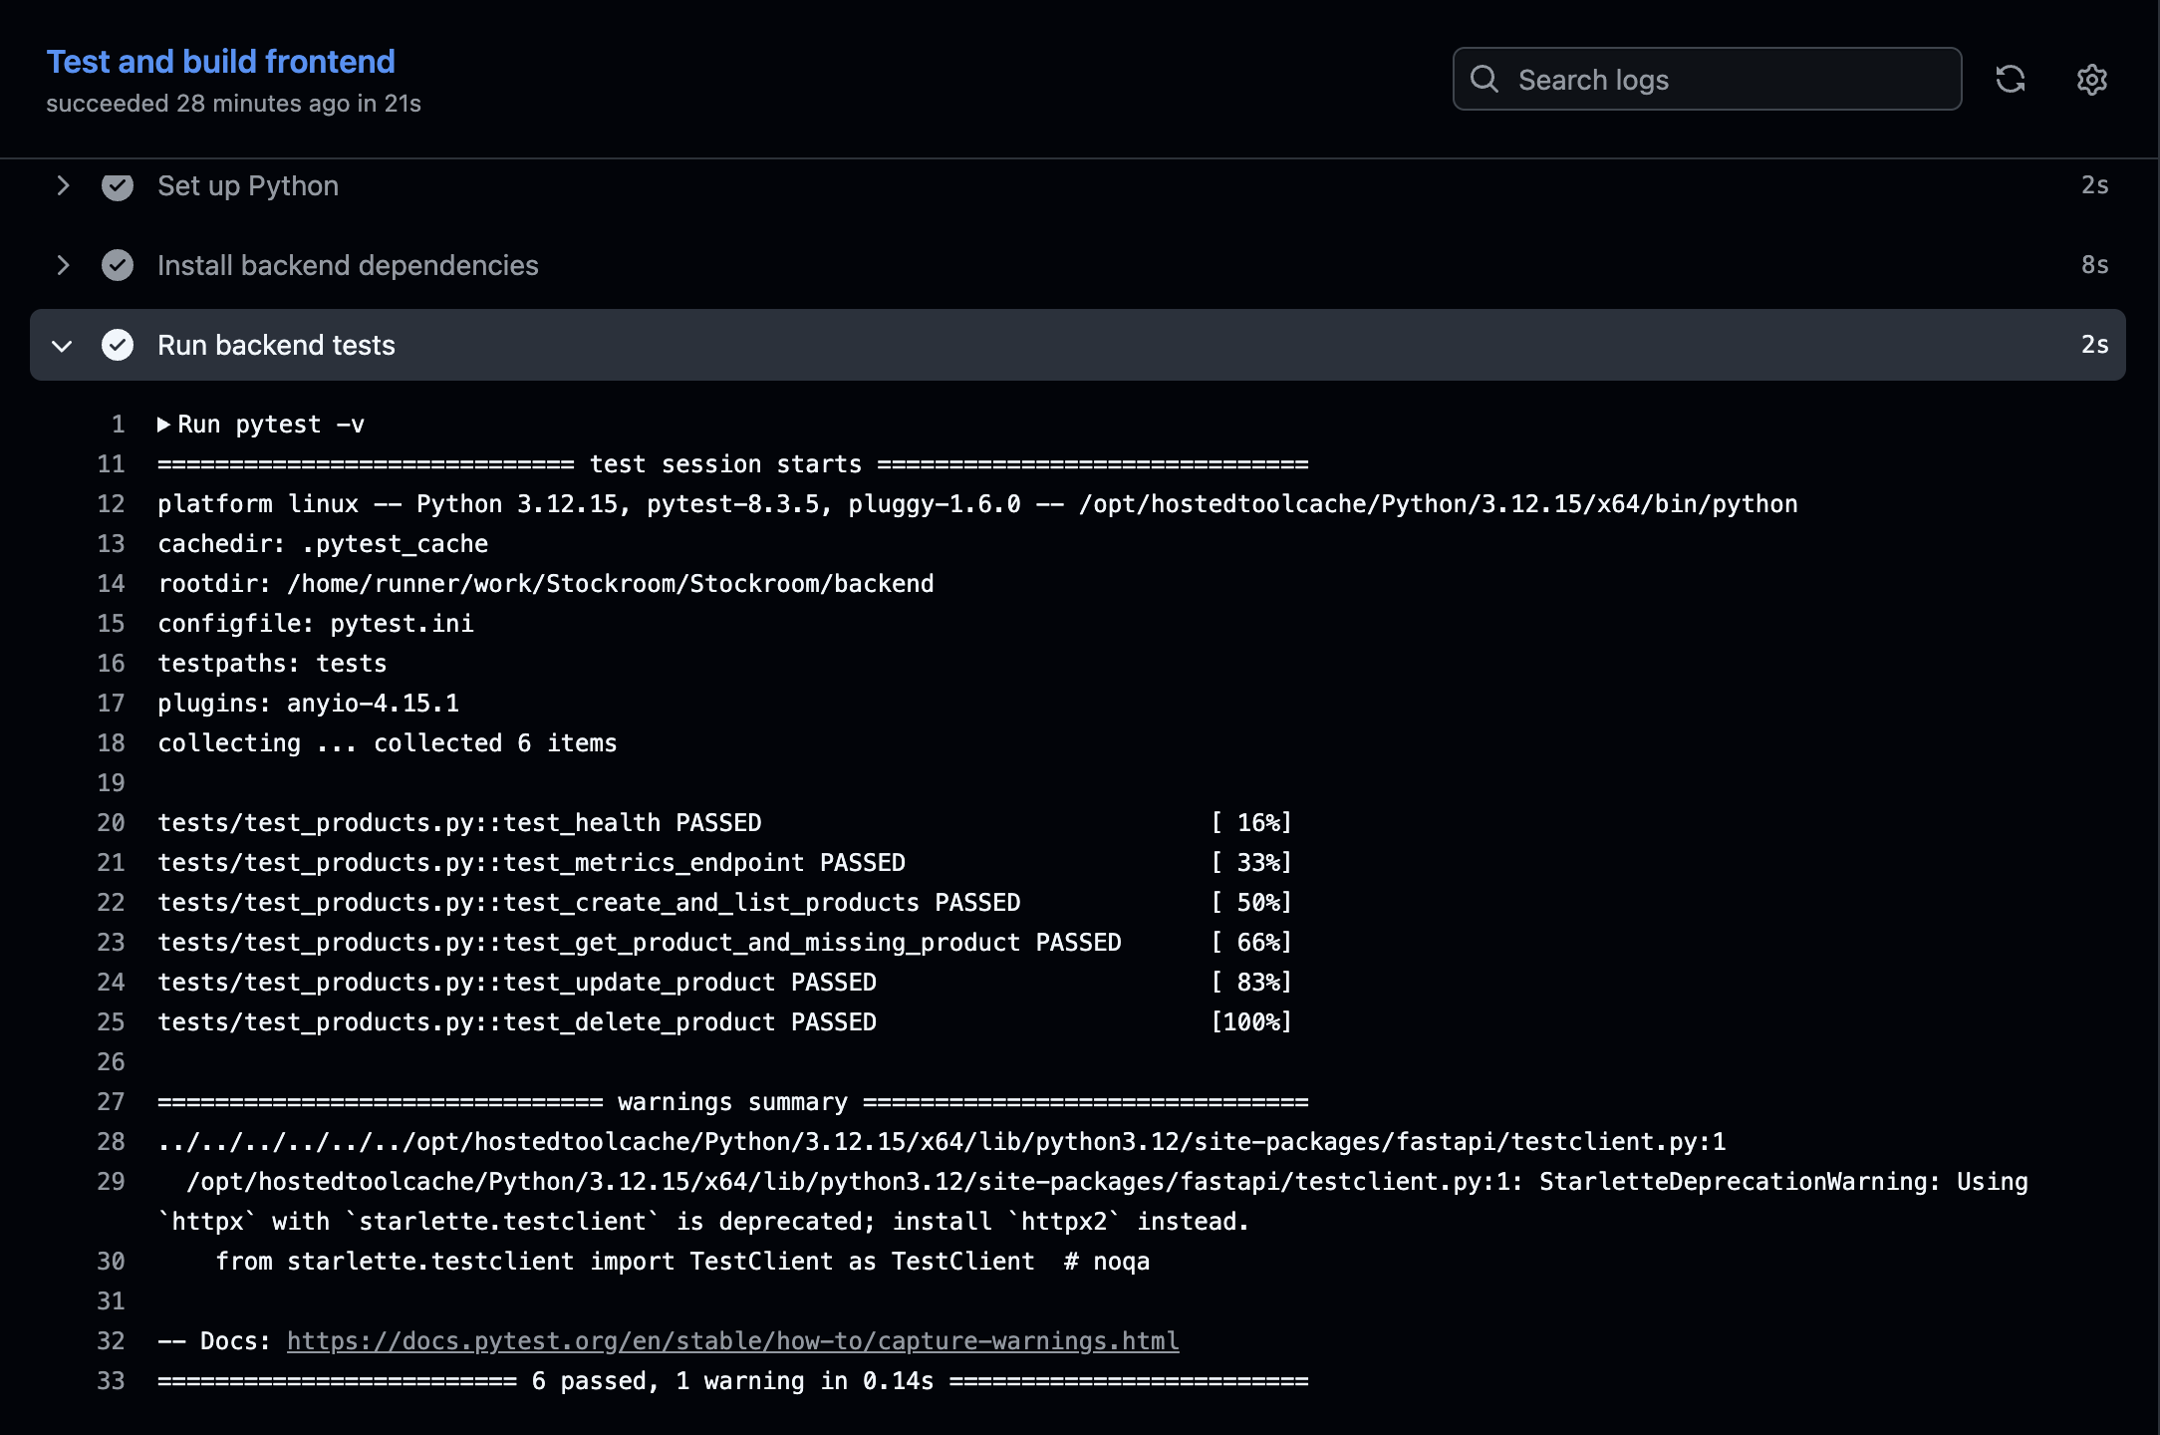
03 / BACKEND
A small REST API keeps the CRUD contract clear
FastAPI, PostgreSQL, SQLAlchemy, and Alembic support the inventory lifecycle.
METHOD
ROUTE
PURPOSE
GET
/api/products
list
GET
/api/products/{id}
detail
POST
/api/products
create
PUT
/api/products/{id}
update
AUTOMATED CHECKS
DELETE
/api/products/{id}
delete
Six API tests cover product operations and metrics.
Tests use an isolated SQLite fixture; they do not depend on the local Postgres service.
Notes:
Sources: README.md, “What the application does” and “Run tests”; evidence/pytest-passing.png. All metrics and screenshots are from this repository's README and evidence folder.

Slide 5
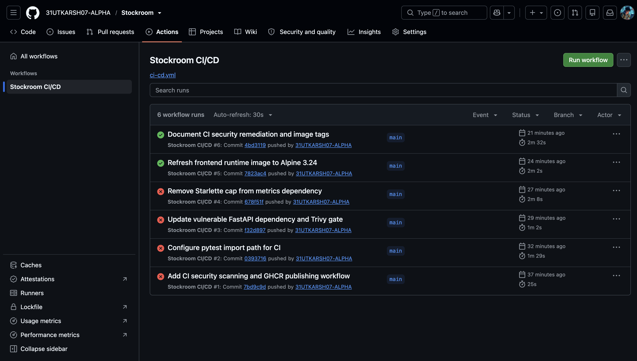
04 / CI/CD
Every main-branch change can produce a traceable release
Tests and the frontend build gate the image build, scan, and publish stage.
01
02
03
04
05
Commit
Verify
Build
Scan
Publish
GitHub main
Pytest + Vite build
Backend + frontend
Trivy
GHCR + source SHA
RELEASE TRACEABILITY
One source revision, two images
Backend and frontend images published to GHCR
Full commit SHA used as each image tag
Notes:
Sources: README.md, “CI/CD and image security”; evidence/github-actions-green.png. All metrics and screenshots are from this repository's README and evidence folder.

Slide 6
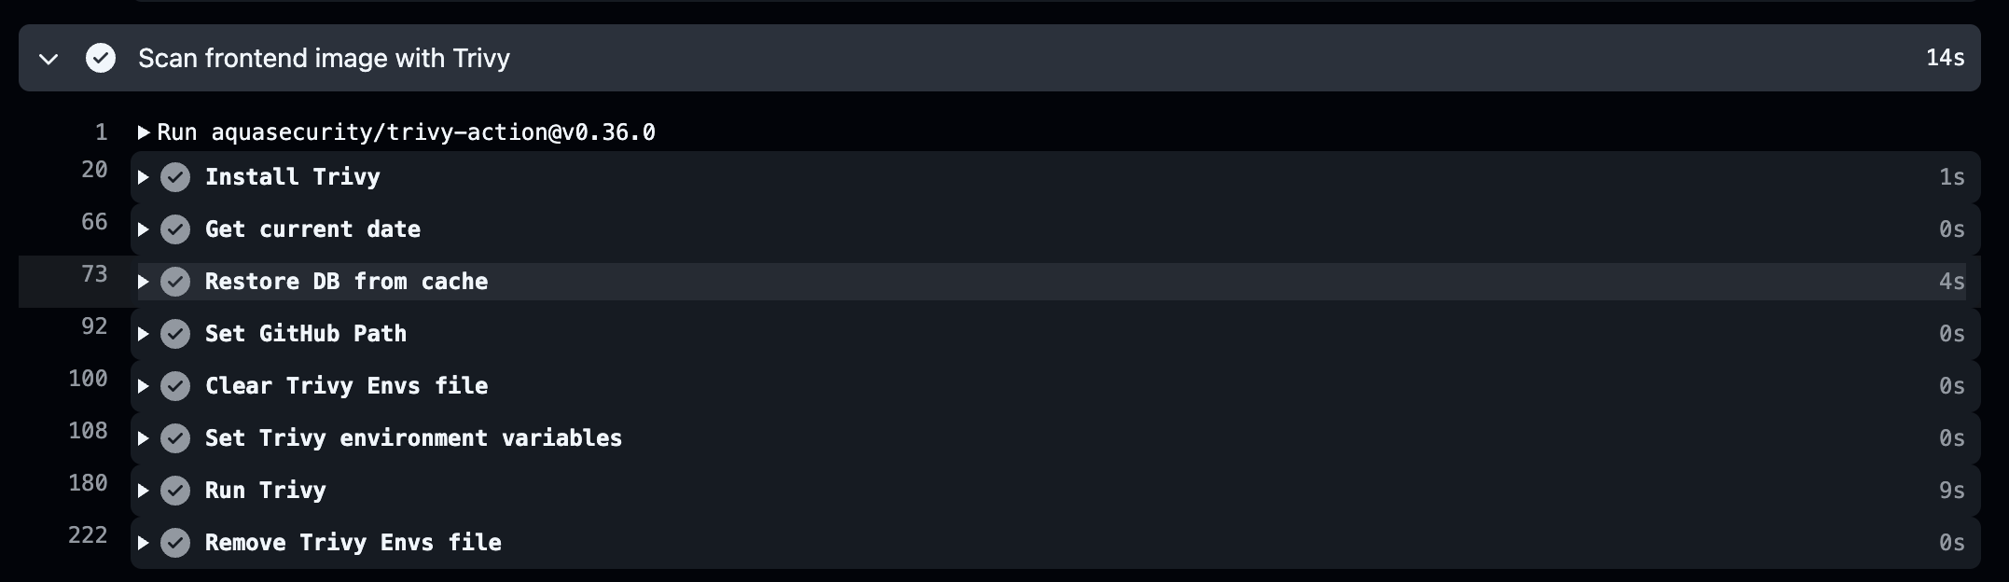
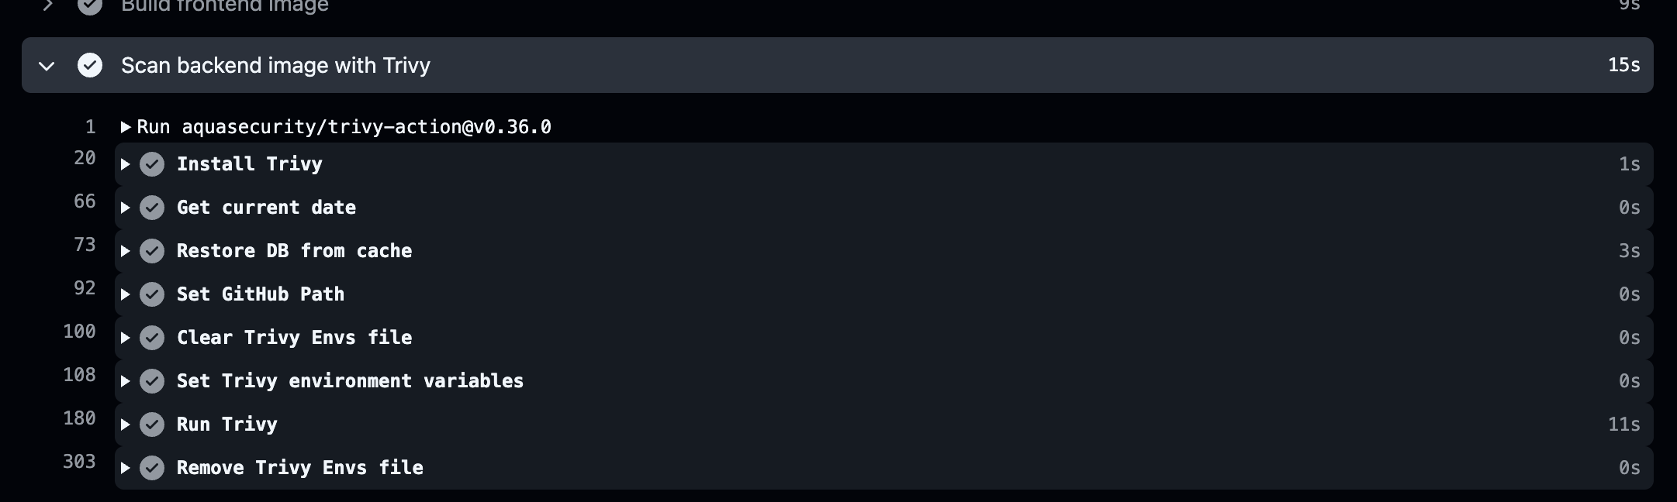
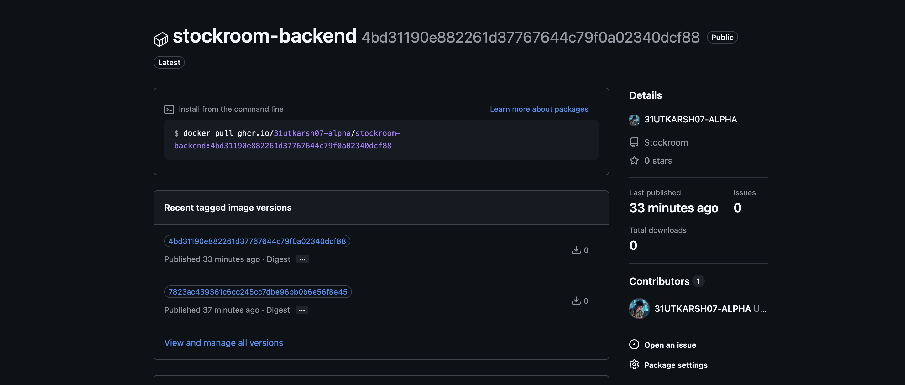
05 / SECURITY
Image scanning is part of the release gate
Trivy checks both application images before the pipeline publishes them.
POLICY
Actionable HIGH and CRITICAL findings block publishing; image tags retain source-SHA traceability.
Notes:
Sources: README.md, “CI/CD and image security”; evidence/trivy-backend-scan.png, evidence/trivy-frontend-scan.png, evidence/ghcr-backend-sha-tag.png. All metrics and screenshots are from this repository's README and evidence folder.

Slide 7
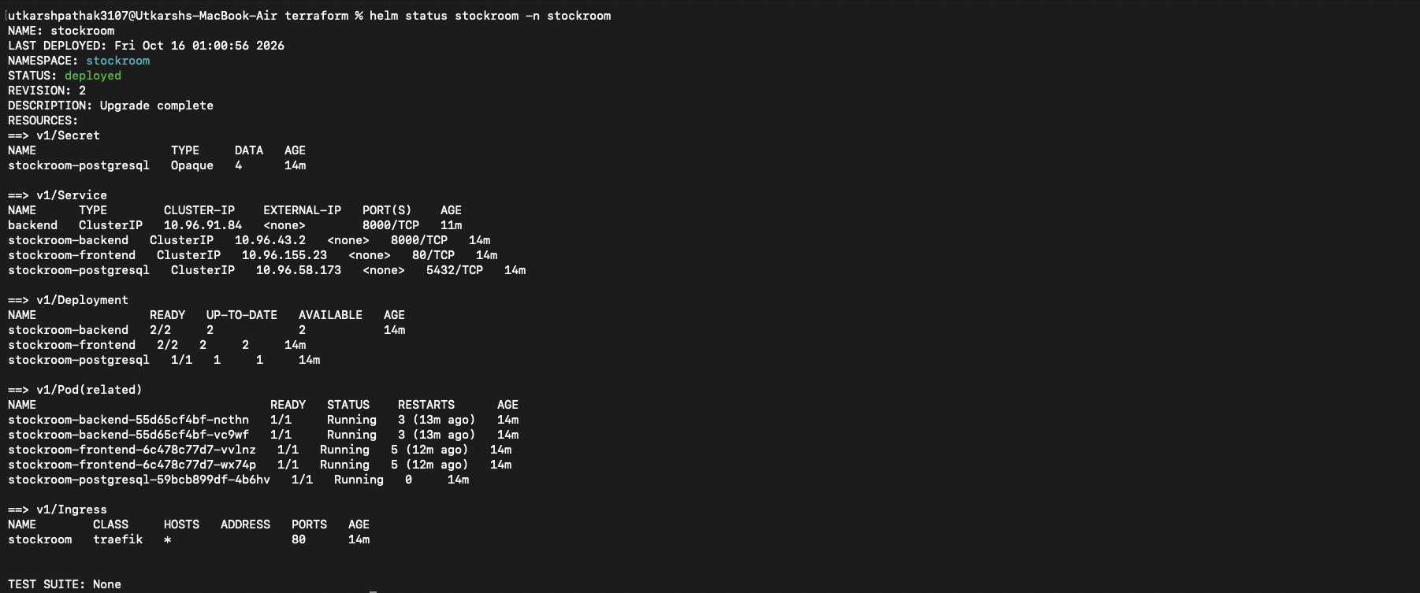
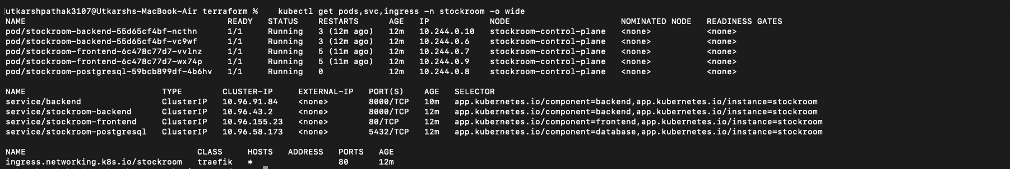
06 / KUBERNETES
Kind and Helm make the deployment reproducible without cloud spend
Traefik routes app traffic; PostgreSQL and the application run inside the local cluster.
LOCAL CLUSTER
PACKAGE MANAGER
TRAFFIC
CLOUD SCOPE
Kind on Docker Desktop
Stockroom Helm chart
Traefik Ingress at 127.0.0.1:8080
No AWS resources created
Notes:
Sources: README.md, “Local Kubernetes deployment”; evidence/k8s-pods-services.png and evidence/helm-release.png. All metrics and screenshots are from this repository's README and evidence folder.

Slide 8
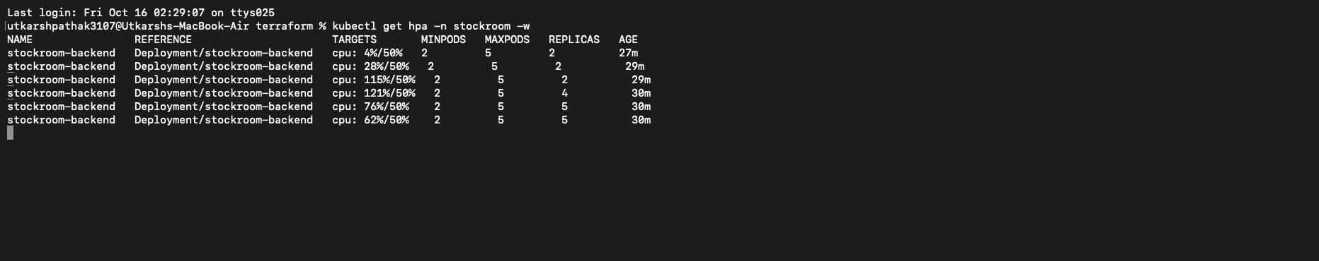
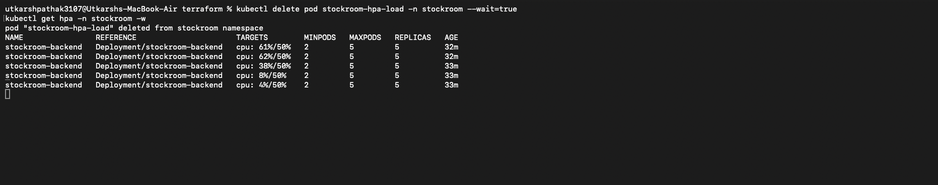
07 / AUTOSCALING
The backend scales from two to five pods on CPU
Metrics Server feeds an autoscaling/v2 HPA targeting average CPU utilization.
CPU TARGET
REPLICA FLOOR
REPLICA CEILING
CPU REQUEST
50%
2
5
100m
of requested CPU
minimum replicas
maximum replicas
per backend pod
LOAD TEST OBSERVATION
CPU rose above target; the HPA increased desired replicas to five. After load removal, utilization fell and scale-down began.
busybox → /api/products
metrics-server → HPA
Notes:
Sources: README.md, “Backend autoscaling”; evidence/hpa-scaling-up.png and evidence/hpa-scaled-down.png. All metrics and screenshots are from this repository's README and evidence folder.

Slide 9
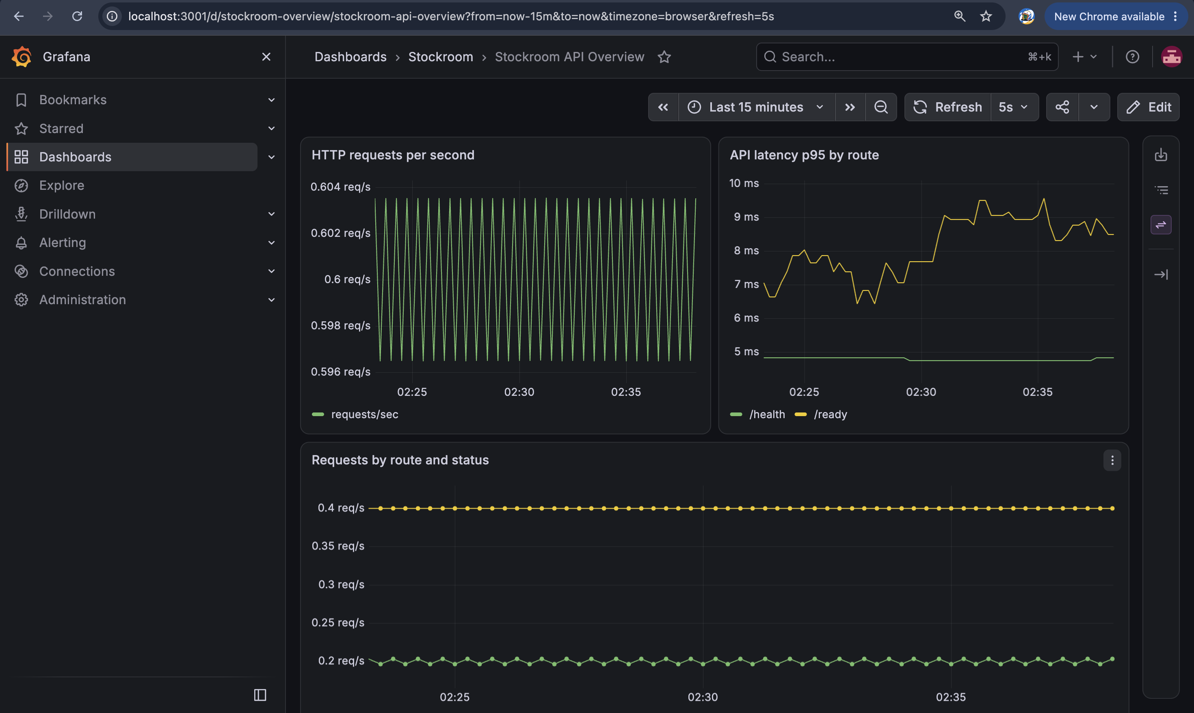
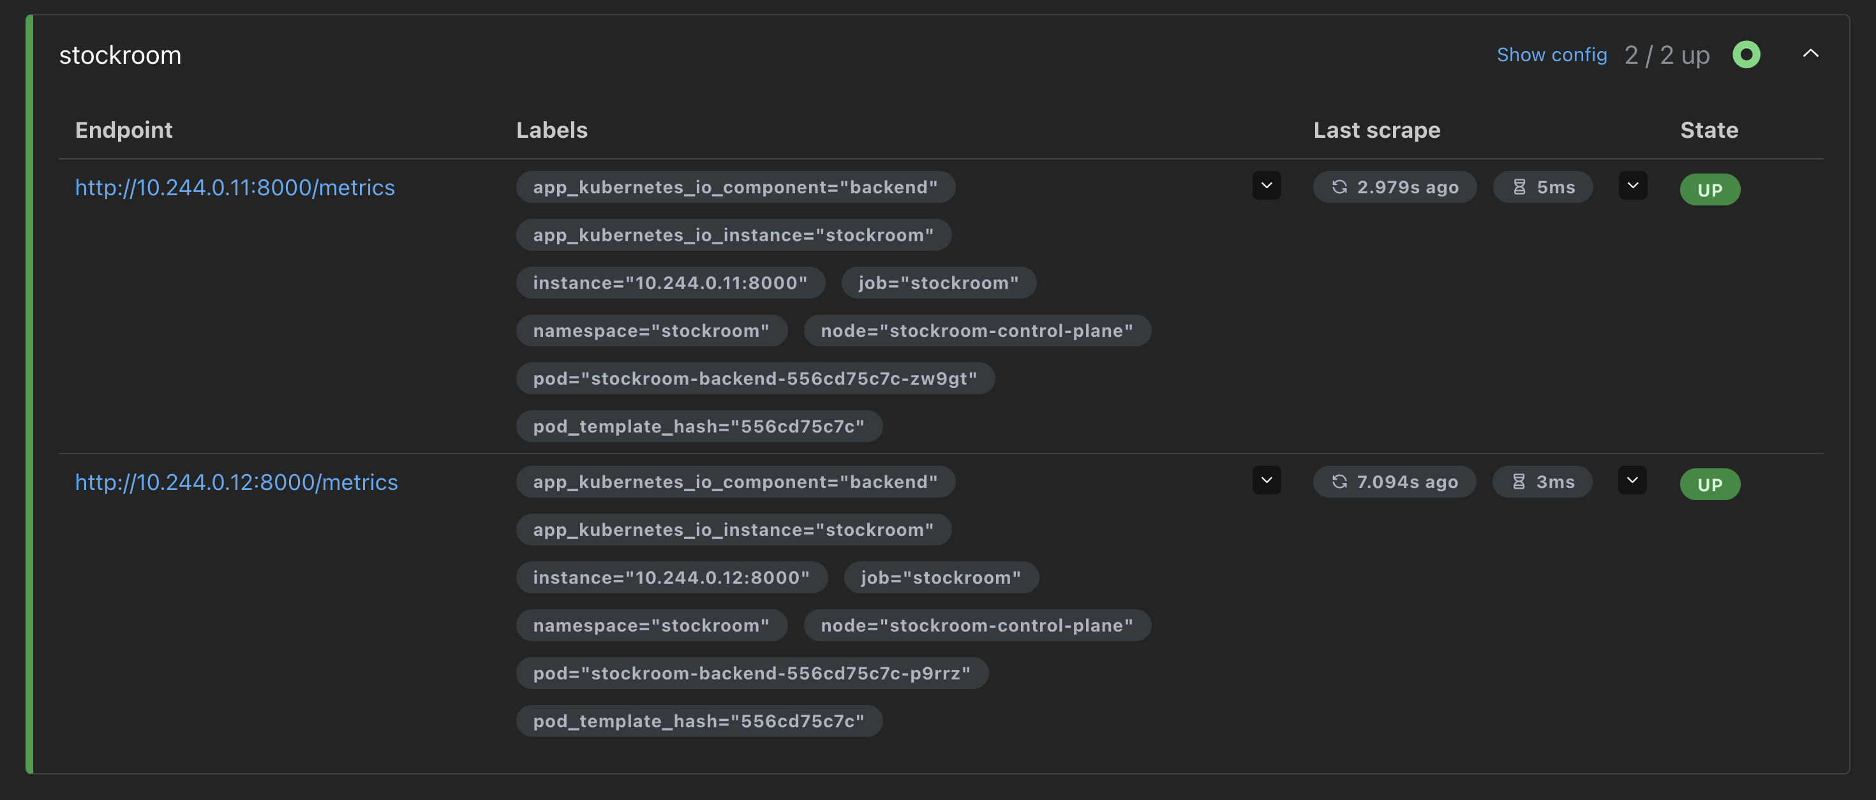
08 / OBSERVABILITY
Metrics turn runtime behavior into something operators can inspect
Prometheus scrapes the API; Grafana displays request rate and route latency.
SIGNALS
HTTP requests per second
API latency by route
Requests by route and status
Prometheus target health
Notes:
Sources: README.md, “Observability with Prometheus and Grafana”; evidence/grafana-dashboard.png and evidence/prometheus-targets.png. All metrics and screenshots are from this repository's README and evidence folder.

Slide 10
09 / REQUIREMENTS
The project covers the full application-to-operations path
Final-project minimum requirements are mapped to working code and repository evidence.
APPLICATION
ENGINEERING
DEVOPS
React responsive frontend
Git + GitHub Actions
Kind + Helm + Ingress
FastAPI REST API + PostgreSQL
Pytest + Docker
CPU HPA + metrics-server
Product CRUD + CSV export
Trivy + GHCR SHA tags
Prometheus + Grafana
SCOPE NOTE
Terraform is included as an AWS VPC/EKS reference, but no AWS plan or cloud resources were created.
Reproduction steps, deployment commands, screenshots, and the local walkthrough are in the repository.
Notes:
Sources: README.md, “Rubric and evidence” and “Final student project minimum requirements audit”. All metrics and screenshots are from this repository's README and evidence folder.

Slide 11
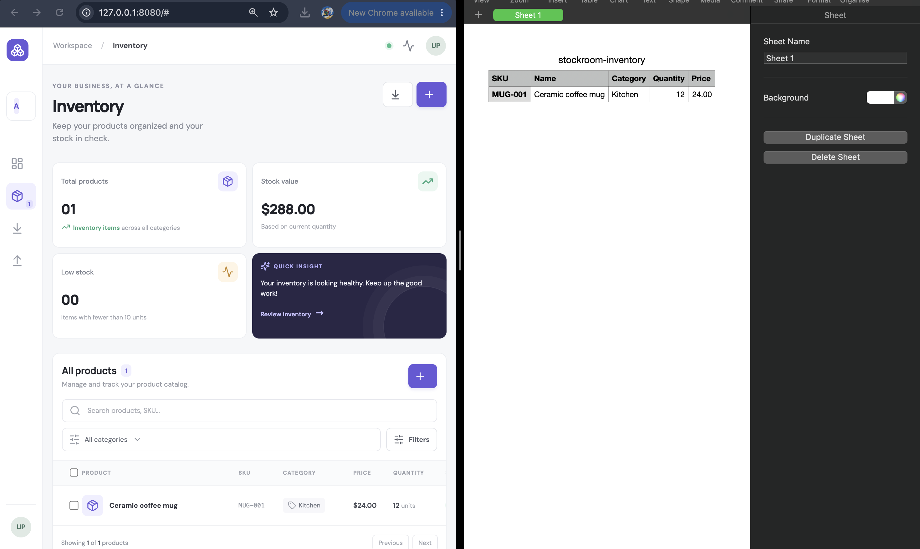
STOCKROOM
From product record
to observable service.
A practical inventory app backed by a tested API and a reproducible, locally operated delivery stack.
Source repository
github.com/31UTKARSH07-ALPHA/Stockroom
Thanks
Notes:
Sources: README.md; evidence/export-csv.png. All metrics and screenshots are from this repository's README and evidence folder.

