Slide 1


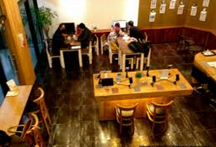
OFF
ON
+1
+3

Slide 2
