Slide 1


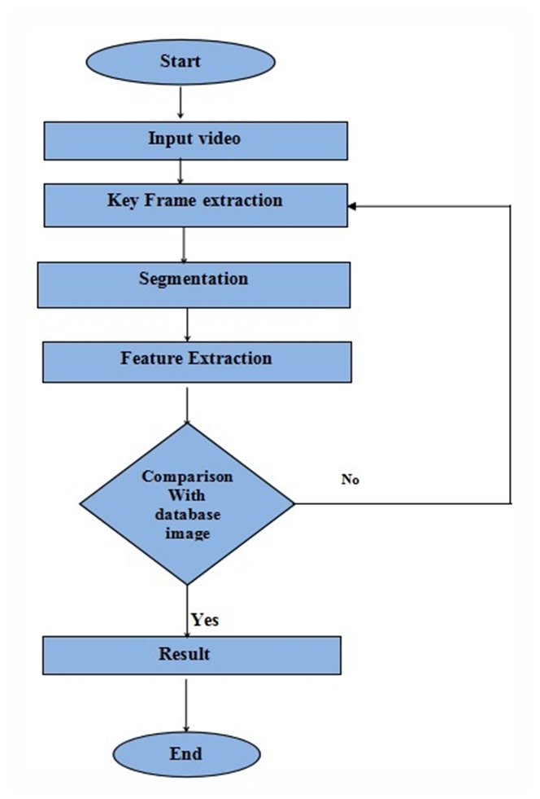
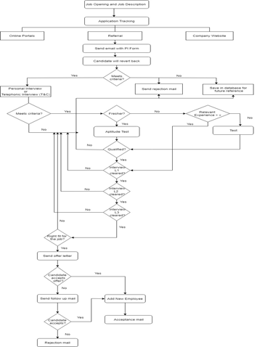




YCCE INNOVATION GALLERY
DEPARTMENT OF INFORMATION TECHNOLOGY
Semester Long Internship Project Undertaken At Arista Infotech Pvt. Ltd.
SESSION 2018-19
Recruitment Management System
Preamble
Flowchart of our Project:
Recruitment is the process of finding and attracting the potential resources for filling up the vacant positions in an organization. Recruitment process is a process of identifying the job vacancy, analyzing job requirements, reviewing applications, screening, shortlisting and selecting the right candidate. Today there are various tools and technologies available which help an organization which help organizations in making their recruitment process hassle free and simple. In our project, we aimed to build a recruitment management system for Arista Infotech Pvt. Ltd. which would help in effectively automating their currently manual recruitment process. The system will have a login module exclusive to the HR of the company. The services provided by the system are adding new vacancy along with it’s description, editing and updating existing job vacancies, editing and deleting received job applications, sorting out eligible candidates and scheduling different rounds of interviews. Java language has been used for coding at the backend level and HTML,CSS, javascript is used to design and enhance appearance of the web(JSP) pages involved.
Conclusion
The development and design of various aspects of the recruitment management system such as database configuration and connection, adding new vacancies, sorting out applications based on criteria corresponding to each job profile and scheduling of different rounds of interviews for shortlisted candidates has been described in this project. The system’s access would be exclusively to the HR.
Snapshot
Future scope
As future implementation our system’s effectiveness can be enhanced using Artificial Intelligence and an online test module can be merged along with the system.
Bibliography
  [1]https://www.javatpoint.com/jsp-tutorial/
  [2] https://www.chillyfacts.com/java-jsp-mysql-loginproject/
  [3] https://www.w3schools.com/html/
  [4] Bryan Basham, Katy Sierra and Bert Bates, “ Head First Servlets and JSP”, Oreilly, 2nd edition, 2008
1.: HR Login Screen
2.: Home Page
Bibliography
4. Add opening page
3. Eligible candidates list
Project By: Shubham Ganvir, Mayur Choure, Cassablonka Pimpalapure and Siddhant Khandwe
Academic Guide: Prof. Nisha Wankhede Industry Guide: Mr. Kushal Shah
Session 2018-19

