Slide 1
Investigating Harassment Emails
Email, Wireshark, and Digital Forensics

Slide 2
Background

Slide 3




Harassment Scenario
Created by Dr. Simson Garfinkel at Naval Postgraduate School
Mimics "Nitroba University Harassment Scenario”
sends email
Lily Tuckrige
lives
forwards email
monitors
If we capture all traffic between the dorm and outside, we can extract useful information from traffic logs
Scenario and network traffic can be accessed here: https://digitalcorpora.org/corpora/scenarios/nitroba-university-harassment-scenario

Slide 4
Harassment Scenario (1)
Nitroba’s IT department received an email from Lily Tuckrige, a teacher in the Chemistry Department. Tuckride has been receiving harassing emails and she suspects that they are being sent by a student in her class Chemistry 109, which she is teaching this summer. The email was received at Tuckrige’s personal email account, lilytuckrige@yahoo.com. She provided a screenshot of the web browser.
The system administrator who received the complaint wrote back to Tuckrige that Nitroba needed the full headers of the email message. Tuckrige responded by clicking the Full message headers button in Yahoo Mail and sent in another screenshot, this one with mail headers.

Slide 5
Harassment Scenario (2)
The mail header shows that the mail message originated from the IP address 140.247.62.34, which is a room in the Nitroba student-shared accommodation. Three women share the room. Nitroba provides an Ethernet connection in every room but not Wi-Fi access, so of the occupants have installed a Wi-Fi router in the room, which is a common practice. There is no password on this Wi-Fi.
Because several email messages appear to come from the IP address, Nitroba decides to place a network sniffer on the ethernet port. All of the packets are logged. On Monday 21 July, Tuckrige received another harassing email. But this time instead of sending it directly, the perpetrator sent it through a web-based service called willselfdestruct.com. The website briefly showed the message to Tuckrige, and then the website reports that the Message Has Been Destroyed.

Slide 6

You need to determine if one of the students in the class was responsible for the harassing email

Slide 7
The information we have
The first harassment email provided by the faculty
Class roster of Chem 109
The second harassment email
The captured network traffic log

Slide 8
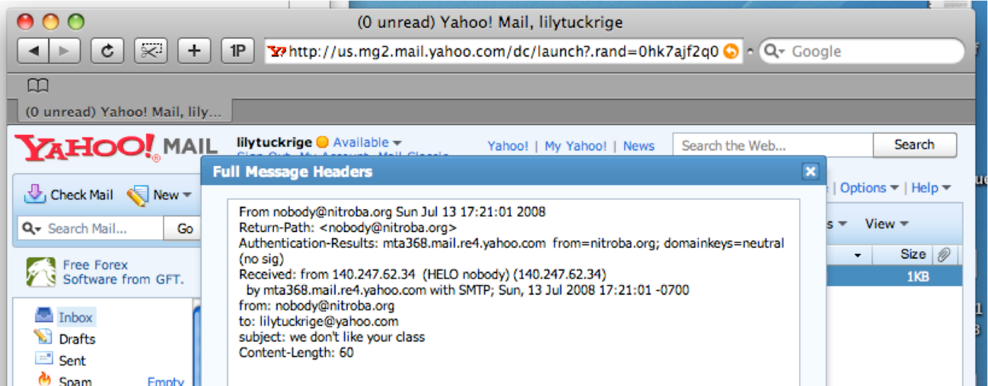
1. The first harassment email
IP of university dorm

Slide 9
2. Chem 109 - Class roster
Teacher: Lily Tuckrige
Students:
Amy Smith
Burt Greedom
Tuck Gorge
Ava Book
Johnny Coach
Jeremy Ledvkin
Nancy Colburne
Tamara Perkins
Esther Pringle
Asar Misrad
Jenny Kant

Slide 10
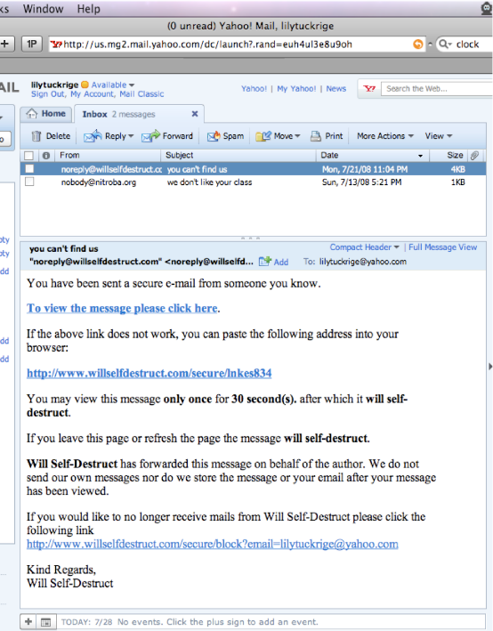
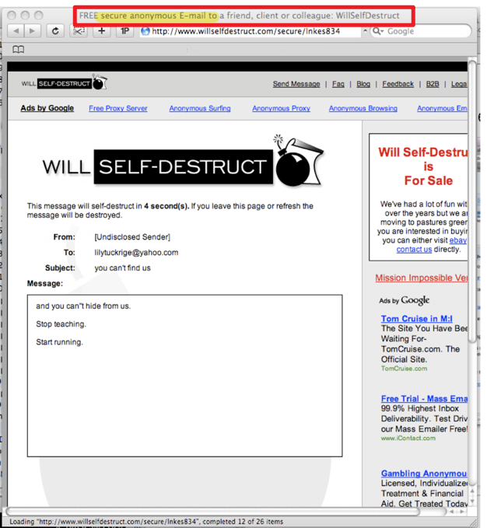
3. The second harassment email
It was sent from www.willselfdestruct.com
When the faculty click a link in the email, the faculty read the content provided by the website
The screenshot is provided by the faculty
larger screenshots are shown on next slide

Slide 13
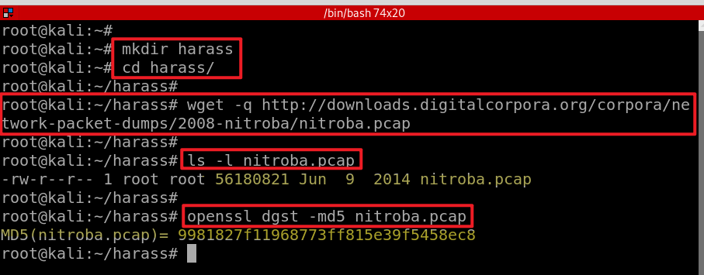
4. The captured network traffic log
Create a working folder
Download traffic log
Verify hash code
Notes:
wget –q https://digitalcorpora.s3.amazonaws.com/corpora/scenarios/2008-nitroba/nitroba.pcap

Slide 14
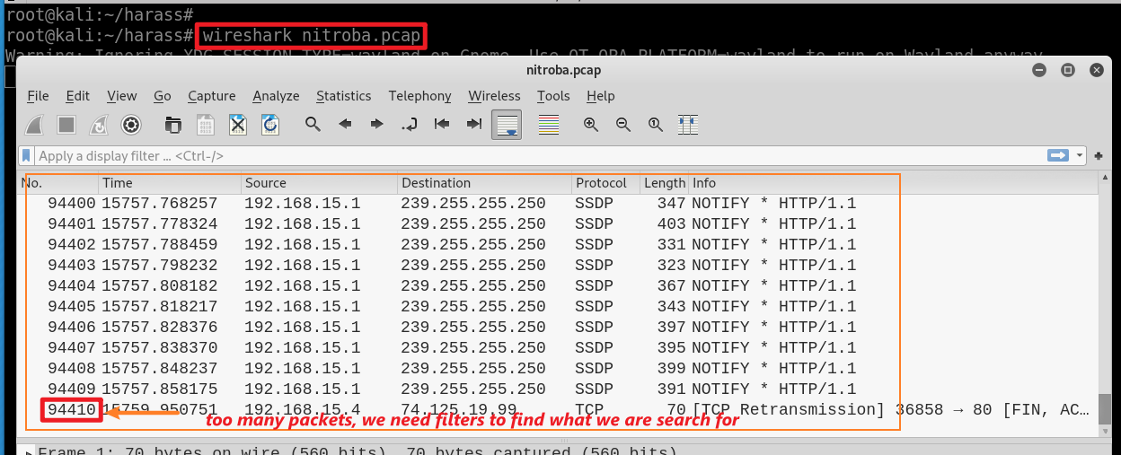
Traffic data review

Slide 15
Scenario Analysis

Slide 16





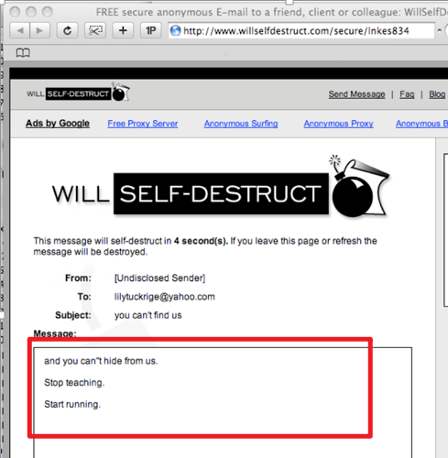
Assumed Scenario
A student in dorm
www.willselfdestruct.com
1
Get www.willselfdestruct.com
A student accesses the website
Website provides a form
A student fills out the form (contains harassment content) on the website
The website sends a notification email to faculty
Faculty click the link in the email
Website sends the harassment content saved on the website
1
2
2
3
POST www.willselfdestruct.com/form
3
Faculty
Save harassment content on server
4
4
5
5
Get www.willselfdestruct.com/secure/linkes834
6
6

Slide 17

Find evidence to reconstruct the scenario if our assumption is correct.

Slide 18
Mapping scenario to evidence
A student accesses the website
Website provides a form
A student fills out the form (contains harassment content) on the website
The website sends a notification email to the faculty
Faculty click the link in the email
Website sends the harassment content saved on the website
1
ID | Who | Did | What | When
1 | IP, mac | HTTP get | www.willselfdestruct.com | ?
3 | IP, mac | HTTP post | harassment content in a form From To Subject content | ?
6 | faculty | HTTP get | harassment content = email content received by the faculty | ?
2
3
4
5
6

Slide 19
Evidence collection

Slide 20
List of questions
Which IP accessed www.willselfdestruct.com?
Does the IP post harassing comments to the website?
Does the HTTP post contain the harassment message?
Is the IP associated with any suspects?
Is the suspect in the faculty’s class?
When did the suspect use www.willselfdestruct.com?

Slide 21
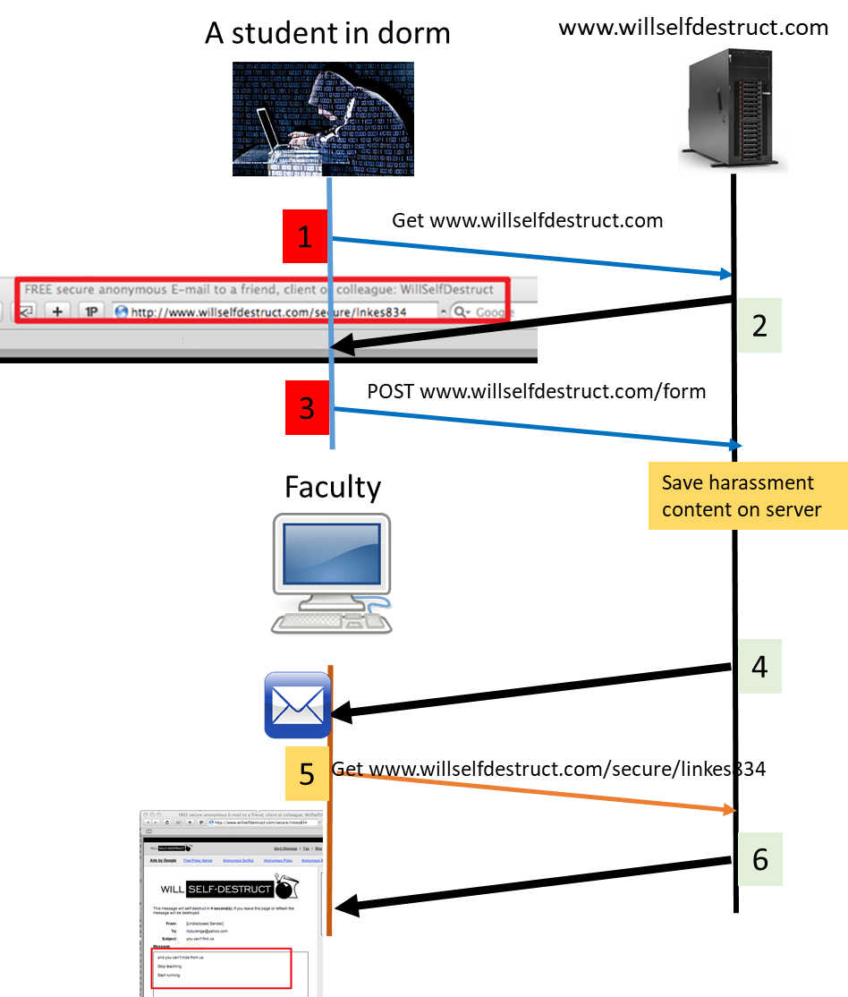
Which IP accessed www.willselfdestruct.com?
The IP is associated with HTTP Requests and Responses
1
2
3

Slide 22
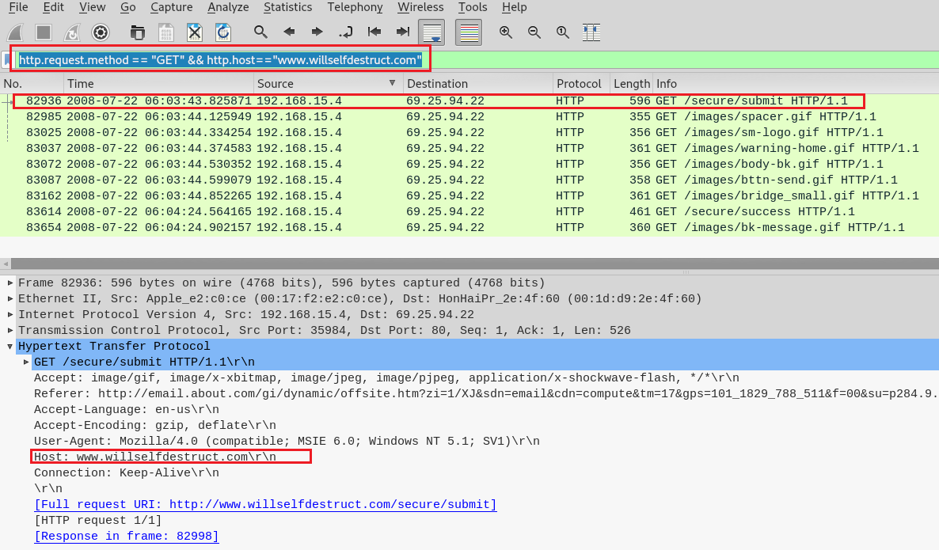
Evidence from
1
Notes:
http.request.method == "GET“ && http.host=="www.willselfdestruct.com"

Slide 23
Alternative: find IP from HTTP response
2
Anyone accessed the website will see the webpage title
Title in .html
<title>FREE secure anonymous E-mail to a friend, client or colleague: WillSelfDestruct</title>
We can search keywords in the title
How?

Slide 24
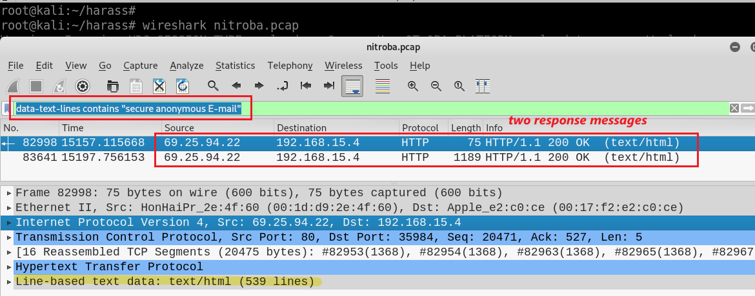
<title>FREE secure anonymous E-mail to a friend, client or colleague: WillSelfDestruct</title>
Find IP by searching the title of a web page
Notes:
data-text-lines contains "secure anonymous E-mail"

Slide 25
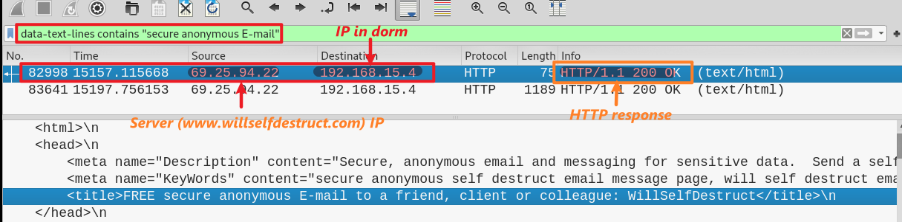
Conclusion: 69.25.94.22 is the web’s IP and 192.168.15.4 is the suspect’s ID

Slide 26

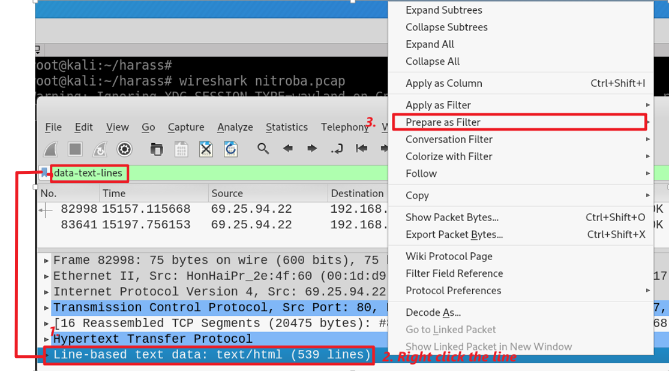
Find the field name (data-text-lines: Line-based test data) for search

Slide 27
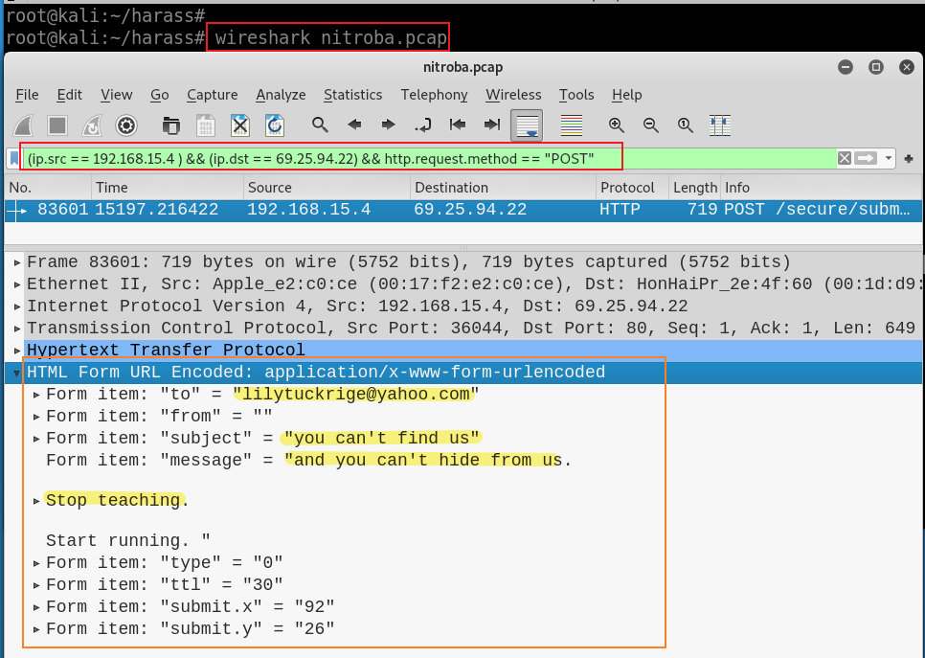
Does the IP post harassing comments to the website?
Search HTTP POST request.
Note: We are only interested in the traffic between 69.25.94.22 (web’s IP) and 192.168.15.4 (the suspect’s IP)
Harassing comment founded!
Notes:
(ip.src == 192.168.15.4 ) && (ip.dst == 69.25.94.22) && http.request.method == "POST"

Slide 28
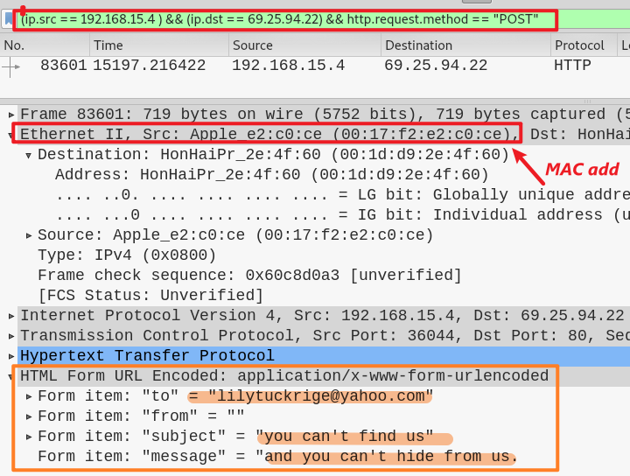
Is the IP associated with any suspects?
No.
A few students may use the same IP
Yes
Need to find the MAC address
MAC address is unique
Found MAC add
00:17:f2:e2:c0:ce

Slide 29
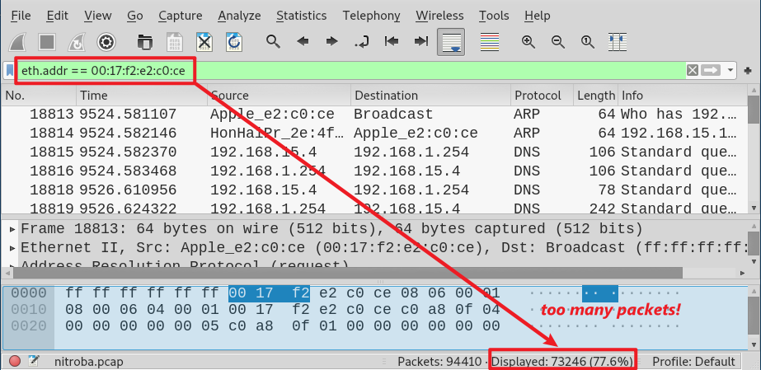
Search all packets sending and receiving by the suspect’s Apple device
Notes:
eth.addr == 00:17:f2:e2:c0:ce

Slide 30
Who owns the MAC address?
The most important question!

Slide 31
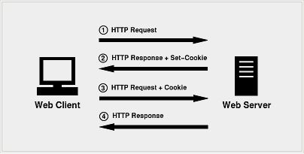
How to connect MAC address with suspect’s ID?
HTTP is a stateless protocol
each request is executed by server independently, without any knowledge of the requests that were executed before it
How to let server remember you?
HTTP cookie (web cookie, browser cookie)
A cookie
Is a small piece of data that a server sends to the user's web browser.
The client browser may store it and send it back with later requests to the same server.
Notes:
eth.addr == 00:17:f2:e2:c0:ce && http.cookie contains "@"

Slide 32
Purpose of Cookies
Session management
Logins, shopping carts, game scores, or anything else the server should remember
Personalization
User preferences, themes, and other settings
Tracking
Recording and analyzing user behavior
We may be able to find suspects’ profiles from Cookies!
Notes:
eth.addr == 00:17:f2:e2:c0:ce && http.cookie contains "@"

Slide 33
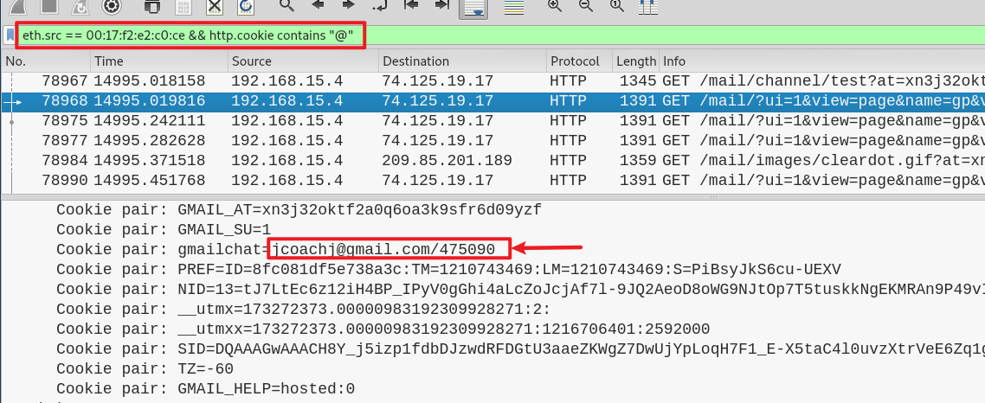
Narrow down the search result using cookie
@ hopefully cookies have email information.
(149 matching packets)
Notes:
eth.src == 00:17:f2:e2:c0:ce && http.cookie contains "@"

Slide 34
Is the suspect in faculty’s class?
Teacher: Lily Tuckrige
Students:
Amy Smith
Burt Greedom
Tuck Gorge
Ava Book
Johnny Coach
Jeremy Ledvkin
Nancy Colburne
Tamara Perkins
Esther Pringle
Asar Misrad
Jenny Kant

Slide 35
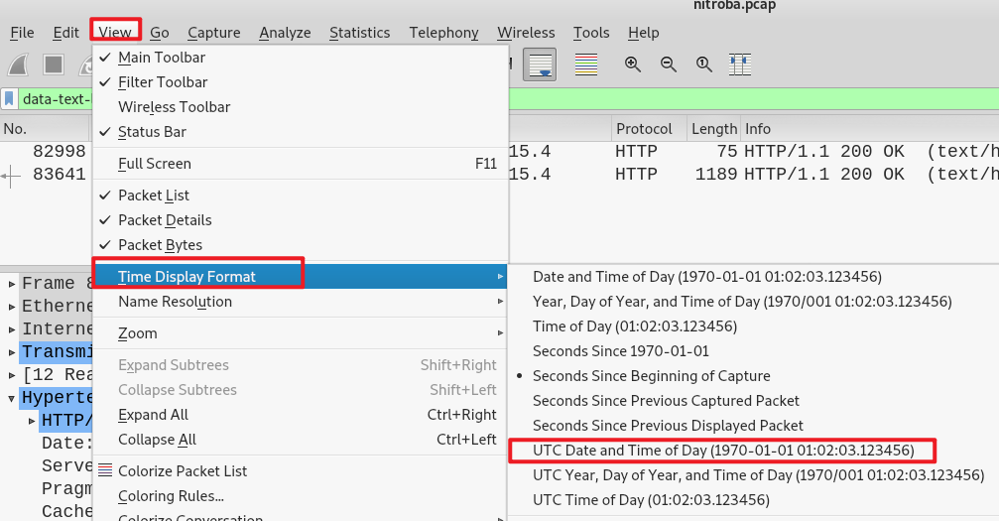
When did the suspect use www.willselfdestruct.com?
Change time format

Slide 36
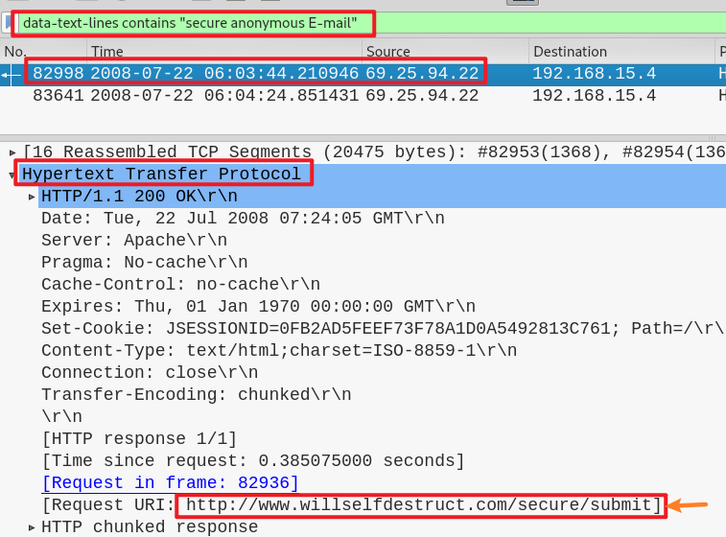
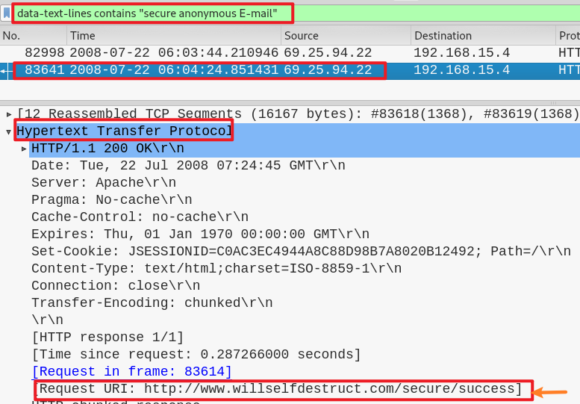

Slide 37
Other helpful filters
http.set_cookie
ip.dst == 192.168.15.4
http.user_agent == "Mozilla/4.0 (compatible; MSIE 6.0; Windows NT 5.1; SV1)“
http.request.uri contains "?"
http.request.method=="POST"

