Slide 1
Investigate Data Leakage Case
Keywords: Windows Security Event Logs, XML
Notes:
http://xmlstar.sourceforge.net/doc/UG/

Slide 2
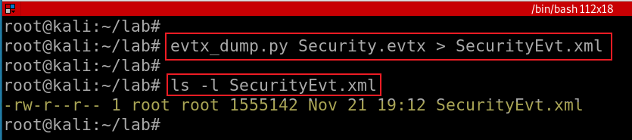
12. List all traces about the system on/off and the user logon/logoff
It should be considered only during a time range between 09:00 and 18:00 in the timezone (Eastern Time) from Question 4.
Exam security event logs for logon/logoff
Notes:
evtx_dump.py Security.evtx > SecurityEvt.xml

Slide 3
Overview
Install XML parser (xmlstarlet)
Validating Security Event Log XML documents
Display element structure of XML document
Format XML document
Query XML documents
Modify or edit XML documents

Slide 4
Install XML parser

Slide 5
xmlstarlet
Is a set of command line utilities (tools)
transform, query, validate, and edit XML documents and files
Using simple set of shell commands
Similar to grep, sed, awk
http://xmlstar.sourceforge.net/doc

Slide 6
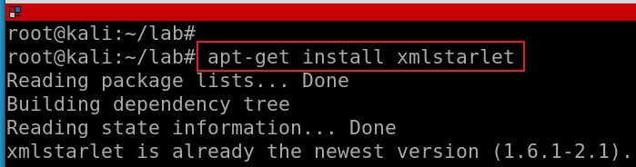
Install xmlstartlet
Notes:
apt-get install xmlstarlet

Slide 7
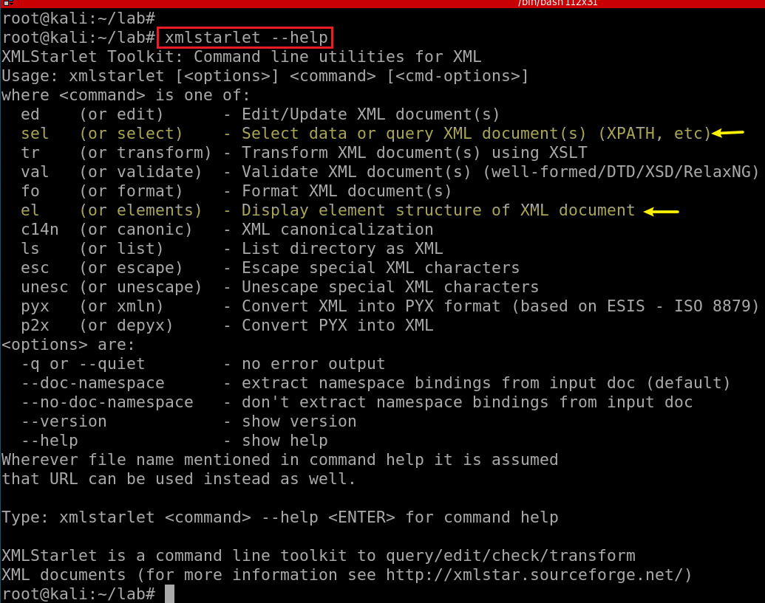

Slide 8
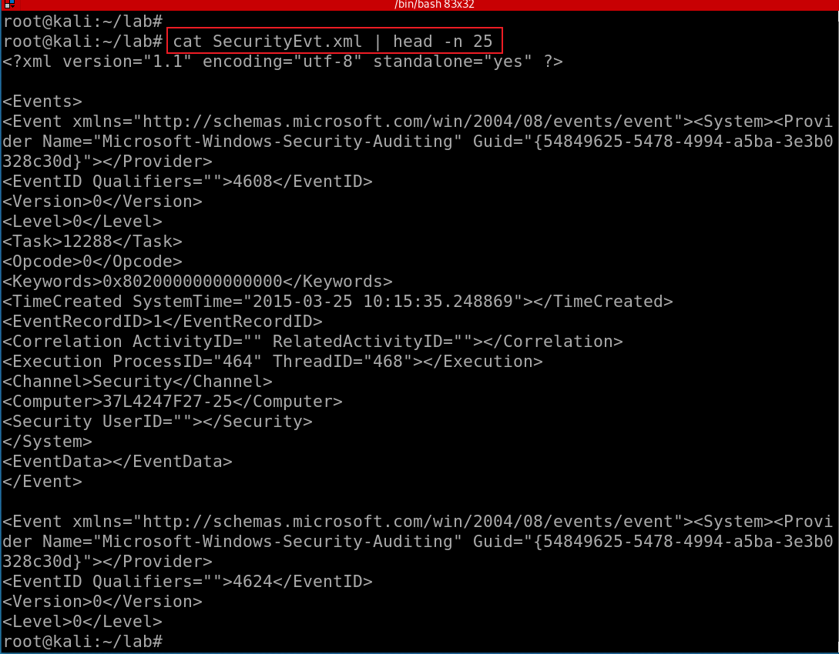
Show SecurityEvt.xml
XML Namespaces provide a method to avoid element name conflicts.
defined by an xmlns attribute in the start tag of an element.
xmlns:prefix="URI".
<table> <tr> <td>Apples</td> <td>Bananas</td> </tr> </table>
<table> <name>African Coffee Table</name> <width>80</width> <length>120</length> </table
Notes:
https://www.w3schools.com/xml/xml_namespaces.asp

Slide 9
validating XML documents

Slide 10
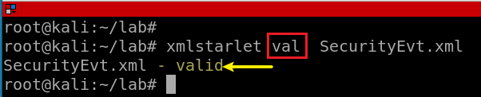
Notes:
xmlstarlet val SecurityEvt.xml

Slide 11
Display element structure of XML document
or elements

Slide 12
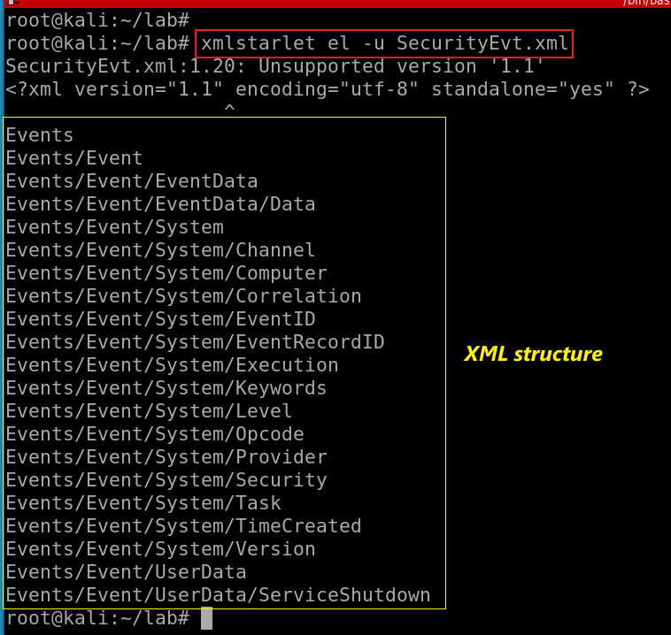
Show the element structure of SecurityEvt.xml
el: Display element structure of XML document
-u: print out sorted unique lines
Notes:
xmlstarlet el -u SecurityEvt.xml
xmlstarlet el -u SecurityEvt.xml 2>/dev/null

Slide 13
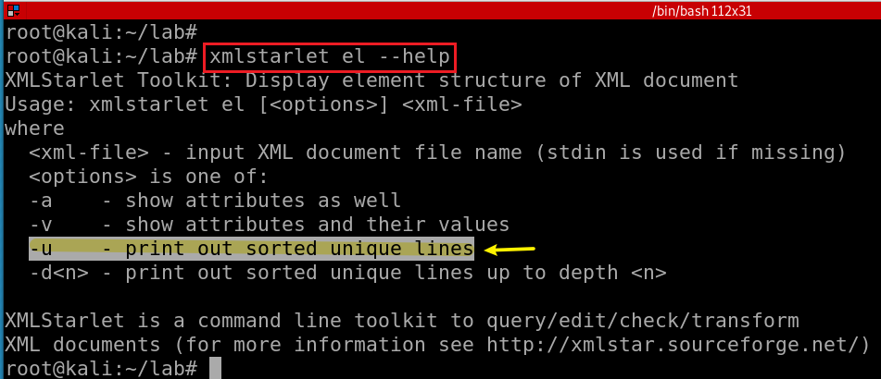
Notes:
xmlstarlet el --help

Slide 14
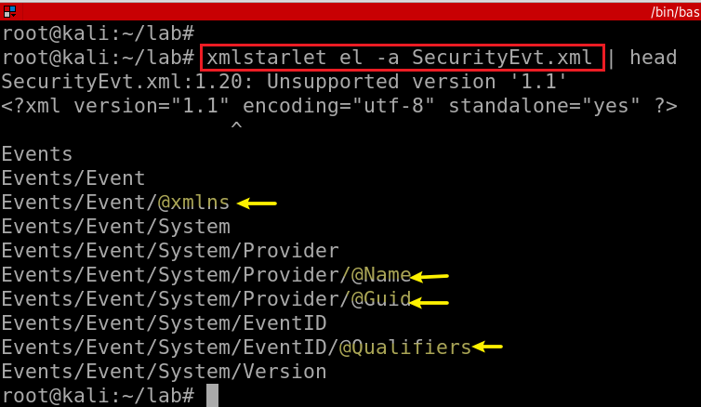
Show the element (attributes) structure of SecurityEvt.xml
-a: show attributes

Slide 15
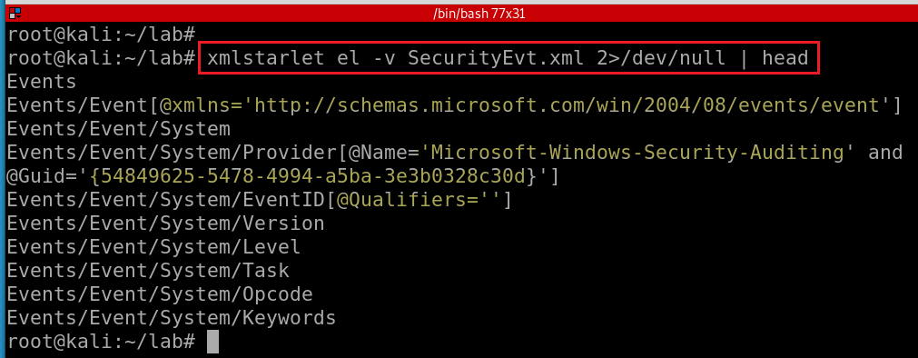
Show element attributes and their values
-v : show attributes and their values
Notes:
xmlstarlet el -v SecurityEvt.xml 2>/dev/null | head

Slide 16
format XML document

Slide 17
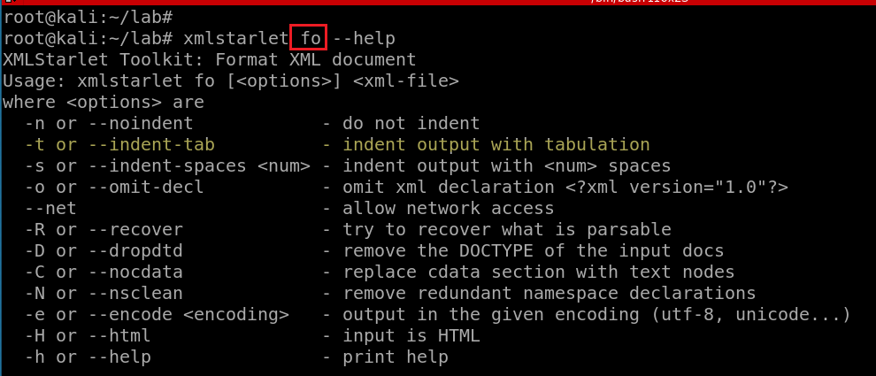

Slide 18
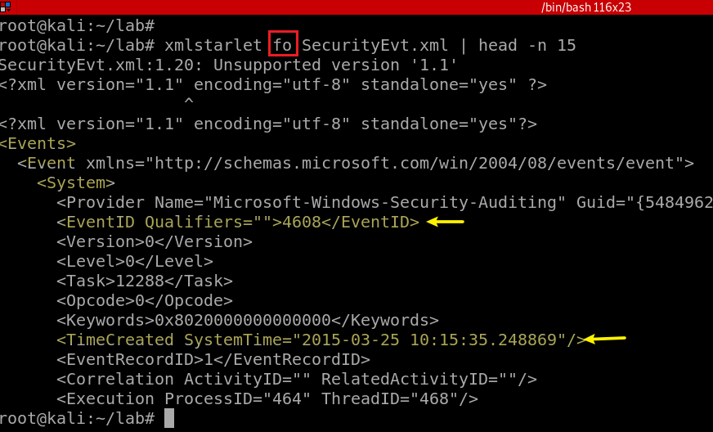
Notes:
xmlstarlet fo -n SecurityEvt.xml | head -n 15

Slide 19
select data or query XML document(s) (XPATH, etc)

Slide 20
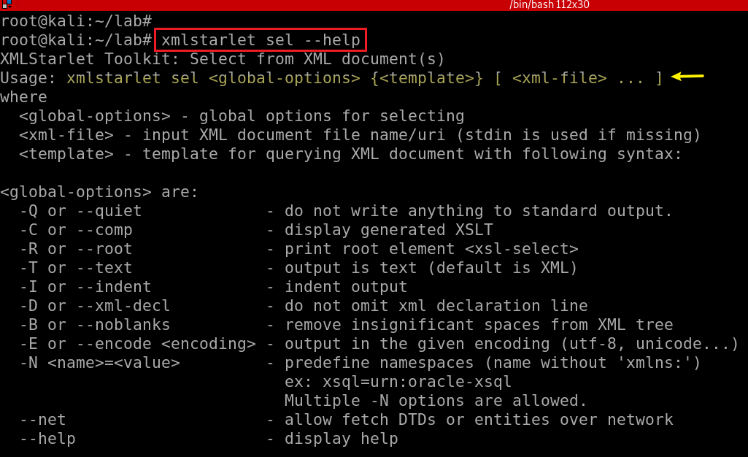

Slide 21
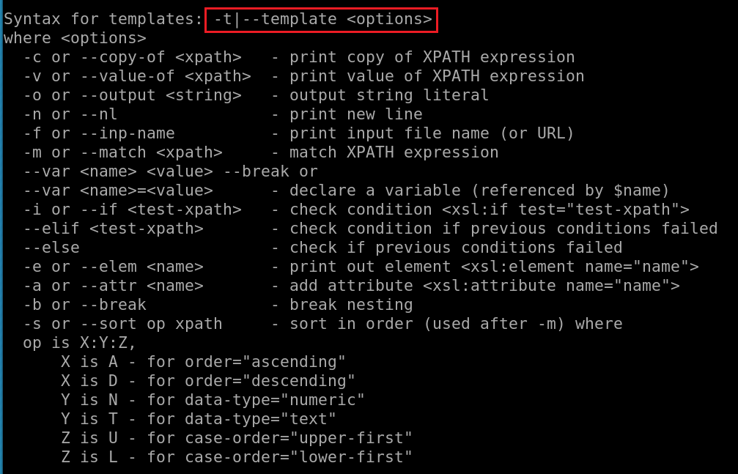
What is XPATH expression?

Slide 22
Xpath expressions
Xpath uses path expressions to select nodes or node-sets in an XML document.
Xpath expressions look very much like the expressions you see when you work with a traditional computer file system.
Must provide XML namespace for queuing data

Slide 23
Xpath expressions
“//” operator, a convenient shorthand for selecting nodes at any level in a document.
x: namespace variable, e.g., x=http://schemas.microsoft.com/win/2004/08/events/event
First Event node
//x:Event[1]
Last event
//x:Event[last()]
Last two events
//x:Event[position()<3]
EventID with an attribute named Qualifiers
//x:EventID[@Qualifiers]
Notes:
https://www.marklogic.com/blog/xpath-punctuation-part-1/

Slide 24
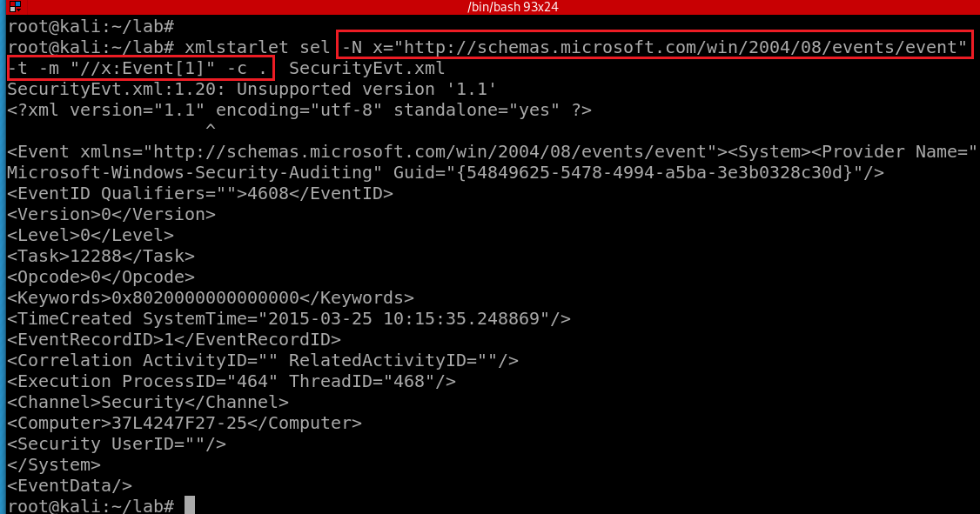
Select the first event by matching the xpath and print the context node
-N: namespace
x: namespace variable
The dot (“.”) : the “context item expression” because it refers to the context item.
This could be a node (such as an element, attribute, or text node), or an atomic value (such as a string, number, or boolean).
When it’s a node, it’s also called the context node.
-c or --copy-of <xpath>: print copy of XPATH expression
options
-m: match XPATH expression
-t|--template <options>
Notes:
xmlstarlet sel -N x="http://schemas.microsoft.com/win/2004/08/events/event" -t -m "//x:Event[1]" -c . SecurityEvt.xml

Slide 25
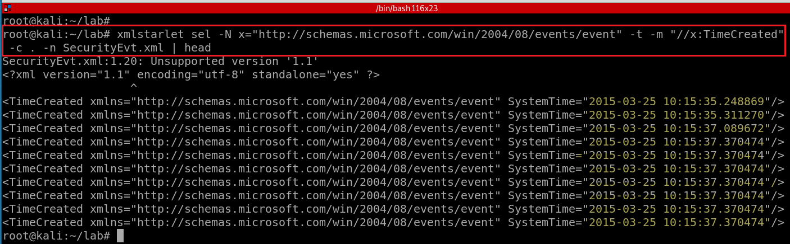
Select TimeCreated of events and print the context node
Notes:
xmlstarlet sel -N x="http://schemas.microsoft.com/win/2004/08/events/event" -t -m "//x:TimeCreated" -c . -n SecurityEvt.xml
http://xmlstar.sourceforge.net/doc/UG/xmlstarlet-ug.html#idm47077139523728

Slide 26
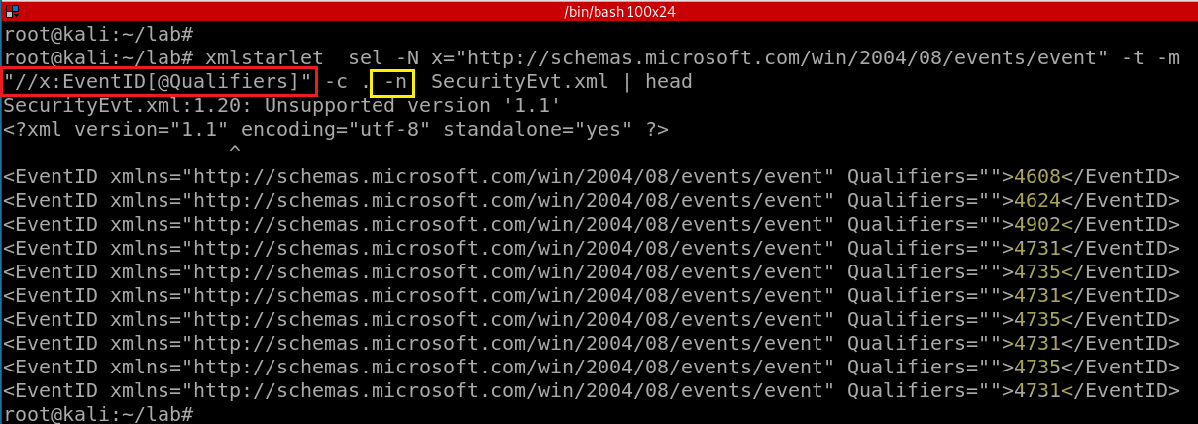
4608 (Windows is starting up)
1100 (service shutdown)
4624 (successful logon)
4634 (logoff)
4625 (logon failure)
4647 (a user initiated the logoff process)...
Select a property of EventID and print the context node
-n: print new line
Notes:
xmlstarlet sel -N x="http://schemas.microsoft.com/win/2004/08/events/event" -t -m "//x:EventID[@Qualifiers]" -c . -n SecurityEvt.xml | head

Slide 27
Substitute xmlstarlet sel results using sed
Notes:
https://www.grymoire.com/Unix/Sed.html#uh-1

Slide 28
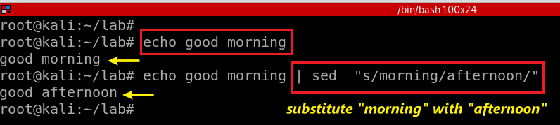
stream editor
Used to perform basic text transformations on an input stream (a file or input from a pipeline).
Can apply regular expression
Substitute morning in text stream with afternoon
Notes:
echo good morning | sed "s/morning/afternoon/"

Slide 29
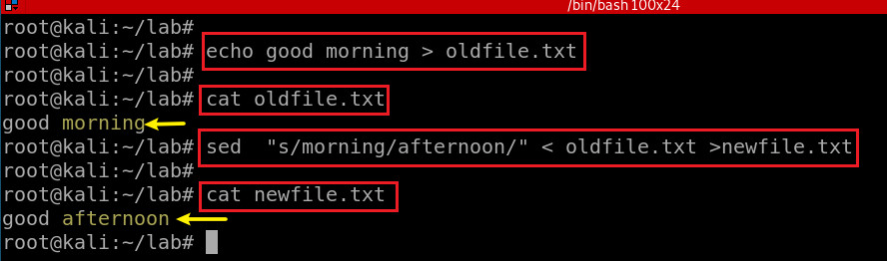
Substitute morning in text stream with afternoon

Slide 30
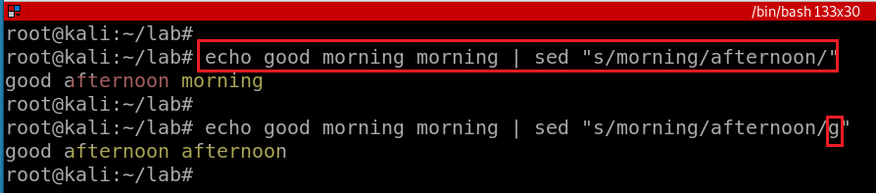
/g - Global replacement

Slide 31
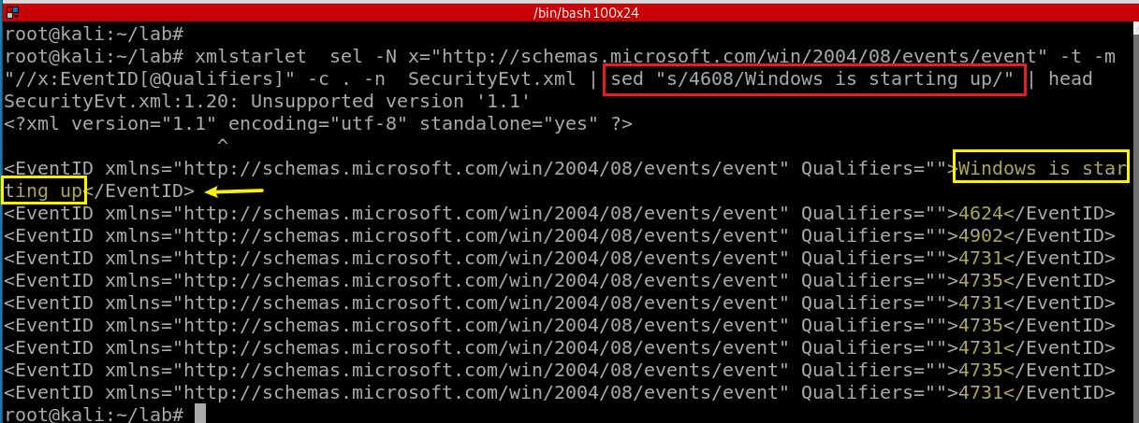
4608 (Windows is starting up)
1100 (service shutdown)
4624 (successful logon)
4634 (logoff)
4625 (logon failure)
4647 (a user initiated the logoff process)...
Notes:
https://www.grymoire.com/Unix/Sed.html

Slide 32
edit XML document(s)

Slide 33
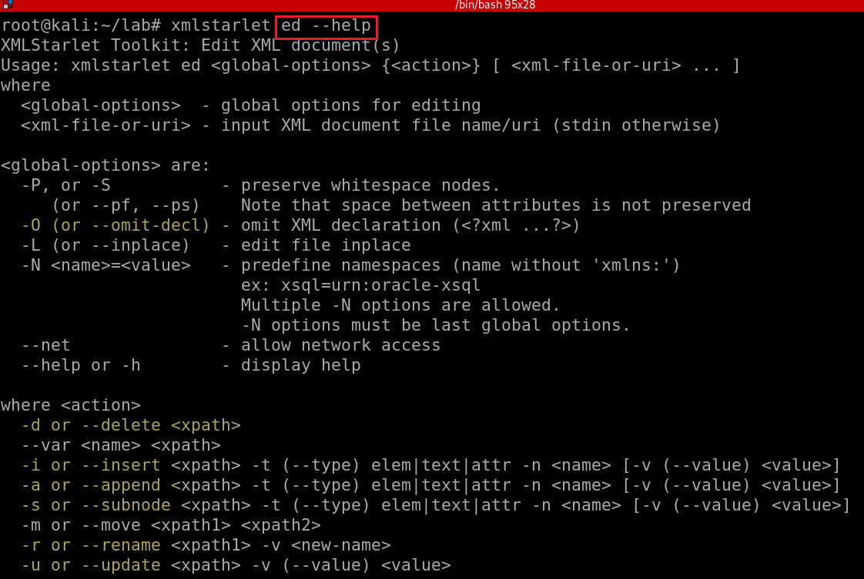
Notes:
xmlstarlet ed --help

Slide 34
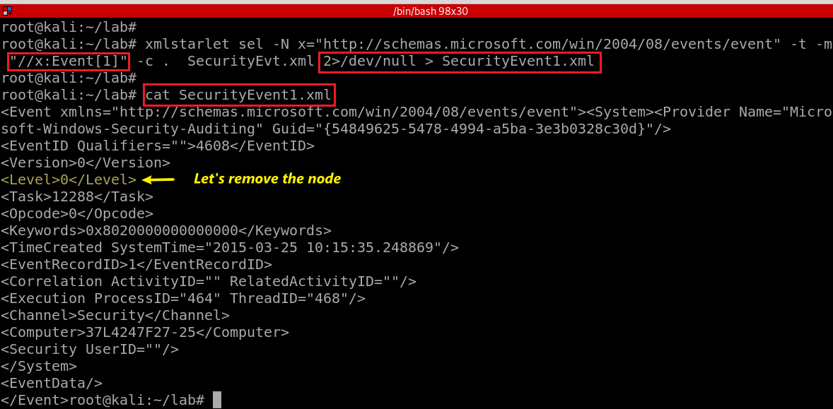
Notes:
xmlstarlet sel -N x="http://schemas.microsoft.com/win/2004/08/events/event" -t -m "//x:Event[1]" -c . SecurityEvt.xml 2>/dev/null > SecurityEvent1.xml

Slide 35
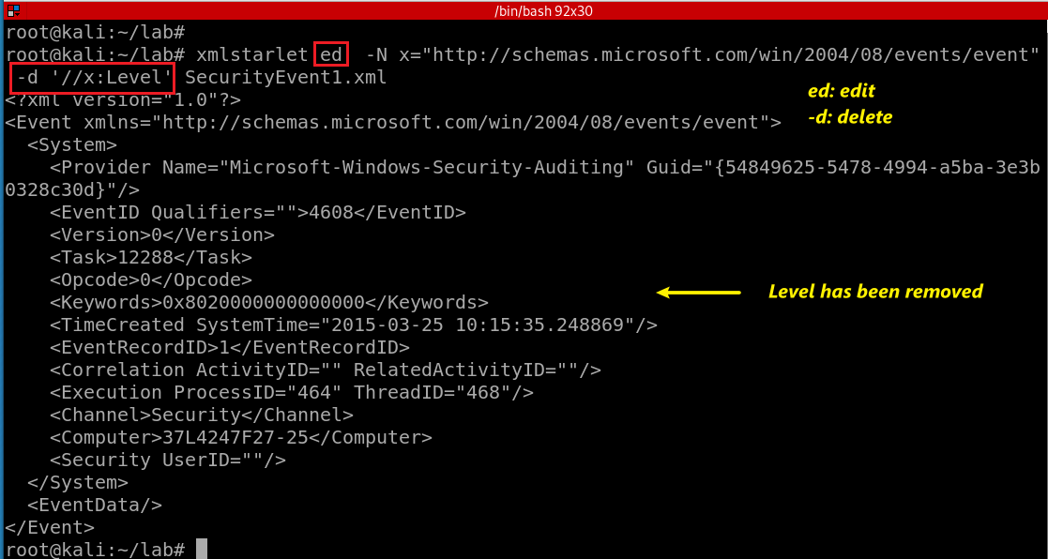
“delete” the node <Level></Level>
Notes:
xmlstarlet ed -N x="http://schemas.microsoft.com/win/2004/08/events/event" -d '//x:Level' SecurityEvent1.xml

Slide 36
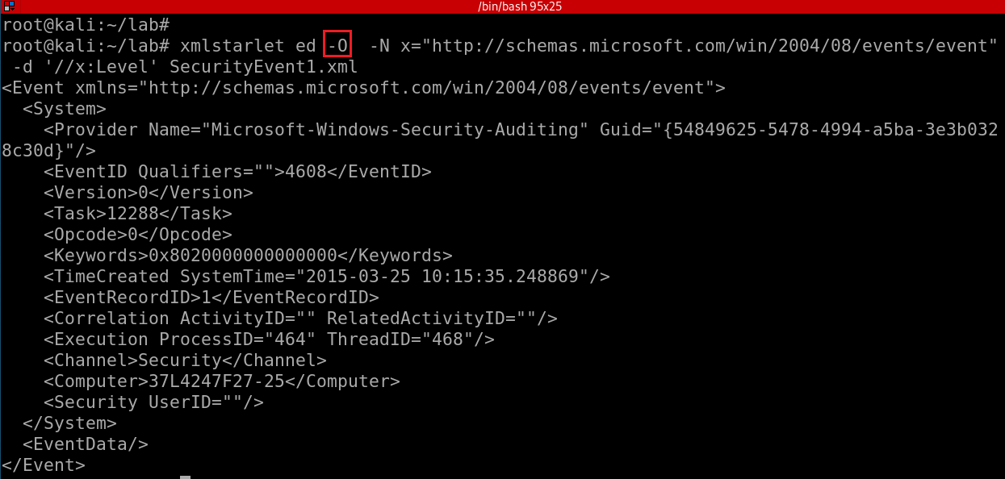
Omit XML declaration (<?xml ...?>) and “delete” the node <Level></Level>
-d: is not actually deleting the note,
only show deleted stream
How to actually delete a node?
Notes:
xmlstarlet ed -O -N x="http://schemas.microsoft.com/win/2004/08/events/event" -d '//x:Level' SecurityEvent1.xml

Slide 37
Deleting namespace declarations
Notes:
http://xmlstar.sourceforge.net/doc/UG/xmlstarlet-ug.html#idm47077139529952
xml ed -N N="http://www.c.com/xyz" -d '//N:*' ns2.xml | \ sed -e 's/ xmlns.*=".*"//g'

Slide 38
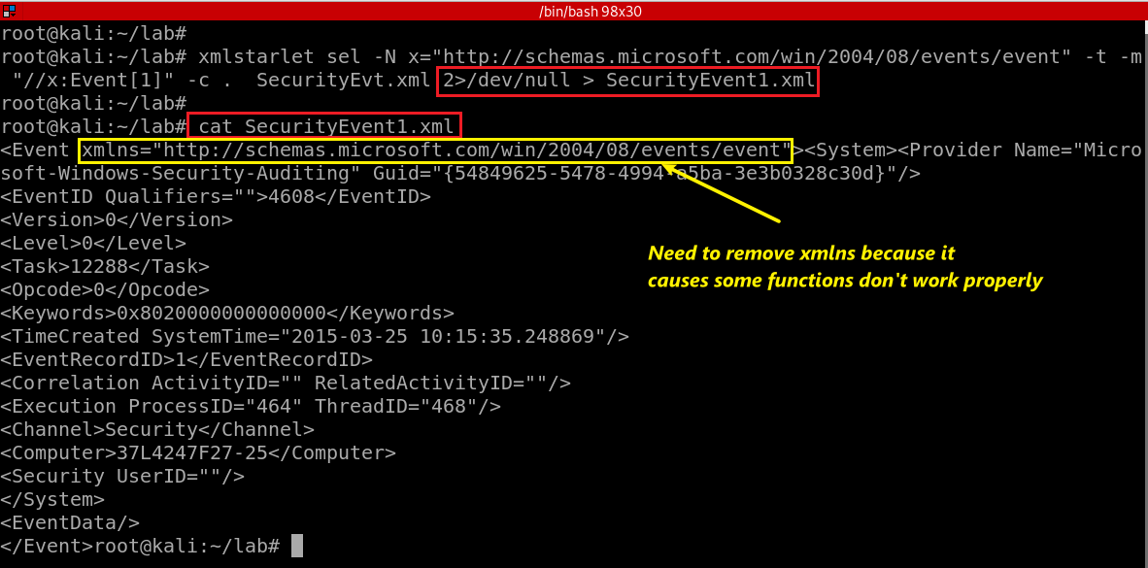
Notes:
xmlstarlet sel -N x="http://schemas.microsoft.com/win/2004/08/events/event" -t -m "//x:Event[1]" -c . SecurityEvt.xml 2>/dev/null > SecurityEvent1.xml

Slide 39
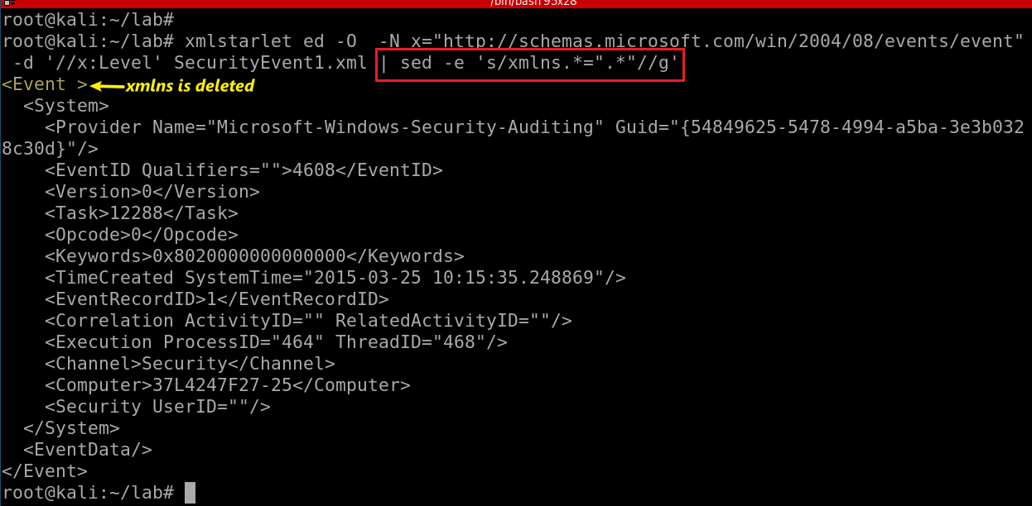
Substitute xmlns with nothing (remove xmlns)
-e: regular expression
s/e1/e2/g:
s: substitute
e1: regex
e2: regex
g: globe
Notes:
xmlstarlet ed -O -N x="http://schemas.microsoft.com/win/2004/08/events/event" -d '//x:Level' SecurityEvent1.xml | sed -e 's/xmlns.*=".*"//g'
http://xmlstar.sourceforge.net/doc/UG/xmlstarlet-ug.html#idm47077139529952

Slide 40
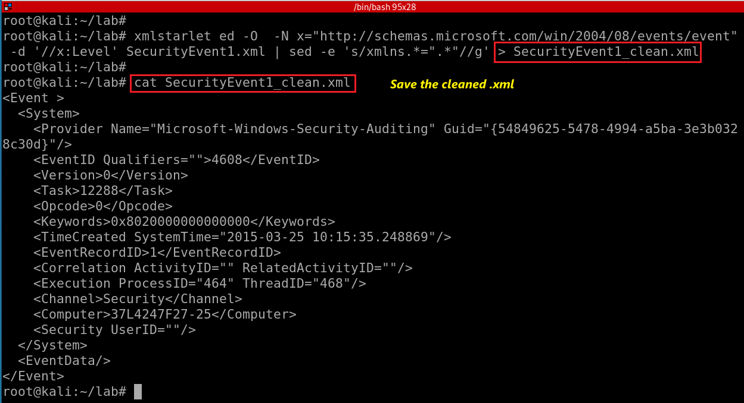
Notes:
xmlstarlet sel -N x="http://schemas.microsoft.com/win/2004/08/events/event" -t -m "//x:Event[1]" -c . SecurityEvt.xml 2>/dev/null > SecurityEvent1.xml
xmlstarlet ed -O -N x="http://schemas.microsoft.com/win/2004/08/events/event" -d '//x:Level' SecurityEvent1.xml | sed -e 's/xmlns.*=".*"//g' > SecurityEvent1_clean.xml

Slide 41
Transforming an XML Document into a CSV

Slide 42
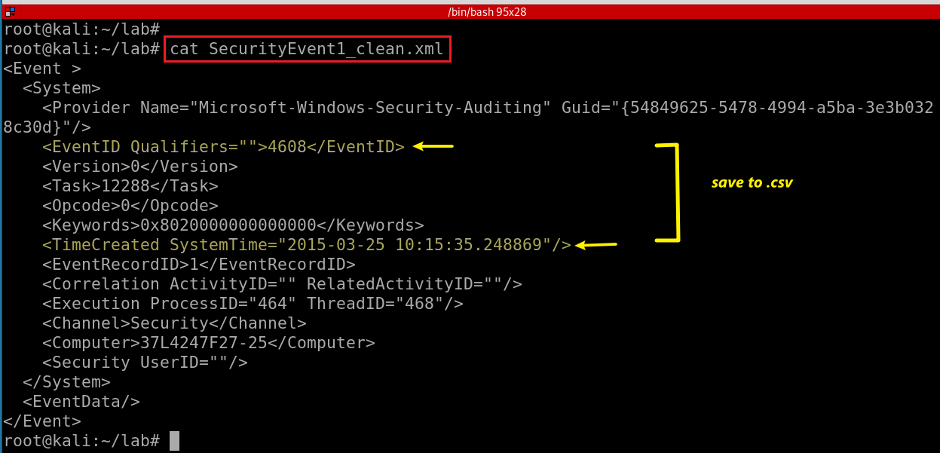
We want to save EventID and ItemCreated to .csv

Slide 43
<Event><System><Provider Name="Microsoft-Windows-Security-Auditing" Guid="{54849625-5478-4994-a5ba-3e3b0328c30d}"></Provider>
<EventID Qualifiers="">4608</EventID>
<Version>0</Version>
<Level>0</Level>
<Task>12288</Task>
<Opcode>0</Opcode>
<Keywords>0x8020000000000000</Keywords>
<TimeCreated SystemTime="2015-03-25 10:15:35.248869"></TimeCreated>
<EventRecordID>1</EventRecordID>
<Correlation ActivityID="" RelatedActivityID=""></Correlation>
<Execution ProcessID="464" ThreadID="468"></Execution>
<Channel>Security</Channel>
<Computer>37L4247F27-25</Computer>
<Security UserID=""></Security>
</System>
<EventData></EventData>
</Event>
Notes:
https://www.joyofdata.de/blog/transforming-xml-document-into-csv-using-xmlstarlet/

Slide 44
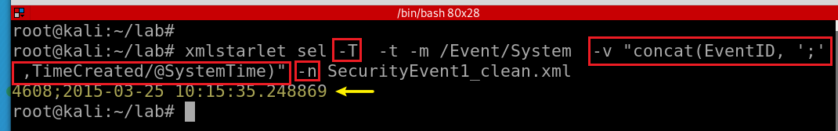
-T: output is text
-t: template
-m: template
-v: print value of xpath
-n: new line
Display EventID and ItemCreated in text
Notes:
xmlstarlet sel -T -t -m /Event/System -v "concat(EventID, ';' ,TimeCreated/@SystemTime)" -n SecurityEvent1_clean.xml

Slide 45
Assignments

Slide 46
Assignments
Timestamp conversion
Convert all events to .csv

