Slide 1
Investigate Data Leakage Case
Keywords: emails, USB, libpff
Notes:
http://xmlstar.sourceforge.net/doc/UG/

Slide 2
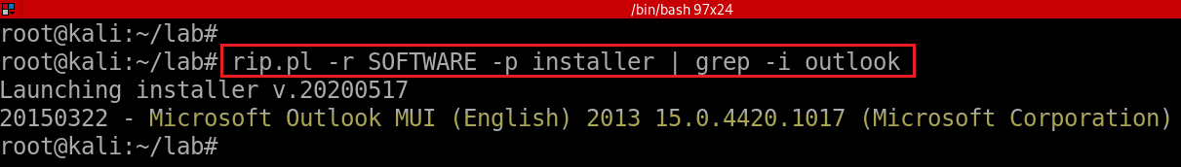
18. What application was used for e-mail communication?
rip.pl installer plugin; grep for Outlook
List of email clients
https://en.wikipedia.org/wiki/Comparison_of_email_clients
Notes:
rip.pl -r SOFTWARE -p installer | grep -i outlook

Slide 3
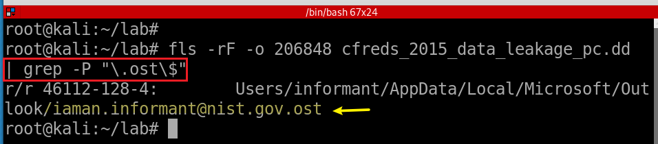
19. Where is the e-mail file located?
20. What was the e-mail account used by the suspect?
-r: Recursive on directory entries
-F: Display only files
Notes:
fls -rF -o 206848 cfreds_2015_data_leakage_pc.dd | grep -P "\.ost\$"

Slide 4
21. List all e-mails of the suspect. If possible, identify deleted e-mails.
Install email extracting tool: libpff
Copy .ost file from a DD image
Extract email via libpff

Slide 5
libpff
libpff is a library to access the Personal Folder File (PFF) and the Offline Folder File (OFF) format.
These format are used by Microsoft Outlook to store email, contacts and other data.
Support file types
PAB (Personal Address Book)
PST (Personal Storage Table)
OST (Offline Storage Table)
https://github.com/libyal/libpff
Notes:
https://github.com/libyal/libpff

Slide 6
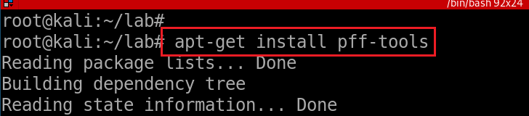
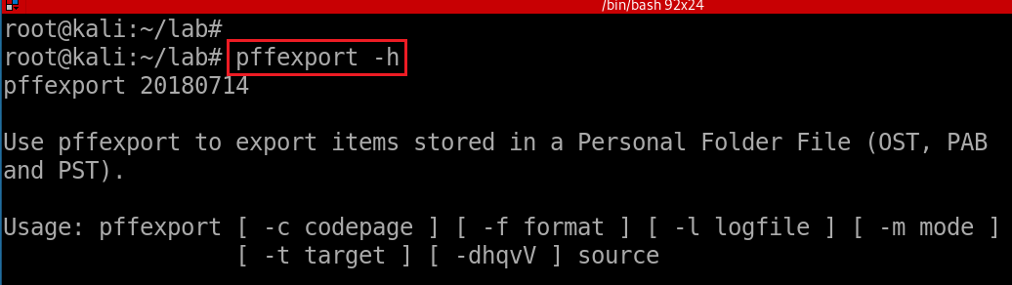
Install pffexport tool
Verify installation
Notes:
apt-get install pff-tools

Slide 7
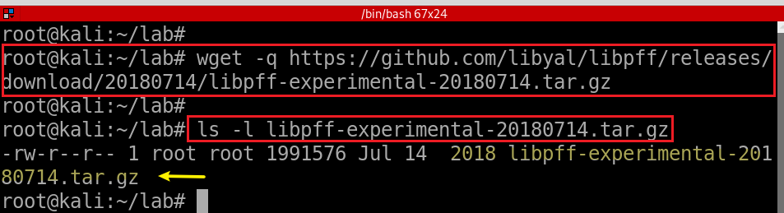
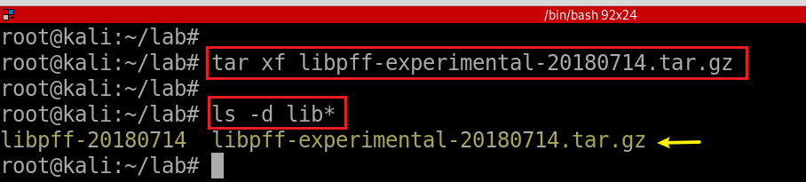
(Optional) Alternative Installation from source code
Download libpff via wget
Extract contents of tar.gz
Notes:
https://github.com/libyal/libpff/wiki/Building
wget -q https://github.com/libyal/libpff/releases/download/20180714/libpff-experimental-20180714.tar.gz
tar -xf libpff-experimental-20180714.tar.gz

Slide 8
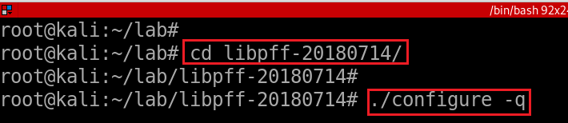


(Optional) Alternative Installation from source code

Slide 9
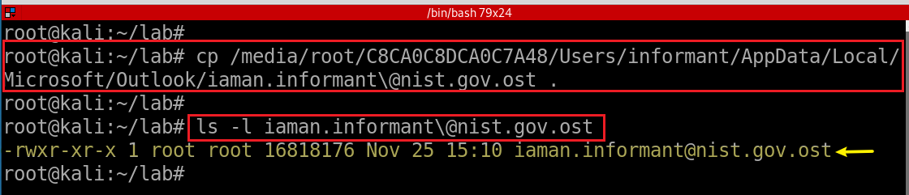
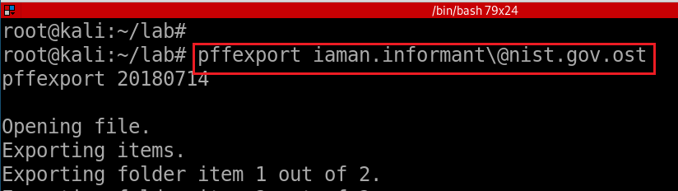
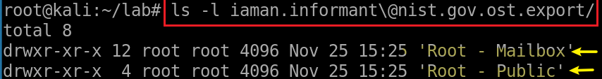
Copy email to current directory
-t: specify the basename of the target directory to export to
Extract emails via pffexport
Verify the default output directory
Notes:
losetup --partscan --find --show --read-only
cp /media/root/C8CA0C8DCA0C7A48/Users/informant/AppData/Local/Microsoft/Outlook/iaman.informant\@nist.gov.ost .
ls -l iaman.informant\@nist.gov.ost

Slide 10
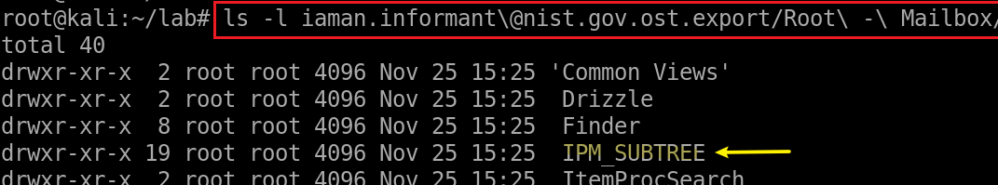
Access a message in suspect’s Mailbox
IPM_SUBTREE
Inbox
Outbox
Sent Items
Deleted Items
interpersonal message, or IPM, subtree. Created by MAPI
Messaging Application Programming Interface (MAPI) creates a tree of folders beneath the root folder of a message store for all clients that send messages to and receive messages from human, rather than computer, recipients.
Notes:
ls -l iaman.informant\@nist.gov.ost.export/Root\ -\ Mailbox/

Slide 11
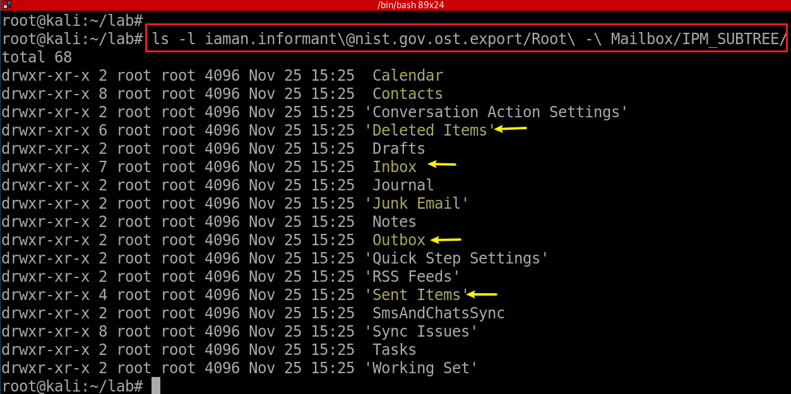
Access a message in suspect’s IPM_SUBTREE

Slide 12
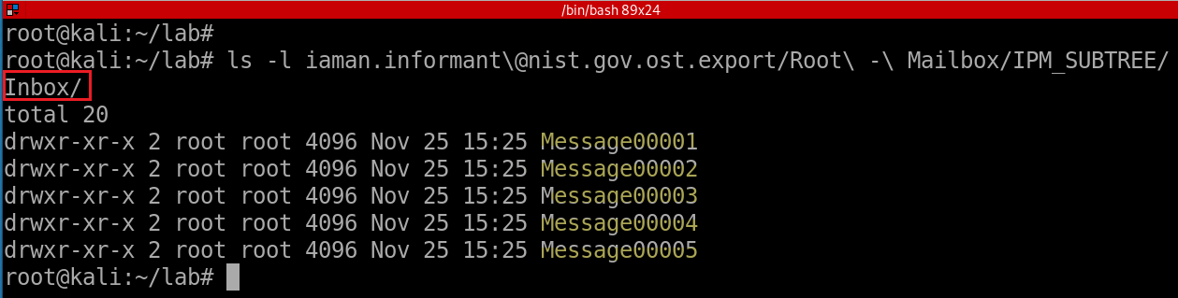
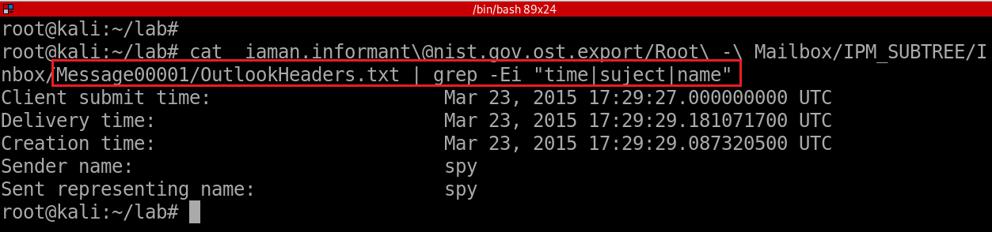
Notes:
ls -l iaman.informant\@nist.gov.ost.export/Root\ -\ Mailbox/IPM_SUBTREE/Inbox/
cat iaman.informant\@nist.gov.ost.export/Root\ -\ Mailbox/IPM_SUBTREE/Inbox/Message00001/OutlookHeaders.txt | grep -Ei "time|suject|name"

Slide 13
22. List external storage devices attached to PC.
What are we looking for?
Possible Answer | Device Name | Volume Name | Serial No. | First Connected Time | Connected Time After Reboot
 | SanDisk Cruzer Fit USB Device |  | 4C530012450531101593 | 2015-03-23 14:31:10 Mon | 2015-03-24 09:38:00 Tue
 | SanDisk Cruzer Fit USB Device | IAMAN $_@ | 4C530012550531106501 | 2015-03-24 09:58:32 Tue | 2015-03-24 09:58:33 Tue

Slide 14
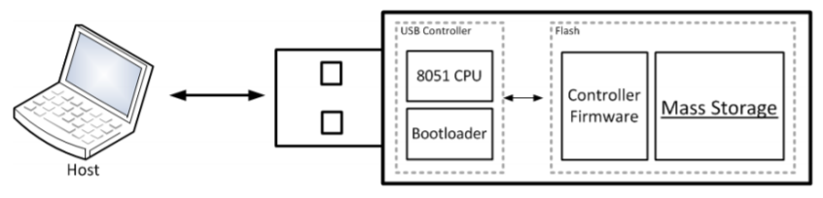
22.0 Understand Plug and Play (PnP) Manager
When a USB is plugged in, the PnP Manager finds device ID (Hardware ID or Compatible ID)
Receives the event => enumerates devices from firmware (of a device) => device ID
OS locates the appropriate driver for the device
Queries the device descriptor (.inf) uses device IDs
OS loads that driver use .inf
Once the device has been identified
Multiple registry keys will be generated
USB Mass Storage device Class (MSC) communication protocols

Slide 15
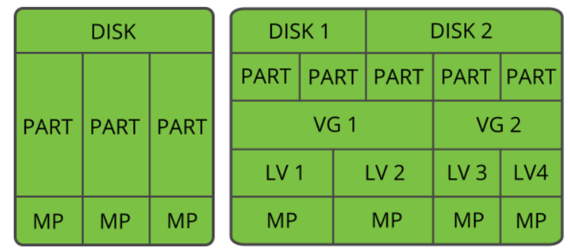
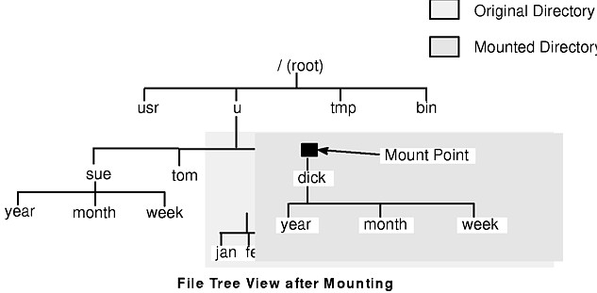
Disk, Partition, Volume, Mountpoint
partition start/end section
Vendor, Product, Serial #
Disk/drive signature (assigned by Win OS)
physical layer
Logical layer
Logical volume: Volume name, Drive letter, Volume serial number XXXX-XXXX (generated when format a volume)
MountPoints: GUID of path or Volume
MountedDevices map to MP GUID: \??\Volume\GUID
Notes:
https://documentation.suse.com/it-it/sles/12-SP3/html/SLES-all/cha-lvm.html

Slide 16
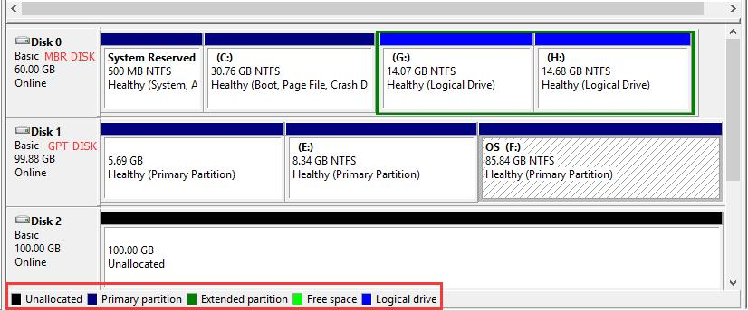
What information want to exam?
Time
First Connected Time (driver installed)
Time USB Last Attached
Time USB Last Attached after reboot
Vendor/ Product ID/ Serial #
User Account
Volume
Mounted Volume
Mounted Volume GUID
Assigned Volume Drive Letter
Volume
Unallocated Space
physical space on a hard drive that doesn't belong to a partition.
no programs can write to the space.
the space doesn't exist to the operating system.
need to either create a new partition using the space or expand an existing partition.
Notes:
https://www.forensicfocus.com/forums/general/usbstor-registry-entries-windows-7/

Slide 17
Locations | Time/Volume Serial # assigned by Windows | Vendor ID | Product ID | Product Serial #
SetupAPI Log | First installed/Connected Time | √ | √ | √
HKLM\SYSTEM\ControlSet###\Enum\USBSTOR\ HKLM\SYSTEM\CurrentControlSet\Enum\USB | First Connected Time Time Last Attached after reboot | √ | √ | √
HKU\informant\SOFTWARE\Microsoft\WindowsNT\CurrentVersion\EMDMgmt |  |  |  | √
HKU\informant\Software\Microsoft\Windows\CurrentVersion\Explorer\MountPoints2\ | User Account that mounted volume, Time USB Last Attached, Volume GUID
HKLM\SYSTEM\MountedDevices\ | Volume GUID and Assigned Volume
Notes:
https://www.forensicfocus.com/forums/general/usbstor-registry-entries-windows-7/

Slide 18
Other Locations to exam
Device (setup) Classes
HKLM\SYSTEM\ControlSet###\Control\DeviceClasses\{a5dcbf10-6530-11d2-901f-00c04fb951ed}\
HKLM\SYSTEM\ControlSet###\Control\DeviceClasses\{53f56307-b6bf-11d0-94f2-00a0c91efb8b}\
Volume Info Cache
HKLM\SOFTWARE\Microsoft\Windows Search\VolumeInfoCache
System Events
\Windows\System32\winevt\Logs\System.evtx

Slide 19
22.1 SetupAPI
The Plug and Play (PnP) manager and SetupAPI log information about device installation in a plain-text log file to
Verify the installation of a device
Troubleshoot device installation problems.
"device did not install"
"wrong driver installed"
"Exit status: FAILURE".
Implemented in Windows Vista and later versions of Windows,
Device installation: setupapi.dev.log
Application installation: setupapi.app.log
Default location %SystemRoot%\inf

Slide 20
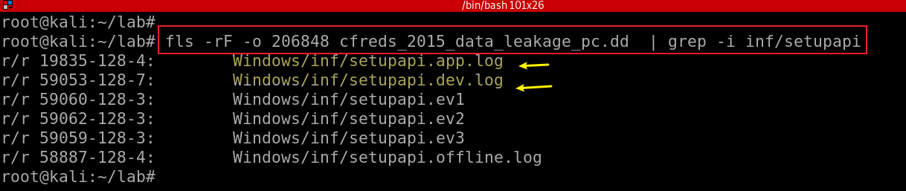
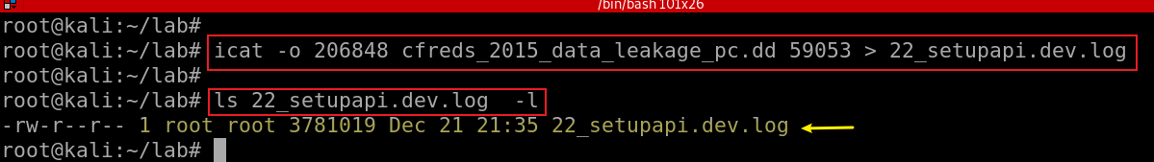
22.1 SetupAPI Log
Find the log file “setupspi.dev.log” by default
Extract setupspi.dev.log
Notes:
fls -rF -o 206848 cfreds_2015_data_leakage_pc.dd | grep -i inf/setupapi
icat -o 206848 cfreds_2015_data_leakage_pc.dd 59053 > 22_setupapi.dev.log
ls -l 22_setupapi.dev.log

Slide 21
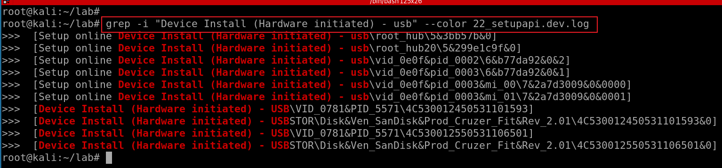
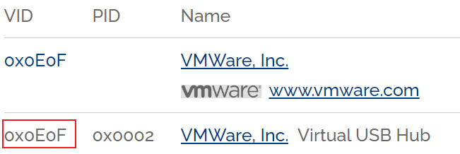
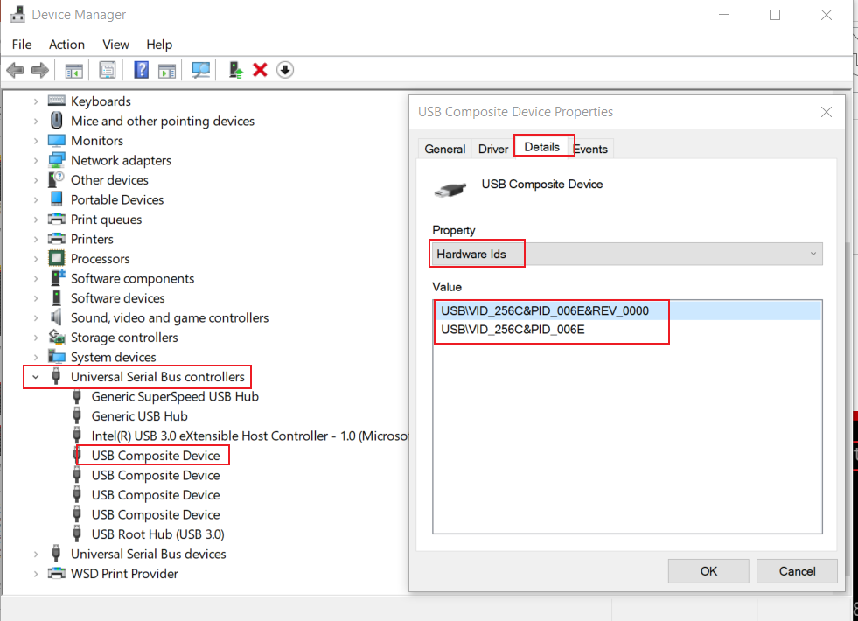
Search for usb installation evets
Two USB devices are discovered
VID/PID/Serial No:
Vendor IDentification: 0781
Product Identification: 5571
Serial No 1: 4C530012450531101593
Serial No 2: 4C530012550531106501
Can be used to restrict what USB devices can be utilized within an environment.
Notes:
grep -i "Device Install (Hardware initiated) - usb" --color 22_setupapi.dev.log

Slide 22
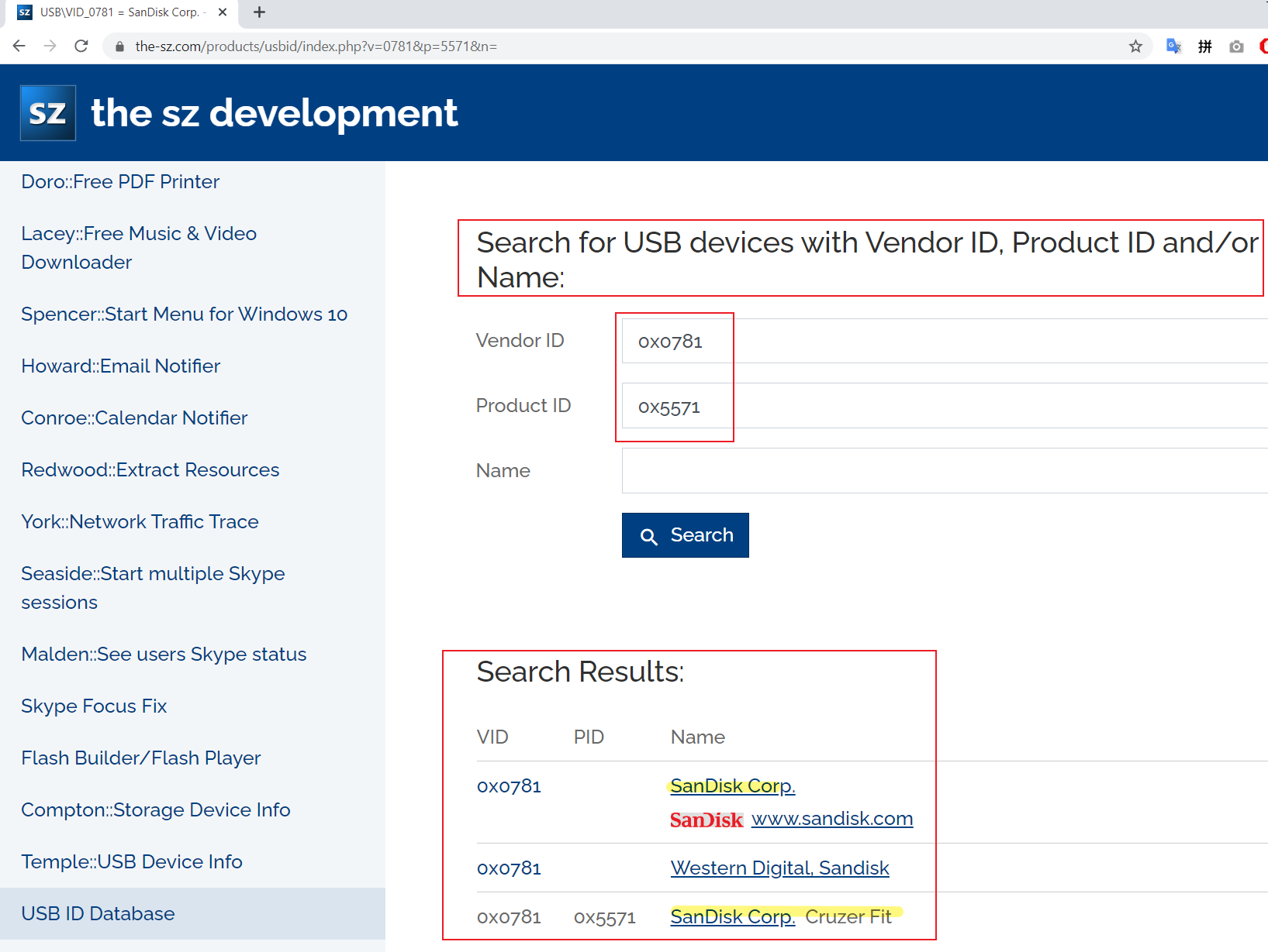
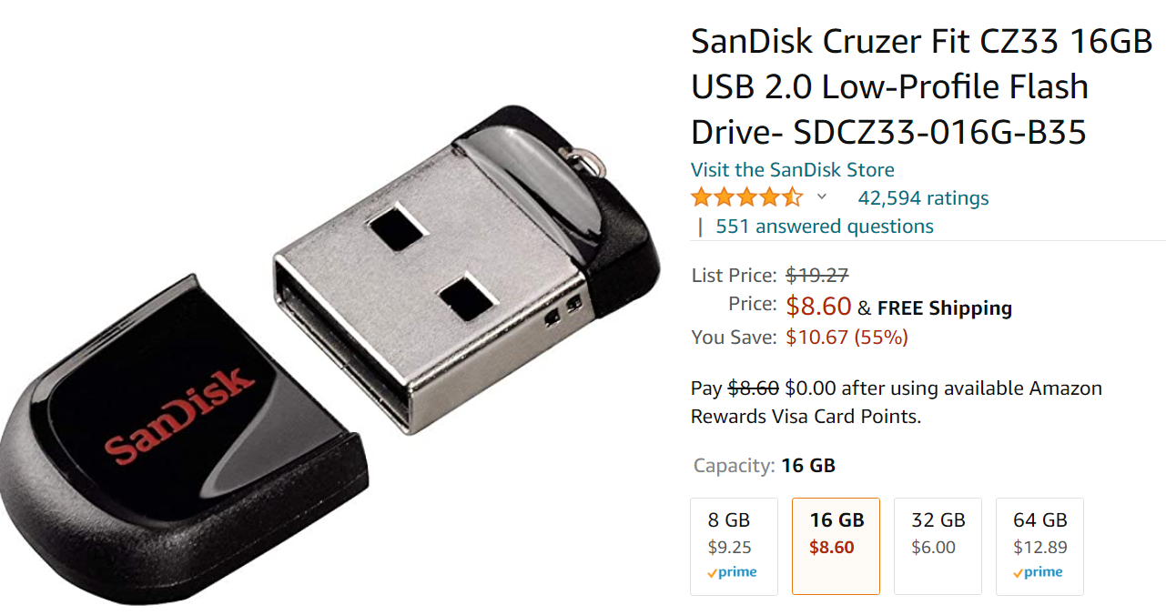
Notes:
https://www.the-sz.com/products/usbid/index.php?v=0781&p=5571&n=

Slide 23
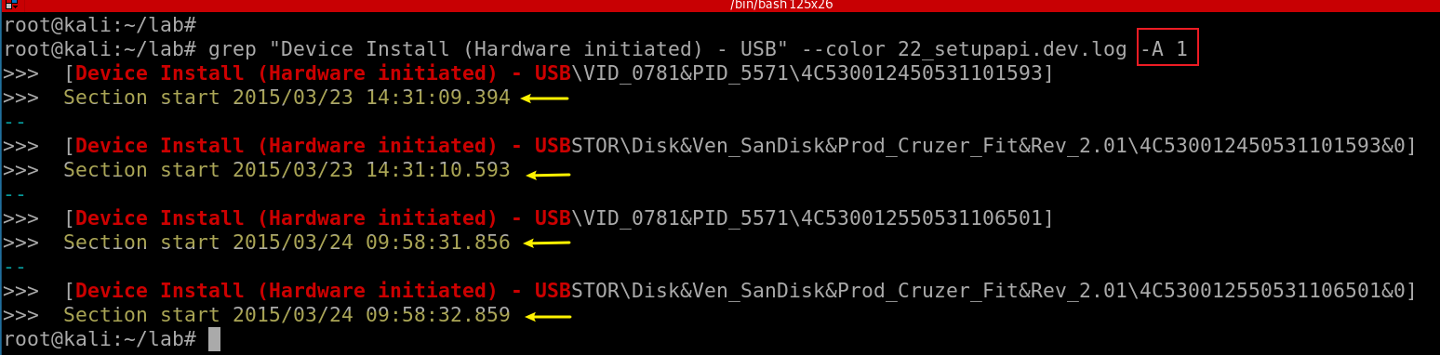
Exam the timestamps of driver installation
serial #
Conclusion:
Two USBs have been attached to the PC
OS recognized USBs right after USBs were attached to the PC
Notes:
grep "Device Install (Hardware initiated) - USB" --color 22_setupapi.dev.log -A 1

Slide 24
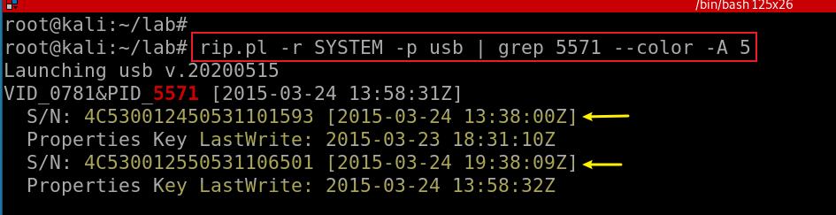
22.2 Exam SanDisk Cruzer Fit USB registry
Search for SanDisk Cruzer Fit USB via product ID
Connected Time After Reboot
Lastwrite Time
'Z' stands for Zulu time, which is also GMT and UTC
UTC-> EST convert: - 5 hours
Note: the timestamps are incorrect (one hour off -6 hours)
Notes:
rip.pl -r SYSTEM -p usb | grep 5571 --color -A 5

Slide 25
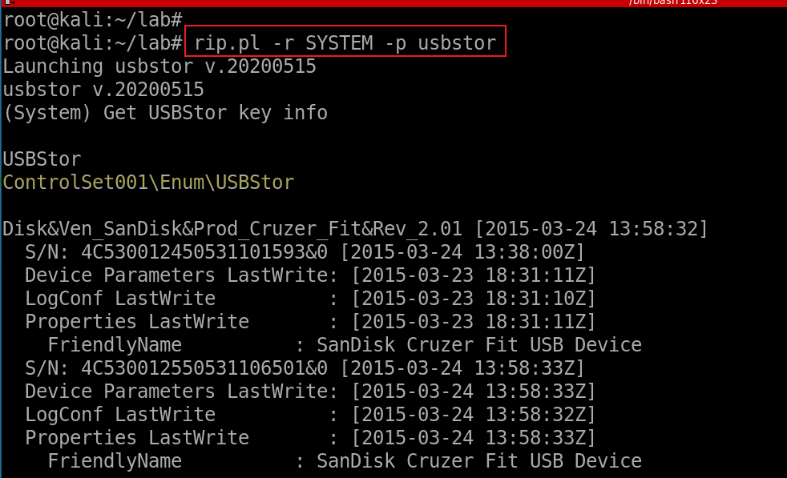
22.3 Exam USBStor registry
What is that?
Notes:
rip.pl -r SYSTEM -p usbstor

Slide 26
22.4 External Memory Device Management
When you insert a flash device like a USB key into a system
EMDMgmt (i.e., a part of ReadyBoost) service looks at the device to determine its performance characteristics
e.g., it's capabilities and see if it's suitable for use
Stores the results of its test in HKLM\SOFTWARE\Microsoft\Windows NT\CurrentVersion\Emdmgmt.
Contains Volume serial number
ReadyBoost consists of a service implemented in
%SystemRoot%\System32\Emdmgmt.dll
that runs in a Service Host process, and
%SystemRoot%\System32\Drivers\Ecache.sys
a volume filter driver,

Slide 27
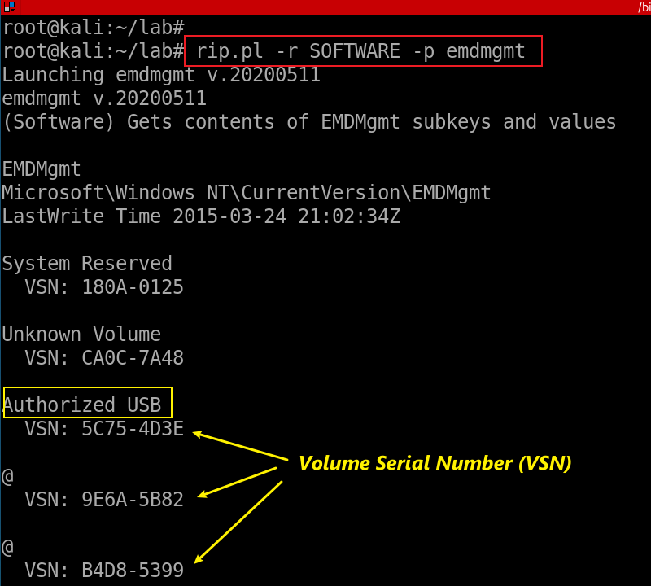
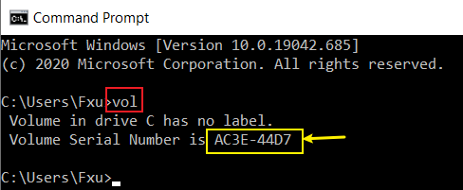
Volume serial number
The volume serial number is written to the volume by Windows each time it is formatted.
This value is calculated using the current date and time, and can be easily viewed by opening a command prompt to the volume (i.e., C:\, D:\, etc.) and typing the vol command.
Notes:
http://windowsir.blogspot.com/2009/05/definitions.html

Slide 28
22.5 MountPoints2
A volume mount point is a drive or volume in Windows that is mounted to a folder that uses the NTFS file system.
A mounted drive is assigned a drive path instead of a drive letter.
Volume mount points enable you to exceed the 26-drive-letter limitation.
By using volume mount points, you can graft, or mount, a target partition onto a folder on another physical disk.
MountPoints2 is a registry entry that stores data to USB devices/ removable hard drives
USB keys (removable device seen so far)
autorun actions for various devices.
Contain GUID of a mount point
May need to correlate the Volume entries to those found in the MountedDevices entries that begin with "\??\Volume"
Notes:
rip.pl -r NTUSER_informant.DAT -p mp2

Slide 29
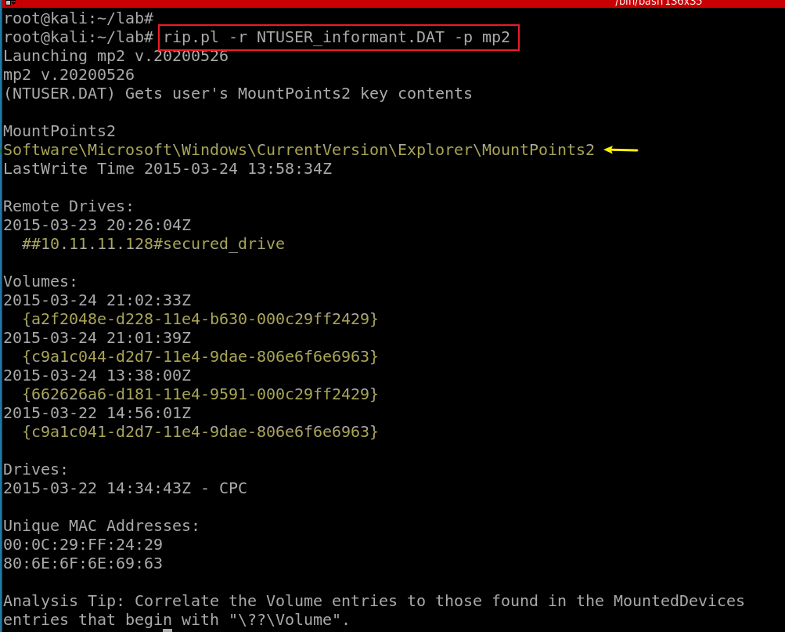
four mountpoint GUID
Notes:
rip.pl -r NTUSER_informant.DAT -p mp2

Slide 30

22.6 Mounted Devices
Devices attached to computer
Persistent volume name
Drive letter
GUID (unique internal identifier of a mount point)
Disk/Drive Signature
Device types include
USB storage devices
DVD/CDROM
root
folder1
file1
file2
folder2
mounting point
GUID
don’t have to have a drive letter
Vol 1
Vol 2
Disk Signature
C:

Slide 31
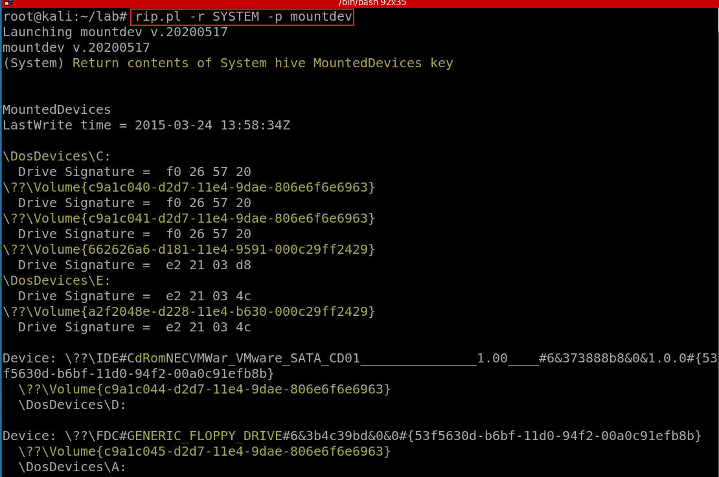
Show MountedDevices use plugin
The Drive/Disk Signature is a unique ID number that Windows writes to a specific location inside the Master Boot Record (MBR) on the first sector of every hard drive that it sees
We can use Drive signature to group disk and volumes
One disk-> multiple volumes
C: is the main partition, Disk has two partitions
GUID of a mount point
Notes:
rip.pl –r SYSTEM –p mountdev

Slide 32
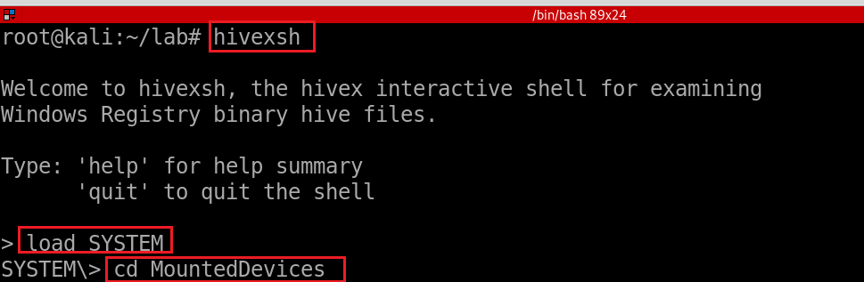
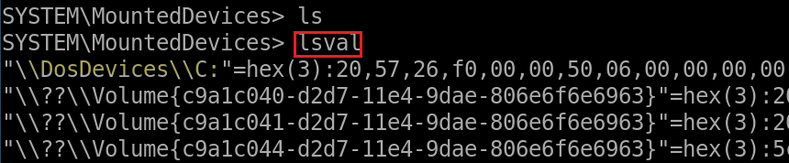
Show MountedDevices using hivexsh

Slide 33
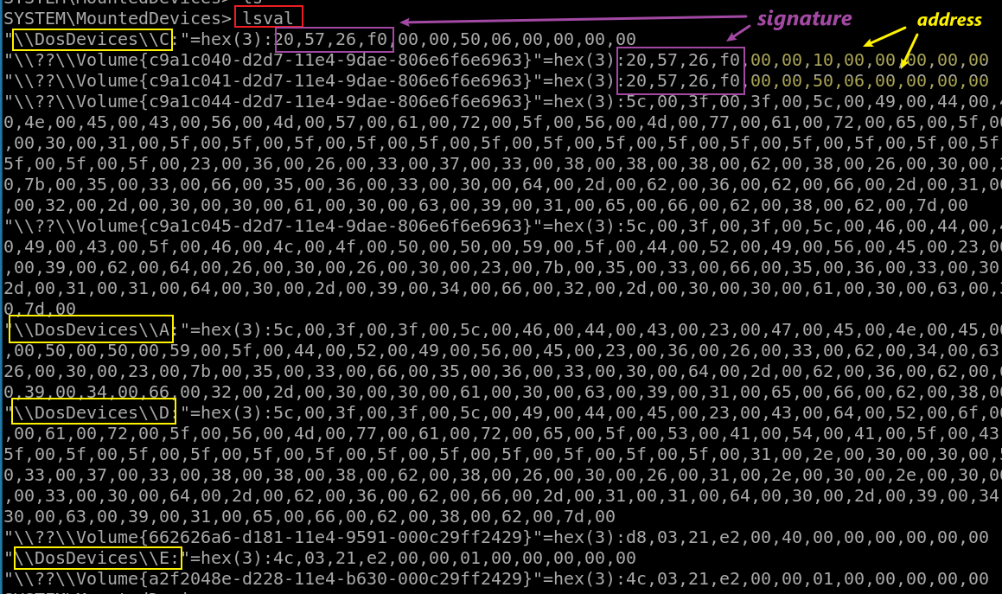
View more details of mounted devices via hivexsh
little endian: in bytes, Hex
Partition 1: 0x 10,00,00
Partition 2: 0x 06,50,00,00
in sectors, Dec
Partition 1: 2048
Partition 2: 206848

Slide 34
22.7 Device (setup) classes
Devices are grouped into a device setup class
If devices have similar manner of set up and configuration
SCSI media changer devices are grouped into the MediumChanger device setup class.
Microsoft defines setup classes for most devices.
OEMs can define new device setup classes, but only if none of the existing classes apply.
For example, a camera vendor does not have to define a new setup class because cameras fall under the Image setup class.
The device setup class GUID defines the ..\CurrentControlSet\Control\DeviceClass\{ClassGuid} registry key
Notes:
rip.pl -r SYSTEM -p devclass

Slide 35
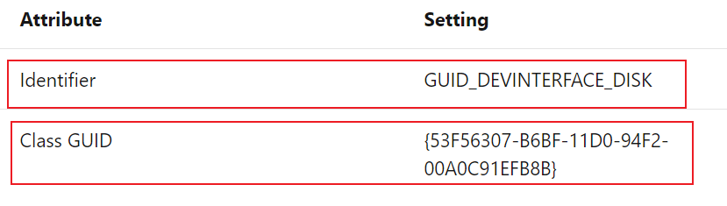
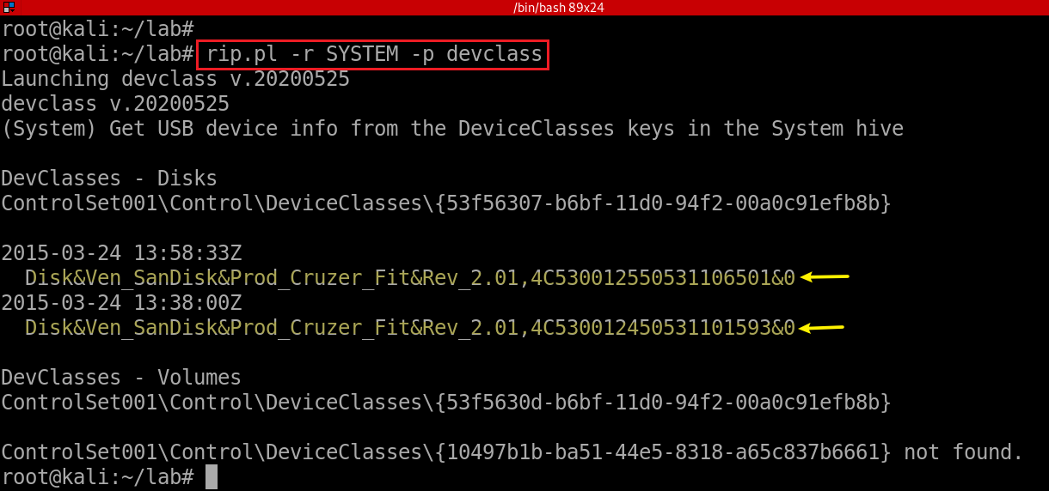
Show device setup classes and particular devices under the classes
Notes:
rip.pl -r SYSTEM -p devclass

Slide 36
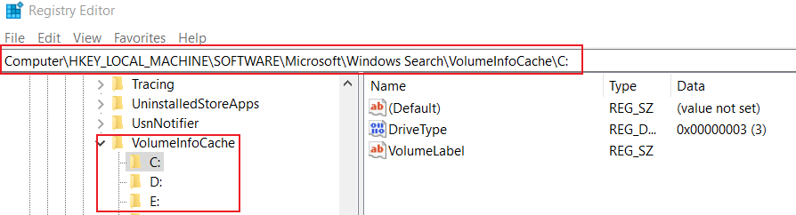
22.8 Volume information Cache
Windows Search registry is to help search function
VolumeInfoCache is a sub-key of Windows Search

Slide 37
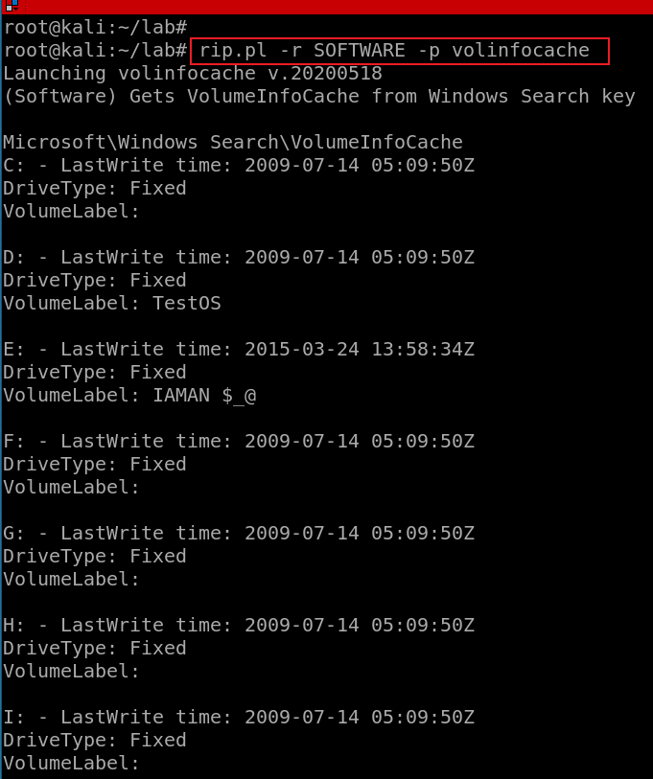
Exam Volume Infor Cache from Windows Search

Slide 38
Possible Answer | Device Name | Volume Name | Serial No. | First Connected Time | Connected Time After Reboot
 | SanDisk Cruzer Fit USB Device |  | 4C530012450531101593 | 2015-03-23 14:31:10 Mon | 2015-03-24 09:38:00 Tue
 | SanDisk Cruzer Fit USB Device | IAMAN $_@ | 4C530012550531106501 | 2015-03-24 09:58:32 Tue | 2015-03-24 09:58:33 Tue
Considerations | - ‘First Connected Time’ can be identified from SetupAPI Log. (→ C:\Windows\inf\setupapi.dev.log) HKLM\SYSTEM\MountedDevices\ HKLM\SYSTEM\ControlSet###\Enum\USBSTOR\ HKLM\SYSTEM\ControlSet###\Control\DeviceClasses\{a5dcbf10-6530-11d2-901f-00c04fb951ed}\ HKLM\SYSTEM\ControlSet###\Control\DeviceClasses\{53f56307-b6bf-11d0-94f2-00a0c91efb8b}\ …… HKU\informant\Software\Microsoft\Windows\CurrentVersion\Explorer\MountPoints2\ HKLM\SOFTWARE\Microsoft\Windows Search\VolumeInfoCache\E: > timestamp: 2015-03-24 09:58:34 Tue > value: VolumeLabel > data: ‘IAMAN $_@’ \Windows\System32\winevt\Logs\System.evtx (Event ID: 20001, 20003…) ……

Slide 39
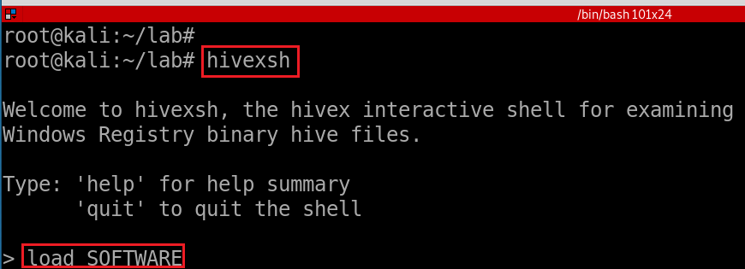
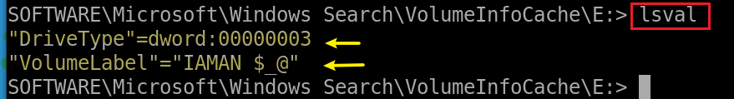
Show Volume information Cache using hivexsh
Notes:
load SOFTWARE
cd Microsoft\Windows Search\VolumeInfoCache\E:

