Slide 1
Investigating the 3rd Party Android Apps
Part 3
Notes:
https://digitalcorpora.s3.amazonaws.com/corpora/mobile/android_10/Non-Cellebrite%20Extraction/Pixel%203.zip

Slide 2




Approach
Approach to answer the question

Slide 3

Investigating whatsapp

Slide 4
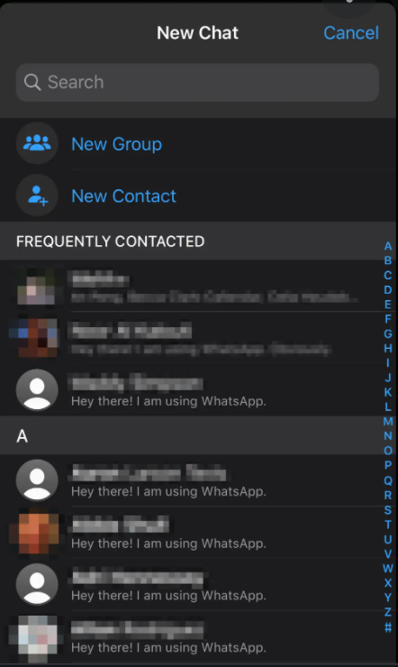
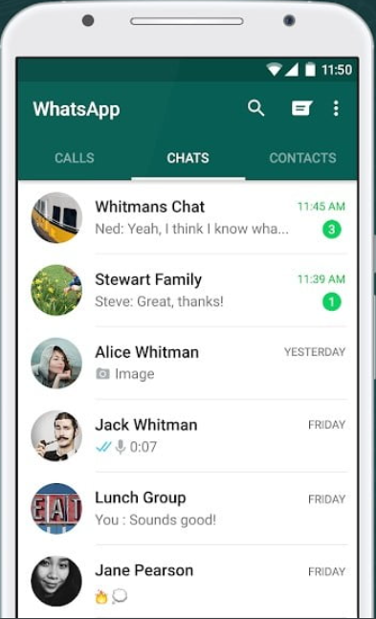
What is whatsapp?
WhatsApp is a free, multiplatform messaging app that allows to you to do
Video and voice calls
Send text messages
Evidence types
Messages
Contacts
Phone number

Slide 5
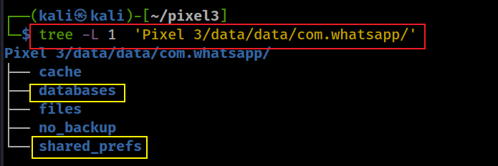
File structure of app

Slide 6
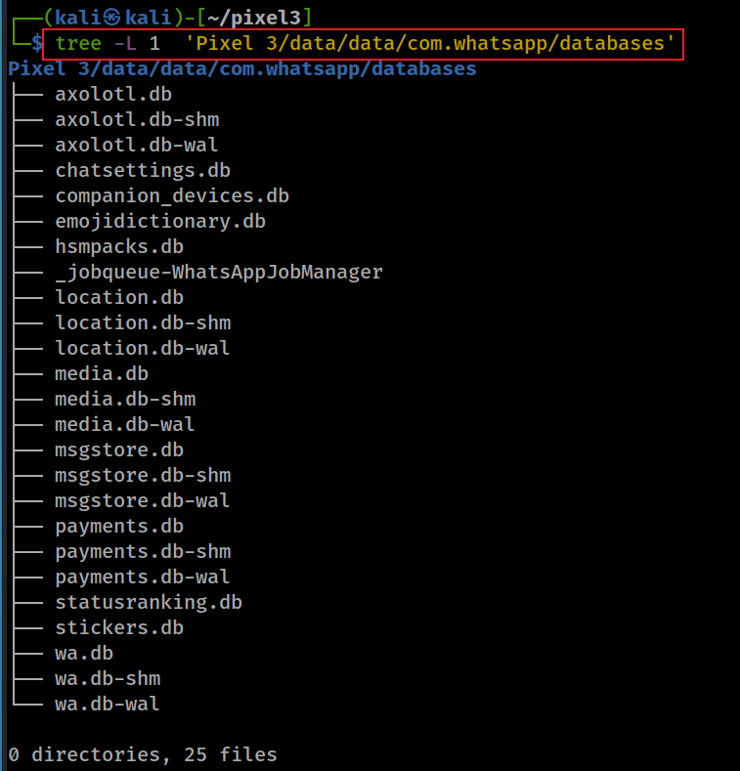
Messages
contacts info
Notes:
tree -L 1 'Pixel 3/data/data/com.whatsapp/databases'

Slide 7
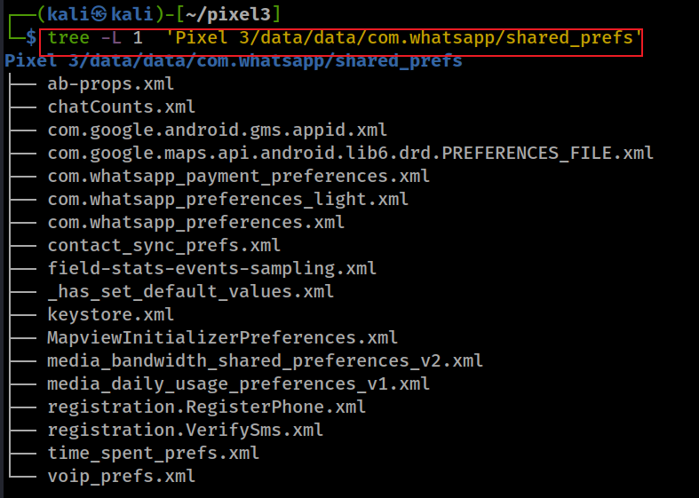

Slide 8
Scenario
A suspect used whatsapp app
Questions
Which phone number is associated with whatsapp?
How many contacts are stored on whatsapp?
Are there any conversations stored in the device?

Slide 9
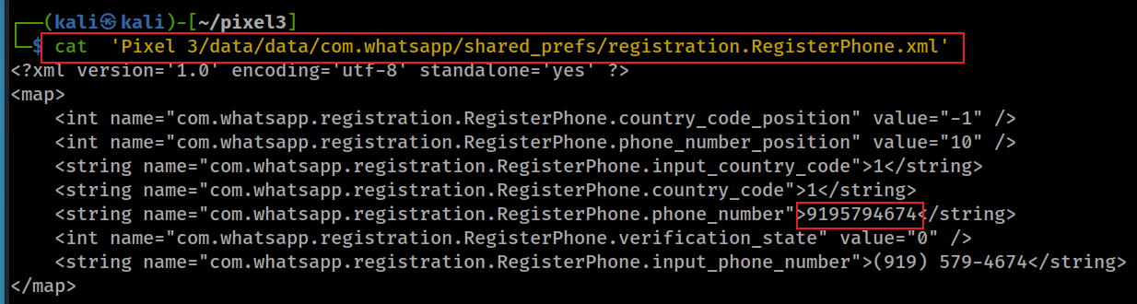
What phone number is associated with whatsapp?
Notes:
cat 'Pixel 3/data/data/com.whatsapp/shared_prefs/registration.RegisterPhone.xml'

Slide 10
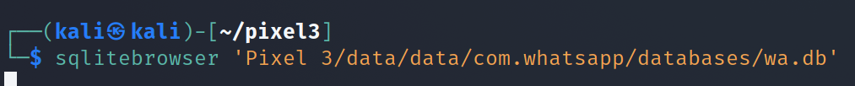
How many contacts are stored on whatsapp?
wa.db database contains a full list of the WhatsApp user's contacts
phone numbers
display names,
other information mentioned upon registering in WhatsApp
Show all tables in wa.db
Notes:
Cmd: sqlitebrowser 'Pixel 3/data/data/com.whatsapp/databases/wa.db'

Slide 11
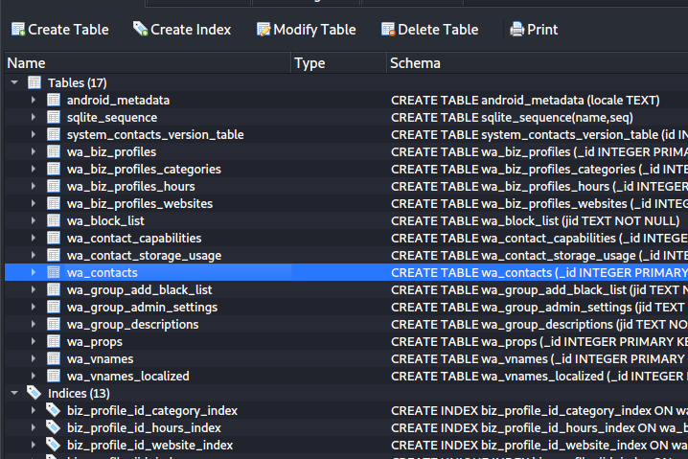

Slide 12
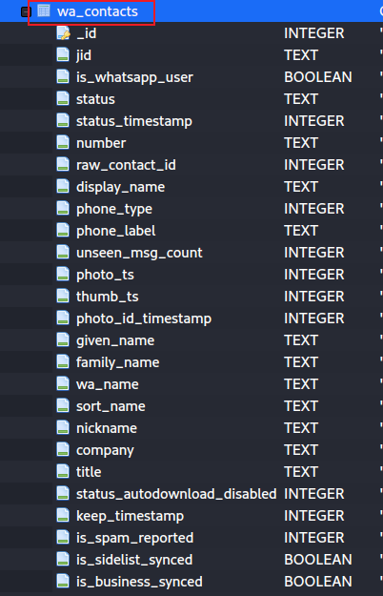

Slide 13
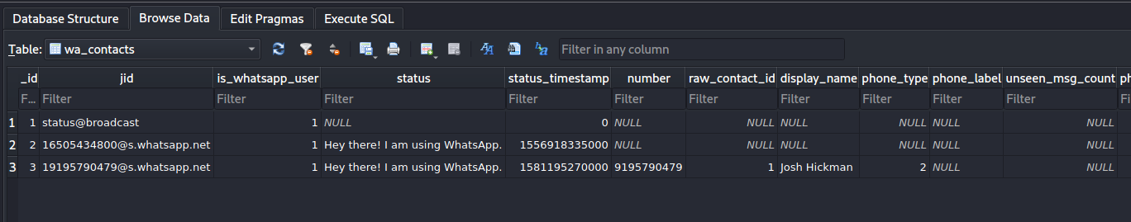
Show column information
contains ’1’ if the contact corresponds to an actual WhatsApp user, ’0’ otherwise
WhatsApp ID of the contact (a string structured as
’x@s.whatsapp.net’, where ’x’ is the phone number of the
contact)
Msg sent timestamp. Unix millisecond epoch time (13 digits)
content
sender’s name
Notes:
https://arxiv.org/pdf/1507.07739.pdf

Slide 14
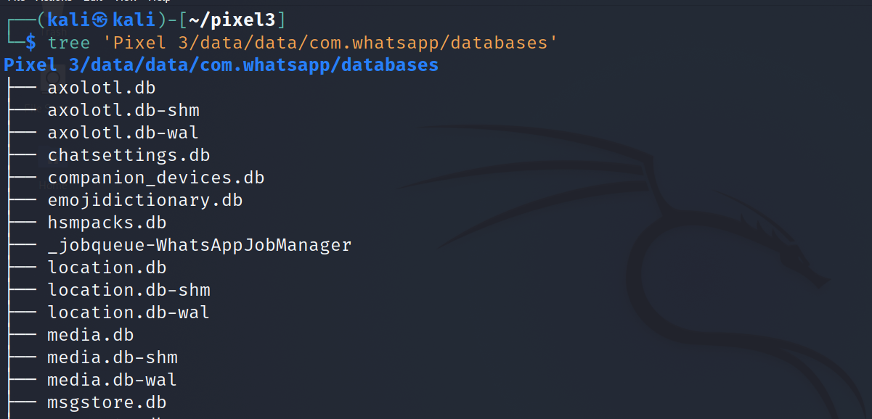
Are there any conversations stored in the device?
Look at the database list

Slide 15
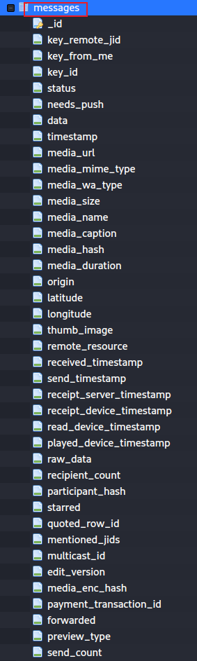
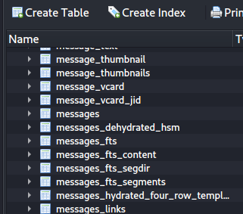
who
Open the database
message content
msg attached to pic or other
time/duration
location
Notes:
sqlitebrowser 'Pixel 3/data/data/com.whatsapp/databases/msgstore.db'

Slide 16
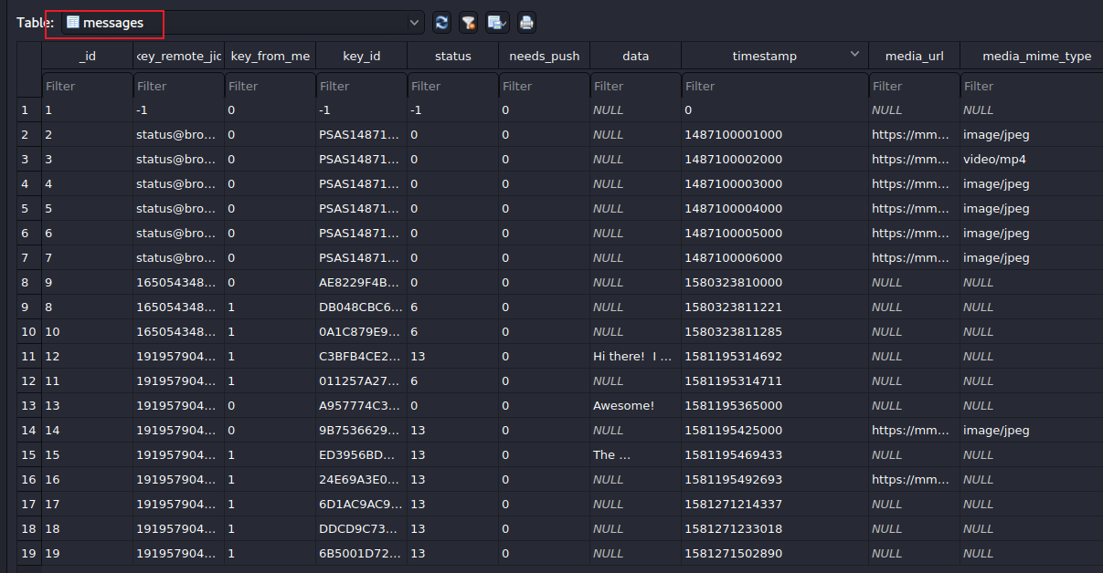
0=received
4=waiting on the server
5=received at the destination
6=control message
13=message opened by the recipient (read)
message content
other columns: https://blog.group-ib.com/whatsapp_forensic_artifacts

Slide 17
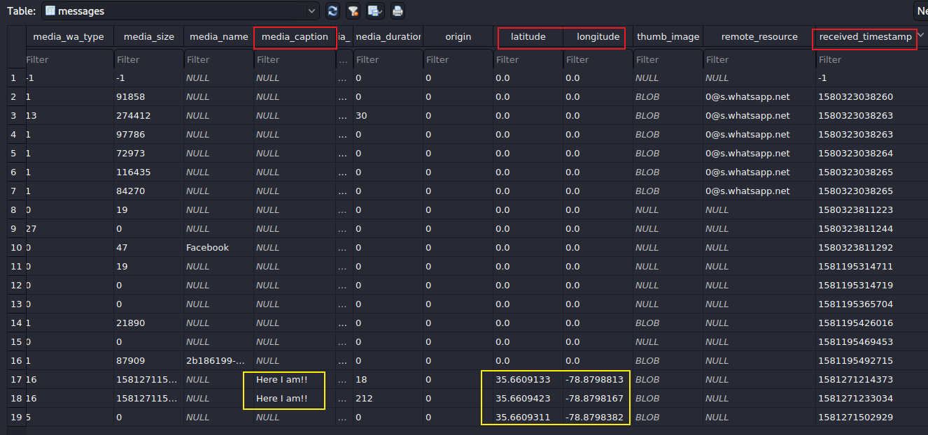

Slide 18
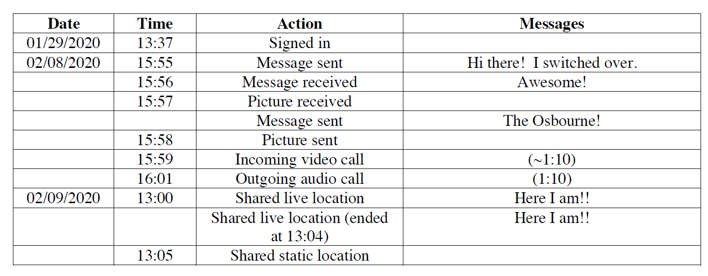

Slide 19
To summarize
Dig into databases (msgstore.db & wa.db) to fetch the information such as messages, contacts etc
Find the phone number associated with whatsapp
Questions: verify which columns are correct timestamps?

Slide 20
Homework (Snapshot)
Similar approach

Slide 21

Snapchat
Snapchat opens right to the camera, so you can send a Snap in seconds! Just take a photo or video, add a caption, and send it to your best friends and family. Express yourself with Filters, Lenses, Bitmojis, and all kinds of fun effects.
Evidence types
SNAP: camera
CHAT : messages
STORIES: friends' Stories, news, shows
SPOTLIGHT: best of Snapchat!
SNAP MAP: map
MEMORIES: look back on Snaps
FRIENDSHIP PROFILE: friends’ info
Notes:
https://play.google.com/store/apps/details?id=com.snapchat.android

Slide 22
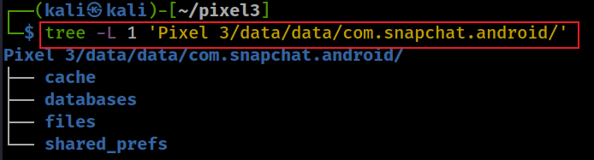
Snapchat level 1 file structure
Notes:
tree -L 1 'Pixel 3/data/data/com.snapchat.android/'

Slide 23
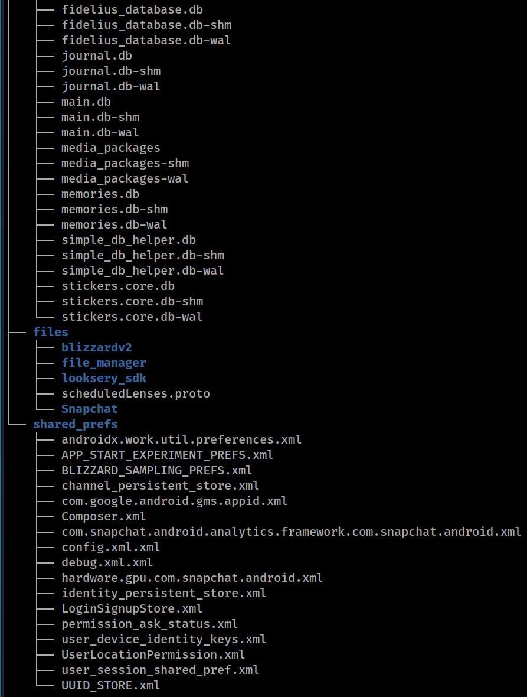
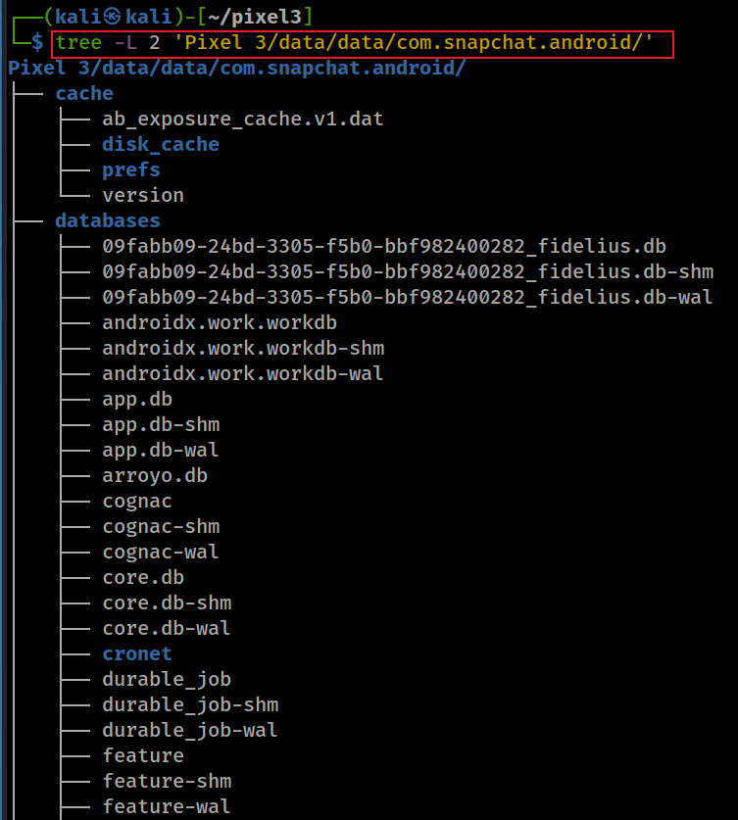
Snapchat level 2 file structure
Notes:
tree -L 2 'Pixel 3/data/data/com.snapchat.android/'

Slide 24
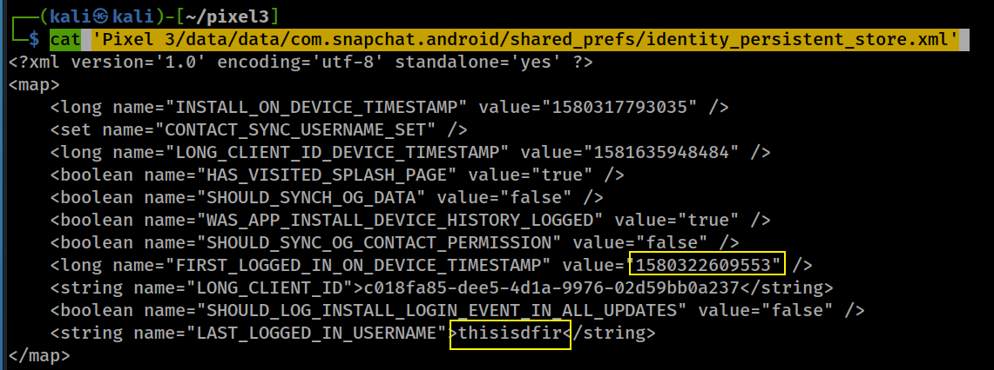
Who was the last logged in snapchat? data/data/com.snapchat.android/shared_prefs/identity_persistent_store.xml

Slide 25
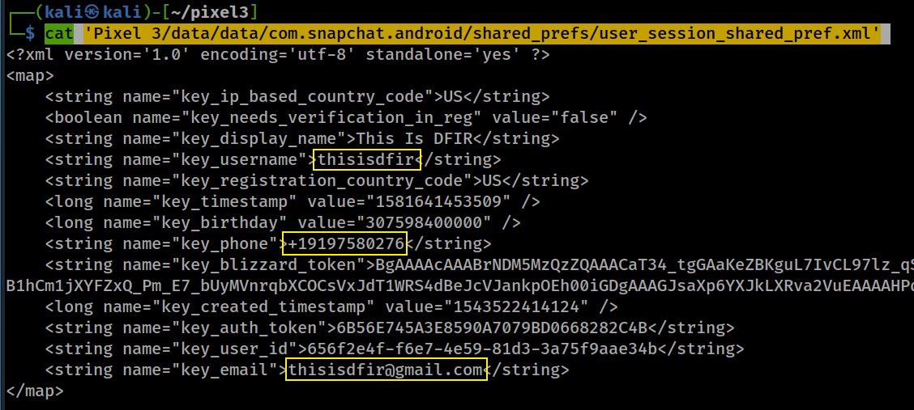
What is email/phone number of snapchat? data/data/com.snapchat.android/shared_prefs/user_session_shared_pref.xml
Notes:
cat 'Pixel 3/data/data/com.snapchat.android/shared_prefs/user_session_shared_pref.xml'

