Slide 1
iOS Application Lifecycles
iOS 13

Slide 2
Overview
iOS Application Lifecycle
Examining Springboard

Slide 3
The iOS Application Lifecycle

Slide 4
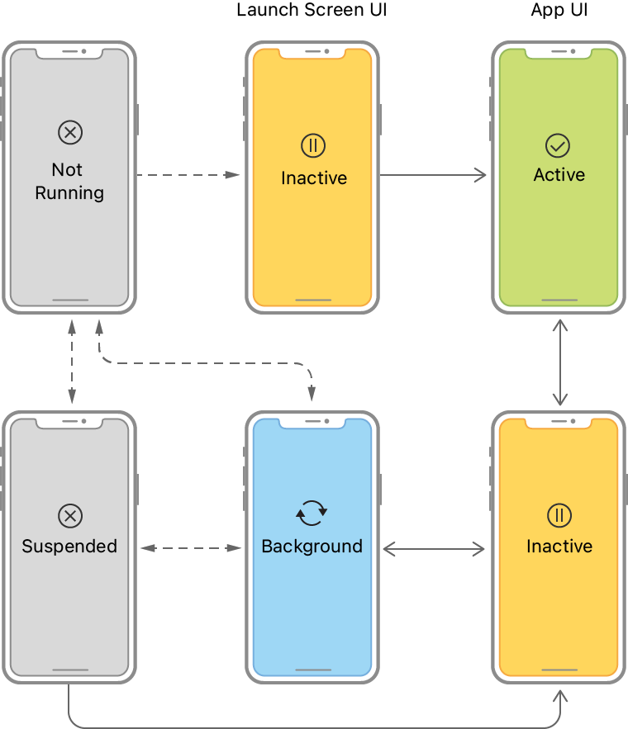
iOS Application Lifecycle Overview
An iOS application runs in several states, which is called the state of the Application life cycle. Developers must be aware of the app life cycle, which helps to understand the application's behavior. Every iOS application passes through the following states as it runs.

Slide 5
iOS Application Lifecycle Overview (2)
Not Running: the app is in a Not Running state when it is not yet launched or terminated by the system or user.
Inactive: the app is in an inactive state when it is in the foreground but receiving events. In other words, we can say that it acts like a bridge state in which the app remains briefly when it transitions to a different state.
Active: it is a normal mode for the app when it is in the foreground state and receiving all the user events.
Background: the app transitions into the background state when the user taps on the home screen while using the application, or it requires some extra execution time. When the app is about to be suspended, then also transitions into this state for a small amount of time. In this state, the app remains in the background and is still able to execute code.
Suspended: in this state, the app remains in the background and doesn't execute code. The app is automatically moved to this state. In this state, the app remains in memory. However, the foreground apps are always given priority over suspended apps and can be purged any time without notice.

Slide 6
How an Application starts
When the User just turned on their phone, no applications are running except those that are belong to the operating system. After the User taps any application icon, Springboard the part of the OS, that operates the home screen of iOS, launches your app. Your app and the shared libraries it needs to execute, will be loaded into the memory, while springboard animates your app’s launch screen, eventually your app begins execution and Application Delegate receives the notifications.

Slide 7
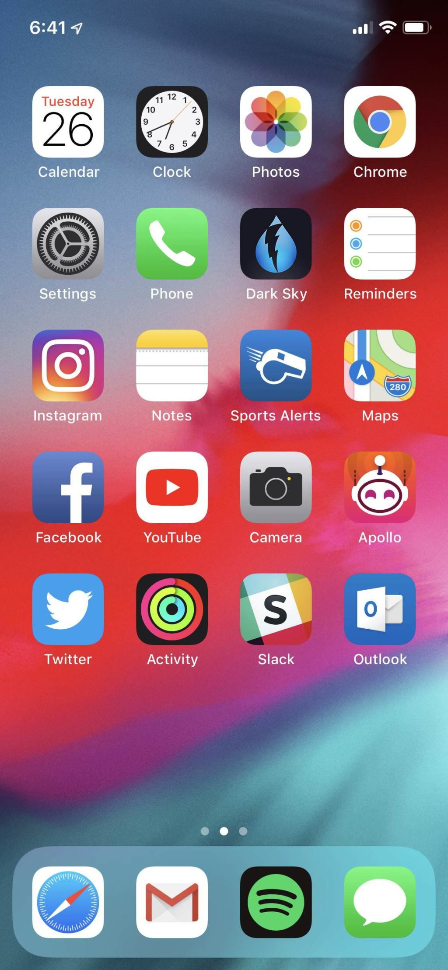
Springboard (Home Screen)
Springboard, or Home Screen is the standard application that manages the home screen of iOS devices. Other tasks include starting WindowServer, launching and bootstrapping applications and setting some of the device's settings on startup.
Typical iOS 13 Home Screen featuring native apps and third-party apps
The Button Bar, holds 4 apps. Remain in place even after switching pages

Slide 8
Application Delegate
The application delegate is an object that gets notified when the object to which it is connected reaches certain events or states. In this case, the Application Delegate is an object which receives notifications when the UIApplication object reaches certain states. In many respects, it is a specialized one-to-one Observer pattern.
This means that the "area of concern" for the AppDelegate is handling special UIApplication states. The most important of these are:
applicationDidFinishLaunching: - good for handling on-startup configuration and construction.
applicationWillTerminate: - good for cleaning up at the end.

Slide 9
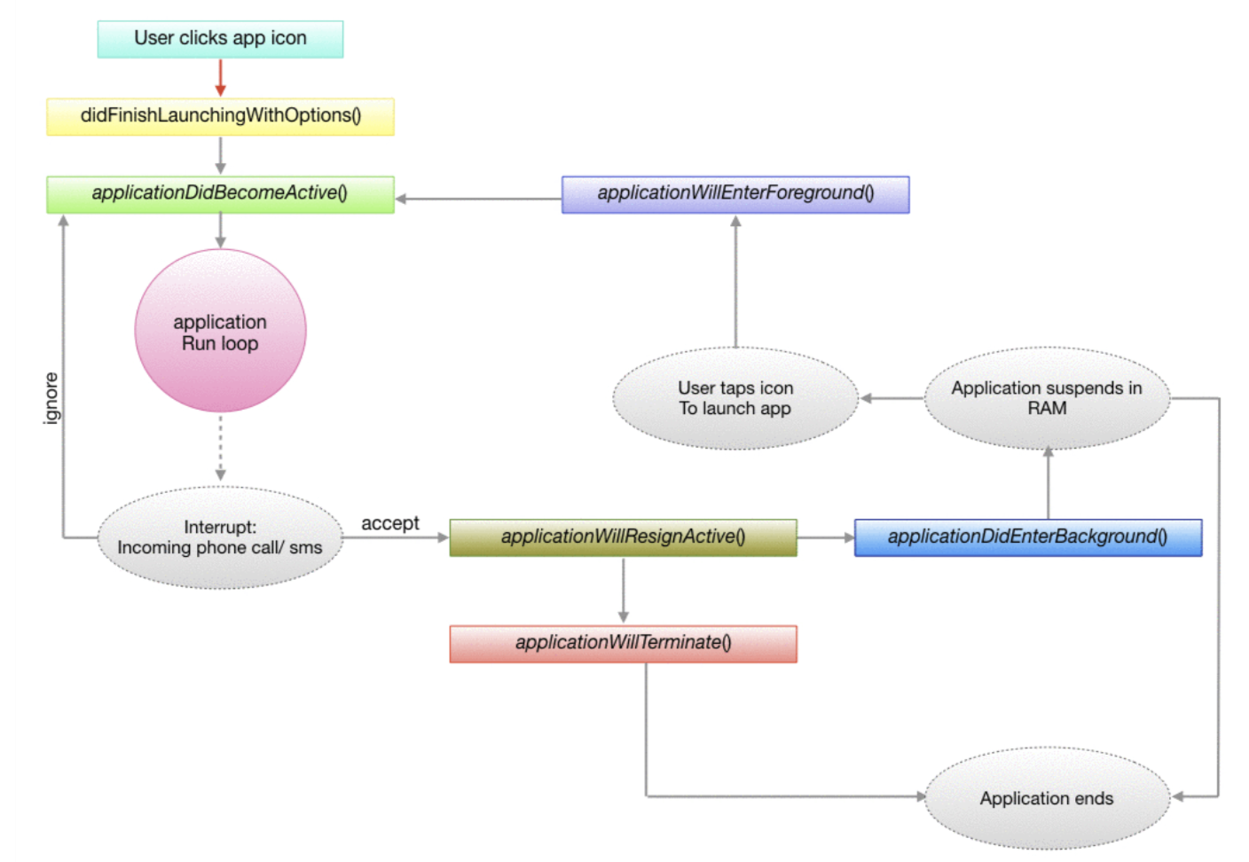
Application Delegate Visualized

Slide 10
Application Delegate (2)
In iOS, there is an UIApplication object which will internally call the UIApplicationMain. UIApplication is responsible for facilitating all the key events to its delegate. So, that the UIApplicationMain function is the main entry point to create the application object, and the application delegate and set up the event cycle.
UIApplicationMain is called on AppDelegate class which adopts the UIApplicationDelegate protocol. Every iOS application has to implement this protocol to get notified about the user events such as app launch, the app goes into the background, the app comes into the foreground, etc.

Slide 11
Application Delegate - Step by Step : Launch
application: willFinishLaunchingWithOptions — This method is called after the application has been launched successfully. It is the first method from the app delegate which will be called. The code is executed if the launch was successful.
application: didFinishLaunchingWithOptions — is called next. This callback method is called when the application has finished launching and restored its state. This method can be used to finalize the interface and provide the root View Controller to the window.

Slide 12
Application Delegate - Step by Step : Foreground
applicationWillEnterForeground: This method is called when the app transitions from background state to active state i.e when the app is relaunched. This method is not invoked when the app starts for the first time i.e when applicationDidFinishLaunch is called but only when it comes from background i.e applicationDidBecomeActive.
applicationDidBecomeActive: This method is called just after applicationWillEnterForeground. It is to let your app know that it moved from an inactive to an active state. This method is used to restart any tasks that were paused.

Slide 13
Application Delegate - Step by Step : Background
applicationDidEnterBackground: This method is called when your application enters the background after becoming inactive. You have approximately 5 seconds to run any tasks you need to back things up in case the app gets terminated later or right after that.

Slide 14
Application Delegate - Step by Step : Inactive State
applicationWillResignActive: This method is called when your application is about to enter into an inactive state from an active state. Consider the case of an incoming phone call or if the user quits the app by hitting the home button. Any ongoing tasks can be paused in this method.

Slide 15
Application Delegate - Step by Step : Termination
applicationWillTerminate: This method is called when your application is about to terminate. Any call final cleanup can be performed here. There are cases where this method might not be called, such as in the case when the device reboots.

Slide 16
Examining Springboard

Slide 17
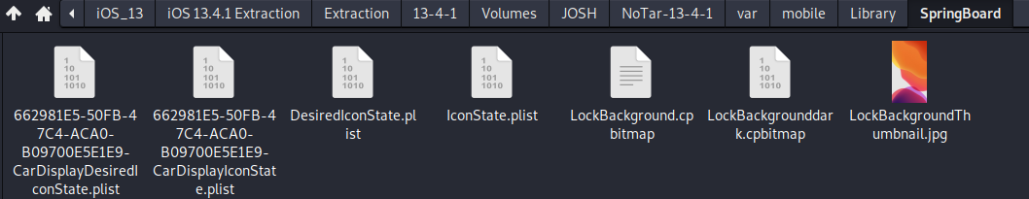
Examining Springboard Layout
The layout of the SpringBoard is in a property list file at ~/var/mobile/Library/SpringBoard/IconState.plist.
Open Terminal in this folder.
Plistutil –I IconState.plist

Slide 18
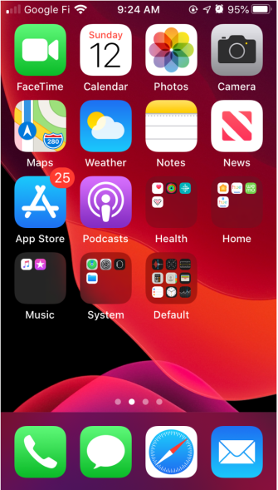
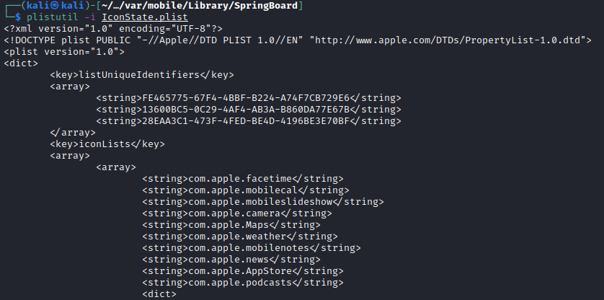
Examining Springboard Layout (2)
What is the home screen layout?
Application Bundle Ids

Slide 19
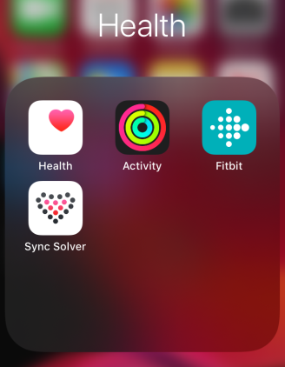
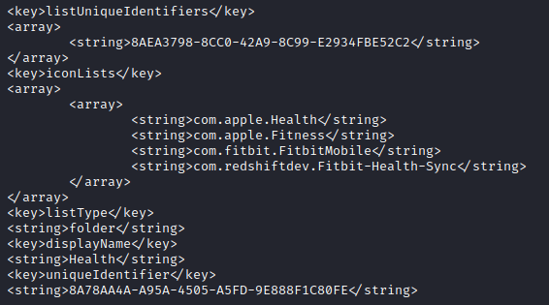
Examining Springboard Layout (2)
What about the Application Folders at the Home Screen?
Application Bundle Ids
Folder Name

Slide 20
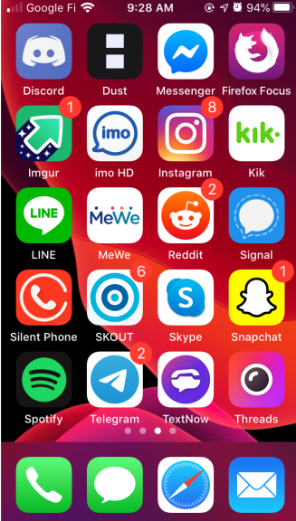
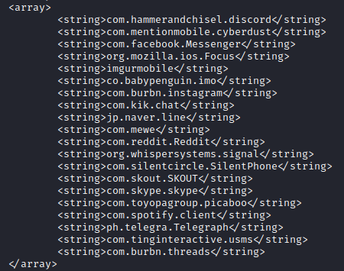
Examining Springboard Layout (3)
Home Screen Page 2

Slide 21
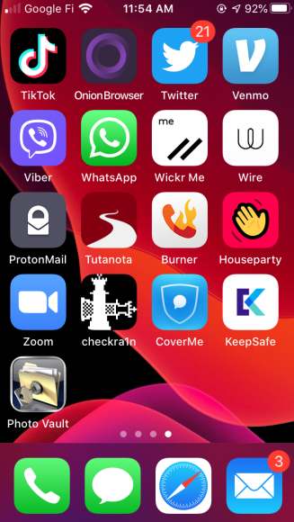
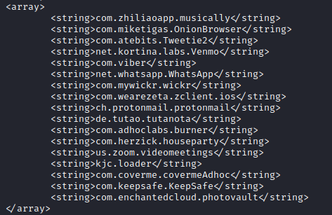
Examining Springboard Layout (4)
Home Screen Page 3

Slide 22
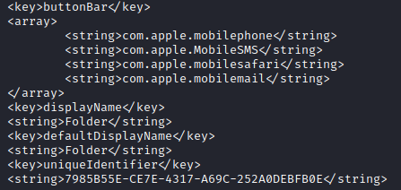

Examining Springboard Layout (5)
What about the Button Bar Layout?

