Slide 1
The Sleuth Kit (TSK)
Version 4.9.0
Notes:
http://www.sleuthkit.org/sleuthkit/docs/api-docs/4.9.0/basicpage.html

Slide 2
Overview
Autopsy vs. The Sleuth Kit
The layer of the TSK architecture
The tools provided by each layer of TSK

Slide 3
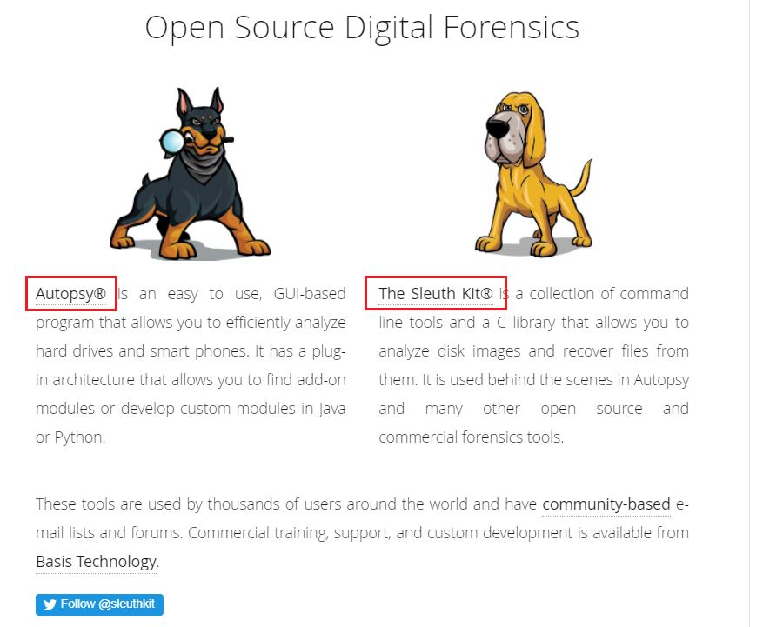

Slide 4
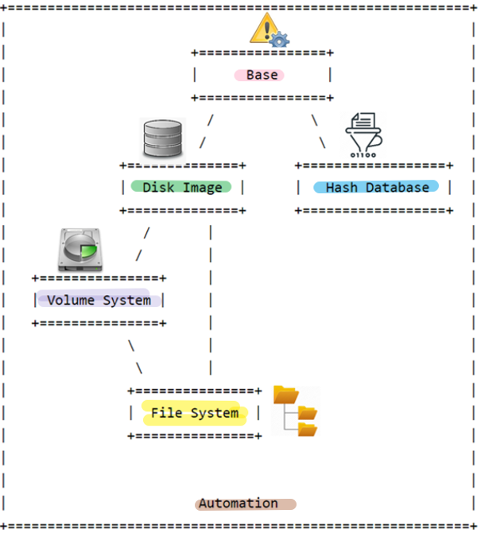


TSK Layers
error handling, types, and convenience functions
Can open and process disk images in various formats
create an index of hashes and perform fast lookups of them
Processing data as a volume system, e.g., DOS partition tables
processing data as a file system, such as FAT or NTFS.
integrates all of the previous layers
Notes:
http://www.sleuthkit.org/sleuthkit/docs/api-docs/4.9.0/basicpage.html

Slide 5


Storage management vs File System management
Customer: Frank
in date: 10/01/2021
out date: 11/01/2021
occupied space: 3
location: B3, B4, B5
https://www.geico.com/living/home/home-protection/storage-units/

Slide 6
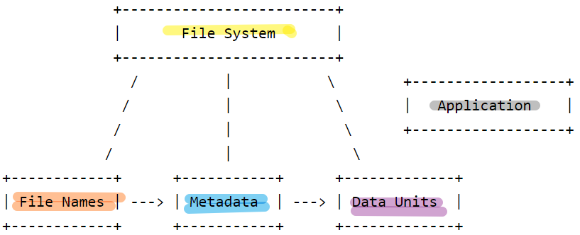
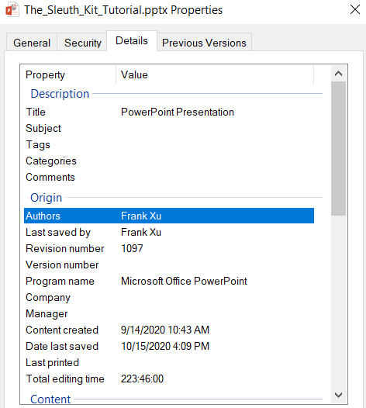
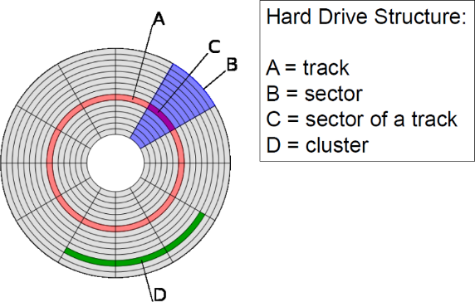
File System Layers
non-essential file system data
journals that record file system updates
lists that record what files have recently been updated
Describe the layout and general features of the file system. Allow others to read, write
a different structure than the metadata structure, exception FAT file system
data units (i.e. blocks and clusters)
files and directories
inode structures in UNIX
MFT entries in NTFS,
directory entry structures in FAT

Slide 7
TSK Tools
Image Files
img_stat: tool will show the details of the image format
img_cat: This tool will show the raw contents of an image file.
Disk Tools
disk_sreset: This tool will temporarily remove a HPA if one exists. After the disk is reset, the HPA will return.
disk_stat: This tool will show if an HPA exists.
mmls: Displays the layout of a disk, including the unallocated spaces.
mmstat: Display details about a volume system (typically only the type).
mmcat: Extracts the contents of a specific volume to STDOUT.
tsk_comparedir: Compares a local directory hierarchy with the contents of raw device (or disk image). This can be used to detect rootkits.
tsk_gettimes: Extracts all of the temporal data from the image to make a timeline. Equivalent to running fls with the '-m' option.
tsk_loaddb: Loads the metadata from an image into a SQLite database. This allows other tools to be easily written in a variety of languages and give them access to the image contents.
tsk_recover: Extracts the unallocated (or allocated) files from a disk image to a local directory.
Notes:
https://wiki.sleuthkit.org/index.php?title=TSK_Tool_Overview
https://linuxhint.com/kali_linux_top_forensic_tools/
https://linuxhint.com/kali_linux_top_forensic_tools_2020_part_2/

Slide 8
File System Tools
fsstat: Shows file system details and statistics including layout, sizes, and labels.
blkcat: Extracts the contents of a given data unit.
blkls: Lists the details about data units and can extract the unallocated space of the file system.
blkstat: Displays the statistics about a given data unit in an easy to read format.
blkcalc: Calculates where data in the unallocated space image (from blkls) exists in the original image. This is used when evidence is found in unallocated space.
ffind: Finds allocated and unallocated file names that point to a given meta data structure.
fls: Lists allocated and deleted file names in a directory.
icat: Extracts the data units of a file, which is specified by its meta data address (instead of the file name).
ifind: Finds the meta data structure that has a given file name pointing to it or the meta data structure that points to a given data unit.
ils: Lists the meta data structures and their contents in a pipe delimited format.
istat: Displays the statistics and details about a given meta data structure in an easy to read format.

Slide 9
Assignment: three tools demo in classes
How to pick up three tools? You last four student ID/SSN digital mod 28. Example, if you last four digital ID is 1234 you need to pick questions 2, 3, 4 because 1234 mod 28 = 2. Note that the index of questions starts from 0
What are the inputs? where are the inputs (url or customize made inputs)
What is the command?
What are the outputs?
Explain each command and how does each parament determines the outputs?
Capture all screenshots.
If you use your own inputs, upload inputs
https://linuxhint.com/kali_linux_top_forensic_tools/ [0-13]
https://linuxhint.com/kali_linux_top_forensic_tools_2020_part_2/ [14-27]

